Slide 1
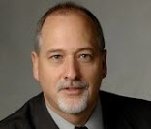
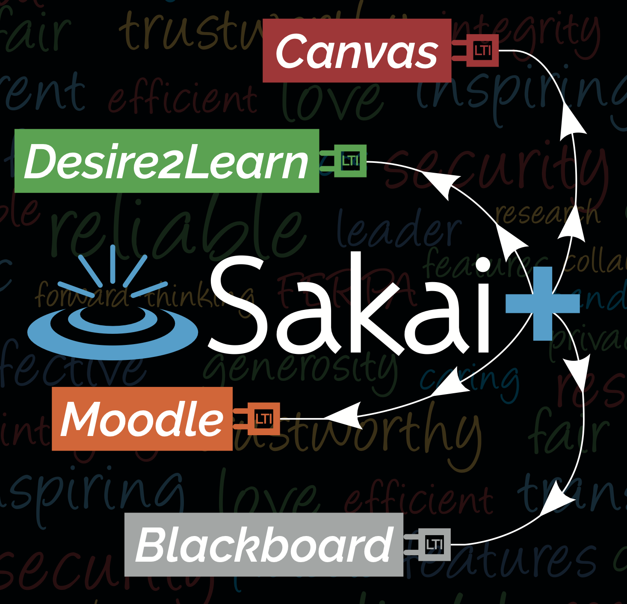
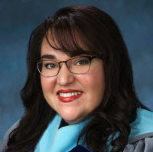

Introducing SakaiPlus
Dr. Charles Severance
Sakai PMC Chair
Dr. Wilma Hodges
Sakai Community Coordinator
www.sakailms.org/plus

Slide 2
The Trends We See…
LMS Satisfaction is "meh" – no system makes everyone happy
Switching to a new LMS is a lot of work and then … "meh"
Faculty and Instructional Designers are looking to LTI tools that lets them create meaningful content and engage students
Content Developers want a high quality experience in any LMS without building a custom publishing / integration environment
The LMS is evolving to be a learning portal with a basic, unexciting, content sequencing experience

Slide 3
Looking at SakaiLMS..
Faculty and instructional designers love Sakai
Sakai continues to innovate
Sakai wants to make life better for
Innovative Instructors
Instructional designers
The IT organization (don't add a lot to their plate)

Slide 4

Innovative learning experiences are happening outside the LMS using LTI 1.3…

Slide 5
Innovative learning experiences are happening outside the LMS using LTI 1.3… Make all of Sakai an LTI 1.3 tool

Slide 7
SakaiPlus – LMS Multiverse
Part of Sakai 23
Sakai can plug into any LMS using LTI Advantage (1.3)
Retrieves and synchronizes roster data
Synchronizes all grade book activity
Launch / grades / notifications from campus LMS

Slide 8
Demo: Using SakaiPlus
Charles Severance

Slide 9
Use Cases
Build course once in SakaiPlus – provide high fidelity experience in any LMS
SakaiPlus as "second lms" for the "cool faculty"
A "hybrid mode" – a little of both
In all cases, the "main LMS" controls single sign on, rosters, and overall grades

Slide 10
Benefit: An Active Community
You can be part of an active and engaged community
Participation
Support
Innovation
In Sakai, you can talk to the people doing the work
You can also *be* the people doing the work if you want

Slide 11
Going forward
We are in a Beta Phase – a few schools / publishers
Weekly meetings between Beta testers and dev team during the Beta
Production 3Q24
Beta tests are free

