Slide 1

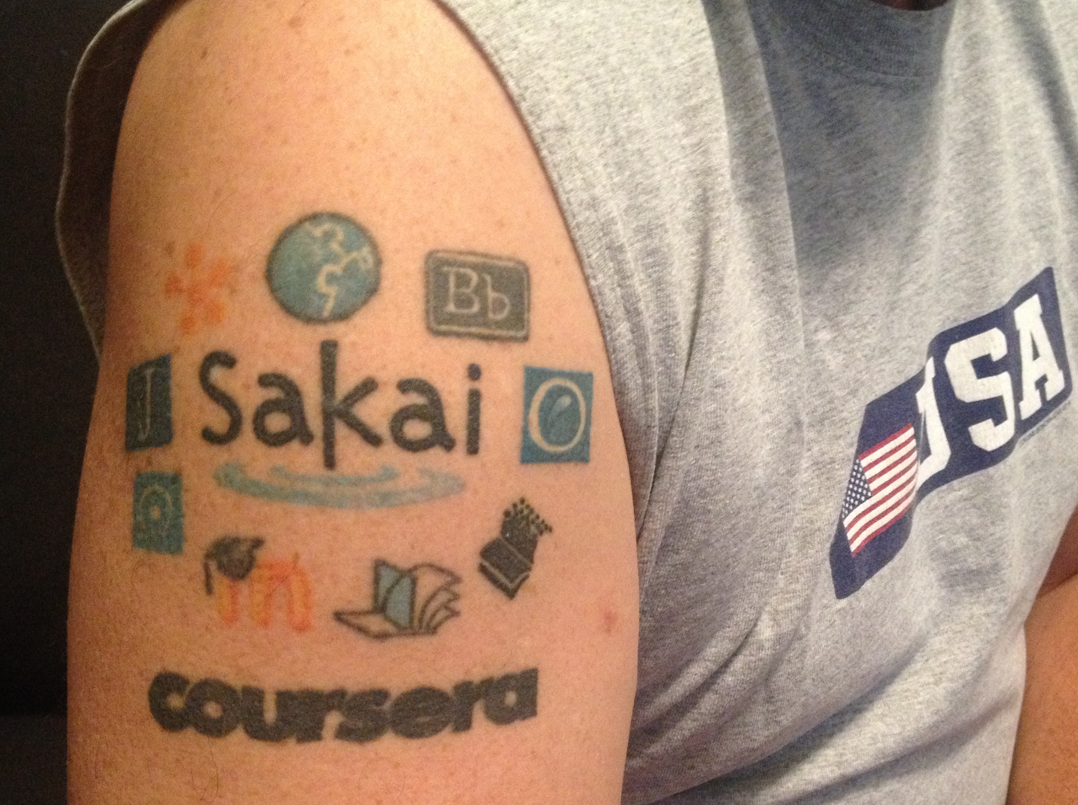
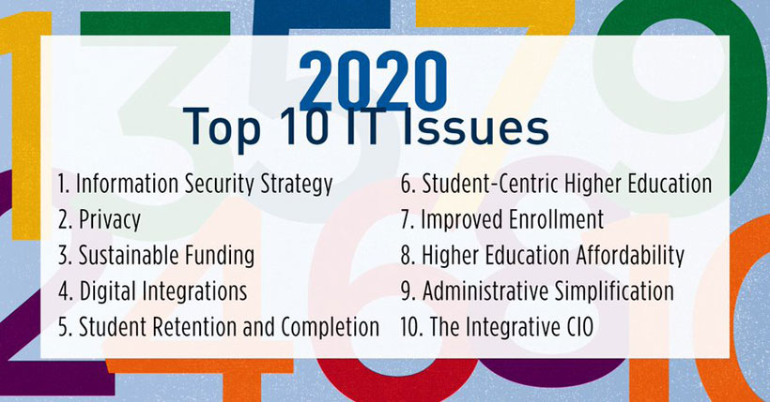
New Approaches to Protecting the Privacy of Student Learning Data in the Cloud
Charles R. Severance
15 Years of Progress?
Self Hosting?
2004
No Interoperability between LMSs
All private student data is local
2020
IMS LTI Advantage – Amazing!
Often, all private student data is on non-owned servers
Decisions regarding student data privacy are made by the IT organization with no input from students…
Not available
Canvas since 2008
Blackboard since 2019
D2L since 2019
Available
Sakai
Moodle
The Fallacy of FERPA
History
Passed in 1974 to stop universities from responding to FOIA requests
A stealth amendment
No design, no discussion…
Not a blueprint for cloud contracts
GDPR is better but it depends ….
When Data Is Sold
Selling the company = selling data
Private companies are very flexible
What is your recourse?
Get a settlement – (new stadium fund)
Shame the company in social media
Lost data is just gone
https://epic.org/privacy/student/ferpa/#history
Privacy and LTI
Privacy Policy / Practice
LTI 1.0 (2010) was designed to allow tools to function without PII
LTI Vendors refused to implement it
We Need New Best Practice
Tools must not fail without PII
Tools must quickly scrub PII
Tools must expire data on schedule
Switch to self hosted open source
(or) Add "max-privacy" open source LMS through LTI
New Policies / Practice / Education
Faculty
Students
Cloud vendors

