Slide 1
Tsugi Analytics
Charles R. Severance
University of Michigan School of Information
https://github.com/csev/talks/tree/master/2020

Slide 2
Goals
Value to teachers and (eventually) students
Efficient space / compute in a relational database
Instant availability of data (no offline analysis / gather process)
Core features not useful to institution / admin – leave that to Caliper
Caliper is not core – it is an optional add on
All Caliper / XAPI work is in the background (actually use idle browsers ☺)
Can cope with Caliper destinations that are unreliable

Slide 3
Implementation
Two types of tracking
Every LTI launch is tracked (i.e. when an application is clicked)
Time on task – requires JavaScript – currently only done with YouTube tool
Event count, last_updated tracked perfectly
Event timing tracked with a re-scalable / leaky bucket strategy
Allocate a fixed length string (default 1024) for each link/student and capture data in 15 minute buckets
Strategy when fixed space starts to fill
Compress data with gzip
Rescale until buckets are 24 hours + compress
Delete oldest bucket + compress until it fits

Slide 4
Performance
Each event is 4 or 5 inexpensive SQL statements – think Aurora serverless
Read / Update the course buckets
Read / Update the user buckets
Optionally add the event to the outbound Caliper / XAPI / Canvas queue
Viewing the data is one SQL statement
Generate the data for an analytics view – one query
Read all the buckets of all the students for a gradebook UI – one query
I have built no models that look at activity data and conclude red/yellow/green but the data would be cheap to retrieve and easy to process
Outgoing event queue processing triggered caby a cron job or from idle browsers session extension code

Slide 5
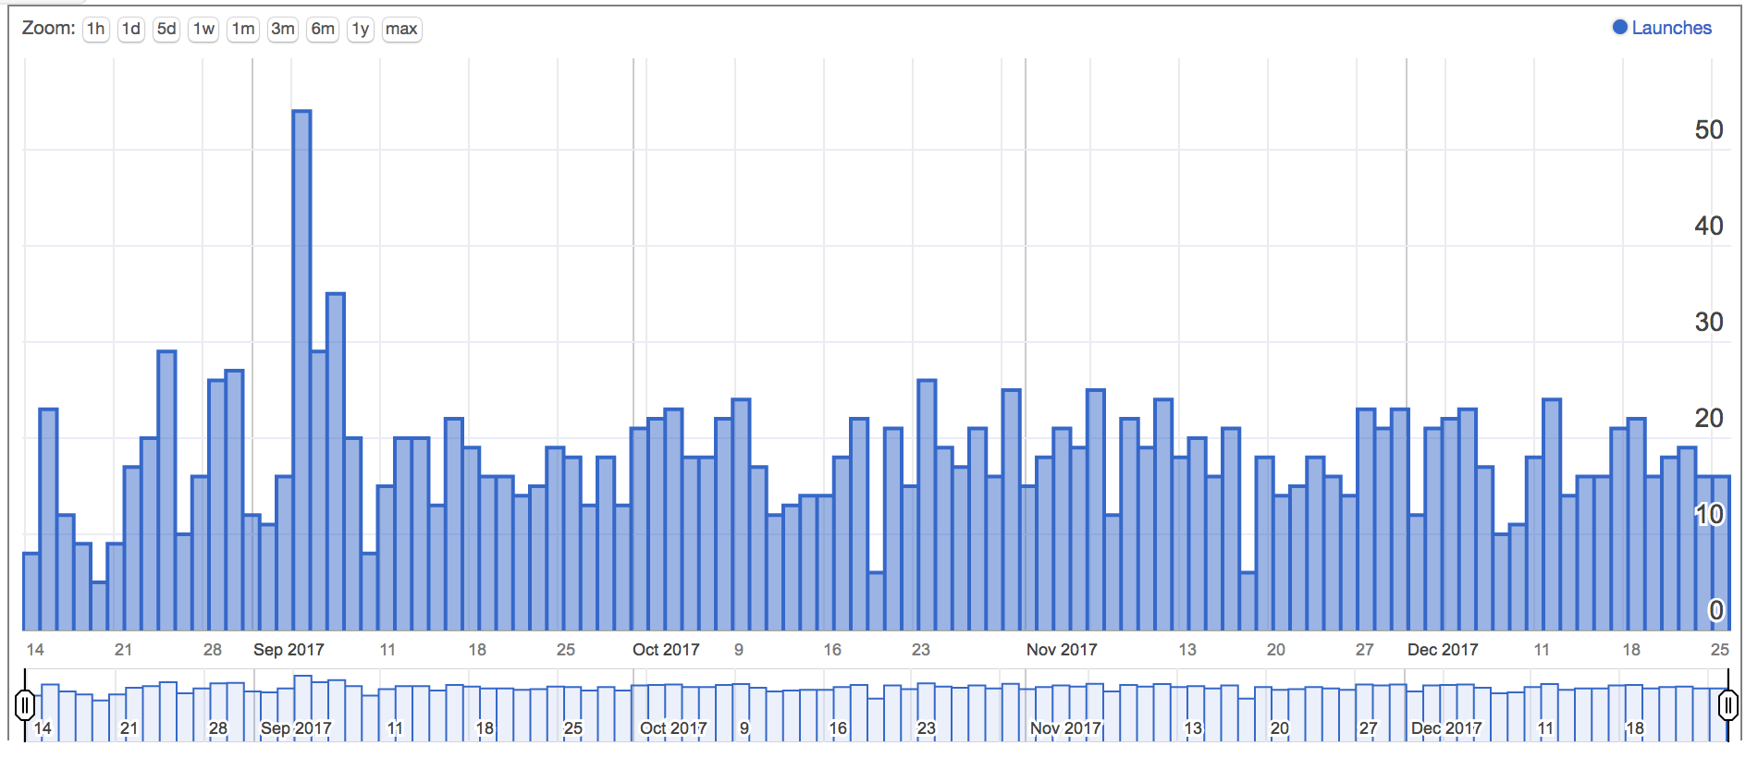
https://www.tsugicloud.org/tsugi/store/details/youtube

Slide 6
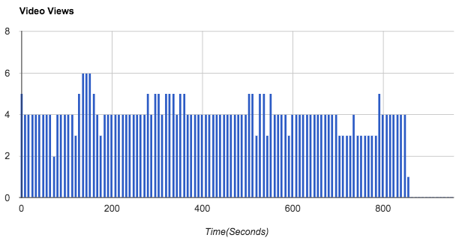
https://www.tsugicloud.org/tsugi/store/details/youtube

Slide 7
Demo / Tech Details
Leaky / Scalable Buckets:
https://github.com/tsugiproject/tsugi-php/blob/master/src/Event/Entry.php
JSON API for Visualization Data:
https://github.com/tsugiproject/tsugi/blob/master/api/analytics.php
Web Components for Viz:
https://github.com/tsugiproject/tsugi-static/tree/master/webcomponents/tsugi
Caliper Push:
https://github.com/tsugiproject/tsugi-php/blob/master/src/Core/Activity.php
Caliper Utility Code:
https://github.com/tsugiproject/tsugi-php/blob/master/src/Util/Caliper.php

