Slide 1


IMS Learning Tool Interoperability 2.0
Building the Standards for Learning Functionality Mashup

Slide 2
Defininitions
Content Mashup – Reusing data in new places / ways
Functionality Mashup – Reusing interactive software in new places / ways
Learning Tools Interoperability – using learning tools in new places / ways

Slide 3
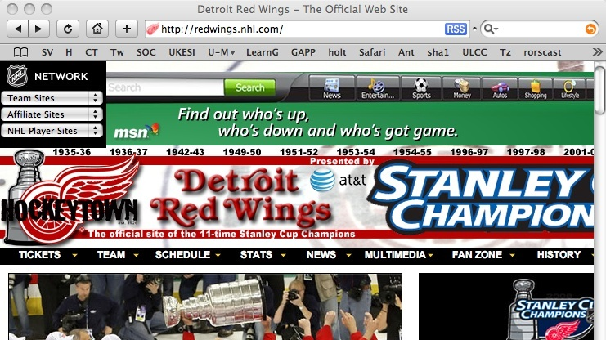
Content Mashup - RSS Feeds

Slide 4
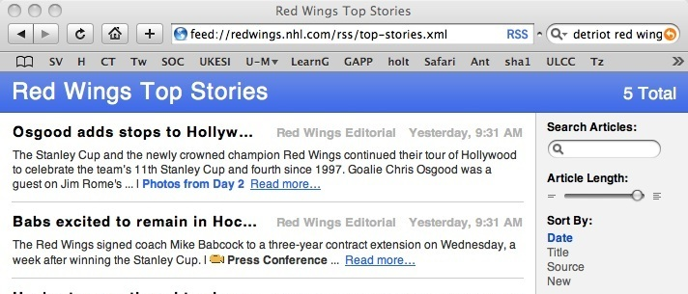
Content Mashup
Using data in a new context

Slide 5
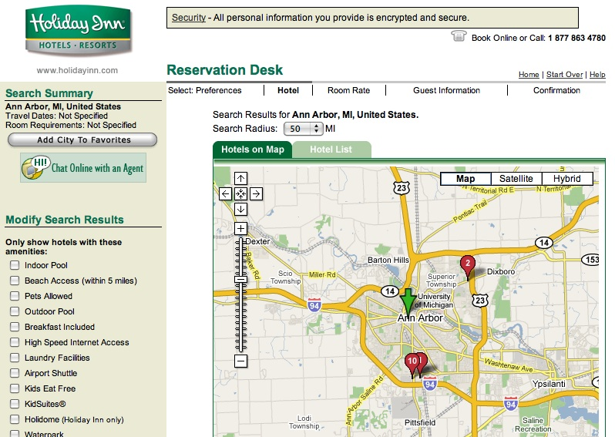
Functionality Mashup
Using Google Maps software in a Hotel web site context

Slide 6
Functionality Mashup
Using Google Maps software in a Hotel web site context

Slide 7

Functionality Mashup

Slide 8
Functionality Mashup

Slide 9
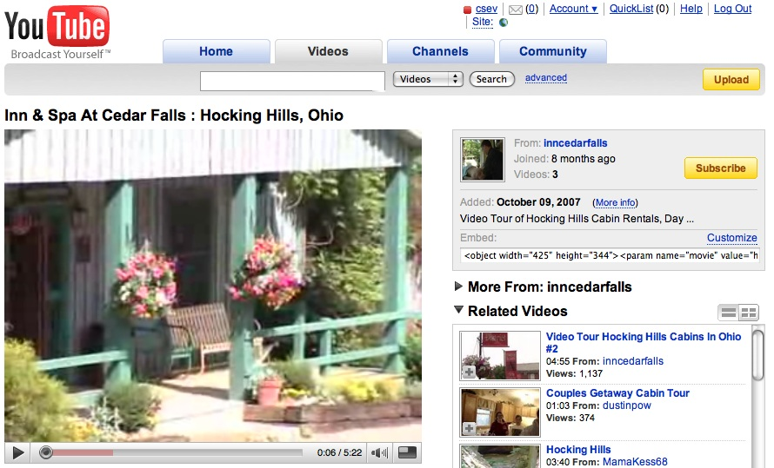
Functionality Mashup

Slide 10
Learning Tool Interoperability
A standard which is currently under development by IMS (www.imsglobal.org) for functionality mash up
Effectively provides Facebook-like capabilities for learning management systems
Read-write access from a tool to the LMS

Slide 11
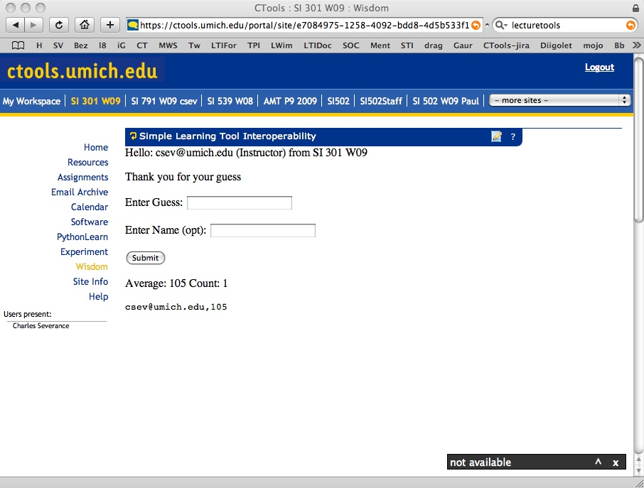

Slide 12
B
R
O
W
S
E
R
L
M
S
T
O
O
L
CLICK
WEB SVC
HOW LTI
LAUNCH
WORKS
AUTO
POST
IDENTITY, COURSE, ORG, SIGNATURE
SESSION
COOKIE
CLICK

Slide 13
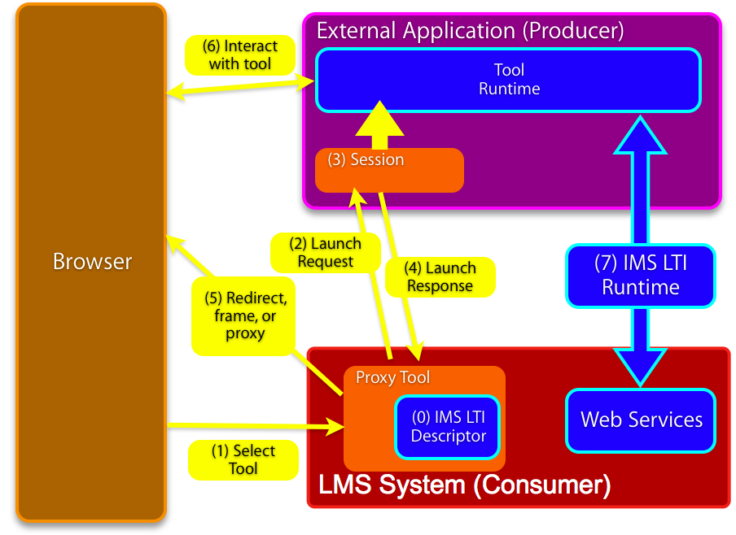
Full IMS LTI

Slide 14
IMS Learning Tool Interoperability 2.0
Currently in Development
Learning Functionality Mash Up
Integrated into “Add Resource” in learning
systems

Slide 15
Scenarios
IMS LTI 2.0 tool installed by the administrator – end-users don’t even realize the tool is hosted externally
IMS LTI 2.0 generic tool available to instructors – to be placed and configured Mash-Up style (like a general-purpose RSS reader or web-content tool)
An IMS LTI 2.0 tool is placed when a publisher cartridge is loaded – often these are partially provisioned

Slide 16
Virtual Tool - Admin Install
Administrator installs a proxy tool and makes it available as a regular tool
Administrator configures services “sandbox” for the remote tool – exchange of key material
  Tool may have permission to connect asynchronously
  Tool may have permission to places “resources” – instances of itself in a course shell

Slide 17
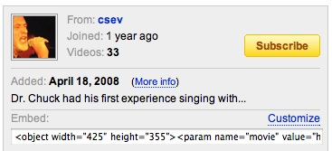
Instructor MashUp – YouTube
Instructor creates some learning object in an external service (freelearningsoftware.com)
The service presents a URL + password
The instructor pastes
this information into
an LTI Consumer Tool
in the LMS

Slide 18
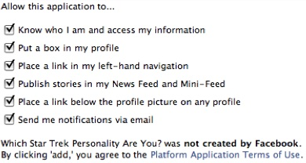
Instructor MashUp – SandBox
For instructor mash up – the Instructor configures the ”sandbox” at the time of mash up
The admin can set an
inherited “sandbox”
for all instructor-
placed tools.

Slide 19
Common Cartridge
Scenario 1: Content points to a pre-trusted host such as content.pearson.com – administrator has a sandbox pre-configured for tools that point to the pre-trusted host
Scenario 2: When there is no pre-arranged trust/sandbox – a placement from a cartridge behaves as an instructor-placed IMS LTI proxy tool.

Slide 20
Sample K12 Scenario
Publisher content integrated into a variety of LMS systems
  Single key per school or single key per course
Single sign on via web services
Provisioning (lazy) of rosters as students launch
Future: Reverse flow for grades or tracking

Slide 21
Current Status
IMS LTI 2.0 Full Spec is progressing well
We are fast tracking some portions of the spec
  LTI + Common Cartridge
  LTI Launch Protocol
We have demo code for the non-spec “Simple LTI”

Slide 22
Experiments / Demos SimpleLTI
We have a number of code bits in hand
  Python and PHP Tool Producer
  Moodle Tool Consumer
  Sakai Tool Consumer
  .NET Tool Consumer
If we can leverage our existing code – we can make demos pretty comfortably

