Slide 1


IMS Learning Tool Interoperability - Demonstrators
Dr. Charles Severance
IMS Global Learning Consortium
Developer Network Coordinator

Slide 2
Demonstrations to Date
Content Integration
  McGraw-Hill Katana
  Pearson TPI
LMS Integration
  Angel
  Sakai
  Moodle
  Microsoft QuickLMS

Slide 3
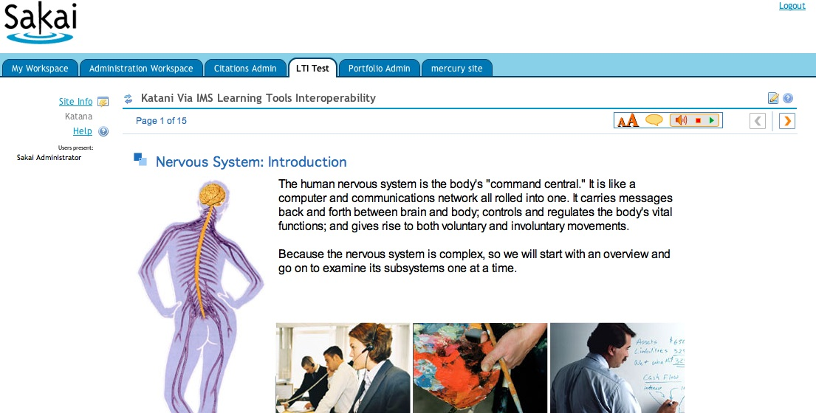
McGraw-Hill / Sakai

Slide 4
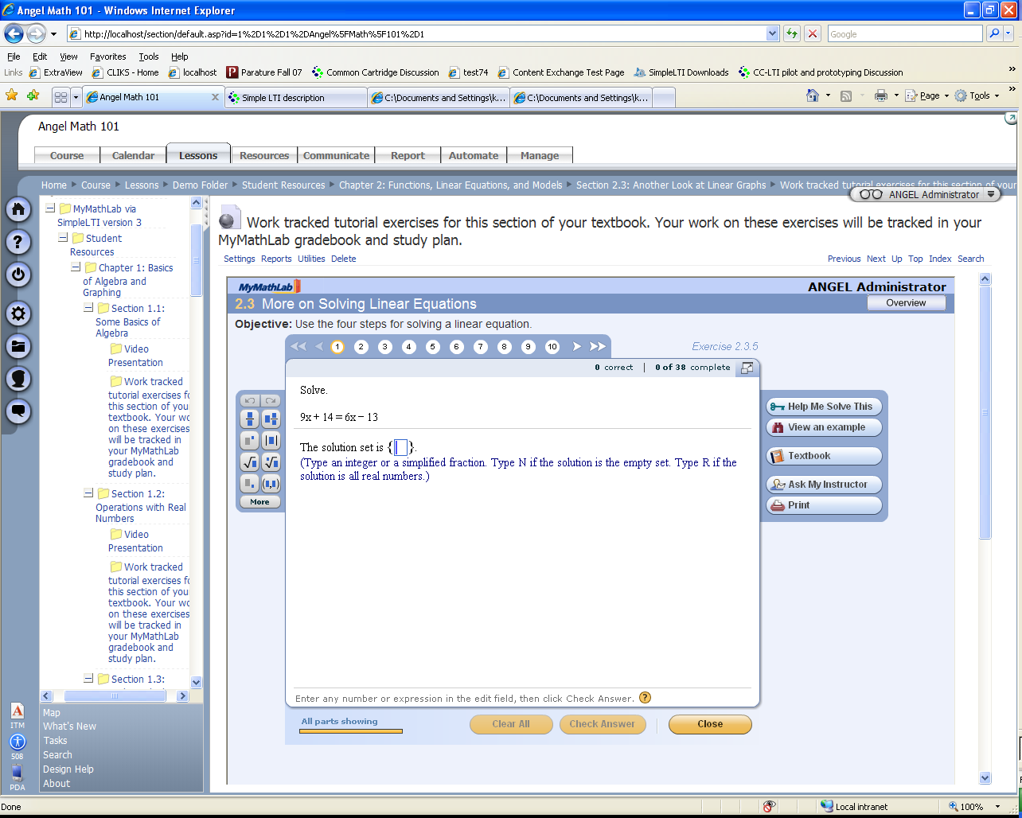
Pearson / Angel

Slide 5
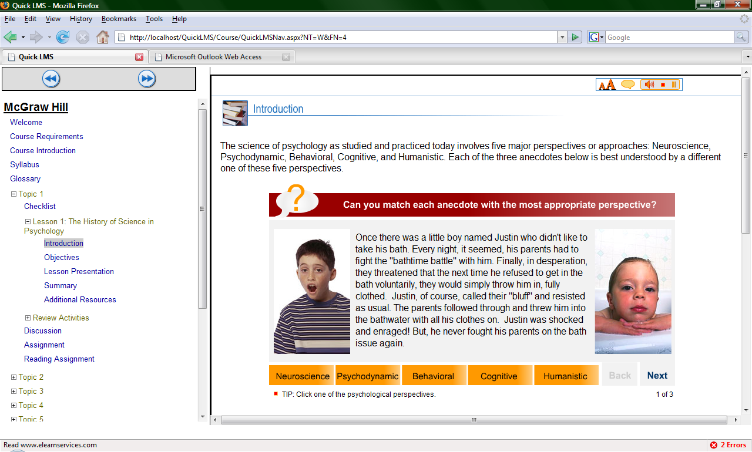
McGraw-Hill / Microsoft

Slide 6
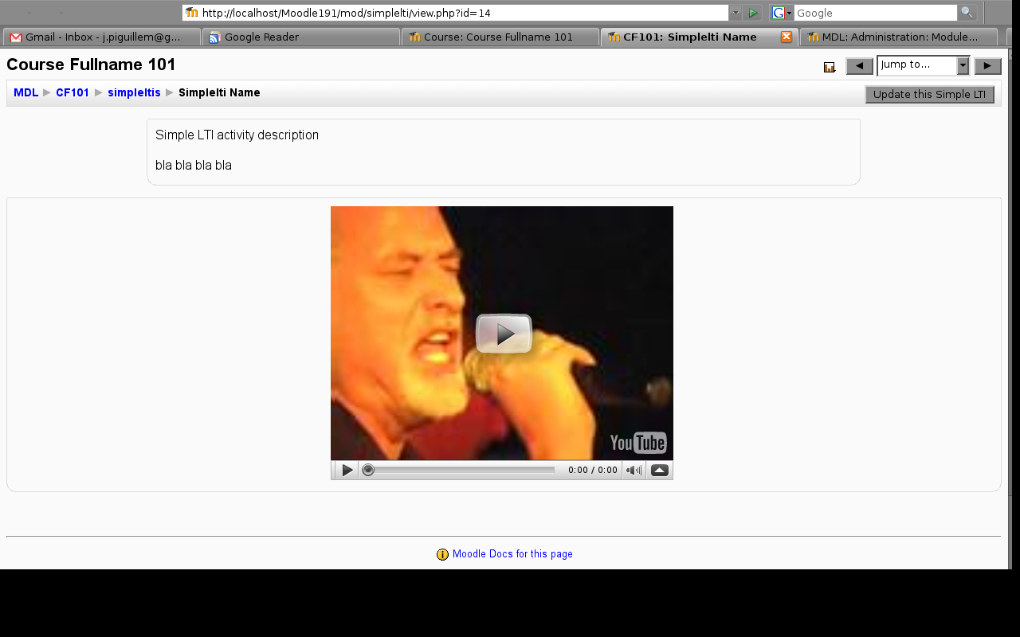
Moodle

Slide 7
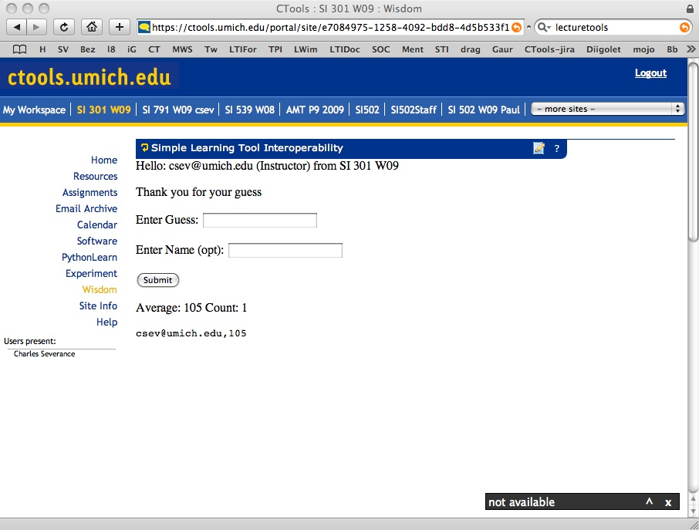
In Production at U-Michigan

Slide 8
IMS LTI 2.0
IMS is developing a broad standard to enable interaction between an LMS system and External content
  Identity, course, role, provisioning, resources, grades, etc
Led by Pearson, BlackBoard, and Wimba
Still in development

Slide 9
IMS Simple LTI
This is a technology demonstrator – not a standard
Goal: explore the issues around interoperability between LMS systems and External tools and Content
Explore architectures needed for software as a service and content as a service
A Subset of the scope of IMS LTI 2.0
Informs the LTI 2.0 development effort

Slide 10
SimpleLTI Scope
Lazy provisioning of users, courses, and roles
  Information is included on each launch – the external tool can and usually does retain roster information
  No guarantee that the external tool will get 100% of the roster
Web services launch and provisioning
One-way flow: Nothing sent back from tool to LMS

Slide 11
SimpleLTI Use Cases
Focus on Software as Service and Content as Service Scenarios
Support for Multi-Tenancy in one service

Slide 12
SimpleLTI Status
Mature specification (informal)
Working code for Python, PHP, Java, and .NET
Available as a Moodle Module, Sakai Tool, or part of the Melete Module Editor in Sakai

Slide 14
B
R
O
W
S
E
R
L
M
S
T
O
O
L
CLICK
WEB SVC
SimpleLTI
LAUNCH
AUTO
POST
IDENTITY, COURSE, ORG, SIGNATURE
SESSION
COOKIE
CLICK

Slide 15
Gateway Approach
Sometimes we develop a “Gateway” server which talks to a Tool/Content’s existing LMS Integration protocol
The gateway talks IMS Simple LTI to the LMS and the gateway talks the proprietary protocol
Allows for quick, reliable and interoperable demos

Slide 16
B
R
O
W
S
E
R
G
A
T
E
W
A
Y
T
O
O
L
CLICK
L
M
S
Proprietary
Protocol
LTI
…..

Slide 17
Resources for a Gateway
Usually 1-2 weeks flow time
Usually 2-3 days of total effort
Key: We need a really sharp high level technical contact who knows LMS integration really well and can help debug when things don’t work
Gateway can be a production transition strategy

Slide 18
Summary
We have a lot of options to explore and demonstrate the capabilities of LTI and help the market prepare for this upcoming standard

