Slide 1

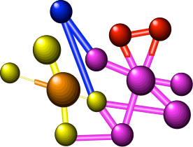
CloudSocial: A New Approach to Enabling Open Content for Broad Reuse
Charles Severance, Ted Hanss, Joseph Hardin
University of Michigan
February 20, 2009

Slide 2
Disclaimer
Report on nascent projects....

Slide 3
Outline
Connecting the LMS and Open Educaitonal Repositories - A brief history
University of Michigan Medical School - Beyond the LMS
CloudSocial - www.cloudsocial.org
IMS Standards - www.imsglobal.org
CloudCollab - www.cloudcollab.com
Warning : This is all under construction

Slide 4




Timeline
2002 - 2003 - Joseph/Chuck - Experimenting in LMS
2004 - 2006 - Joeseph/Chuck Sakai Project
Joseph’s obsession: Better Flow between LMS and OER
2006 - Present - Joseph/Ted - OER open.umich.edu
2007 - Present - Next Generation LMS - Michigan Medical School
2007 - Present - Chuck is Teaching Full Time
2008 - Present - Chuck works part time for IMS

Slide 5
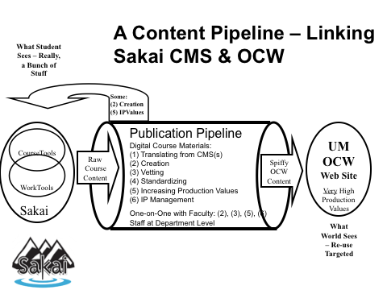

Slide 6







LMS
Publish
OER

Slide 7
OER
LMS
Import
Import
Publish
Import
LMS
LMS
OER
LMS
This won’t scale. At some point - success leads to failure. Moving the data into and out of the LMS is a bad plan.
Import
Import
OER
Publish
Import
Import
OER
Share
LMS
Publish
Publish
Import
Import
Publish
Import
LMS
OER
LMS
OER
OER
Publish
LMS
Import
LMS
OER
Import
Import
Publish
OER
LMS

Slide 8
Brainstorming
Beyond the LMS

Slide 9
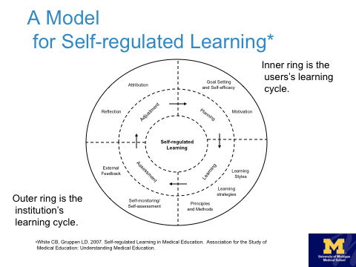

Slide 10
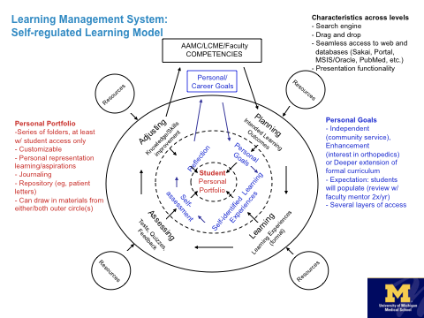

Slide 11
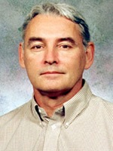
Next Generation LMS
Self Regulated Learning
A blending of the individual needs and the instituional needs
LMS cannot constrict content
Lifelong Education
Competency tracking across courses and throughout life
Portfolio is implicit
Informal and formal learning
Support for ad hoc learning
Support for setting personal goals
Open Educational Resources are foundational
  Don’t worry about resources
  We know this takes time - we are patient

Slide 12
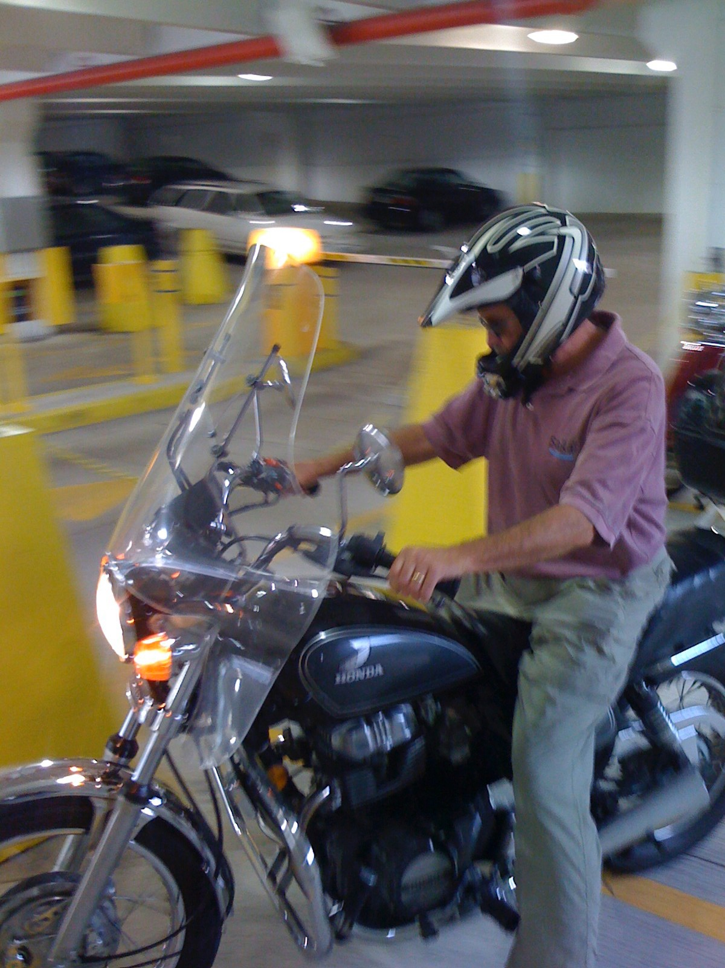
Brainstorming
Met every two weeks with Dean, Faculty, Educational Designers, Open Michigan staff, Software Developers
Brainstormed - Gave presentations, shared big ideas
Installed and played with LMS/Portfolio Systems: Sakai,
Moodle, LAMS, Mulhara, Pebble - debated strengths and
weaknesses
Summer 2008: Dean Fantone said, “Enough Talking!”

Slide 13
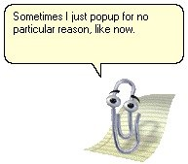
Conclusion from Brainstorm
The scope of this was the entire web - it was not one application
PubMed - we cannot pull that into an LMS
Google Searches and random surfing to learn
If we wanted to build software - it had to be “everywhere” - it had to follow the user as they went around the web
Our software needed to be an “assistant” -
the Microsoft “paperclip”

Slide 14
The Dean’s Challenge
Advanced Medical Therapeutics Course - Fourth Year Students
Four weeks - nearly all online - well produced web content
Often done from hotel rooms while students interview for internships
What could we do with that course?
Failure *was* an option - we should push it and risk it

Slide 15
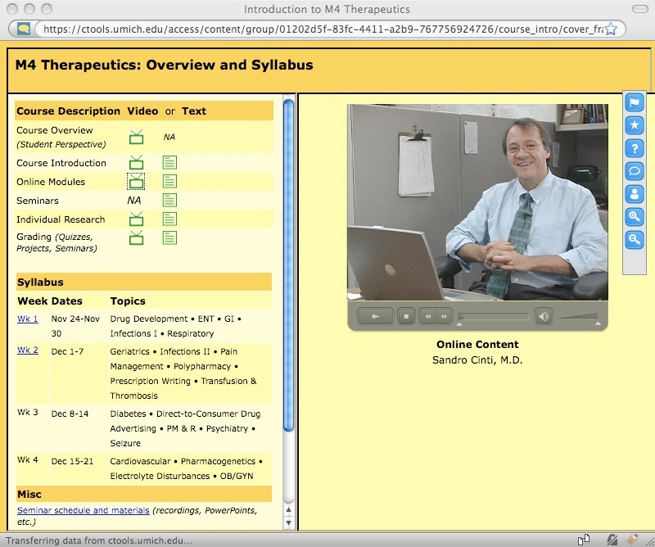
Tools:
Tracking / Presense
Comment / Twitter
NotePad
ToDo List
Question/Answer
Quiz Tracking

Slide 16
Results of First Pilot
Good News
  Everything worked technically
  Faculty loved the idea
  Students loved the idea
  The TODO was the most popular tool
  We learned a lot - terriffic feedback
Bad News
  Students work very much alone and at weird times
  Their time perspective was - “get this over with as quickly as possible”
  No time to ask a question and get an answer
  No time to care what other students were thinking

Slide 17
Positive Effects
Forced us to deploy CloudSocial in production
Built PHP Framework to allow a new tool to be written in 2 days and a new feature to be added in a few hours
Validated techincal the “Tool Mashup” protocol was sound
Proved that we “caused no harm” - Medical School is more confident
Changed our perspective from “will this work” to “what can we do”

Slide 18
Next Steps
Longitudinal Case Study Course
  No prepared web content
  Group work - 12 groups with faculty mentors
  Use Google, PubMed, whatever they find
  Looking at ShiftSpace.org
Open Content Anatomy Web Site
  Used heavily by students in Year 1
  Used from many different directions
  Large, intricate body of valuable content
  Mostly freely available on the web
  OER-like

Slide 19
CloudSocial
(aka “the paperclip”)
www.cloudsocial.org

Slide 20
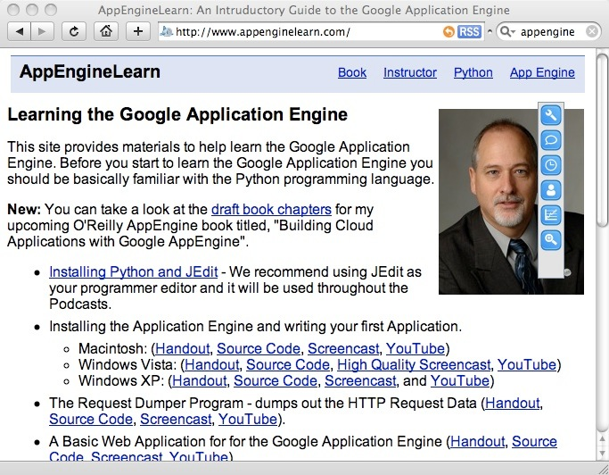
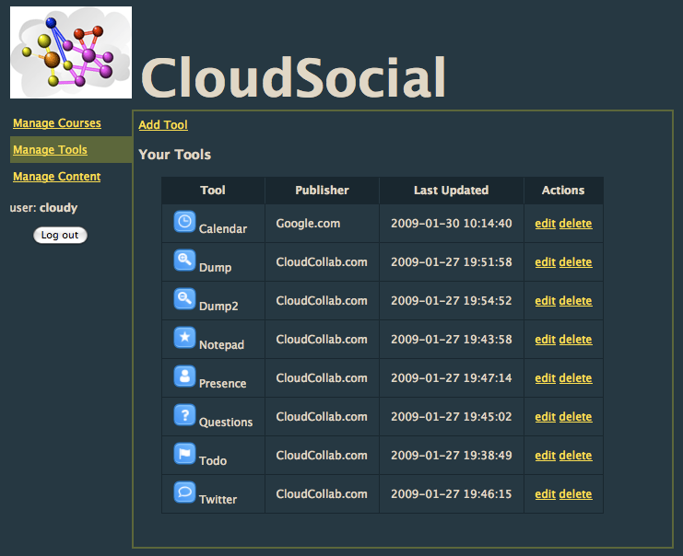
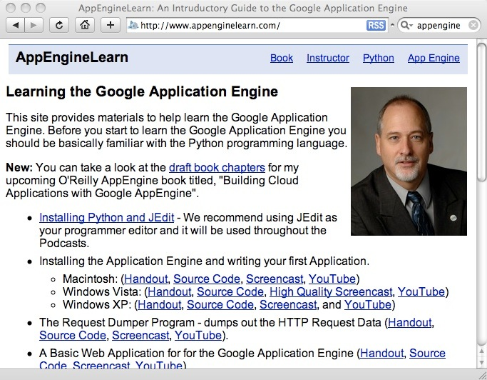
Instrutor picks tools for their course. Tools can come from any learning system.
When the page loads, the CloudSocial run time reads tool list and displays menu.
Content Owner adds CloudSocial Run Time to the Content
<script type="text/javascript"
src="http://www.cloudsocial.net/js/ile-main.js">
</script>
<script type="text/javascript">
ile_init("ILE_33936-10-27_KEY");
</script>

Slide 21
CloudSocial Goals
Stop creating/editing content in Learning Management Systems
Stop creating content for a particular course
Create contextualizale resources - put them on the web with decent URLs to the page level - Add the CloudSocial RunTime to all pages
Contextualize your own material for your students using CloudSocial *the first time you teach*
New Problem: How to best Collectively Create and Manage Materials
“Create Globally, Educate Locally --- www.cnx.org”

Slide 22
Trends in Teaching and Learning
Move toward the “web” as the source of learning content
Move toward open participatory learning and open educational resources
A hybrid approach towards learning where organizational boundaries and educational structure is less clear
Move toward social learning - learning and exploring
with groups
Text

Slide 23
Making Content the Focus
Content lives on the web - on any server using any technology
Instead of moving the content into lots of LMS systems...
Bring your LMS systems “with you” as you visit different sources of content on the Internet

Slide 24
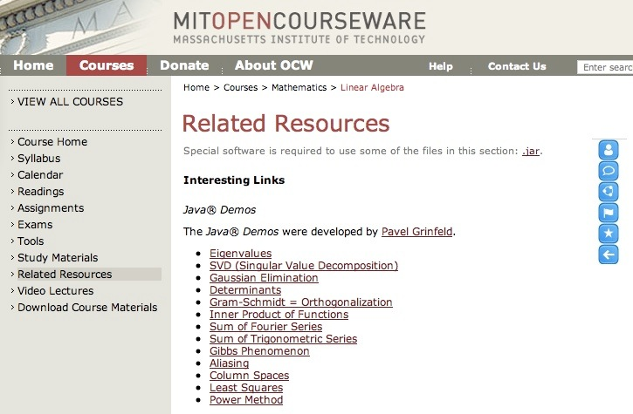
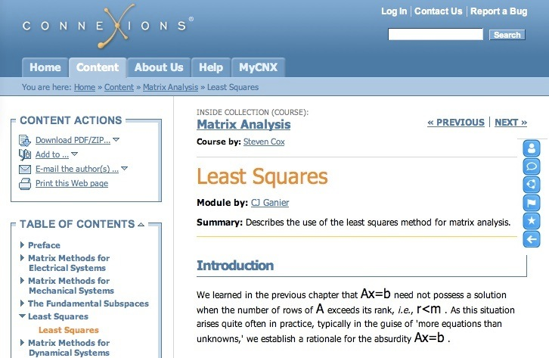
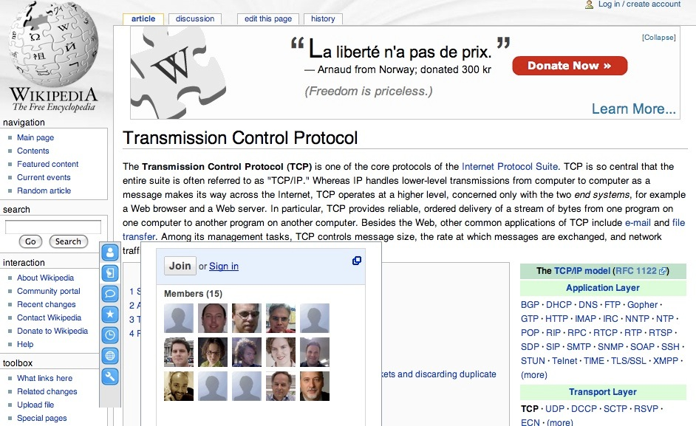

Slide 25
CloudSocial.org
CloudSocial is not an LMS
CloudSocial acts as an intermediary between content owners and learning systems
CloudSocial allows any LMS to embed itself in content for learners who visit that content launched from their LMS
CloudSocial does not touch, store, or handle learning activity data - learning activity data remains on the LMS systems which provide the tools

Slide 26










cloudcollab.com
CloudSocial.org

Slide 27
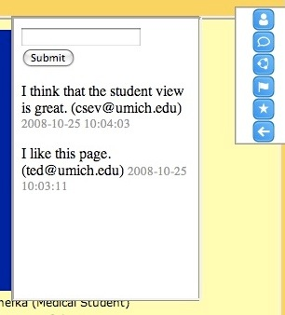
Tool Sources
It is technically possible for tools to come from any LMS that suport IMS Learning Tools Interoperability
I have not yet convinced these systems to build IMS LTI Tools (yet)

Slide 28
Inverting the Content/LMS
Today we focus on putting Content into as Many LMS systems as possible
In the future there will be many sources of content - not just LMS systems - it will be hard to get interchange formats working in all these systems (including legacy)
So lets put the LMS Into the Content.

Slide 30
First Launch
Launch
Content Server
“LMS”
System
Redirect
Config
Tool
cnx.org
Tool
GET
Content Server
Tool
CloudSocial Session Established

Slide 31
Switch to
new page
open.
umich.
edu
LMS
System
Config
Tool
cnx.org
Tool
GET
ocw.mit
.edu
Tool
CloudSocial Session Established

Slide 32
Technical Steps
User selects external content from within the LMS (or other system supporting groups of people)
LMS contacts CloudSocial servers and establishes session context for user/course/insitution combination
User is redirected to the content
Content contacts CloudSocial servers using Ajax/JavaScript and pulls down menu for course and displays

Slide 33
Tool Context
CloudSocial maintains context for the tools
Institution / Course / Role / User / Page
Page context is optional

Slide 34
Learning Tools in the Cloud
The CloudSocial servers only hold a tiny bit of tool configuration for a course - they are not the “LMS”
If done properly, the tools that follow the user around the web can be running back on their campus.
Think of a toolset from each of the major LMS vendors - this insures that sensitive data stays “back home” - and that the user experience is consistent with the rest of their learning
The “embedded Moodle” toolset (kind of like Moodle blocks)

Slide 35
Underlying Technology
This is all based on IMS Learning Tools Interoperability (LTI)
  LMS Launch into CloudSocial uses LTI
  CloudSocial launching to individual tools uses LTI
This means that a piece of content can be used with any LMS that makes its tools available over IMS Learning Tools Interoperability.
A mix of tools can be supported

Slide 36
Benefits
Institution and instructors
  Offers students richer learning experiences as we can't provide it all ourselves.
  Allows us to "pave the footprints in the snow", that is we provide tools and content context where students are headed themselves.
Students
  Can carry this material with them in and out of formal educational experiences and over time.
  Can be the basis for them providing learning experiences for others

Slide 37
IMS Standards
Dr. Charles Severance
Developer Network Coordinator
IMS Global Learning Consortium
cseverance@imsglobal.org

Slide 38
Two IMS Standards
IMS Learning Tools Interoperability - Tool “mash up”
  User Identity, Course, Roster, Role
  Run-Time Services
IMS Common Cartridge - Course Import/Export/Exchange
  Web Content, Discussion Forums, QTI Materials, and LTI (soon)
  LTI in Common Cartridge allows large/high-value content to be referenced rather than included

Slide 39
IMS Developer Network
Lets not just write specs - lets write code while we write specs!
Demos - feedback to the spec development process
It is a “developers network” - I call folks up and we hack
  BlackBoard, Wimba, ANGEL Learning, Sakai, Moodle, McGraw-Hill, Pearson, Microsoft, ...

Slide 40
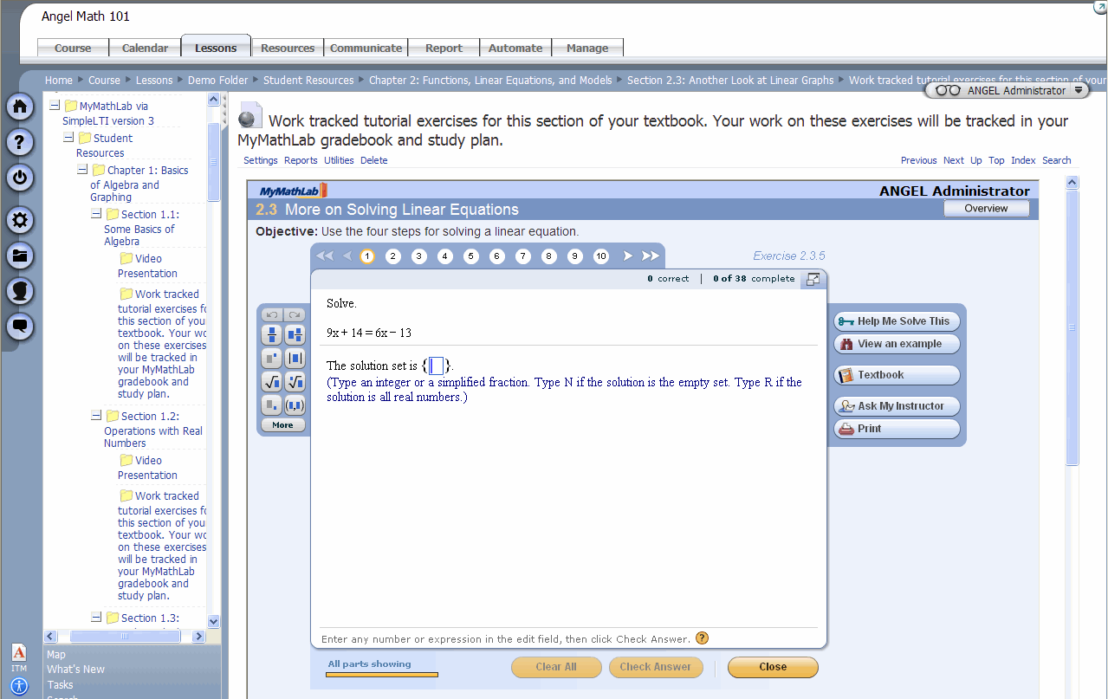

Slide 41
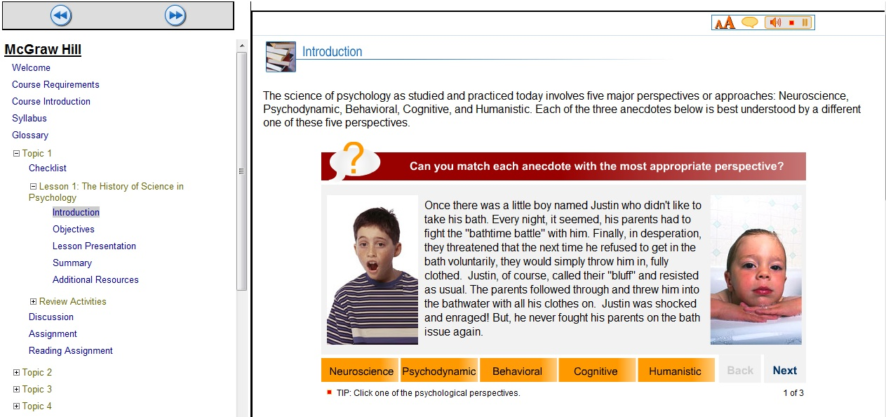

Slide 42
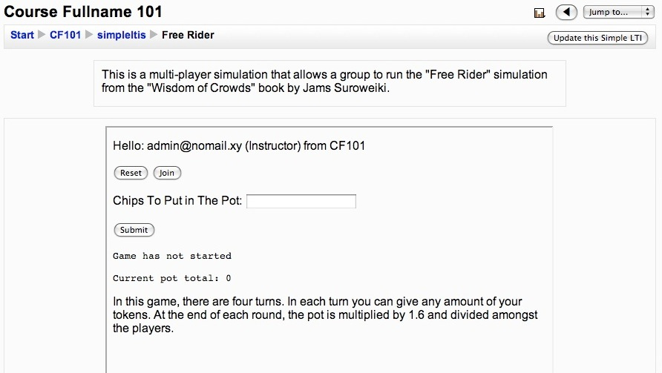
This is my “Clicker”

Slide 43
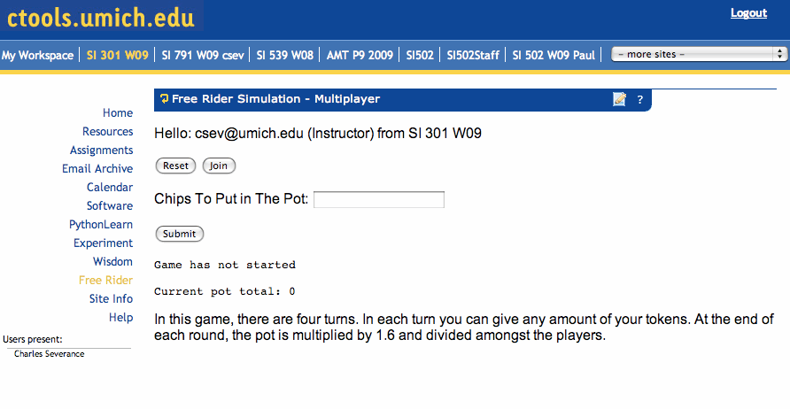
This is my “Clicker”

Slide 44
IMS Advertisement
IMS needs more academic participation
Specification development is members-only because we effectively do it all under mutual NDA - It is kind of fun, actually
But we feel that this is the only way to align interoperability and data interchange specs on “Day One”
www.imsglobal.org

Slide 45

CloudCollab
Yet Another Open Source Learning Management System
www.cloudcollab.com

Slide 46
CloudCollab Differences
Written in Python - Hosted on Google App Engine for free - so every teacher and student can have their *own* LMS in production ....
Intends to be reference implementation of IMS Standards
Multi-Tenancy Capable using IMS LTI - Can host tool instances for multiple LMS systems, multiple courses, and multiple organizations
Flexibility: Can be a LTI “tool container”, personal learning environment, small group LMS, small school LMS

Slide 47
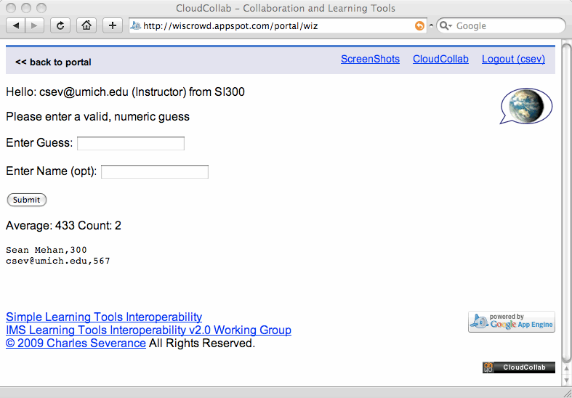

Slide 48
More CloudCollab Differences
Tool Development is simple - Framework takes care of the detail
Wisdom of Crowd guessing tool: 110 lines of Python (includes data models) and 21 lines of HTML.
O’Reilly Book: “Building Cloud Applications with Google AppEngine”
  May 2009
  Early version at www.appenginelearn.com

Slide 50
CloudCollab Summary
Very early days - 4000 lines of code - 1 developer
Two tools - both games for my Social Computing Course :)
I am not in a rush - My main goal is thatI work to make development is easy - testing with grad students who have 1 programming course
  www.cloudcollab.com
  wiscrowd.appspot.com - Demo server

Slide 51
Overall Summary

Slide 52
Distributed Learning Operating System
The same content can be used by millions of students simultaneously - with each having a view that is controlled by their “course”
A course launched from Moodle (or any LMS) could use Moodle tools
The learning data can be kept exclusively on a campus’s servers to comply with legal issues
At the same time these launches can come from other
social systems like LinkedIn or Facebook

Slide 53
Looking Ahead
Build and harden the technology
Document the technology for ease of use and development
Deploy CloudSocial services in a consortium model that is trusted and seen to be “owned by all” - like handle.net
Convince content owners to use the technology
Make it easy to build new tools that can plug in

Slide 54
Possible Content Partners
Individual faculty members
open.umich.edu
Commercial Publishers
ConneXions
EduCommons
MIT OCW
WIkipedia
???

Slide 55
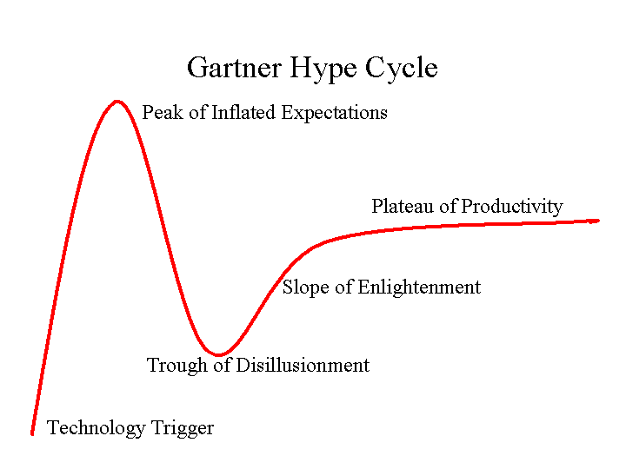
My Approach
I am a faculty member and IMS Consultant - I do this in my spare time
This is fun - there is no rush
I am involving lots of students
I want to stay ahead of the hype curve
I want a few good collaborators who can help make it right
Viral

Slide 56
Thanks
IMS Global Learning Consortium, the William and Flora Hewlett Foundation, the University of Michigan Medical School, Microsoft, Pearson Education, McGraw-Hill Higher Education, ANGEL Learning, Blackboard, LearnGauge, Wimba, Sakai Foundation, Google Summer of Code, and the Software Engineering for Information Systems Group (GESSI) at Universitat Politecnica de Calalunya.
Joseph Hardin, Ted Hanss, Joe Fantone, Casey White, Raj Mangrulkar, Chris Chapman, Mike Bleed, Gaurav Bhatnagar, Noah Botimer, Ali Asad Lotia, Clint Newsome, Eileen Quintero, Amanda Visconti

Slide 57
Summary
CloudSocial inverts the relationship between content and LMS
Put the LMS into the Content instead of putting the content into the LMS
Allows millions of learners independently walking through the same content simultaneously viewing the material from different contexts
This is at the formative stage - many paths forward

Slide 58
Summary
CloudSocial is revolutionary and transformative
But there is a gentle transition path from the present to the future
So we don’t have to lose that which is comfortable to experiment with that which is new
http://groups.google.com/group/cloudsocial

