Slide 1

IMS Learning Tool Interoperability 2.0
Dr. Charles Severance
IMS GLC Developer Network Coordinator
csverance@imsglobal.org / www.dr-chuck.com

Slide 2
IMS Learning Tools Interoperability
Describes a “Proxy Tool” for a Learning Management System
How the tool is installed and registered in the LMS
Tool lifecycle interactions

Slide 3
IMS LTI (cont.)
How the Tool is launched from the LMS including passing roster information
Run-Time Services allowing the tool to read, write, and exchange information with the LMS

Slide 4



LMS
The core LTI use case is that we can augment the tools included in an LMS with externally provided tools.

Slide 5


L
M
S
TOOL
or
Content
LTI also enables large-scale of provisioning of features or content across multiple LMS Systems
L
M
S
….
L
M
S

Slide 6
Common
Cartridge
L
M
S
Content
L
M
S
When LTI is combined with
the IMS Common Cartridge,
publishers can distribute cartridges containing active, authenticated links back centrally hosted content.

Slide 7





L
M
S
L
M
S
Advanced: LTI also allows tools from a learning management system from one vendor to be used in a learning management system from another vendor. An example of this approach is the BlackBoard Connect project which integrates Sakai and Moodle (coming) functionality into BlackBoard.

Slide 8
















Context
Context
Context
Ultimately the “location” or “source” of a tool or content becomes less and less important.

Slide 9


Technical Inspiration for LTI
Adopts many patterns from the approach FaceBook uses for tool integration
Architecturally aligned with the BlackBoard Proxy Tool in BlackBoard 9.0

Slide 10
Learning Tools Interoperability
Leadership
Chairs: Greg McFall, Pearson, Lance Newman, BlackBoard, Bruno Van Haetsdaele, Wimba
IMS Representative: Mark McKell
Weekly Working Group Meetings throughout 2008
Very prolific in document production

Slide 11
LTI Progress in 2008
March 2008: Very mature draft of our initial approach – implementations in BlackBoard, Moodle, and Sakai
April 2008 – BlackBoard offered Bb 9 ProxyTool to the working group as an alternative technical approach – we switched to the new approach

Slide 12
LTI In 2008
May 2008 – Published an informal “Implementation Document” called SimpleLTI that described the new launch protocol to allow some software experimentation to be done
October 2008 – Produced a prototype CC+LTI spec and used this to produce a demo at educause

Slide 13
Educause 2008
Participants: Pearson, McGraw-Hill, Microsoft, and Angel
Built cartridges including LTI from both publishers and played the cartridges in both LMS systems

Slide 14
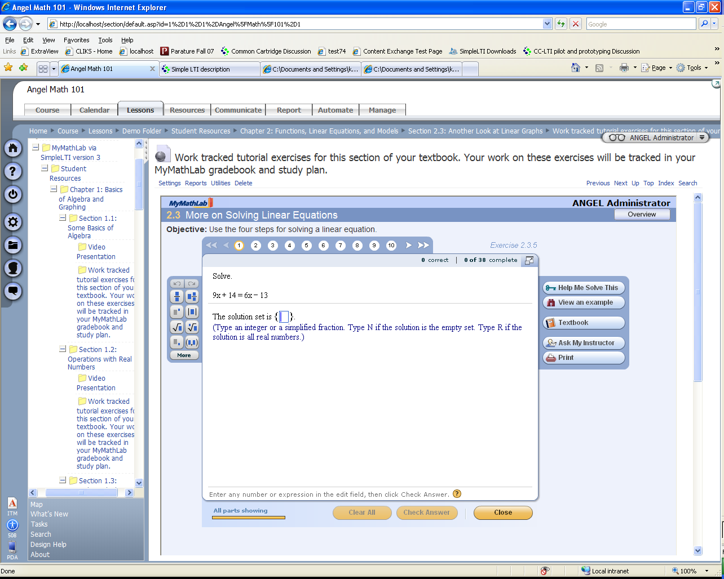
Pearson / Angel

Slide 15
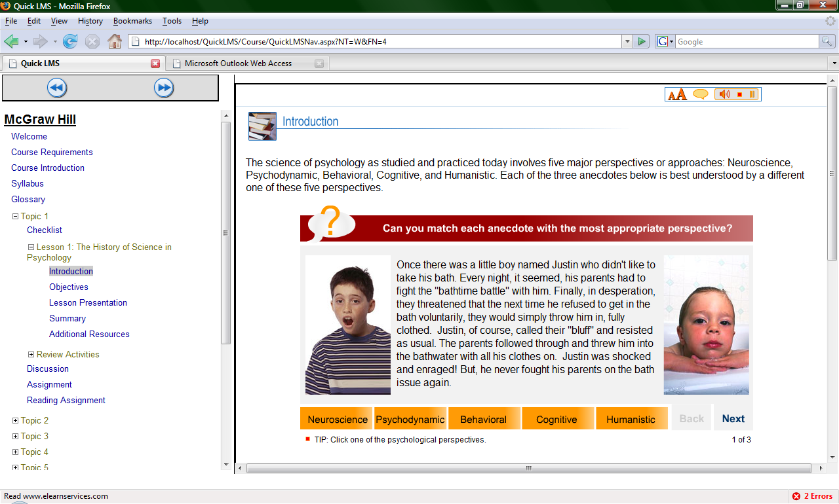
McGraw-Hill / Microsoft

Slide 16
LTI LMS Integrations
Content Integration
  McGraw-Hill Katana
  Pearson TPI
LMS Integration
  Angel
  Sakai
  Moodle
  MIR Learn (Microsoft)
  BlackBoard 9 Proxy

Slide 17
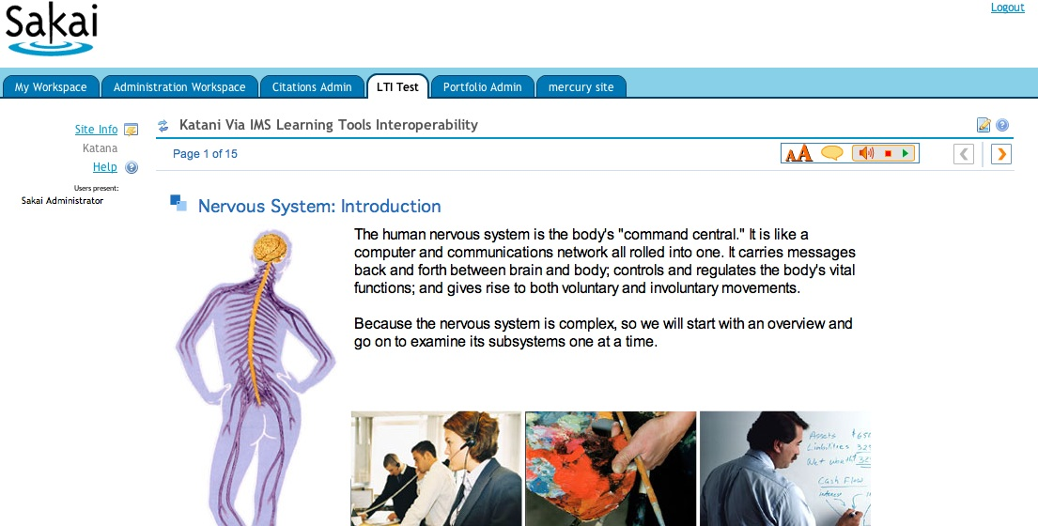
McGraw-Hill / Sakai

Slide 18
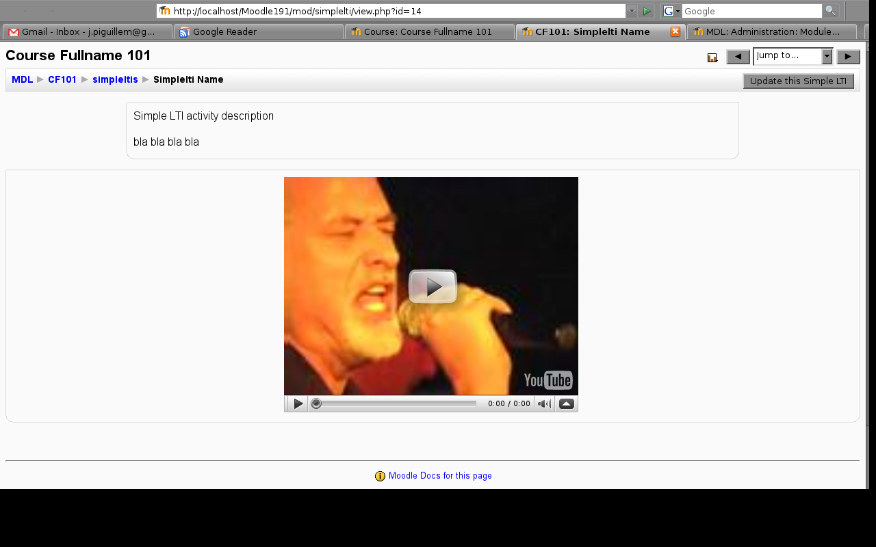
Moodle

Slide 19
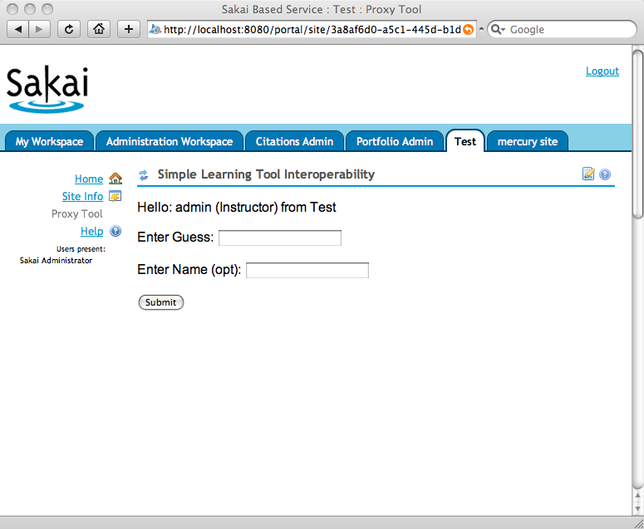
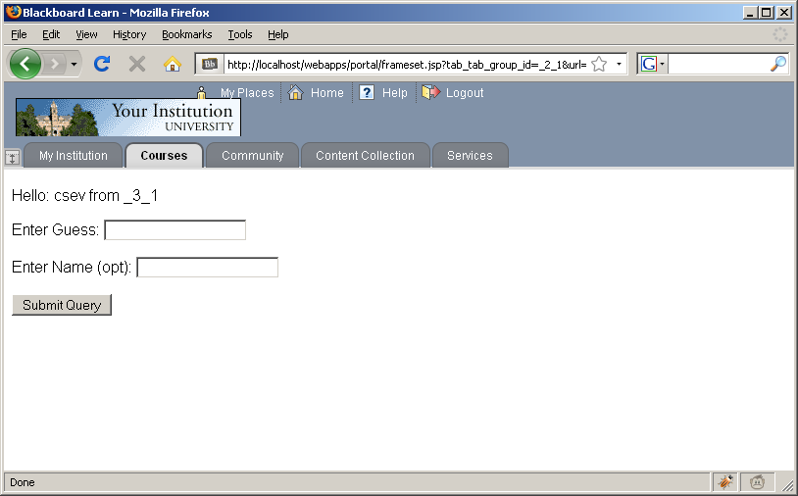
BlackBoard
Sakai

Slide 20
TestFest – Feburuary 2009
A number of experimental implementations of the pre-release version of LTI were demonstrated at the Common Cartridge Test Fest:
  CommonNeed / Stuart Sim (Grails)
  KERIS
  MIRLearn - Microsoft/LearnGauge

Slide 21
LTI in 2009
February 2009: Documents are effectively complete with high consensus within the working group
Moving toward CM / DN Draft and beginning to work on interoperable implementations of LTI 2.0

Slide 22
Common Cartridge and LTI
We will be adding a subset of Learning Tools Interoperability 2.0 to IMS Common Cartridge 1.1
A very basic subset of LTI which supports launch-only (i.e. no runtime services)
Goal is to allow IMS CC Cartridges with Basic LTI to be produced starting Fall 2009

Slide 23
Looking Forward - Strategy
Once we add LTI to Common Cartridge, we have full-spectrum solution to providing high quality user experience which we can iterate over time.
Currently publishers generally have more capabilities than LMS systems when it comes to dynamic learning paths informed by assessment information.

Slide 24
Common Cartridge 1.0
Learner Requirements
Rendered in LMS
Proprietary Publisher Integration
Many question types
Learning Design
Dynamic Paths

Slide 25
Common Cartridge 1.1
Learner Requirements
Rendered in LMS
Publisher Provided Via LTI
Many question types
Learning Design
Dynamic Paths

Slide 26
Common Cartridge x.y
Learner Requirements
Rendered in LMS
Publisher Provided Via LTI
QTI 2.x
More question types
Learning Design

Slide 27
Common Cartridge y.z
Learner Requirements
Rendered in LMS
Publisher Provided
Innovative content and approaches.
QTI 2.x
IMS LD ?.?
We innovate and standardize the effective innovations.

Slide 28
Iterative Approach
With CC 1.1 including LTI we now have a way to meet a broad range of learner requirements through a combination of LMS and external resources
Beyond CC 1.1, we can improve the features of the cartridge over time to described increasingly advanced functionality in the cartridge

Slide 29
Summary
Thank you for your time
IMS LTI gives us a service-oriented approach to deploying tools and content
Going forward we have a very natural way to innovate and evolve while meeting a broad ranger of learner needs.

