Slide 1


IMS Learning Tool Interoperability
Charles Severance
IMS Global Learning Consortium
Developer Network Coordinator

Slide 2
IMS Learning Tools Interoperability
Describes a “Proxy Tool” for a Learning Management System
How the tool is installed and registered in the LMS
Tool lifecycle interactions

Slide 3
IMS LTI (cont.)
How the Tool is launched from the LMS including passing roster information
Run-Time Services allowing the tool to read, write, and exchange information with the LMS

Slide 4



LMS
The core LTI use case is that we can augment the tools included in an LMS with externally provided tools.

Slide 5


L
M
S
TOOL
or
Content
LTI also enables large-scale of provisioning of features or content across multiple LMS Systems
L
M
S
….
L
M
S

Slide 6
Common
Cartridge
L
M
S
Content
L
M
S
When LTI is combined with
the IMS Common Cartridge,
publishers can distribute cartridges containing active, authenticated links back centrally hosted content.

Slide 7





L
M
S
L
M
S
Advanced: LTI also allows tools from a learning management system from one vendor to be used in a learning management system from another vendor. An example of this approach is the BlackBoard Connect project which integrates Sakai and Moodle (coming) functionality into BlackBoard.

Slide 8
















Context
Context
Context
Ultimately the “location” or “source” of a tool or content becomes less and less important.

Slide 9
Learning Tools Interoperability
Timeline
SimpleLTI – Not a formal spec – May 2008
BasicLTI – Launch + Outcomes – Part of IMS Common Cartridge 1.1 – July 2009
IMS LTI 2.0 – End of 2009
  Runtime
  Provisioning
  Launch

Slide 10


Technical Inspiration for LTI 2.0
Adopts many patterns from the approach FaceBook uses for tool integration
Architecturally aligned with the BlackBoard Proxy Tool in BlackBoard 9.0

Slide 11
Learning Tools Interoperability
Leadership
Chairs: Greg McFall, Pearson, Lance Newman, BlackBoard, Bruno Van Haetsdaele, Wimba
IMS Representative: Mark McKell
Weekly Working Group Meetings throughout 2008
Very prolific in document production

Slide 12
LTI Progress in 2008
March 2008: Very mature draft of our initial approach – implementations in BlackBoard, Moodle, and Sakai
April 2008 – BlackBoard offered Bb 9 ProxyTool to the working group as an alternative technical approach – we switched to the new approach

Slide 13
LTI In 2008
May 2008 – Published an informal “Implementation Document” called SimpleLTI that described the new launch protocol to allow some software experimentation to be done
October 2008 – Produced a prototype CC+LTI spec and used this to produce a demo at educause

Slide 14
Educause 2008
Participants: Pearson, McGraw-Hill, Microsoft, and Angel
Built cartridges including LTI from both publishers and played the cartridges in both LMS systems

Slide 15
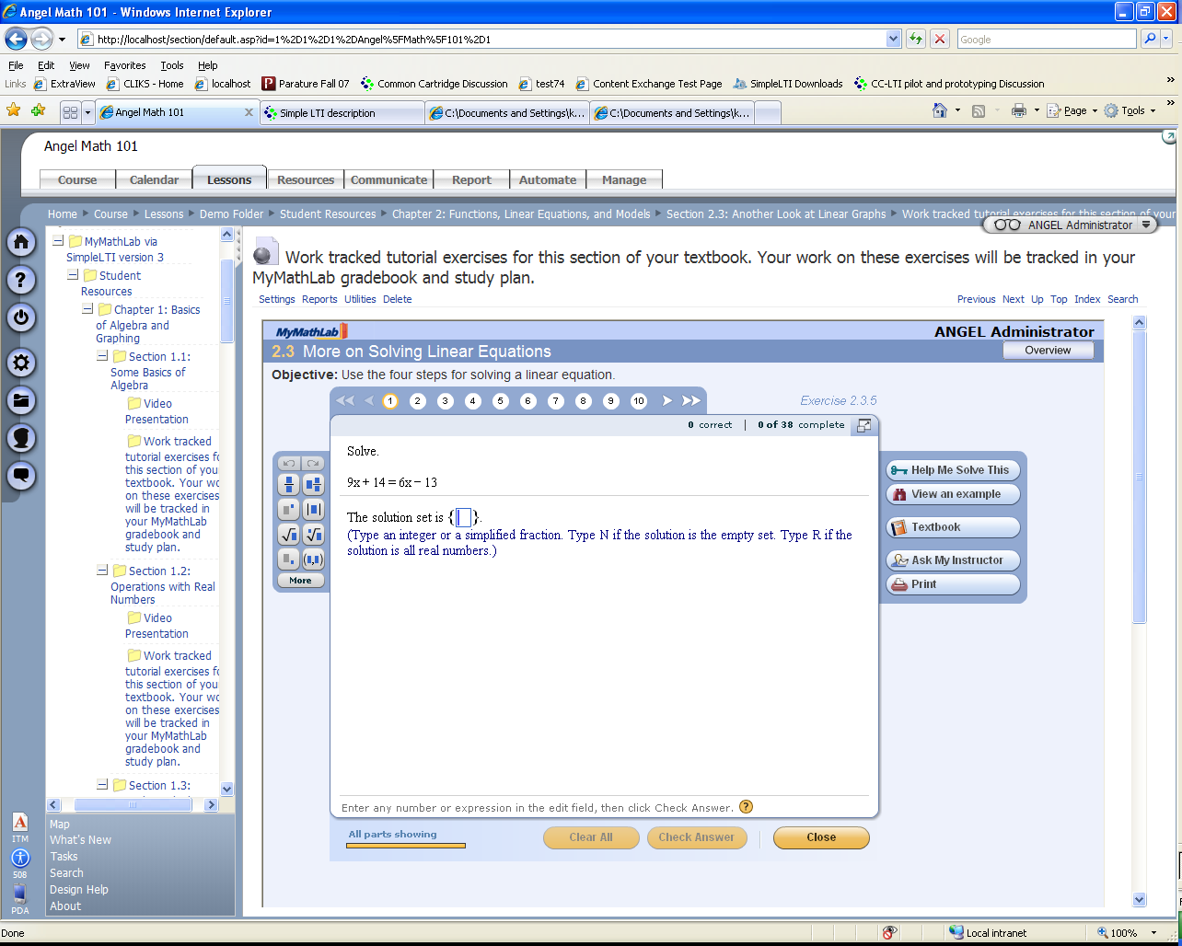
Pearson / Angel

Slide 16
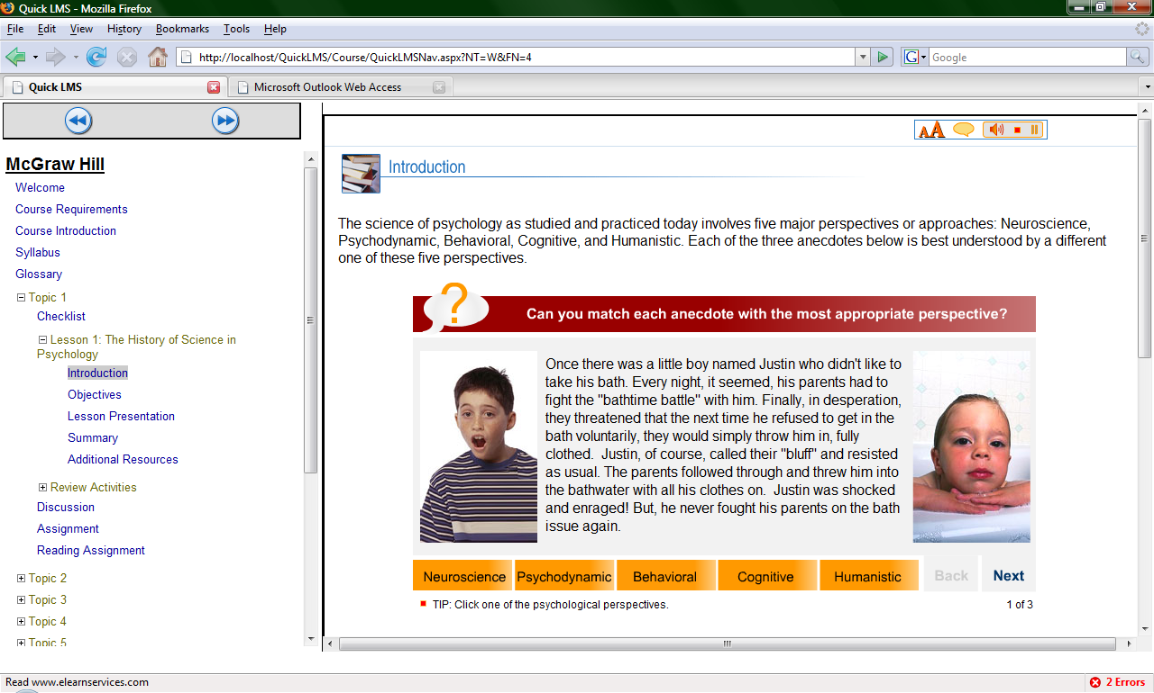
McGraw-Hill / Microsoft

Slide 17
Simple LTI Integrations
Content Integration
  McGraw-Hill Katana
  Pearson TPI
  K12 - www.k12.com
  Google Documents (SAML)
LMS Integration
  Angel
  Sakai
  Moodle
  Microsoft QuickLMS
  Blackboard Building Block

Slide 18
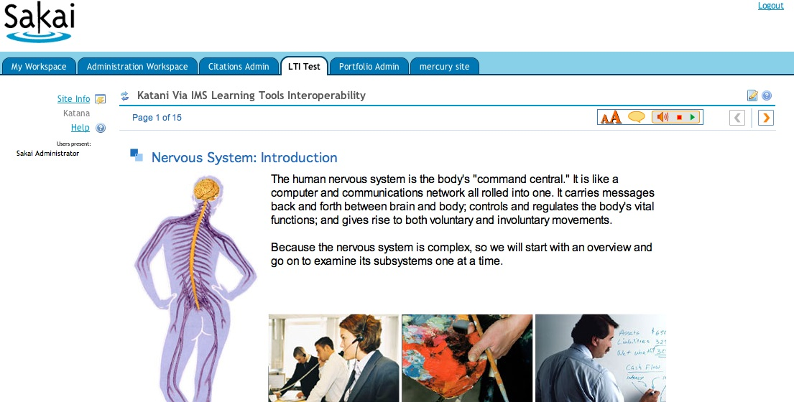
McGraw-Hill / Sakai

Slide 19
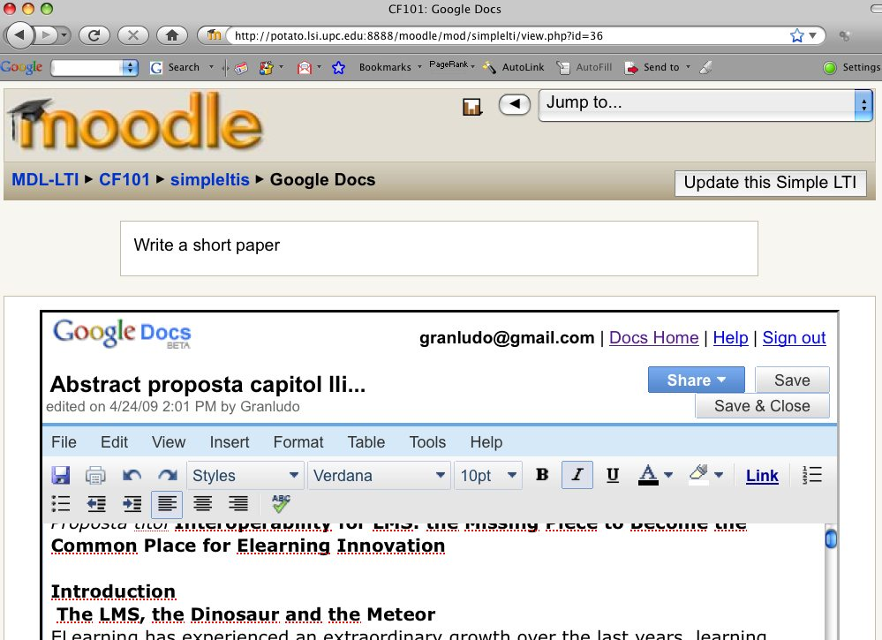

Slide 20
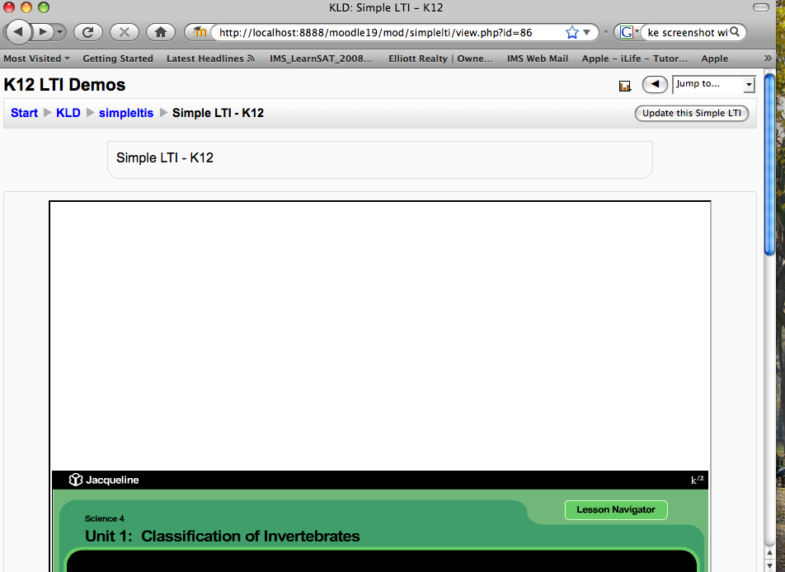
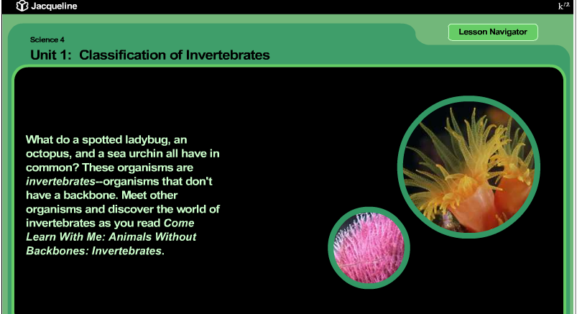

Slide 21
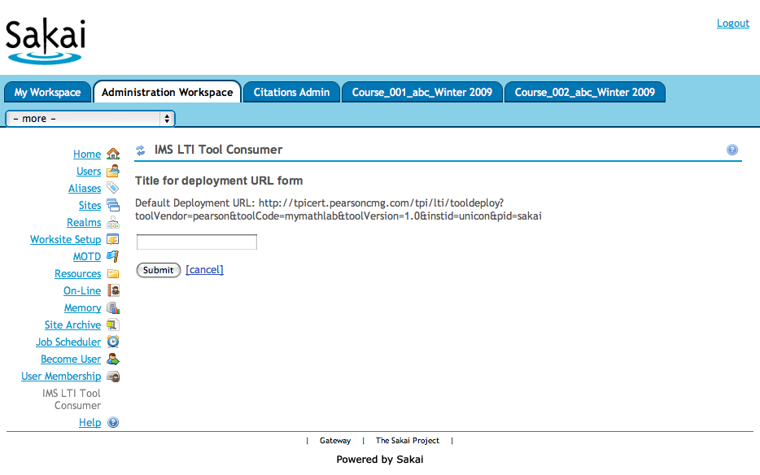
Pearson LTI 2.0 (pre-release)

Slide 22
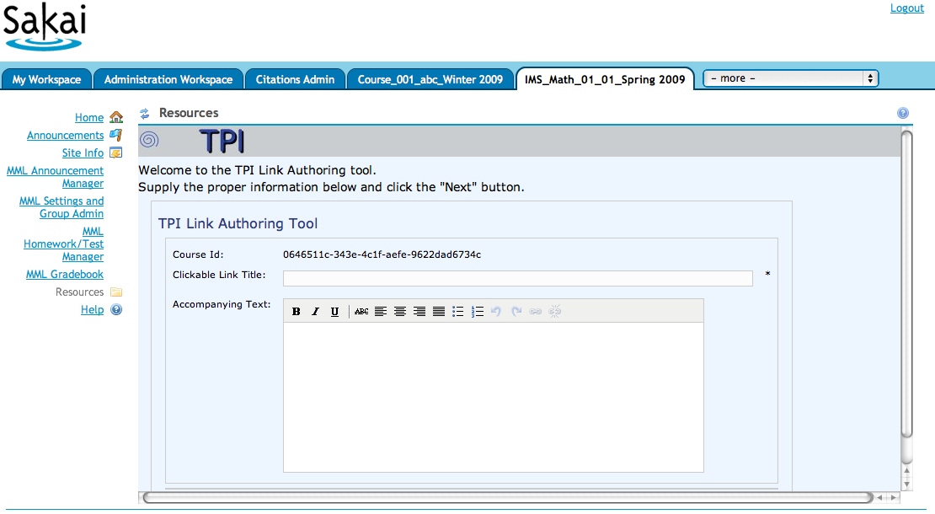
Pearson LTI 2.0 (pre-release)

Slide 23
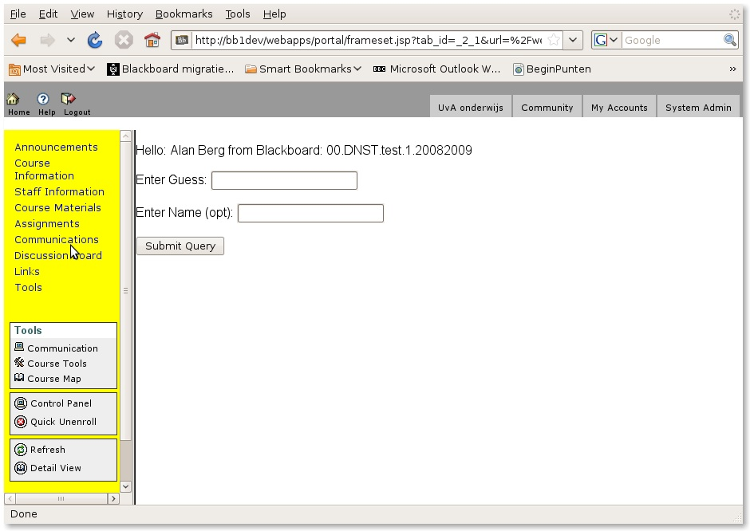

Slide 24
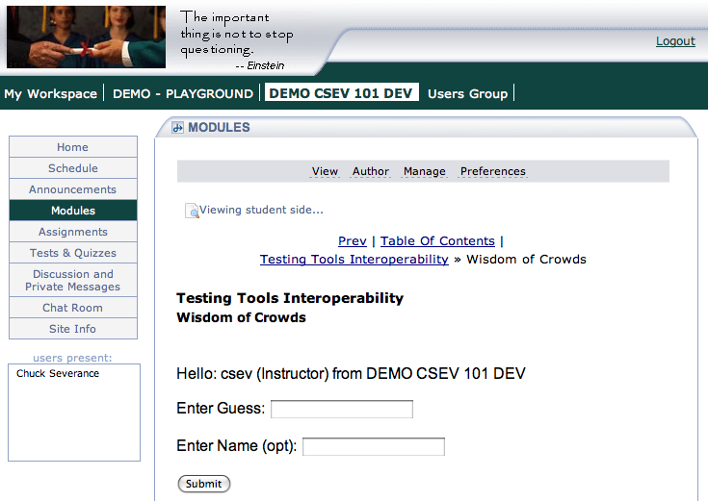

www.tsugiproject.org

Slide 25
LTI in 2009
February 2009: Documents are effectively complete with high consensus within the working group
Moving toward CM / DN Draft and beginning to work on interoperable implementations of LTI 2.0

Slide 26
Common Cartridge and LTI
We will be adding a subset of Learning Tools Interoperability 2.0 to IMS Common Cartridge 1.1
A very basic subset of LTI which supports launch and simple outcomes based on IMS TI 1.0
Goal is to allow IMS CC Cartridges with Basic LTI to be produced starting Fall 2009

Slide 27
Common
Cartridge
L
M
S
Content
L
M
S
When LTI is combined with
the IMS Common Cartridge,
publishers can distribute cartridges containing active, authenticated links back centrally hosted content.

Slide 28
Looking Forward - Strategy
Once we add LTI to Common Cartridge, we have full-spectrum solution to providing high quality user experience which we can iterate over time.
Currently publishers generally have more capabilities than LMS systems when it comes to dynamic learning paths informed by assessment information.

Slide 29
Common Cartridge 1.0
Learner Requirements
Rendered in LMS
Proprietary Publisher Integration
Many question types
Learning Design
Dynamic Paths

Slide 30
Common Cartridge 1.1
Learner Requirements
Rendered in LMS
Publisher Provided Via LTI
Many question types
Learning Design
Dynamic Paths

Slide 31
Common Cartridge x.y
Learner Requirements
Rendered in LMS
Publisher Provided Via LTI
QTI 2.x
More question types
Learning Design

Slide 32
Common Cartridge y.z
Learner Requirements
Rendered in LMS
Publisher Provided
Innovative content and approaches.
QTI 2.x
IMS LD ?.?
We innovate and standardize the effective innovations.

Slide 33
Iterative Approach
With CC 1.1 including LTI we now have a way to meet a broad range of learner requirements through a combination of LMS and external resources
Beyond CC 1.1, we can improve the features of the cartridge over time to described increasingly advanced functionality in the cartridge

Slide 34
Learning Tools Interoperability
Timeline
SimpleLTI – Not a formal spec – May 2008
BasicLTI – Launch + Outcomes – Part of IMS Common Cartridge 1.1 – July 2009
IMS LTI 2.0 – End of 2009
  Runtime
  Provisioning
  Launch

Slide 35
Summary
Thank you for your time
IMS LTI gives us a service-oriented approach to deploying tools and content
Going forward we have a very natural way to innovate and evolve while meeting a broad ranger of learner needs.

