Slide 1
IMS Developer’s Workshop Notes
July 16, 2009
Montreal
Dr. Charles Severance
IMS Global Learning Consortium
Developer Network Coordinator

Slide 2
Community Developer Forum
http://www.imsglobal.org/community/forum/index.cfm?forumid=11
Requires free IMS Community Account
Won’t provide access to unreleased specs
Will talk a lot about code and implementation

Slide 3
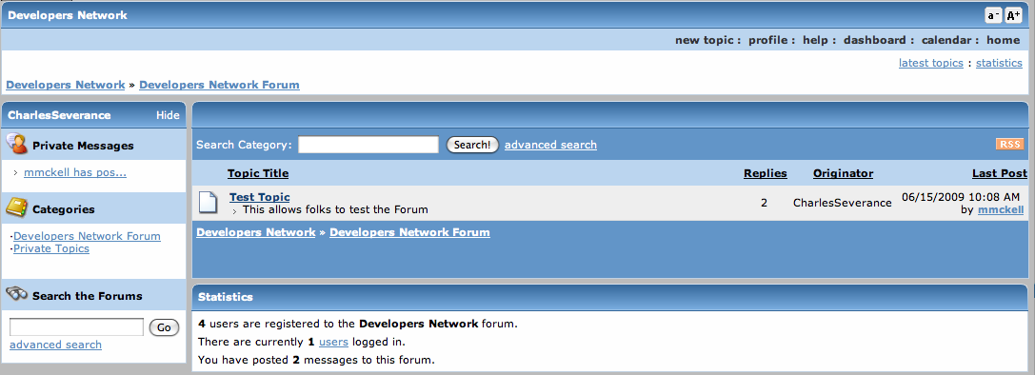

Slide 4
Affiliate Developer Forum
http://www.imsglobal.org/community/forum/index.cfm?forumid=5
Requires IMS Affiliate or Contributing Membership
Can talk about unreleased specifications

Slide 5
Text Editor
Make sure you have some kind of plain text editor to edit files. Word will not work. Even Notepad and text edit can mess up file formats when saving. Something like BBEdit, TextMate, TextWrangler, Notepad+, JEdit, Windows command-line edit, VIM, Eclipse, or other editor which can edit text files and not mess them up is fine.

Slide 6


Java ?? PHP ??
You can use either Java or PHP for the workshop - they are equivalent. The code we will edit is nearly equivalent in either language.
While the Java setup below may seem simpler, it assumes that you have already installed Java and are familiar with Tomcat.
So unless you are an experienced servlet developer in Java – use PHP.
Experienced programmers can follow along on both at the same time if you like.

Slide 7
Pre-Step - Java
Unzip ims-workshop/data/ims-code/ims-tomcat-5.5.23.zip into a folder.
This is a fully-configured and ready to start Tomcat.
The source code is in webapps/java-servlet
Run startup.bat or startup.sh - watch catalina.out
Navigate to http://localhost:8080/java-servlet - You should see the welcome screen

Slide 8
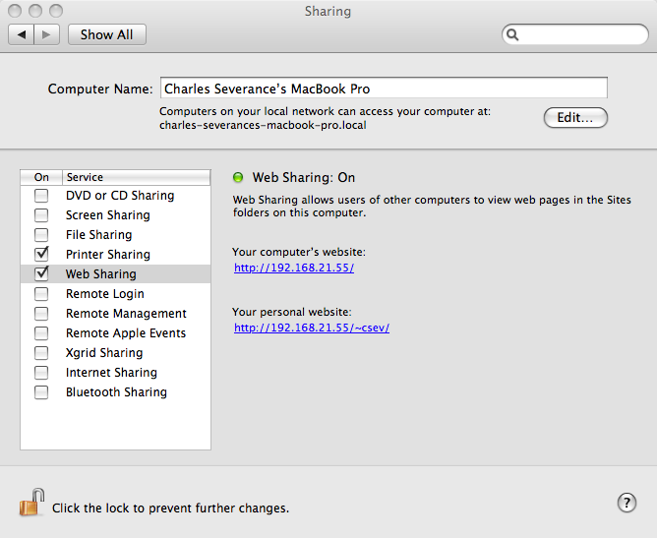
Mac-Only: Disable Web Sharing
The built-in PHP for Mac does not include the unzipping library so we need to turn it off.
System Preferences -> Sharing

Slide 9
Pre-Step – Install PHP
Install XAMPP (Windows or PC)
http://www.apachefriends.org/en/xampp.html
Unzip ims-workshop/data/ims-code/php-simple.zip and move into XAMPP
Macintosh:
/Applications/XAMPP/htdocs/php-simple
Windows:
C:\xampp\htdocs\php-simple

Slide 10
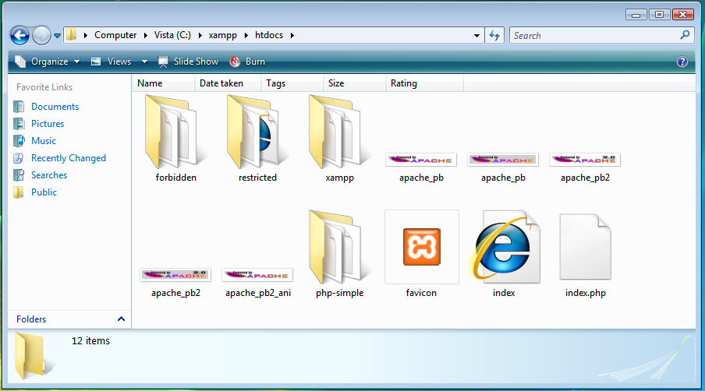
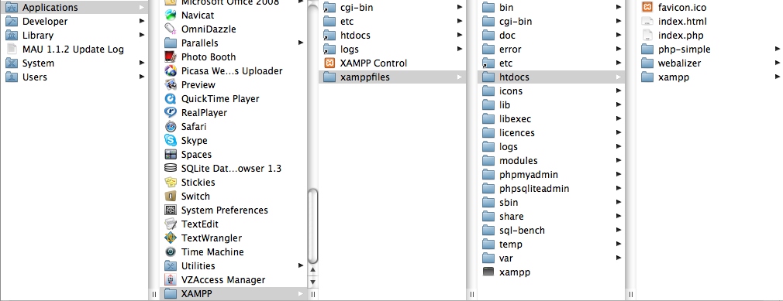

Slide 11
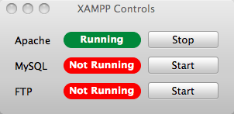
Start XAMP
Windows – Desktop Control Panel
  You may get security dialogs – read carefully and press “allow”
Macintosh
  Applications -> XAMPP -> XAMPP Control

Slide 12
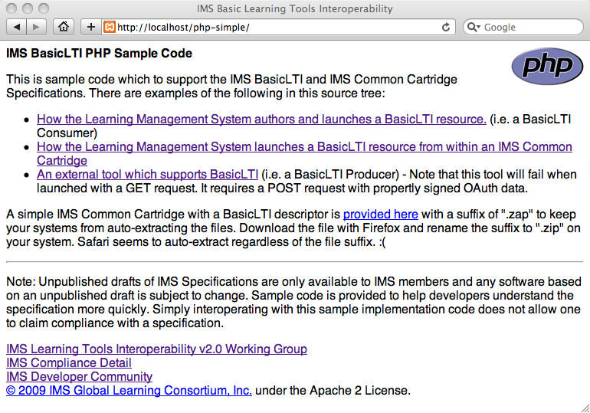
Test your PHP Install

Slide 13
Exercise 1 - Explore
Launch to your “tool.php/tool.jsp” with LMS and Resource secrets – and use right and wrong secrets – verify success and failure

Slide 14
Exercise 2 – Fix the LMS Info
In blti_util.php / blti_util.jsp – change the LMS information so it no longer looks like we are the same people ☺
// Setup some fake data from the LMS
private Properties getLMSDummyData(Properties postProp) {
postProp.setProperty("resource_link_id","120988f929-274612");
postProp.setProperty("user_id","292832126");
postProp.setProperty("roles",”Learner");
postProp.setProperty("lis_person_name_full","Charles R. Severance");
postProp.setProperty("lis_person_contact_email_primary","csev@umich.edu");
postProp.setProperty("lis_person_sourced_id",”umich.edu:csev");
postProp.setProperty("context_id","456434513");
postProp.setProperty("context_title","SI301 - Java");
return postProp;
}

Slide 15
Exercise 2 – Fix the LMS Info
Then go to your lms.php / lms.jsp
Launch to tool.php / tool.jsp to test your changes
Then launch to
  http://wiscrowd.appspot.com/wiscrowd/12345/
  Key = 12345 secret = secret
We will play a multi-user game and possibly crash my Google Application

Slide 16
Exercise 3 - Upload A Cartridge
Navigate to cc.php / cc.jsp
Select the cartridge and upload – look at the various items from the cartridge
Launch the BasicLTI link – Welcome back!

Slide 17
Exercise 4 – Hack the Cartridge!
Unzip
Easy version:
  Hack BasicLTI/wiscrowd.xml
Advanced
  Copy BasicLTI/wiscrowd.xml to freerider.xml and edit
  Hack imsmanifext.xml, add resource and organization
Re-zip – from the directory with imsmanifest.xml
Re-Upload and launch to FreeRider

Slide 18
<?xml version="1.0" encoding="UTF-8"?>
<basicltiresource xmlns="http://www.imsglobal.org/services/cc/imsblti_v1p0"
xmlns:xsi="http://www.w3.org/2001/XMLSchema-instance">
<title>Wisdom of Crowds</title>
<custom>
<parameter key="isbn">9780596800697</parameter>
</custom>
<launch_url>http://wiscrowd.appspot.com/wiscrowd/1234/</launch_url>
<vendor>
<code>www.wiscrowd.com</code>
<name>Wisdom of Crowds</name>
<description>
A simple guessing game.
</description>
<contact>
<email>cseverance@imsglobal.org</email>
</contact>
<url>http://www.wiscrowd.com/</url>
</vendor>
</basicltiresource>
Change to “freerider”

Slide 19
Exercise 5 – Step through tool
Slightly different flows
  PHP: datastore.php
  Java: lms.jsp (Consumer lookup happens in the main code)

Slide 20
Exercise 6 – Quick look at the CC
cc.php / cc.jsp

