Slide 1


IMS Basic Learning Tools Interoperability
Charles Severance
IMS Global Learning Consortium
Developer Network Coordinator

Slide 2
Learning Tools Interoperability
Terminology and Timeline
SimpleLTI – Not a formal spec – May 2008
  simplelti.appspot.com
BasicLTI – Launch + Outcomes – Part of IMS Common Cartridge 1.1 – July 2009
IMS LTI 2.0 – End of 2009
  Runtime / Provisioning / Launch

Slide 3
BasicLTI – A Profile of LTI 2.0
Focus on Launch and CC Integration
Will be an approved and released IMS specification
First IMS Developer’s Workshop on BasicLTI and IMS Common Cartridge
  Thursday July 16, 2009 – Montreal, CA
  www.imsglobal.org

Slide 4
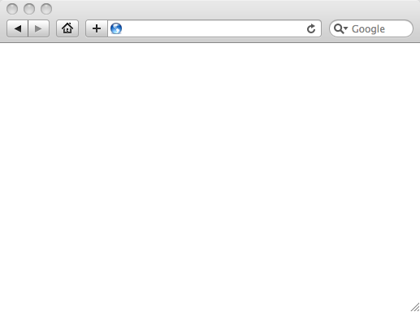
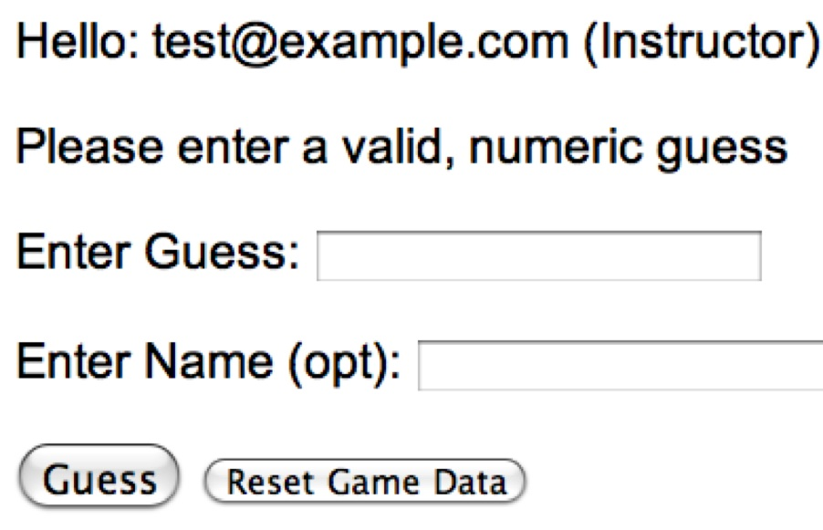
LMS (LTI Consumer)
User Experience
Welcome
Local Resource
Lame iFrame
LTI Tool
Movie
Tool (LTI Producer)
© Copyright 2009 IMS Global Learning Consortium
All Rights Reserved.

Slide 5
LMS (LTI Consumer)
Again in slow motion…
LMS Looks up User and Course Information.
Information is signed using secret and OAuth
Welcome
Local Resource
Lame iFrame
LTI Tool
Movie
Form data sent to Browser
Tool (LTI Producer)
© Copyright 2009 IMS Global Learning Consortium
All Rights Reserved.

Slide 6
LMS (LTI Consumer)
Form is immediately auto-submitted using JavaScript.
<form action=”tool”/>
<input name=”user_id”
value=”2348d8dd” />
<input name=”oauth_token”
value=”abc.edu” />
</form>
Tool (LTI Producer)
Tool looks up secret and validates signature.
Tool provisions user, course, and session.
Tool sends redirect
© Copyright 2009 IMS Global Learning Consortium
All Rights Reserved.

Slide 7
LMS (LTI Consumer)
Browser follows redirect…
<head>
<meta redirect
page=”main.php”>
</head>
Tool (LTI Producer)
Tool produces
first page.
© Copyright 2009 IMS Global Learning Consortium
All Rights Reserved.

Slide 8
LMS (LTI Consumer)
Tool (LTI Producer)
© Copyright 2009 IMS Global Learning Consortium
All Rights Reserved.

Slide 9
BasicLTI Data Model Elements
lti_version = basiclti-1.0
resource_link_id = 120988f929-274612
user_id = 292832126
roles = Instructor
lis_person_name_full = Charles R. Severance
lis_person_contact_email_primary = csev@umich.edu
lis_person_sourced_id = csev
context_id = 456434513
context_title = SI301 - PHP
tool_consumer_instance_guid = umich.edu
tool_consumer_instance_description = University of Michigan

Slide 10
BasicLTI in Common Cartridge
Welcome
Local Resource
Folder
LTI Tool
Discussion
QTI Pool
Common Cartridge 1.1 will include the ability to define a Basic LTI resource and include that resource in course organizational structures

Slide 11
BasicLTI Descriptor (CC 1.1)
<?xml version="1.0" encoding="UTF-8"?>
<basicltiresource
xmlns="http://www.imsglobal.org/services/cc/imsblti_v1p0"
xmlns:xsi="http://www.w3.org/2001/XMLSchema-instance">
<title>A Simple Descriptor</title>
<custom>
<parameter key="Cool:Factor">120</parameter>
</custom>
<launch_url>
http://wiscrowd.appspot.com/wiscrowd/12345/
</launch_url>
</basicltiresource>

Slide 12
<basicltiresource
xmlns="http://www.imsglobal.org/services/cc/imsblti_v1p0"
xmlns:xsi="http://www.w3.org/2001/XMLSchema-instance">
<title>Title</title>
<description>Description</description>
<icon>url to an icon for this tool (optional)</icon>
<secure_icon>url to an icon for this tool (optional)</secure_icon>
<cartridge_icon identifieref="BLTI001_Icon" />
<custom>
<parameter key="keyname">value</parameter>
</custom>
<launch_url>url to the Basic LTI launch URL</launch_url>
<secure_launch_url>url to the Basic LTI launch URL</secure_launch_url>
<extensions platform="www.lms.com">
<parameter key="keyname">value</parameter>
</extensions>
<vendor>
…
</vendor>
</basicltiresource>

Slide 13
<vendor>
<code>vendor.com</code>
<version>4.32</version>
<name>Pearson Education</name>
<description>
This is a Gradebook that supports many column types.
</description>
<contact>
<email>support@vendor.com</email>
</contact>
<url>http://www.vendor.com/product</url>
</vendor>

Slide 14
BasicLTI Security Model
BasicLTI Security is based on OAuth and a shared Secret between the Tool Provider and Tool Consumer
Launches are signed using the secret in the LMS and validated in the external tool

Slide 15
BasicLTI Security Details
Uses OAuth for signing messages / security
  www.oauth.net
  Sample IMS BasicLTI code includes and uses the sample code from OAuth (PHP, Java, and Python)
Use by Google, Twitter, etc
OAuth is quickly becoming the de-facto security for REST

Slide 16
OAuth Technical Details
Specification at www.oauth.net is very clear
Signs message using time-stamp, nonce
Message signing – Trust between pairs of servers
“Three-legged-OAuth” – Trust between servers plus user identity (not used in BasicLTI)

Slide 17
Levels of Security – per Tool
The LMS must generate all the security values
The tool can choose the level of security
  Time skew (5-10 seconds)
  Nonces only get used one time

Slide 18
Shared Key/Secrets
Must be passed out of band
Two levels of key/secret
  LMS-wide password – site license
  Resource-level or course-level secret – individual license or one course license

Slide 19
LMS-Wide Key/Secret
LMS Admin calls tool provider (pearson.edu) and tells the LMS Identifier – usually a domain name like ctools.umich.edu
Tool provider generates secret and gives to the LMS Admin
LMS Admin installs the secret in the LMS and associates it with all launched that match *.pearson.edu

Slide 20
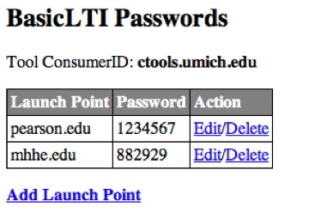
LMS-Wide Key/Secret

Slide 21
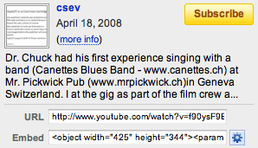
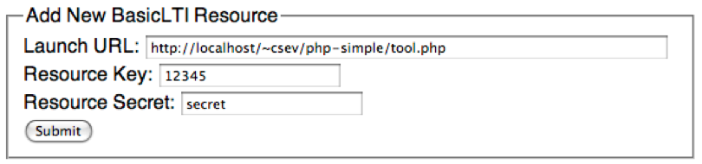
Resource Level Key/Secret
Modeled after “cut and paste this” from sites like YouTube

Slide 22
Tool Perspective: What to Trust?
LMS Secret implies that user_id and course_id values that are the same from launch to launch are the same person
With resource-level secrets, all values such as user_id and course_id in launches should be modelled linked to the resource or key.

Slide 23
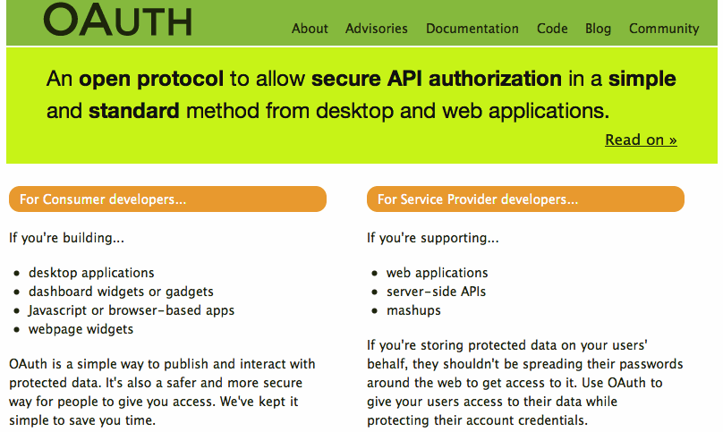

Slide 24
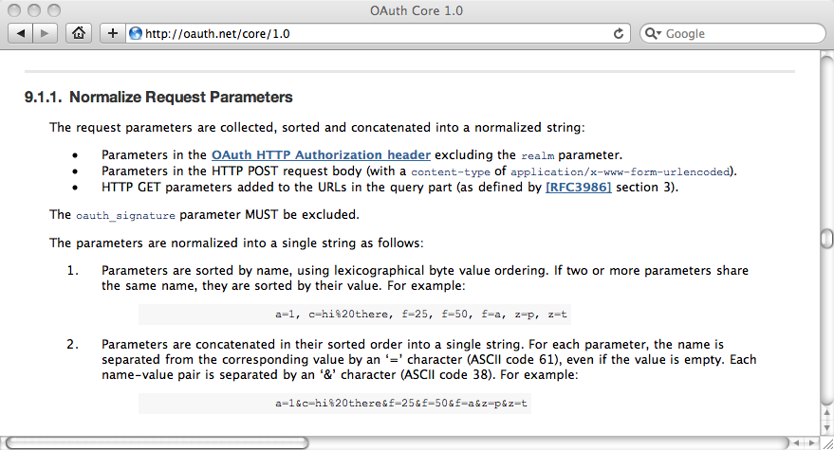

Slide 25
OAuth Message Signing
LMS Prepares message (user_id, etc)
LMS Adds nonce, timestamp, consumer_id
LMS Computes Base String
LMS adds secret and computes signature
LMS appends signature (not secret)
Message is transmitted
Receiver looks up secret using consumer_id
Receiver removes signature and adds secret
Receiver computes base string to produce new signature
Message is validated by checking nonce, timestamp skew, and signature match

Slide 26
OAuth Base Message String
Section 9.x of the oauth.net spec
Method (GET/POST)
Normalized URL
Sorted and htmlescape parameters
Sign using SHA1 / HMAC, RSA / SHA1, or PLAINTEXT methods

Slide 27
OAuth
flow
URL
URL
Parameters
LMS
Data
HTTP
Method
Normalized
URL
SORT
Concatenate/Encode Base String
HMAC / SHA1
Shared
Secret
LMS
Parameters
URL
oauth_signature, etc.
Browser Form / Tool

Slide 28
OAuth Base Message String
POST&http%3A%2F%2Flocalhost%2F~csev%2Fphp-simple%2Ftool.php&basiclti_submit%3DLaunch%2520Endpoint%2520with%2520BasicLTI%2520Data%26context_id%3D456434513%26context_title%3DSI301%2520-%2520PHP%26lis_person_contact_email_primary%3Dcsev%2540umich.edu%26lis_person_name_full%3DCharles%2520R.%2520Severance%26lis_person_sourced_id%3Dcsev%26lti_version%3Dbasiclti-1.0%26oauth_consumer_key%3Dbasiclti-lms%253Aumich.edu%26oauth_nonce%3Da57921d9e9ac1d8547c41f70d4aaba35%26oauth_signature_method%3DHMAC-SHA1%26oauth_timestamp%3D1246941417%26oauth_version%3D1.0%26resource_link_id%3D120988f929-274612%26roles%3DInstructor%26tool_consumer_instance_description%3DUniversity%2520of%2520Michigan%26tool_consumer_instance_guid%3Dumich.edu%26user_id%3D292832126
oauth_signature = kjqD5TpgdhjPOq0gqoPVntJ8yPU=

Slide 29
OAuth Implementation Patterns
LMS – Create an array / property bag or parameters – pass to OAuth to sign – then send signed data
Tool – Receive POST – call OAuth to pull data from request – ask Oauth to Validate – Oauth calls your “store” to lookup keys, nonces, and tokens

Slide 30
LMS
key
secret
OAuth
basiclti-version=1.0
user_id=12345
…
basiclti-version=1.0
user_id=12345
…
oauth_consumer_key=89878
oauth_timestamp=012929
pauth_signature=9922
Tool
© Copyright 2009 IMS Global Learning Consortium
All Rights Reserved.

Slide 31
<div id="ltiLaunchFormSubmitArea">
<form action="http://localhost:8080/basiclti/tool" name="ltiLaunchForm" method="post">
<input type="hidden" size="40" name="user_id" value="19288-8063"/>
<input type="hidden" size="40" name="lis_person_name_full" value="Charles R. Severance"/>
<input type="hidden" size="40" name="context_id" value="092102092020"/>
<input type="hidden" size="40" name="context_title" value="SI101"/>
<input type="hidden" size="40" name="oauth_signature" value="Xddn2A+jzwjgBIVYkvixCdcc&#61;"/>
<input type="hidden" size="40" name="oauth_nonce" value="1244834250435893000"/>
<input type="hidden" size="40" name="resource_link_id" value="120988f929-274612"/>
<input type="hidden" size="40" name="roles" value="Learner"/>
<input type="hidden" size="40" name="oauth_signature_method" value="HMAC-SHA1"/>
<input type="hidden" size="40" name="oauth_timestamp" value="1244834250"/>
<input type="hidden" size="40" name="lti_version" value="basiclti-1.0"/>
<input type="hidden" size="40" name="lis_person_contact_email_primary" value="csev@umich.edu"/>
<input type="hidden" size="40" name="oauth_version" value="1.0"/>
<input type="hidden" size="40" name="oauth_consumer_key" value=”basiclti-lms:umich.edu"/>
</form>
</div>
<script language="javascript">
document.getElementById("ltiLaunchFormSubmitArea").style.display = "none";
document.ltiLaunchForm.submit();
</script>

Slide 32
Tool
basiclti-version=1.0
user_id=12345
…
oauth_consumer_key=89878
oauth_timestamp=012929
pauth_signature=9922
O
A
U
T
h
Data
Store
key
secret
© Copyright 2009 IMS Global Learning Consortium
All Rights Reserved.

Slide 33
Learning Information Services
If an LMS supports LIS, the LMS can pass LIS data to the external tool in case the external tool also is configured to use LIS
  lis_person_sourced_id
  lis_course_offering_sourced_id
  lis_course_section_sourced_id

Slide 34
LMS (LTI Consumer)
lis_person_sourced_id
lis_course_offering_id
LIS
Tool (LTI Producer)
SIS
© Copyright 2009 IMS Global Learning Consortium
All Rights Reserved.

Slide 35
Basic LTI - Outcomes
Basic LTI depends on IMS Tools Interoperability 1.0 for its support of outcomes.
If the LMS Supports TI 1.0 Outcomes the following parameters are added
  ti1_outcome_url=http://websvc.uni.edu/OutComes
  ti1_launch_identifier=6789876567898765

Slide 36
Outcome Callback (SOAP)
The outcome callback assumes some sort of security arrangement which the LMS Admin gives to the Tool Admin to authorize the tool to send outcomes
The tool sends back the launch_identifier and a grade (string), properly signed

Slide 37
Outcome Recommendations
Interpret the string as a number between 0.0 and 1.0
Interpret the string as a number between 0 and 100 with no decimal
Interpret the string as a letter grade, ignoring case – The grade should either be a single letter or a single letter plus "+" or "-" (i.e. it should be one or two letters only)
Interpret the string as "pass" or "fail" ignoring case
If the string starts with one of several agreed-to prefixes followed by a colon (feedback:, comment:, cmi:, scorm:, etc) the remainder of the string after the colon is a serialization of data in a particular form.
If two or more vendors choose to negotiate their own format for the outcomes, use the syntax with a colon except start the prefix with "x-" to indicate "extension".
If nothing else matches simply treat the grade as a string

Slide 38
BasicLTI – IMS-Provided Code
Sample Java + PHP implementations at
  http://code.google.com/p/ims-dev/
Use/include sample code from oauth.net
Both structured to provide reusable code
  org.imsglobalorg.basiclti.BasicLTIUtil.java
  blti_util.php

Slide 39
org.imsglobalorg.basiclti.BasicLTIUtil.java
boolean validateDescriptor(String descriptor)
boolean parseDescriptor(Properties launch_info,
Properties postProp, String descriptor)
Properties signProperties(Properties postProp,
String url, String method, String key, String secret,
String org_secret, String org_id, String org_desc)
String postLaunchHTML(Properties postProp,
String endpoint, boolean debug)

Slide 40
blti_util.php
validateDescriptor($descriptor)
// Returns launch url and custom properties
parseDescriptor($xmldata)
signParameters($oldparms, $endpoint, $method,
$key, $secret, $org_secret, $org_id, $org_desc)
postLaunchHTML($newparms, $endpoint, $debug)

Slide 41
Basic LTI – Open Source Code
Building Block – Alan Berg – U. Amsterdam
PowerLinks – Stephen Vickers – U. Edinburgh
  http://projects.oscelot.org/gf/project/wct-basiclti/
Will be demonstrated at BB DevCon July 16, 2009
Both use the org.imsglobal.baslclti.BasicLTIUtil utility code

Slide 42
BasicLTI – Open Source Code
Sakai BasicLTI Portlet available (Maybe in 2.7)
  https://source.sakaiproject.org/contrib//csev/trunk/basiclti/
  Example of using the IMS Utility code
Moodle 2.0, 1.9, 1.8 planned
Python in the Tsugi (portal/AppEngine) framework
  http://www.tsugiproject.org

Slide 43
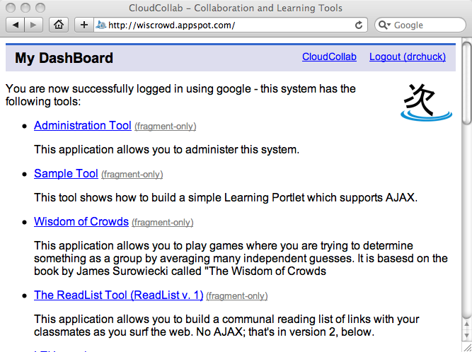

www.tsugiproject.org

Slide 44
Up Next…
Lets get ready to write some code!

