Slide 1



IMS Learning Tools Interoperability
Charles Severance
IMS Global Learning Consortium
Developer Network Coordinator

Slide 2
IMS Learning Tools Interoperability
Describes a standardized “Proxy Tool” for a Learning Management System
How the tool is installed and registered in the LMS
Describes tool lifecycle interactions
Current LTI specifications patterned after the BB9 Proxy Tool

Slide 3
IMS LTI (cont.)
Covers tool launching from the LMS including passing roster information from the LMS to the tool
Run-Time Services allowing the tool to read, write, and exchange information with the LMS
Blackboard, Pearson, Wimba, Angel, Microsoft, McGraw-Hill, Sakai, and IMS have been investing development resources all along to inform process

Slide 4



LMS
The core LTI use case is that we can augment the tools included in an LMS with externally provided tools.

Slide 5


L
M
S
TOOL
or
Content
LTI also enables large-scale of provisioning of features or content across multiple LMS Systems
L
M
S
….
L
M
S

Slide 6
Common
Cartridge
L
M
S
Content
L
M
S
When LTI is combined with
the IMS Common Cartridge,
publishers can distribute cartridges containing active, authenticated links back centrally hosted content.

Slide 7





L
M
S
L
M
S
Advanced: LTI also allows tools from a learning management system from one vendor to be used in a learning management system from another vendor. An example of this approach is the BlackBoard Connect project which integrates Sakai and Moodle (coming) functionality into BlackBoard.

Slide 8















Context
Context
Context
Ultimately the “location” or “source” of a tool or content becomes less and less important.

Slide 9
Learning Tools Interoperability
Terminology and Timeline
SimpleLTI – Not a formal spec – May 2008
  simplelti.appspot.com
BasicLTI – July 2009
  Part of IMS Common Cartridge 1.1
IMS LTI 2.0 – End of 2009
  Runtime / Provisioning / Launch

Slide 10
Basic LTI – A Profile of LTI 2.0
Focus on Launch and Common Cartridge Integration
A proper subset of LTI 2.0 when it is released
Will be an approved and released IMS specification
Supports very simple use cases with no required run-time web services

Slide 11
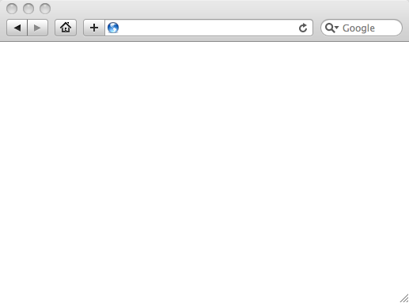
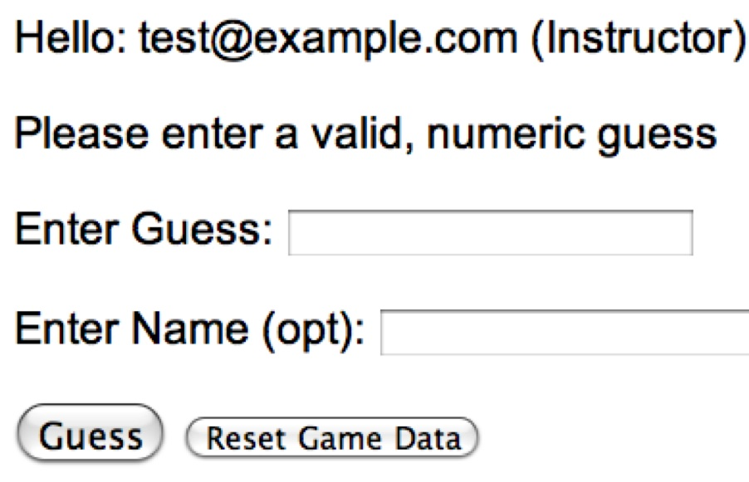
LMS (LTI Consumer)
User Experience
Welcome
Local Resource
Lame iFrame
LTI Tool
Movie
Tool (LTI Producer)
© Copyright 2009 IMS Global Learning Consortium
All Rights Reserved.

Slide 12
LMS (LTI Consumer)
Again in slow motion…
LMS Looks up User and Course Information.
Information is signed using secret and OAuth
Welcome
Local Resource
Lame iFrame
LTI Tool
Movie
Form data sent to Browser
Tool (LTI Producer)
© Copyright 2009 IMS Global Learning Consortium
All Rights Reserved.

Slide 13
LMS (LTI Consumer)
Form is immediately auto-submitted using JavaScript.
<form action=”tool”/>
<input name=”user_id”
value=”2348d8dd” />
<input name=”oauth_token”
value=”abc.edu” />
</form>
Tool (LTI Producer)
Tool looks up secret and validates signature.
Tool provisions user, course, and session.
Tool sends redirect
© Copyright 2009 IMS Global Learning Consortium
All Rights Reserved.

Slide 14
LMS (LTI Consumer)
Browser follows redirect…
<head>
<meta redirect
page=”main.php”>
</head>
Tool (LTI Producer)
Tool produces
first page.
© Copyright 2009 IMS Global Learning Consortium
All Rights Reserved.

Slide 15
LMS (LTI Consumer)
Tool (LTI Producer)
© Copyright 2009 IMS Global Learning Consortium
All Rights Reserved.

Slide 16
LTI Demonstrations
Content Integration
  McGraw-Hill Katana
  Pearson LTI 2.0
  K12 - www.k12.com
  Google Documents (SAML)
LMS Integration
  Angel
  Sakai Porlet / Melete
  Moodle
  Microsoft MIRLearn
  Blackboard Building Block

Slide 17
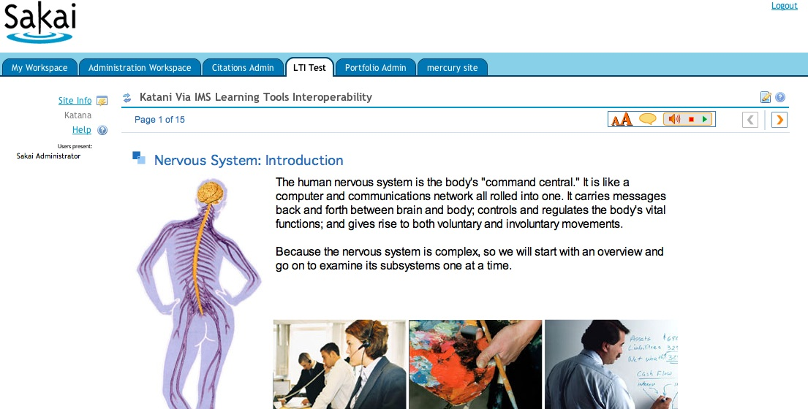
McGraw-Hill / Sakai

Slide 18
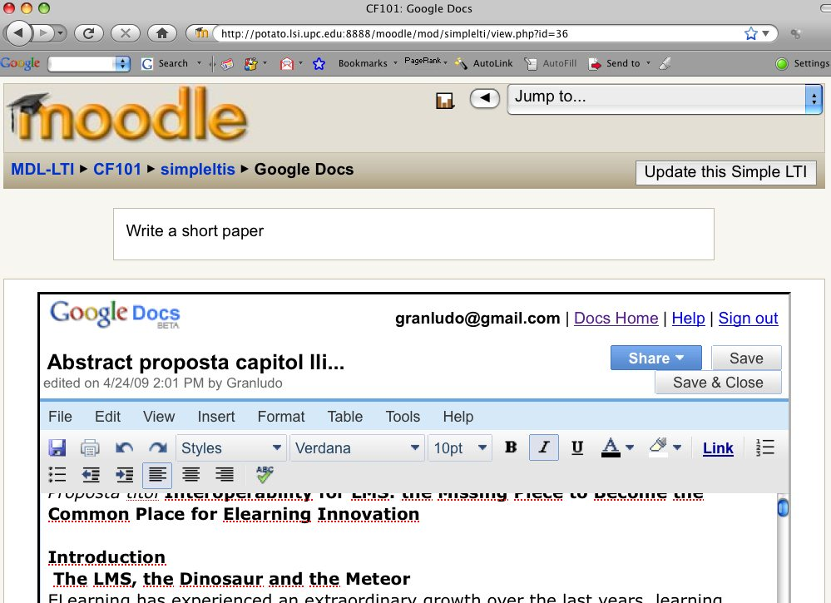

Slide 19
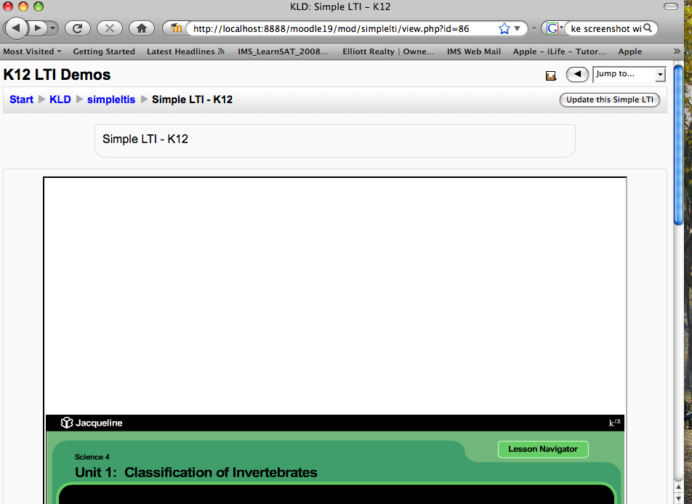
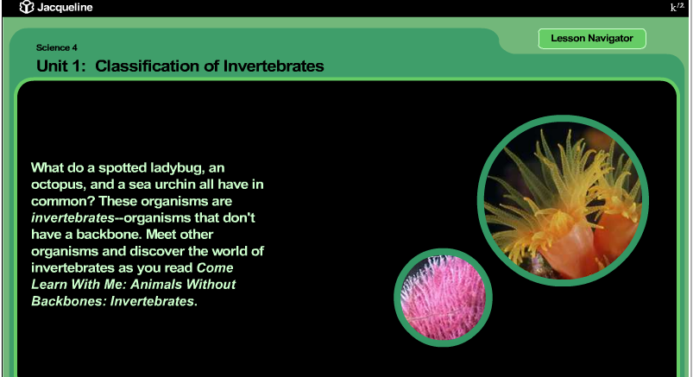

Slide 20
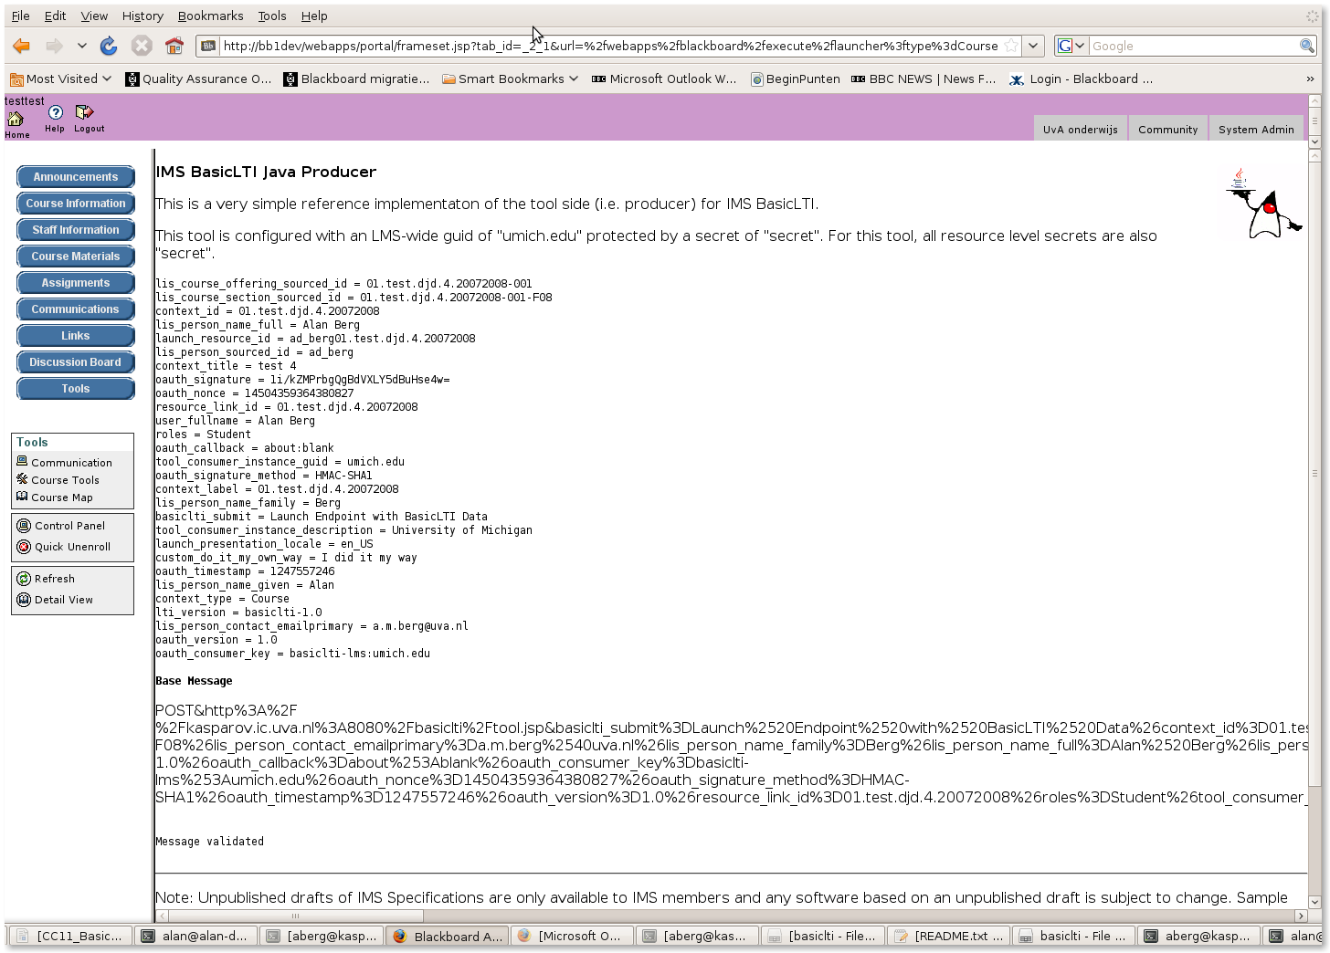

Slide 21
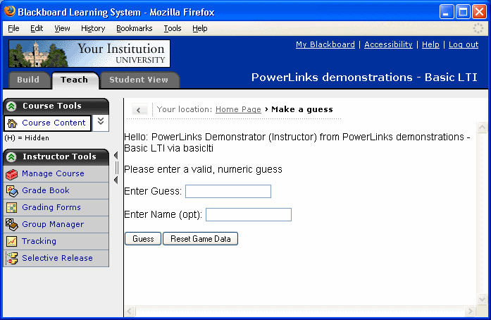

Slide 22
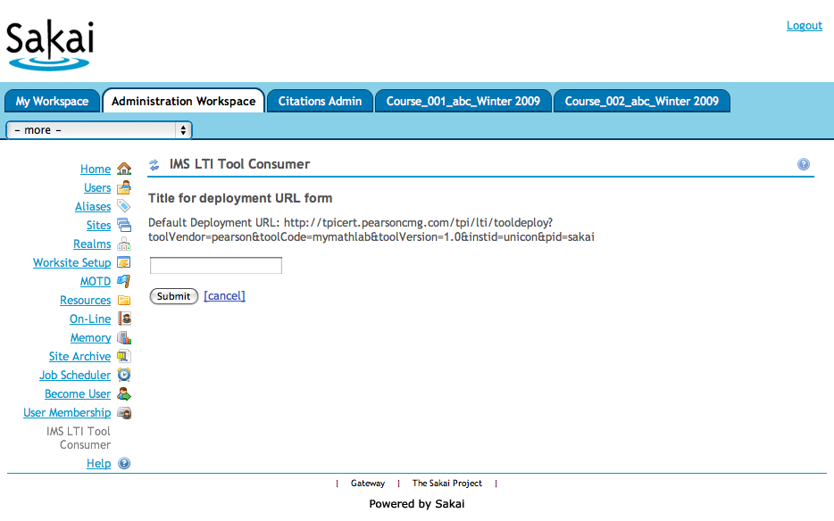
Pearson LTI 2.0 (pre-release)

Slide 23
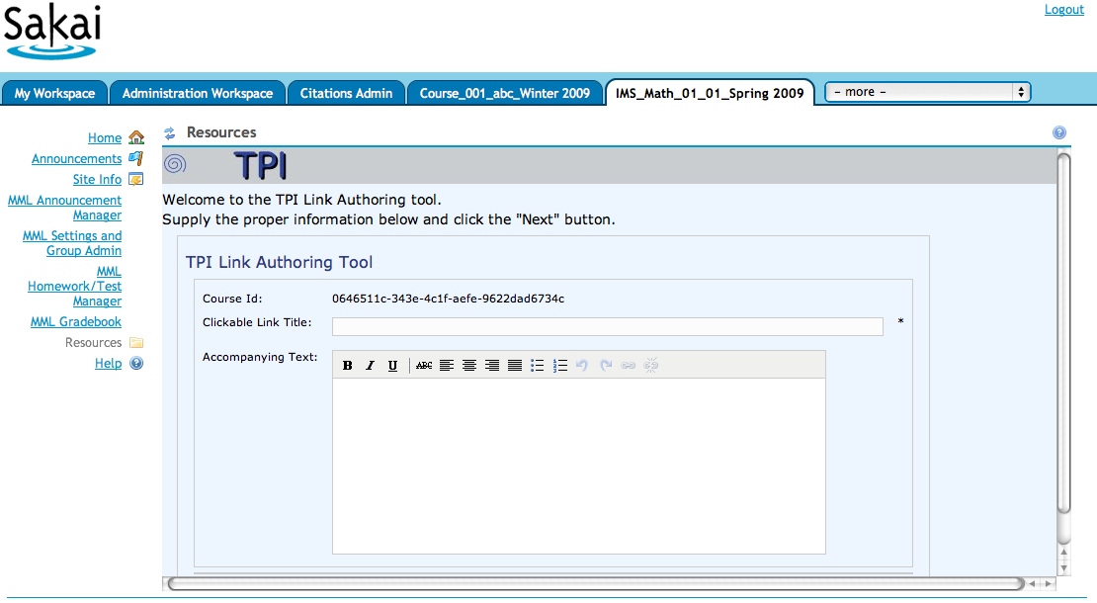
Pearson LTI 2.0 (pre-release)

Slide 24
Common Cartridge and LTI
We will be adding support for Basic Learning Tools Interoperability 2.0 to IMS Common Cartridge 1.1
Goal is to allow IMS CC Cartridges with Basic LTI to be produced starting Fall 2009

Slide 25
Common
Cartridge
L
M
S
Content
L
M
S
When LTI is combined with
the IMS Common Cartridge,
publishers can distribute cartridges containing active, authenticated links back centrally hosted content.

Slide 26
Looking Forward - Strategy
Once we add LTI to Common Cartridge, we have full-spectrum solution to providing high quality user experience which we can iterate over time.
Currently publishers generally have more capabilities than LMS systems when it comes to dynamic learning paths informed by assessment information.

Slide 27
Common Cartridge 1.0
Learner Requirements
Rendered in LMS
Proprietary Publisher Integration
Many question types
Learning Design
Dynamic Paths

Slide 28
Common Cartridge 1.1
Learner Requirements
Rendered in LMS
Publisher Provided Via LTI
Many question types
Learning Design
Dynamic Paths

Slide 29
Common Cartridge x.y
Learner Requirements
Rendered in LMS
Publisher Provided Via LTI
QTI 2.x
More question types
Learning Design

Slide 30
Common Cartridge y.z
Learner Requirements
Rendered in LMS
Publisher Provided
Innovative content and approaches.
QTI 2.x
IMS LD ?.?
We innovate and standardize the effective innovations.

Slide 31
Iterative Approach
With CC 1.1 including LTI we now have a way to meet a broad range of learner requirements through a combination of LMS and external resources
Beyond CC 1.1, we can improve the features of the cartridge over time to described increasingly advanced functionality in the cartridge

Slide 32
BasicLTI Data Model Elements
lti_version = basiclti-1.0
resource_link_id = 120988f929-274612
user_id = 292832126
roles = Instructor
lis_person_name_full = Charles R. Severance
lis_person_contact_email_primary = csev@umich.edu
lis_person_sourced_id = csev
context_id = 456434513
context_title = SI301 - PHP
tool_consumer_instance_guid = umich.edu
tool_consumer_instance_description = University of Michigan

Slide 33
BasicLTI Technical Details
Uses OAuth for signing messages / security
  www.oauth.net
  Sample IMS BasicLTI code includes and uses the sample code from OAuth (PHP, Java, and Python)
  Use by Google, Twitter, etc
  Quickly becoming the de-facto security for REST

Slide 34
OAuth Technical Details
Specification at www.oauth.net is very clear
Signs message using time-stamp, nonce
Message signing – Trust between pairs of servers
“Three-legged-OAuth” – Trust between servers plus user identity (not used in Basic LTI)

Slide 35
BasicLTI in Common Cartridge
<?xml version="1.0" encoding="UTF-8"?>
<basicltiresource xmlns="http://www.imsglobal.org/services/cc/imsblti_v1p0"
xmlns:xsi="http://www.w3.org/2001/XMLSchema-instance">
<title>A Simple Descriptor</title>
<custom>
<parameter key="Cool:Factor">120</parameter>
</custom>
<launch_url>http://localhost/~csev/php-simple/tool.php</launch_url>
</basicltiresource>

Slide 36
BasicLTI + CC – Sample Code
Sample Java + PHP implementations at
  Miniature LMS Launching a tool
  Miniature External Tool
  Simple Cartridge Loader
  http://code.google.com/p/ims-dev/
Provides a trivial test harness
All use / include sample code from oauth.net

Slide 37
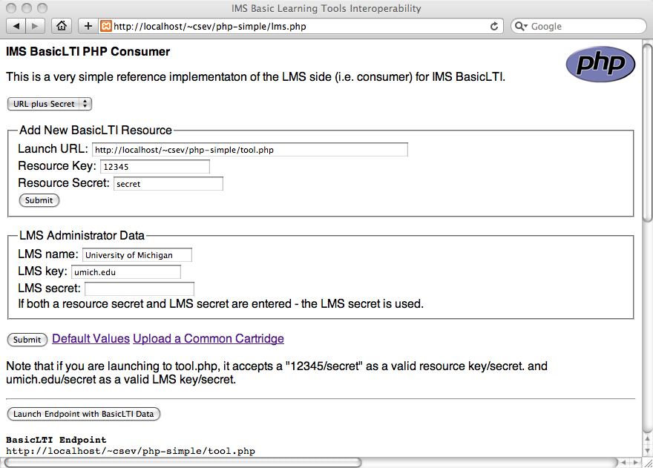

Slide 38
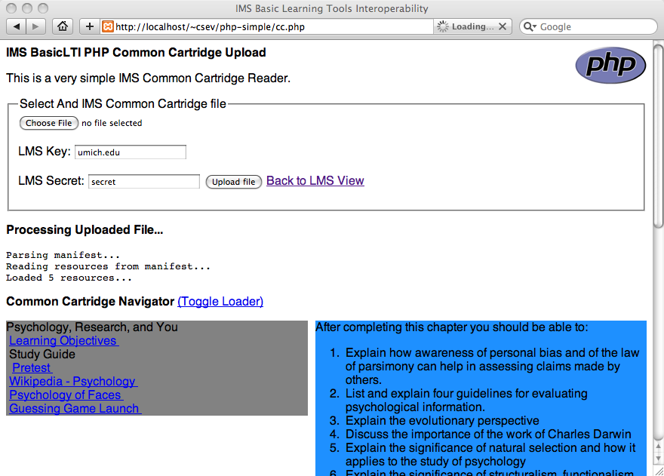

Slide 39
Basic LTI Open Source Plans
These are not commitments – anything can change including the market or resource availability
  Sakai – 2.7 (2.6, 2.5) – University of Michigan
  Moodle 2.0 (1.9, 1.8) – UPC - Barcelona Tech
  Blackboard Building Block – University of Edinburgh, University of Amsterdam (UVA)
  WebCT PowerLink – University of Edinburgh

Slide 40
Summary
IMS LTI gives us a service-oriented approach to deploying tools and content
Going forward we have a very natural way to innovate and evolve while meeting a broad ranger of learner needs.

Slide 41
IMS Community Forum
Viewing is open to the public – A free IMS Community Membership required to post
Does not include distribution of specs prior to public spec release
Peer-to-peer developer community communication
http://www.imsglobal.org/community/forum/index.cfm?forumid=11

Slide 42
Common Cartridge Alliance
Focus is on the implementation phase of IMS Common Cartridge and Basic LTI
Access to drafts during review phase
Software tools, staff-supported discussion forums, and general support
http://www.imsglobal.org/cc/alliance.html

Slide 43
Up Next: Members-only Webinar
Will go over the Basic LTI CM/DN draft in detail
  Help organizations review and comment on the draft
Will cover the sample code for Basic LTI in detail
  Allow organizations to start working on implementations
Answer any questions
Goal: Adopt, Implement, Deliver, Impact

