Slide 1


IMS Basic Learning Tools Interoperability
Charles Severance
IMS Global Learning Consortium
Developer Network Coordinator

Slide 2
Thanks: LTI Working Group
Basic LTI would not be possible without months of focused and dedicated effort by the LTI Working Group
  Lance Neumann, Blackboard (Chair)
  Greg McFall, Pearson (Chair)
  Bruno Van Haetsdaele, Wimba (Chair)

Slide 3
Talk Outline
Introduction to Basic LTI
Technical Overview
Sample Implementation Source Code
Implementations Underway
Next Steps and Questions

Slide 4
Basic LTI: Executive Summary
Allows an LMS to launch an External Tool and securely provide user identity, course information, and role information to the external tool
Uses a HTTP POST through the browser – secured by the OAuth security (www.oauth.net)

Slide 5

Learning Tools Interoperability
Basic LTI SERVICES
TOOL CONSUMER
TOOL PROVIDER
BasicLTILaunch
Resource
Basic LTI Tool Proxy Runtime
User
Terminology
Instructor
Administrator

Slide 6
Basic LTI Status
Basic LTI is in Internal Draft (aka CM/DN) and going through the IMS Intellectual Property clearing process
Soon the IMS Technical Advisory Board will be voting on the spec
Implementation has started in a number of places

Slide 7
Basic LTI is Included in Full LTI
Full LTI
Provisioning
Services
Event
Messages
Richer
Trust Model
Basic LTI
Run-Time
Services

Slide 8
Learning Tools Interoperability
Basic LTI SERVICES
TOOL CONSUMER
TOOL PROVIDER
BasicLTILaunch
Resource
Basic LTI Tool Proxy Runtime
User
Terminology
Instructor
Administrator

Slide 9
Use Cases
LMS and External Tool have a TC-wide shared secret used across an LMS
External Tool provides a Key, URL, and Secret to an Instructor to allow “mash up” into a course
Basic LTI Resource Links can be included in an IMS Common Cartridge

Slide 10
TC-Wide Secret Use Case
When there is high-level trust established between the TC admin and the TP admin, the TP can make connections and assumptions about identity across multiple courses

Slide 11
Instructor Mash Up Use Case
When the TP gives an Instructor a URL, Key, Password combination it allows the instructor to make links to the TP resource in multiple LMS systems including those where they cannot change administrator settings

Slide 12
Learning Tools Interoperability
Basic LTI SERVICES
TOOL CONSUMER
TOOL PROVIDER
BasicLTILaunch
Resource
Basic LTI Tool Proxy Runtime
User
Launch Sequence
Instructor
Administrator

Slide 13
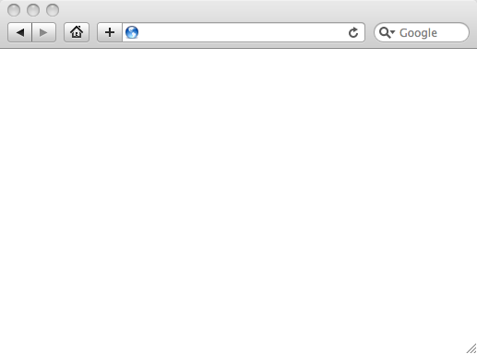
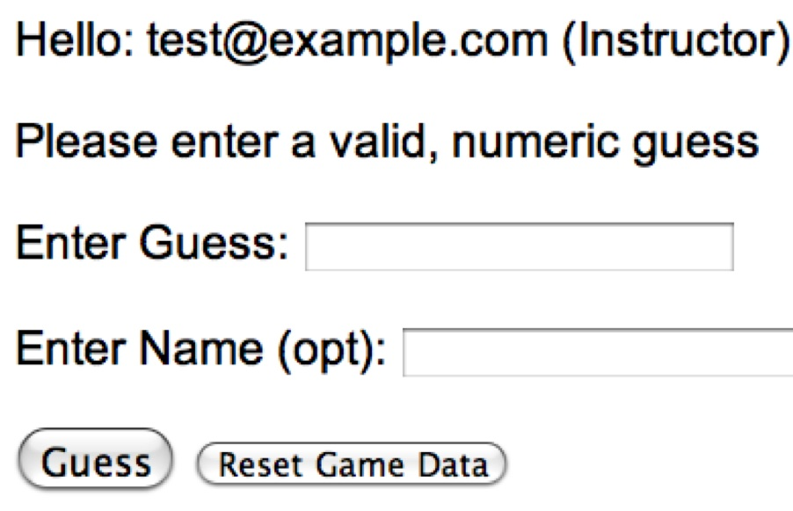
LMS (LTI Consumer)
User Experience
Welcome
Local Resource
Lame iFrame
LTI Tool
Movie
Tool (LTI Provider)
© Copyright 2009 IMS Global Learning Consortium
All Rights Reserved.

Slide 14
LMS (LTI Consumer)
Again in slow motion…
LMS Looks up User and Course Information.
Information is signed using secret and OAuth
Welcome
Local Resource
Lame iFrame
LTI Tool
Movie
Form data sent to Browser
Tool (LTI Provider)
© Copyright 2009 IMS Global Learning Consortium
All Rights Reserved.

Slide 15
LMS (LTI Consumer)
Form is immediately auto-submitted using JavaScript.
<form action=”tool”/>
<input name=”user_id”
value=”2348d8dd” />
<input name=”oauth_token”
value=”abc.edu” />
</form>
Tool (LTI Provider)
Tool looks up secret and validates signature.
Tool provisions user, course, and session.
Tool sends redirect
© Copyright 2009 IMS Global Learning Consortium
All Rights Reserved.

Slide 16
LMS (LTI Consumer)
Browser follows redirect…
<head>
<meta redirect
page=”main.php”>
</head>
Tool (LTI Provider)
Tool produces
first page.
© Copyright 2009 IMS Global Learning Consortium
All Rights Reserved.

Slide 17
LMS (LTI Consumer)
Tool (LTI Provider)
© Copyright 2009 IMS Global Learning Consortium
All Rights Reserved.

Slide 18
Basic LTI Sample Launch Data
lti_version=LTI-1p0
lti_message_type=basic-lti-launch-request
resource_link_id = 120988f929-274612
user_id = 292832126
roles = Instructor
lis_person_name_full = Charles R. Severance
lis_person_contact_email_primary = csev@umich.edu
context_id = 456434513
context_title = SI301 - PHP
tool_consumer_instance_guid = ctools.umich.edu
tool_consumer_instance_description = University of Michigan

Slide 19
What is a Context?
A course, project, etc – pretty much a group of people with roles
The core Basic LTI parameters do not mention "course"

Slide 20
Required and Recommended
lti_version=LTI-1p0
lti_message_type=basic-lti-launch-request
resource_link_id=88391-e1919-bb3456
user_id=0ae836b9-7fc9-4060-006f-27b2066ac545
roles=Learner,Mentor
tool_consumer_instance_guid=lmsng.school.edu
The required parameter set is kept small to give Tool Providers flexibility. The recommended parameter set only includes opaque identifiers.

Slide 21
Basic LTI in Common Cartridge
Welcome
Local Resource
Folder
LTI Tool
Discussion
QTI Pool
Common Cartridge 1.1 will include the ability to define a Basic LTI resource and include that resource in course organizational structures

Slide 22
Basic LTI Descriptor (CC 1.1)
<?xml version="1.0" encoding="UTF-8"?>
<basic_lti_link
xmlns="http://www.imsglobal.org/services/cc/imsblti_v1p0"
xmlns:xsi="http://www.w3.org/2001/XMLSchema-instance">
<title>A Simple Descriptor</title>
<custom>
<parameter key="Cool:Factor">120</parameter>
</custom>
<launch_url>
http://wiscrowd.appspot.com/wiscrowd/12345/
</launch_url>
</basic_lti_link>

Slide 23
<basic_lti_link
xmlns="http://www.imsglobal.org/services/cc/imsblti_v1p0"
xmlns:xsi="http://www.w3.org/2001/XMLSchema-instance">
<title>Title</title>
<description>Description</description>
<icon>url to an icon for this tool (optional)</icon>
<secure_icon>url to an icon for this tool (optional)</secure_icon>
<cartridge_icon identifieref="BLTI001_Icon" />
<custom>
<parameter key="keyname">value</parameter>
</custom>
<launch_url>url to the Basic LTI launch URL</launch_url>
<secure_launch_url>url to the Basic LTI launch URL</secure_launch_url>
<extensions platform="www.lms.com">
<parameter key="keyname">value</parameter>
</extensions>
<vendor>
…
</vendor>
</basic_lti_link>

Slide 24
<vendor>
<code>vendor.com</code>
<version>4.32</version>
<name>VendorCo Education</name>
<description>
This is a Gradebook that supports many column types.
</description>
<contact>
<email>support@vendor.com</email>
</contact>
<url>http://www.vendor.com/product</url>
</vendor>

Slide 25
Basic LTI Security Model
Basic LTI Security is based on OAuth and a shared Secret between the Tool Provider and Tool Consumer
Launches are signed using the secret in the LMS and validated in the external tool

Slide 26
Basic LTI Message Security
Uses OAuth for signing messages / security
  www.oauth.net
  Sample IMS Basic LTI code includes and uses the sample code from OAuth (PHP, Java, and Python)
Use by Google, Twitter, etc
OAuth is quickly becoming the de-facto security for REST

Slide 27
OAuth Technical Details
Specification at www.oauth.net is very clear
Signs message using time-stamp, one-use token (nonce)
Message signing – Trust between pairs of servers
“Three-legged-OAuth” – Trust between servers plus user identity (not used in Basic LTI)

Slide 28
Levels of Security – per Tool
The LMS must generate and send all the OAuth security values
The receiving tool tool can choose the level of security based on their needs
  Time skew (5-10 seconds)
  Store Nonces for a time range and check to see if they are only used once

Slide 29
Shared Key/Secrets
Must be passed out of band between administrators or instructors
Two levels of key/secret
  LMS-wide password – site license
  Resource-level or course-level secret – individual license or one course license

Slide 30
LMS-Wide Key/Secret
LMS Admin calls tool provider (pearson.edu) and tells the LMS Identifier – usually a domain name like ctools.umich.edu
Tool provider generates secret and gives to the LMS Admin
LMS Admin installs the secret in the LMS and associates it with all launches that match *.pearson.edu

Slide 31
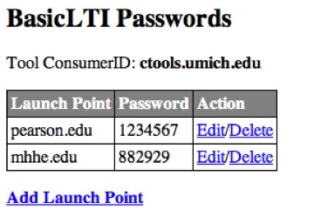
LMS-Wide Key/Secret

Slide 32
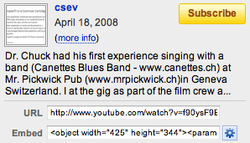
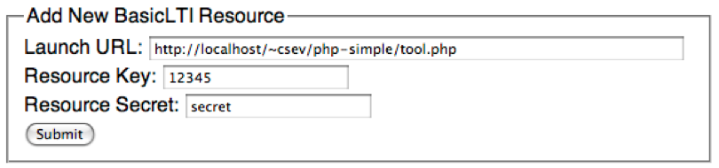
Resource Level Key/Secret
Modeled after “cut and paste this” from sites like YouTube

Slide 33
Tool Perspective: What to Trust?
LMS Secret implies that user_id and course_id values that are the same from launch to launch are the same person
With resource-level secrets, all values such as user_id and course_id in launches should be modelled linked to the resource or key.

Slide 34
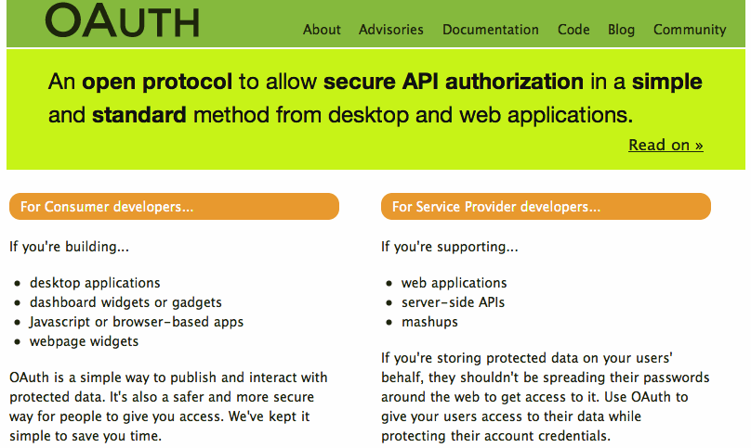

Slide 35
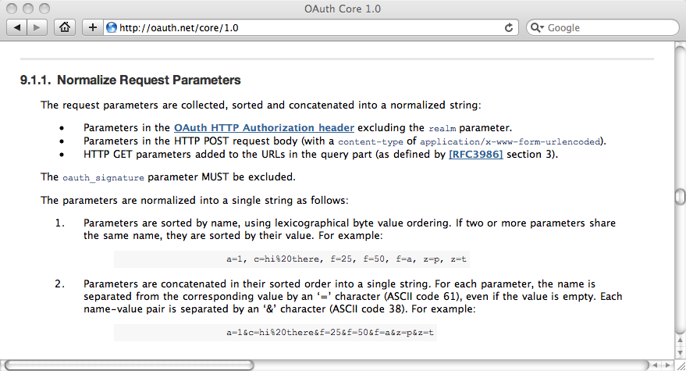

Slide 36
OAuth Message Signing
LMS Prepares message (user_id, etc)
LMS Adds nonce, timestamp, consumer_id
LMS Computes Base String
LMS adds secret and computes signature
LMS appends signature (not secret)
Message is transmitted
Receiver looks up secret using consumer_id
Receiver removes signature and adds secret
Receiver computes base string to produce new signature
Message is validated by checking nonce, timestamp skew, and signature match

Slide 37
OAuth Base Message String
Section 9.x of the oauth.net spec
Method (GET/POST)
Normalized URL
Sorted and htmlescape parameters
Sign using SHA1 / HMAC, RSA / SHA1, or PLAINTEXT methods

Slide 38
OAuth
flow
URL
URL
Parameters
LMS
Data
HTTP
Method
Normalized
URL
SORT
Concatenate/Encode Base String
HMAC / SHA1
Shared
Secret
LMS
Parameters
URL
oauth_signature, etc.
Browser Form / Tool

Slide 39
OAuth Base Message String
POST&http%3A%2F%2Flocalhost%2F~user%2Fphp-simple%2Ftool.php&basiclti_submit%3DLaunch%2520Endpoint%2520with%2520BasicLTI%2520Data%26context_id%3D456434513%26context_title%3DSI301%2520-%2520PHP%26lis_person_contact_email_primary%3Duser%2540school.edu%26lis_person_name_full%3DJane%2520Q.%2520Public%26lis_person_sourcedid%3Duser%26lti_message_type%3Dbasiclti-lti-launch-request%26lti_version%3DbasicLTI-1p0%26oauth_consumer_key%3Dlmsng.school.edu%26oauth_nonce%3D0f353c60b12cd5db55ce2bf4cbeb6f8b%26oauth_signature_method%3DHMAC-SHA1%26oauth_timestamp%3D1249621439%26oauth_version%3D1.0%26resource_link_id%3D120988f929-274612%26roles%3DInstructor%26tool_consumer_instance_description%3DUniversity%2520of%2520Michigan%26tool_consumer_instance_guid%3Dschool.edu%26user_id%3D292832126
oauth_signature = kjqD5TpgdhjPOq0gqoPVntJ8yPU=

Slide 40
OAuth Implementation Patterns
LMS – Create an array / property bag or parameters – pass to OAuth to sign – then send signed data
Tool – Receive POST – call OAuth to pull data from request – ask Oauth to Validate – Oauth calls your “store” to lookup keys, nonces, and tokens

Slide 41
LMS
key
secret
OAuth
lti_version=LTI-1p0
user_id=12345
…
lti_version=LTI-1p0
user_id=12345
…
oauth_consumer_key=89878
oauth_timestamp=012929
pauth_signature=9922
Tool
© Copyright 2009 IMS Global Learning Consortium
All Rights Reserved.

Slide 42
<div id="ltiLaunchFormSubmitArea">
<form action="http://localhost/~user/php-simple/tool.php"
name="ltiLaunchForm" id="ltiLaunchForm" method="post"
encType="application/x-www-form-urlencoded">
<input type="hidden" name="oauth_version" value="1.0"/>
<input type="hidden" name="oauth_nonce" value="0f353c60b12cd5db55ce2bf4cbeb6f8b"/>
<input type="hidden" name="oauth_timestamp" value="1249621439"/>
<input type="hidden" name="oauth_consumer_key" value="lmsng.school.edu"/>
<input type="hidden" name="resource_link_id" value="120988f929-274612"/>
<input type="hidden" name="user_id" value="292832126"/>
<input type="hidden" name="roles" value="Instructor"/>
<input type="hidden" name="lis_person_name_full" value="Jane Q. Public"/>
<input type="hidden" name="lis_person_contact_email_primary" value="user@school.edu"/>
<input type="hidden" name="lis_person_sourcedid" value=”school.edu:user"/>
<input type="hidden" name="context_id" value="456434513"/>
<input type="hidden" name="context_title" value="SI301 - PHP"/>
<input type="hidden" name="lti_message_type" value="basic-lti-launch-request"/>
<input type="hidden" name="lti_version" value=" LTI-1p0"/>
<input type="hidden" name="tool_consumer_instance_guid" value="school.edu"/>
<input type="hidden" name="tool_consumer_instance_description"
value="University of Michigan"/>
<input type="submit" name="basiclti_submit" value="Launch Endpoint with BasicLTI Data"/>
<input type="hidden" name="oauth_signature_method" value="HMAC-SHA1"/>
<input type="hidden" name="oauth_signature" value="TQWRCGWFiT7ct5qRysMK0lwPOUY="/>
</form>

Slide 43
<div id="ltiLaunchFormSubmitArea">
<form action="http://localhost/~user/php-simple/tool.php"
name="ltiLaunchForm" id="ltiLaunchForm" method="post"
encType="application/x-www-form-urlencoded">
<input type="hidden" name="oauth_version" value="1.0"/>
[… snip …]
<input type="hidden" name="oauth_signature" value="TQWRCGWFiT7ct5qRysMK0lwPOUY="/>
</form>
<script language="javascript">
document.getElementById("ltiLaunchFormSubmitArea").style.display = "none";
nei = document.createElement('input');
nei.setAttribute('type', 'hidden');
nei.setAttribute('name', 'basiclti_submit');
nei.setAttribute('value', 'Launch Endpoint with BasicLTI Data');
document.getElementById("ltiLaunchForm").appendChild(nei);
document.ltiLaunchForm.submit();
</script>

Slide 44
Tool
lti_version=LTI-1p0
user_id=12345
…
oauth_consumer_key=89878
oauth_timestamp=012929
pauth_signature=9922
O
A
U
T
h
Data
Store
key
secret
© Copyright 2009 IMS Global Learning Consortium
All Rights Reserved.

Slide 45
Learning Tools Interoperability
TOOL PROVIDER
TOOL CONSUMER
BasicLTILaunch with LIS pointers
LIS
SERVICES
The TP calls LIS
services, if available.

Slide 46
Learning Information Services
If an LMS supports LIS, the LMS can pass LIS data to the external tool in case the external tool also is configured to use LIS
  lis_person_sourced_id
  lis_course_offering_sourced_id
  lis_course_section_sourced_id
  lis_result_sourcedid

Slide 47
LIS Security
The LMS (Tool Consumer) simply provides LIS values to the external tool
The LTI Tool Consumer does not participate in the provisioning or security arrangements between the Tool Provider and the LIS Services
These are set up separately

Slide 48
Basic LTI – LIS Outcomes
If LIS Outcome Services are available to the Tool Producer, the LMS can send the external tool an id value used to identify a particular outcome
This id (lis_result_sourcedid) can be used in the call to the LIS services
We still need to define the various common outcome formats (CMI, QTI Results, etc…)

Slide 49
BasicLTI – IMS-Provided Code
Sample Java + PHP implementations at
  http://code.google.com/p/ims-dev/
Use/include sample code from oauth.net
Both structured to provide reusable code
  org.imsglobalorg.basiclti.BasicLTIUtil.java
  blti_util.php
Copyright IMS, Apache 2 – Usable anywhere

Slide 50
org.imsglobalorg.basiclti.BasicLTIUtil.java
String validateDescriptor(String descriptor)
boolean parseDescriptor(Properties launch_info,
Properties postProp, String descriptor)
Properties signProperties(Properties postProp,
String url, String method, String key, String secret,
String org_secret, String org_id, String org_desc)
String postLaunchHTML(Properties postProp,
String endpoint, boolean debug)

Slide 51
blti_util.php
validateDescriptor($descriptor)
// Returns launch url and custom properties
parseDescriptor($xmldata)
signParameters($oldparms, $endpoint, $method,
$key, $secret, $org_secret, $org_id, $org_desc)
postLaunchHTML($newparms, $endpoint, $debug)

Slide 52
Basic LTI Building Block
Stephen Vickers – U. Edinburgh
  Blackboard building block
  http://www.spvsoftwareproducts.com/bb/basiclti/demo.swf
  http://projects.oscelot.org/gf/project/wct-basiclti/
Both use the org.imsglobal.baslclti.BasicLTIUtil utility code
Outstanding example of the "Virtual Tool" pattern

Slide 53
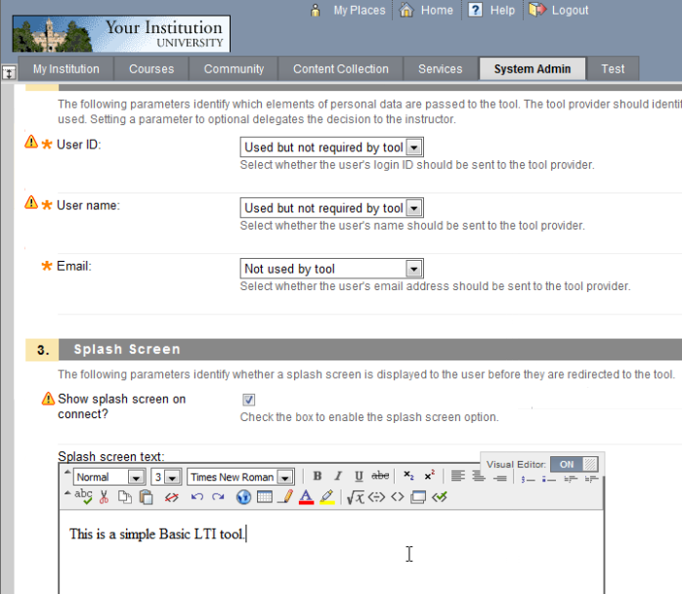
http://www.spvsoftwareproducts.com/bb/basiclti/demo.swf

Slide 54
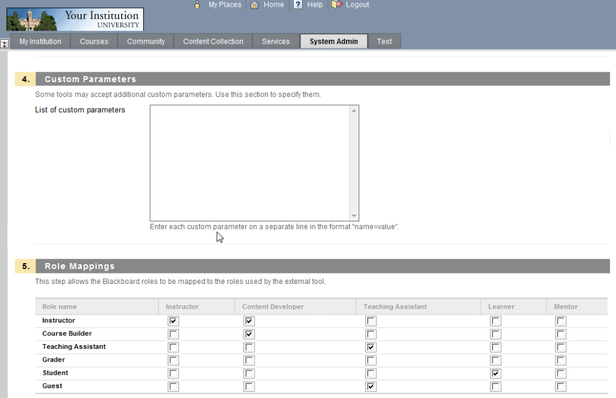
http://www.spvsoftwareproducts.com/bb/basiclti/demo.swf

Slide 55
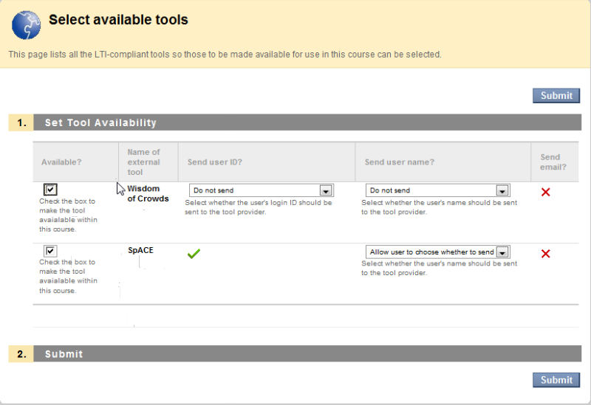
http://www.spvsoftwareproducts.com/bb/basiclti/demo.swf

Slide 56
BasicLTI – Open Source Code
Sakai BasicLTI Portlet available (Likely in 2.7)
  https://source.sakaiproject.org/contrib//csev/trunk/basiclti/
  Example of using the IMS Utility code
Support for Basic LTI in Sakai/Melete 2.7
Moodle 2.0, 1.9, 1.8 planned
Python in the Tsugi (portal/AppEngine) framework
  http://www.tsugiproject.org

Slide 57
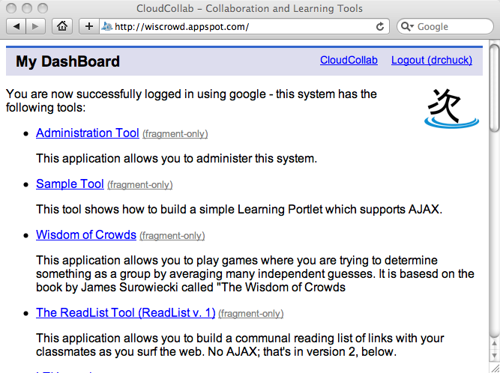
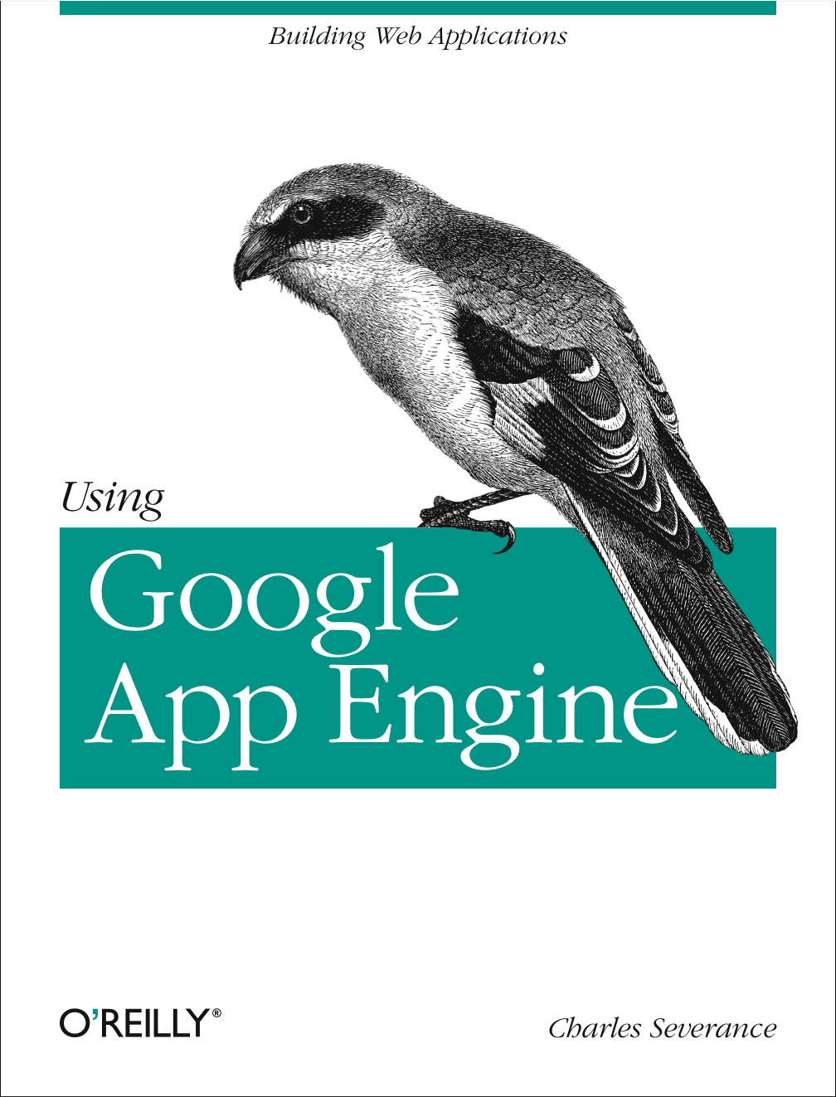
www.tsugiproject.org

Slide 58
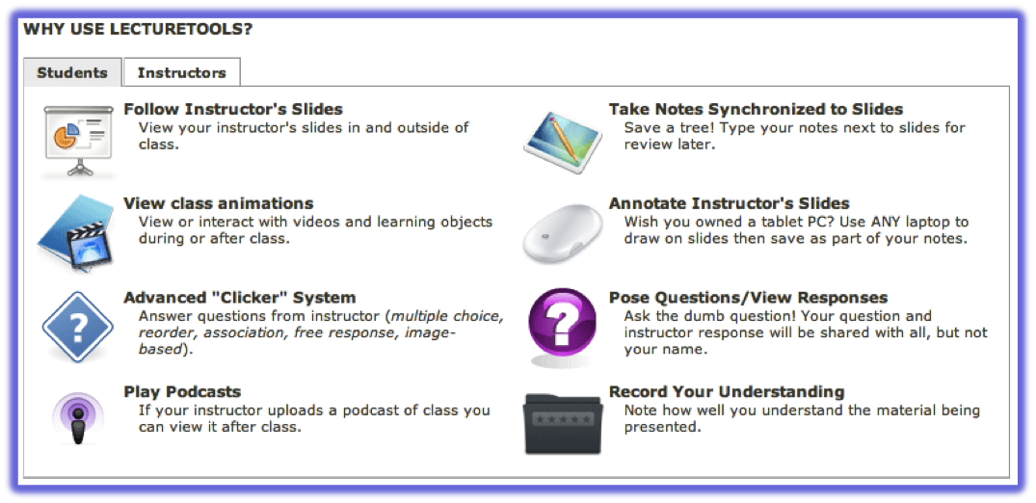
Sakai@
umich.edu
Blackboard@
wcc.edu
Blackboard@
flint.umich.edu
Basic LTI
Case Study: www.lecturetools.org

Slide 59
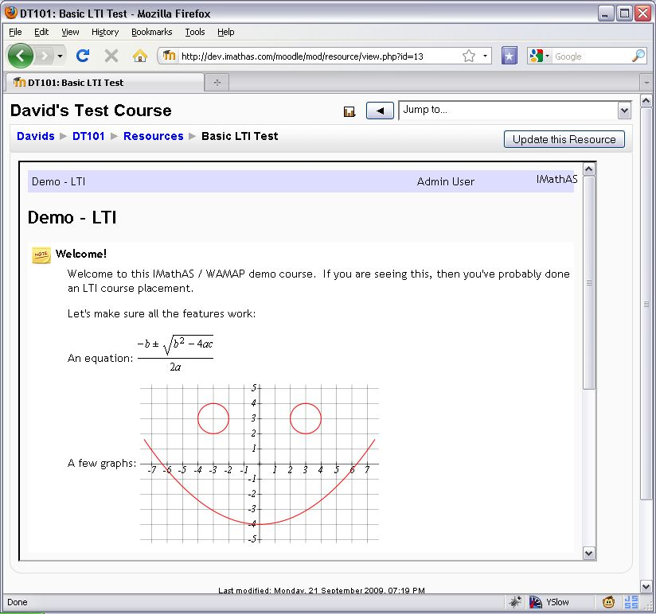
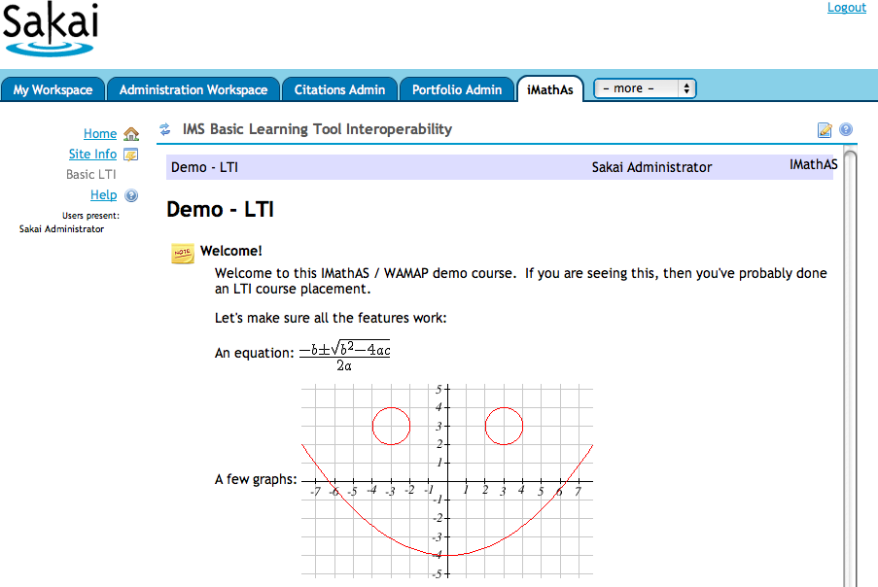
Case Study: www.imathas.com / David Lippman

Slide 60
Commercial Implementations
I am available to help get your implementations up, running, and interoperable
We would love for folks to share and expose their plans in the IMS discussion forums
If you want to talk off-line that is OK as well

Slide 61





















Slide 62
Discussion Forums
CC Alliance Forum – Private / Members Only
  http://www.imsglobal.org/community/forum/index.cfm?forumid=7
Public Developer Forum
  http://www.imsglobal.org/community/forum/index.cfm?forumid=5

Slide 63
Up Next…
IMS Basic LTI will put unprecedented ability to teach and innovate in new ways in the hands of students and teachers
Lets get this into the marketplace right now!
Tell me how I can help: cseverance@imsglobal.org
Questions…

