Slide 1


Impacting Teaching and Learning Through Standards
Charles Severance, PhD.
Affiliate Coordinator
IMS Global Learning Consortium (IMS GLC)
http://www.imsglobal.org/

Slide 2
Basic LTI: Executive Summary
Allows an LMS to launch an External Tool and securely provide user identity, course information, and role information to the external tool
Uses a HTTP POST through the browser – secured by the OAuth security (www.oauth.net)

Slide 3
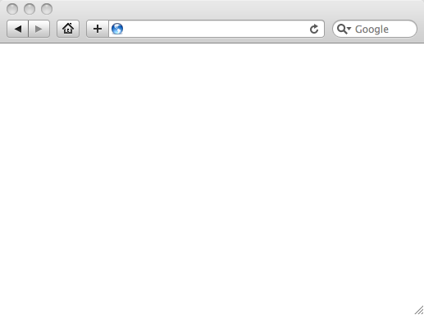
LMS (LTI Consumer)
User Experience
Welcome
Local Resource
Lame iFrame
LTI Tool
Movie
Tool (LTI Provider)
© Copyright 2009 IMS Global Learning Consortium
All Rights Reserved.

Slide 4
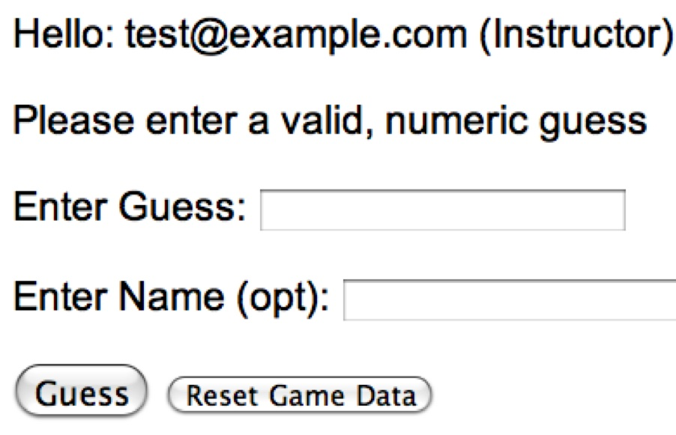
LMS (LTI Consumer)
User Experience
Welcome
Local Resource
Lame iFrame
LTI Tool
Movie
Tool (LTI Provider)
© Copyright 2009 IMS Global Learning Consortium
All Rights Reserved.

Slide 5
LMS (LTI Consumer)
Again in slow motion…
LMS Looks up User and Course Information.
Information is signed using secret and OAuth
Welcome
Local Resource
Lame iFrame
LTI Tool
Movie
Form data sent to Browser
Tool (LTI Provider)
© Copyright 2009 IMS Global Learning Consortium
All Rights Reserved.

Slide 6
LMS (LTI Consumer)
Form is immediately auto-submitted using JavaScript.
<form action=”tool”/>
<input name=”user_id”
value=”2348d8dd” />
<input name=”oauth_token”
value=”abc.edu” />
</form>
Tool (LTI Provider)
Tool looks up secret and validates signature.
Tool provisions user, course, and session.
Tool sends redirect
© Copyright 2009 IMS Global Learning Consortium
All Rights Reserved.

Slide 7
LMS (LTI Consumer)
Browser follows redirect…
<head>
<meta redirect
page=”main.php”>
</head>
Tool (LTI Provider)
Tool produces
first page.
© Copyright 2009 IMS Global Learning Consortium
All Rights Reserved.

Slide 8
LMS (LTI Consumer)
Tool (LTI Provider)
© Copyright 2009 IMS Global Learning Consortium
All Rights Reserved.

Slide 9
Basic LTI Sample Launch Data
lti_version=LTI-1p0
lti_message_type=basic-lti-launch-request
resource_link_id=120988f929-274612
user_id=292832126
roles=Instructor
lis_person_name_full=Charles R. Severance
lis_person_contact_email_primary = csev@umich.edu
context_id=456434513
context_title=SI301 - PHP
tool_consumer_instance_guid=ctools.umich.edu
tool_consumer_instance_description=University of Michigan

Slide 10
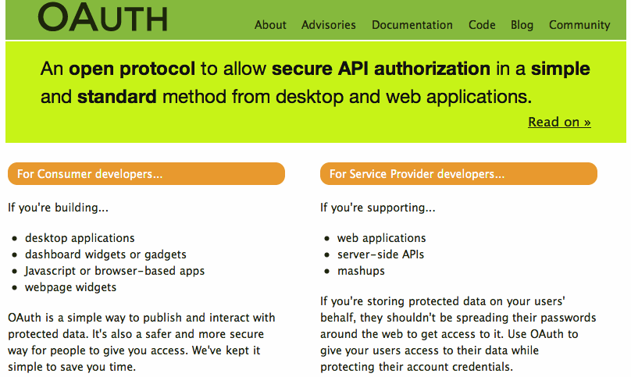

Slide 11
Basic LTI and IMS Common Cartridge
Welcome
Local Resource
Folder
LTI Tool
Discussion
QTI Pool
Common Cartridge 1.1 will include the ability to define a Basic LTI resource and include that resource in course organizational structures

Slide 12
Learning Tools Interoperability
TOOL PROVIDER
TOOL CONSUMER
BasicLTILaunch with LIS pointers
LIS
SERVICES
The TP calls LIS
services, if available.

Slide 13
Pushing Basic LTI Adoption
Sample Java + PHP Basic LTI implementations at
  http://code.google.com/p/ims-dev/
Use/include sample code from oauth.net
Both structured to provide reusable code
  org.imsglobalorg.basiclti.BasicLTIUtil.java
  blti_util.php
Copyright IMS, Apache 2 – Usable anywhere

Slide 14
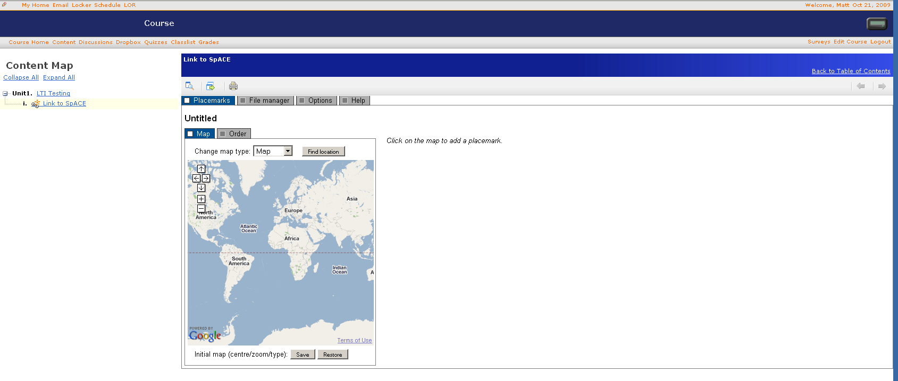
Desire2Learn
Implemented IMS Basic LTI in 8.4.2

Slide 15

Icodeon – Content Player
The Icodeon content player supports IMS Common Cartridge 1.1 which includes live links to premium content using Basic LTI

Slide 16
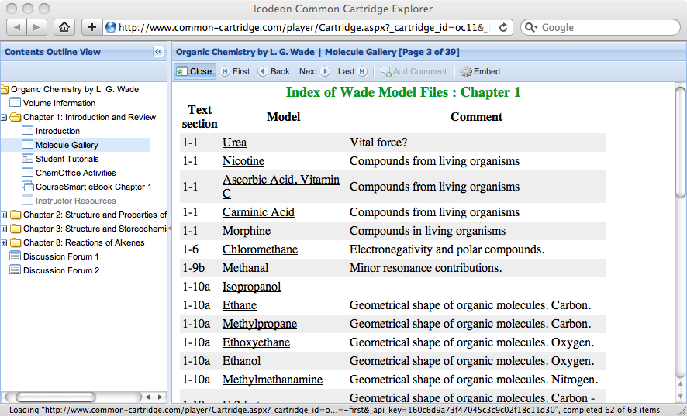
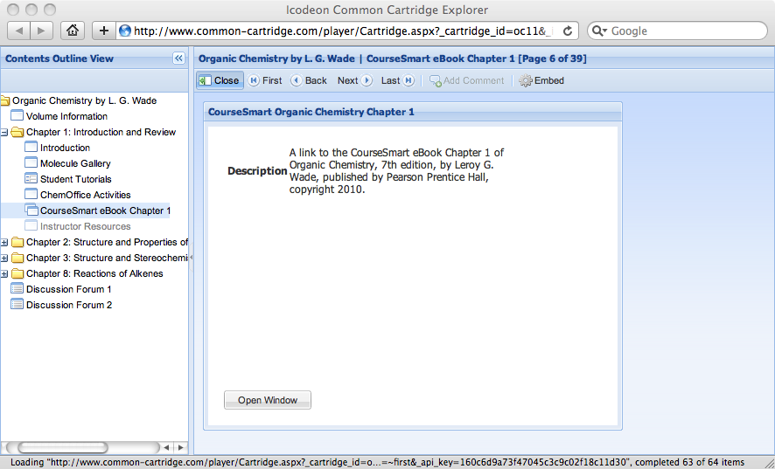
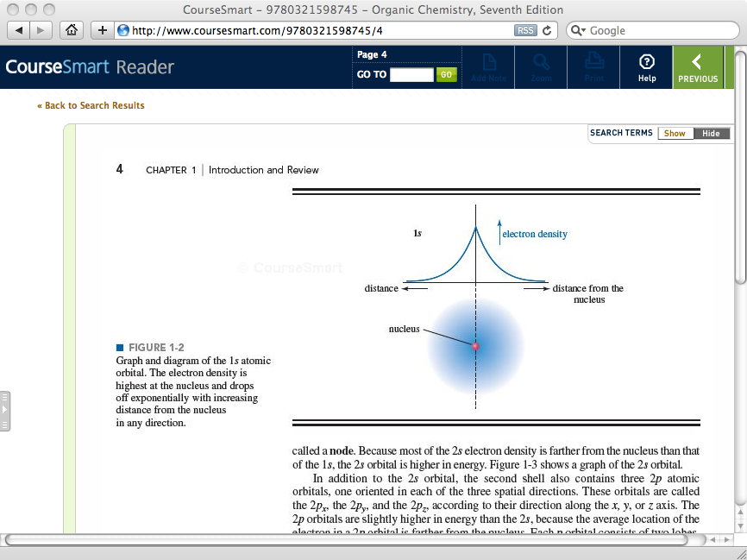



Slide 17
Basic LTI Building Block / PowerLink
Stephen Vickers – U. Edinburgh
  Blackboard Building Block and PowerLink
  http://www.spvsoftwareproducts.com/bb/basiclti/demo.swf
  http://projects.oscelot.org/gf/project/wct-basiclti/
Uses the IMS-Provided utility code
Excellent example of the "Virtual Tool" pattern

Slide 18
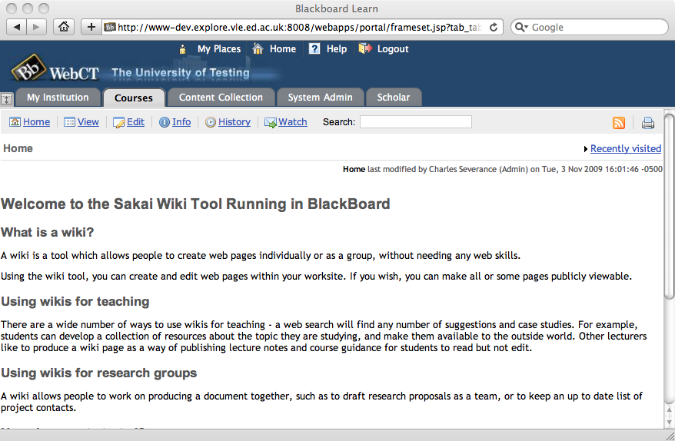
http://www.spvsoftwareproducts.com/bb/basiclti/demo.swf

Slide 19
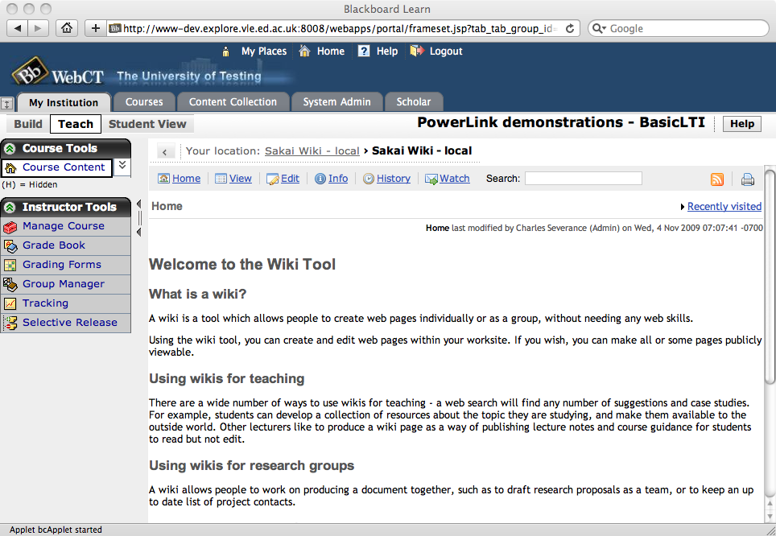
http://www.spvsoftwareproducts.com/bb/basiclti/demo.swf

Slide 20

BasicLTI – Sakai
Sakai BasicLTI Consumer Portlet available (Expected in 2.7)
  https://source.sakaiproject.org/contrib//csev/trunk/basiclti/
  Example of using the IMS Utility code
Support for Basic LTI in Sakai/Melete 2.7
Sakai BasicLTI Tool Provider in Sakai 2.7

Slide 21
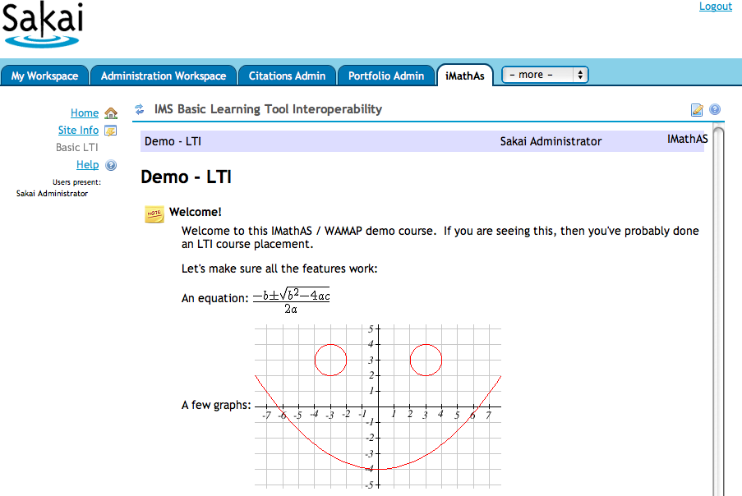
http://www.imathas.com/

Slide 22
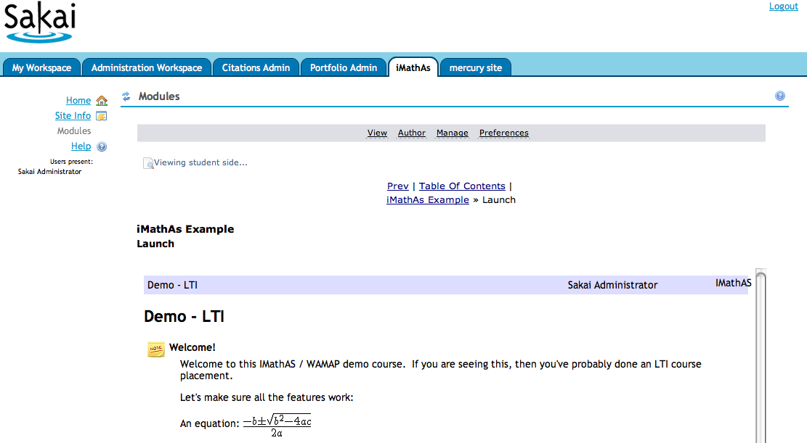

Slide 23
http://www.spvsoftwareproducts.com/bb/basiclti/demo.swf

Slide 24

IMS Basic LTI and IMS Common Cartridge are on the roadmap for Moodle and development work has started
  It should appear in Moodle 2.0 out of the box
  Basic LTI should be back ported to 1.9,1.8 for a dot release

Slide 25
Basic LTI Coverage (approximate)
Desire2Learn
Sakai 2.7
Moodle 2.0, 1.9, 1.8
Blackboard 8
Blackboard 9
WebCT Vista
ANGEL Learning
Liferay
uPortal
These are just what I *hope* will be available within 3-6 months.

Slide 26
Where Do Tools Come From?
Tool Vendors – Write once run anywhere
  As LMS's ship with Basic LTI out of the box, this becomes the low-effort solution for the Wimba's of the world
Faculty / Students / Tech Support
  PHP Tool Kit
  Python / Google App Engine Tool Kit

Slide 27
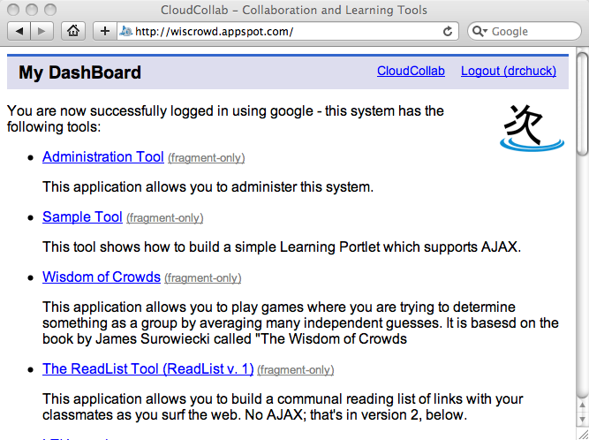
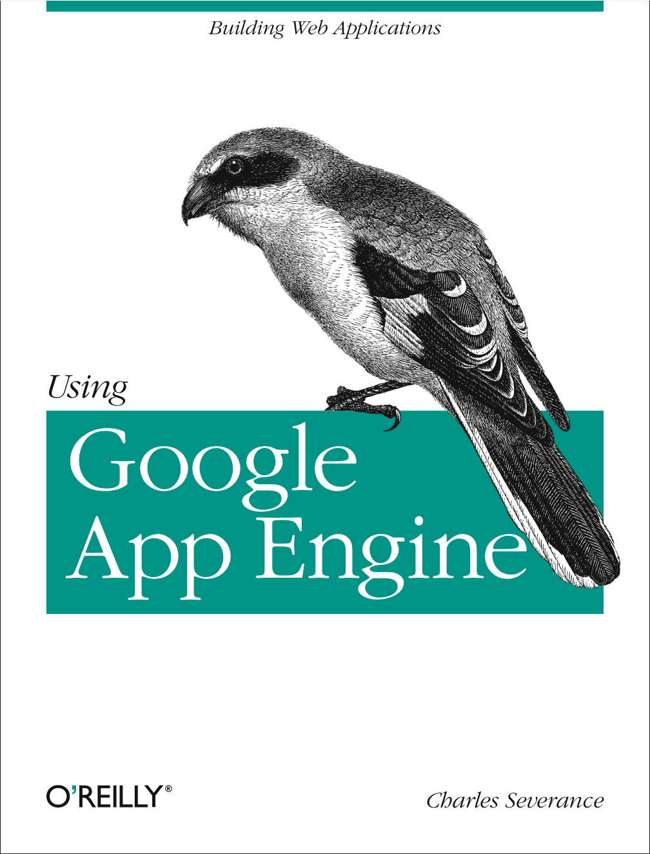
www.tsugiproject.org

Slide 28
Up Next…
IMS Basic LTI and IMS CC puts unprecedented ability to teach and innovate in new ways in the hands of students and teachers
This is moving quickly into the marketplace
Questions…
  cseverance@imsglobal.org

