Slide 1



IMS Basic Learning Tools Interoperability (Basic LTI)
Charles Severance, Ph.D.
Affiliate Coordinator
IMS Global Learning Consortium (IMS GLC)
http://www.imsglobal.org/

Slide 2
The IMS Global Learning Consortium creates standards for the development and adoption of technologies that enable high-quality, accessible, and affordable learning experiences.
IMS Mission & Vision
*IMS once stood for “Instructional Management System,” the product category that now includes Learning Management Systems, Course Management Systems, Virtual Learning Environments, and Instructional Management Systems
Notes:
Mission of IMS GLC – the vision is captured as well by the last phrase.
In many respects, is the “World Wide Web Consortium (W3C)” for learning and educational technology.

Slide 3
Specific Objectives
Cost: Reduce cost to integrate new applications and to upgrade existing applications
User Experience: Improved integration results in more efficient and effective user (instructor & learner) experiences
Adoption: Improving user efficiency is the most critical attribute in successful adoption of new technology in the teaching & learning experience

Slide 4
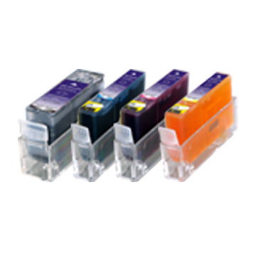
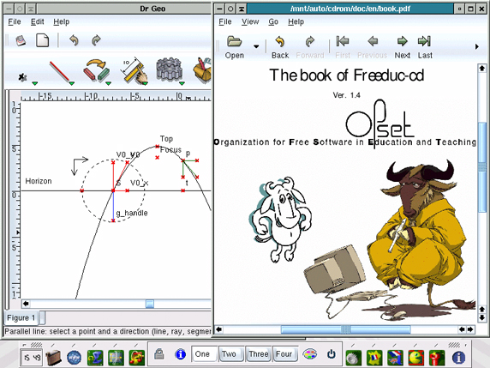
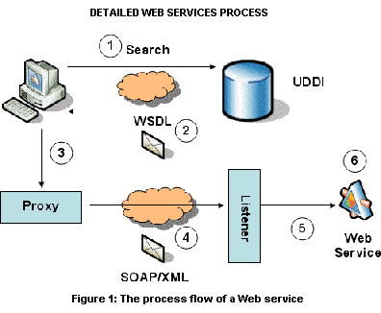
Standards Core: IMS Digital Learning Services (DLS) Standards
Common Cartridge:
Enabling distributed learning content and assessments in a collaborative learning context
Learning Tools Interoperability (LTI):
Enabling a wide variety of web-based learning applications in a seamless learning context with exchange of results
Learning Information Services (LIS):
Provisioning of users from the authoritative system and outcomes reporting/analysis
Enabling Interoperability for the Next Generation of Learning Technology and Services
http://www.imsglobal.org/digitallearningservices.html

Slide 5
IMS Learning Tools Interoperability

Slide 6
Basic LTI: Executive Summary
Allows an LMS to launch an External Tool and securely provide user identity, course information, and role information to the external tool
Uses a HTTP POST through the browser – secured by the OAuth security (www.oauth.net)

Slide 7
Basic LTI is Included in Full LTI
IMS Learning Tools
Interoperability
Provisioning
Services
Event
Services
Richer
Trust Model
Basic LTI
Run-Time
Services

Slide 8
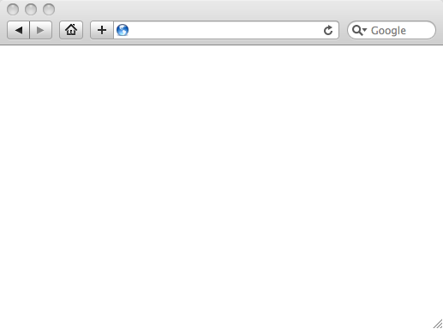
LMS (LTI Consumer)
User Experience
Welcome
Local Resource
Lame iFrame
LTI Tool
Movie
Tool (LTI Provider)
© Copyright 2009 IMS Global Learning Consortium
All Rights Reserved.

Slide 9
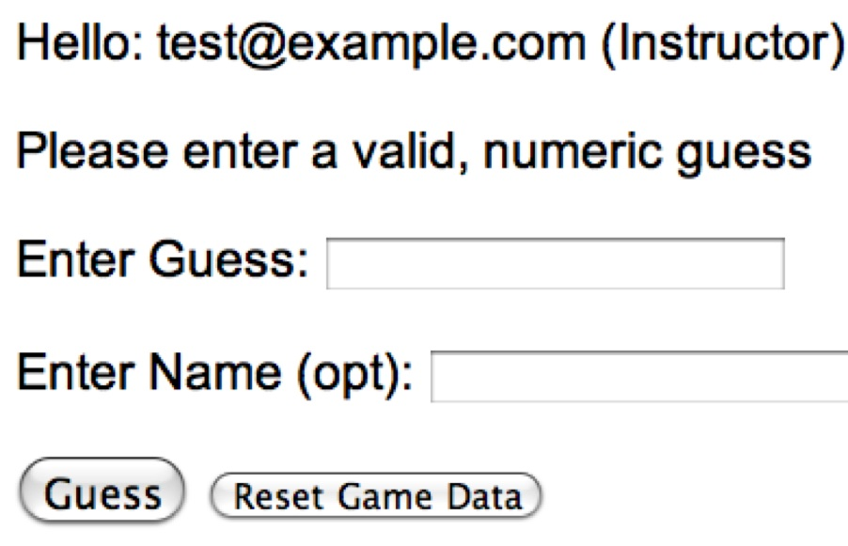
LMS (LTI Consumer)
User Experience
Welcome
Local Resource
Lame iFrame
LTI Tool
Movie
Tool (LTI Provider)
© Copyright 2009 IMS Global Learning Consortium
All Rights Reserved.

Slide 10
LMS (LTI Consumer)
Again in slow motion…
LMS Looks up User and Course Information.
Information is signed using secret and OAuth
Welcome
Local Resource
Lame iFrame
LTI Tool
Movie
Form data sent to Browser
Tool (LTI Provider)
© Copyright 2009 IMS Global Learning Consortium
All Rights Reserved.

Slide 11
LMS (LTI Consumer)
Form is immediately auto-submitted using JavaScript.
<form action=”tool”/>
<input name=”user_id”
value=”2348d8dd” />
<input name=”oauth_token”
value=”abc.edu” />
</form>
Tool (LTI Provider)
Tool looks up secret and validates signature.
Tool provisions user, course, and session.
Tool sends redirect
© Copyright 2009 IMS Global Learning Consortium
All Rights Reserved.

Slide 12
LMS (LTI Consumer)
Browser follows redirect…
<head>
<meta redirect
page=”main.php”>
</head>
Tool (LTI Provider)
Tool produces
first page.
© Copyright 2009 IMS Global Learning Consortium
All Rights Reserved.

Slide 13
LMS (LTI Consumer)
Tool (LTI Provider)
© Copyright 2009 IMS Global Learning Consortium
All Rights Reserved.

Slide 14
Basic LTI Sample Launch Data
lti_version=LTI-1p0
lti_message_type=basic-lti-launch-request
resource_link_id=120988f929-274612
user_id=292832126
roles=Instructor
lis_person_name_full=Charles R. Severance
lis_person_contact_email_primary = csev@umich.edu
context_id=456434513
context_title=SI301 - PHP
tool_consumer_instance_guid=ctools.umich.edu
tool_consumer_instance_description=University of Michigan

Slide 15
REST Message Signing / OAuth
Specification at www.oauth.net is very clear
Signs message using time-stamp, one-use token (nonce)
Message signing – Trust between pairs of servers
“Three-legged-OAuth” – Trust between servers plus user identity (not used in Basic LTI)

Slide 16
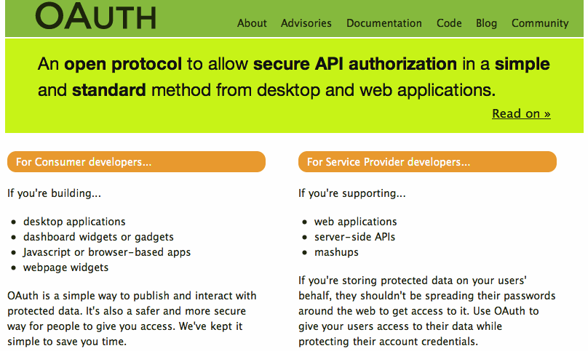

Slide 17
OAuth Base Message String
POST&http%3A%2F%2Flocalhost%2F~user%2Fphp-simple%2Ftool.php&basiclti_submit%3DLaunch%2520Endpoint%2520with%2520BasicLTI%2520Data%26context_id%3D456434513%26context_title%3DSI301%2520-%2520PHP%26lis_person_contact_email_primary%3Duser%2540school.edu%26lis_person_name_full%3DJane%2520Q.%2520Public%26lis_person_sourcedid%3Duser%26lti_message_type%3Dbasiclti-lti-launch-request%26lti_version%3DbasicLTI-1p0%26oauth_consumer_key%3Dlmsng.school.edu%26oauth_nonce%3D0f353c60b12cd5db55ce2bf4cbeb6f8b%26oauth_signature_method%3DHMAC-SHA1%26oauth_timestamp%3D1249621439%26oauth_version%3D1.0%26resource_link_id%3D120988f929-274612%26roles%3DInstructor%26tool_consumer_instance_description%3DUniversity%2520of%2520Michigan%26tool_consumer_instance_guid%3Dschool.edu%26user_id%3D292832126
oauth_signature = kjqD5TpgdhjPOq0gqoPVntJ8yPU=

Slide 18
Basic LTI and IMS Common Cartridge
Welcome
Local Resource
Folder
LTI Tool
Discussion
QTI Pool
Common Cartridge 1.1 will include the ability to define a Basic LTI resource and include that resource in course organizational structures

Slide 19
IMS Learning Information Services
If an LMS supports LIS, the LMS can pass LIS data to the external tool in case the external tool also is configured to use LIS
  lis_person_sourced_id
  lis_course_offering_sourced_id
  lis_course_section_sourced_id
  lis_result_sourcedid

Slide 20
Learning Tools Interoperability
TOOL PROVIDER
TOOL CONSUMER
BasicLTILaunch with LIS pointers
LIS
SERVICES
The TP calls LIS
services, if available.

Slide 21
Pushing Basic LTI Adoption
Sample Java + PHP Basic LTI implementations at
  http://code.google.com/p/ims-dev/
Use/include sample code from oauth.net
Both structured to provide reusable code
  org.imsglobalorg.basiclti.BasicLTIUtil.java
  blti_util.php
Copyright IMS, Apache 2 – Usable anywhere

Slide 22
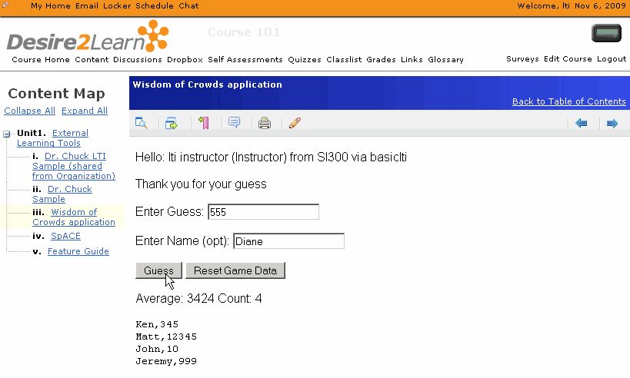
Desire2Learn
IMS Basic LTI Support in 8.4.2 (Released Nov 2009)

Slide 23

Icodeon – Content Player
The Icodeon content player supports IMS Common Cartridge 1.1 which includes live links to premium content using Basic LTI

Slide 24
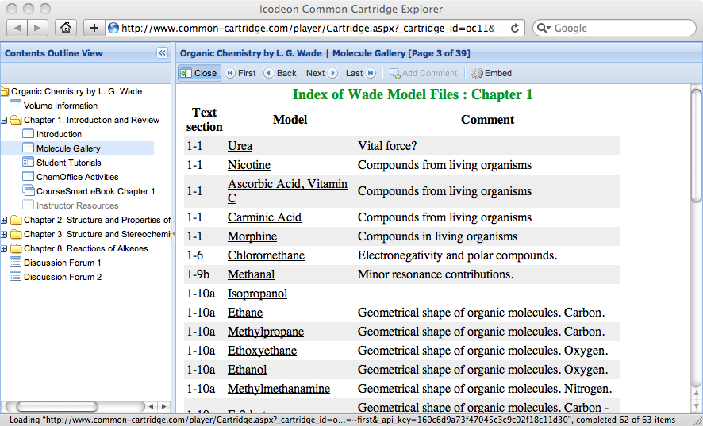
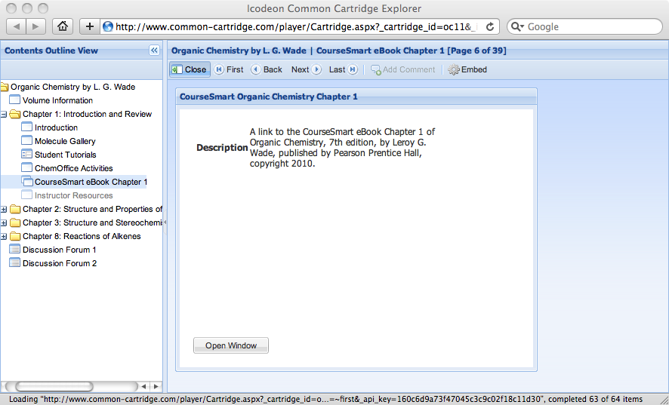
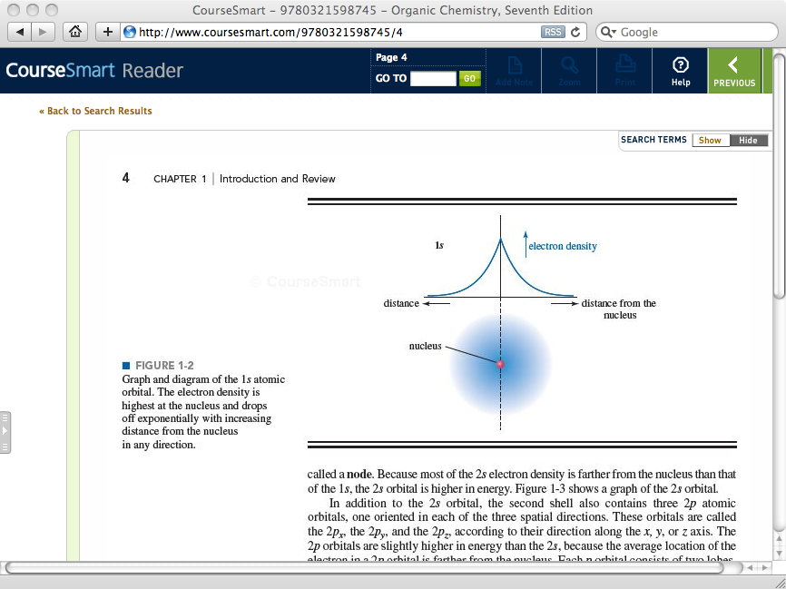



Slide 25
Basic LTI Building Block / PowerLink
Stephen Vickers – U. Edinburgh
  Blackboard Building Block and PowerLink
  http://www.spvsoftwareproducts.com/bb/basiclti/demo.swf
  http://projects.oscelot.org/gf/project/wct-basiclti/
Uses the IMS-Provided utility code
Excellent example of the "Virtual Tool" pattern

Slide 26
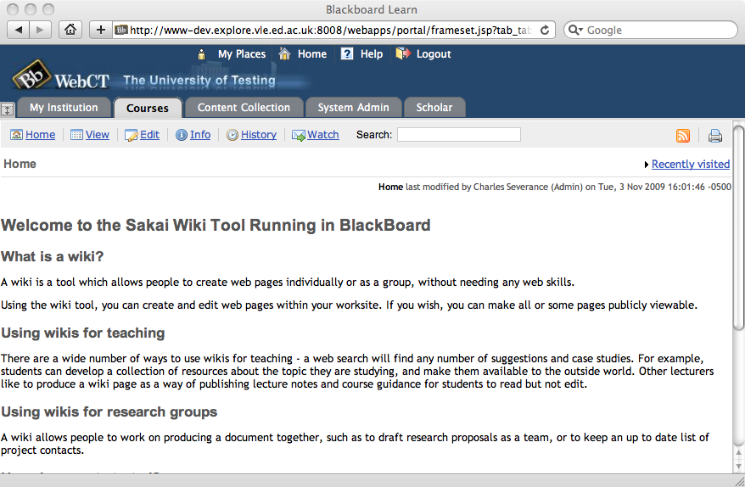
http://www.spvsoftwareproducts.com/bb/basiclti/demo.swf

Slide 27
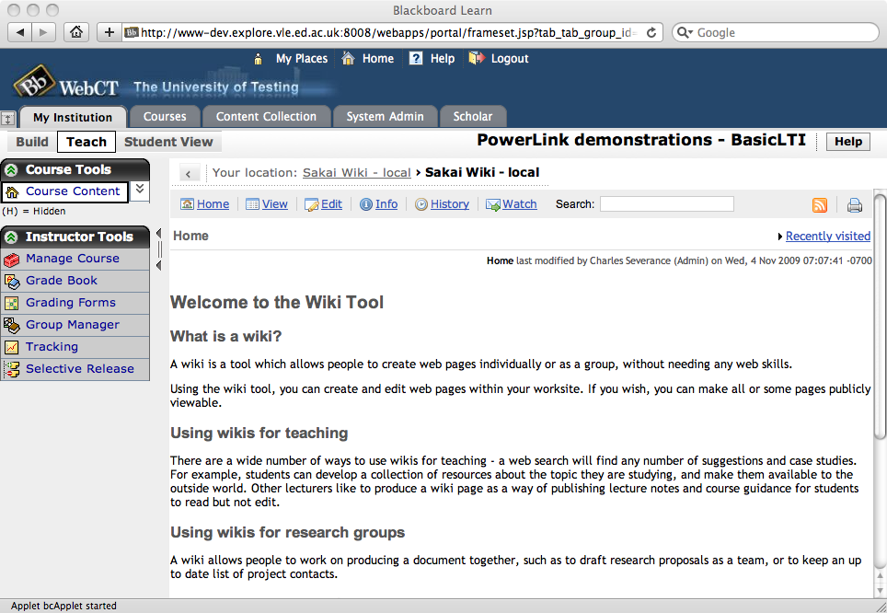
http://www.spvsoftwareproducts.com/bb/basiclti/demo.swf

Slide 28

BasicLTI – Sakai
Sakai BasicLTI Consumer Portlet available (Expected in 2.7)
  https://source.sakaiproject.org/contrib//csev/trunk/basiclti/
  Example of using the IMS Utility code
Support for Basic LTI in Sakai/Melete 2.7
Sakai BasicLTI Tool Provider in Sakai 2.7

Slide 29
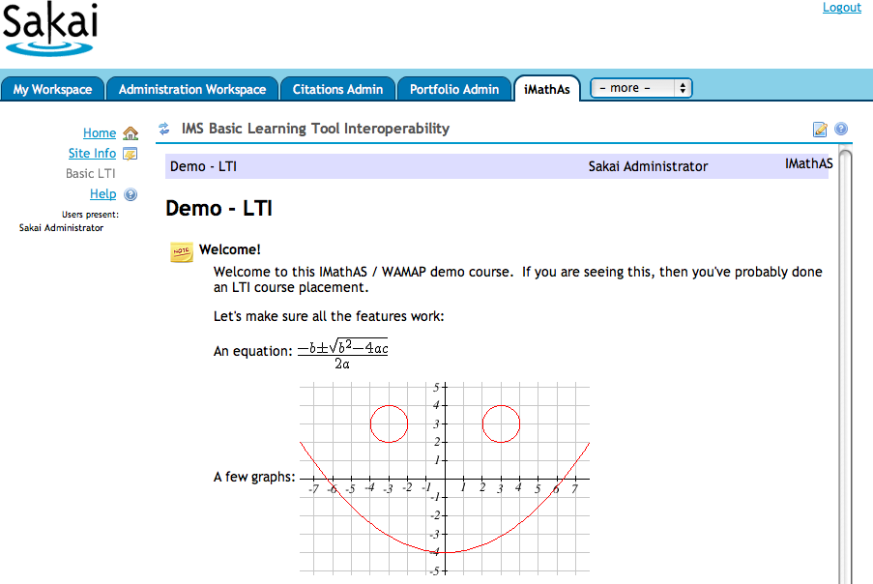
http://www.imathas.com/

Slide 30
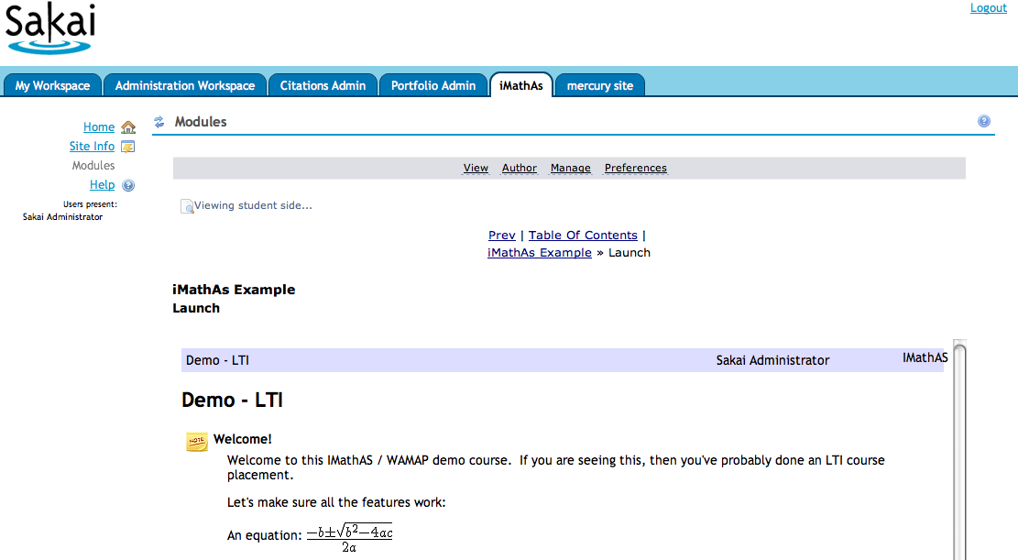

Slide 31
http://www.spvsoftwareproducts.com/bb/basiclti/demo.swf

Slide 32
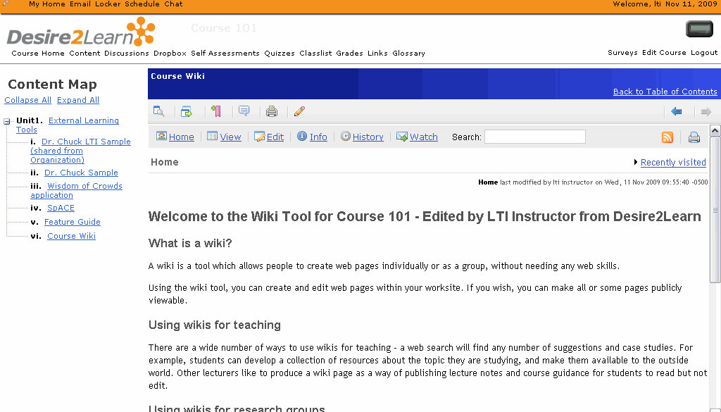

Slide 33

IMS Basic LTI and IMS Common Cartridge are on the roadmap for Moodle and development work has started
  It should appear in Moodle 2.0 out of the box
  Basic LTI should be back ported to 1.9,1.8 for a dot release
http://code.google.com/p/basiclti4moodle/

Slide 34
ANGEL Learning – Penn State
Penn State University is working on building a nugget for ANGEL Learning that supports Basic LTI Consumer
They are also building Basic LTI Tool Provider support for PLONE
Release and license plans and software availability are completely unknown at this point

Slide 35
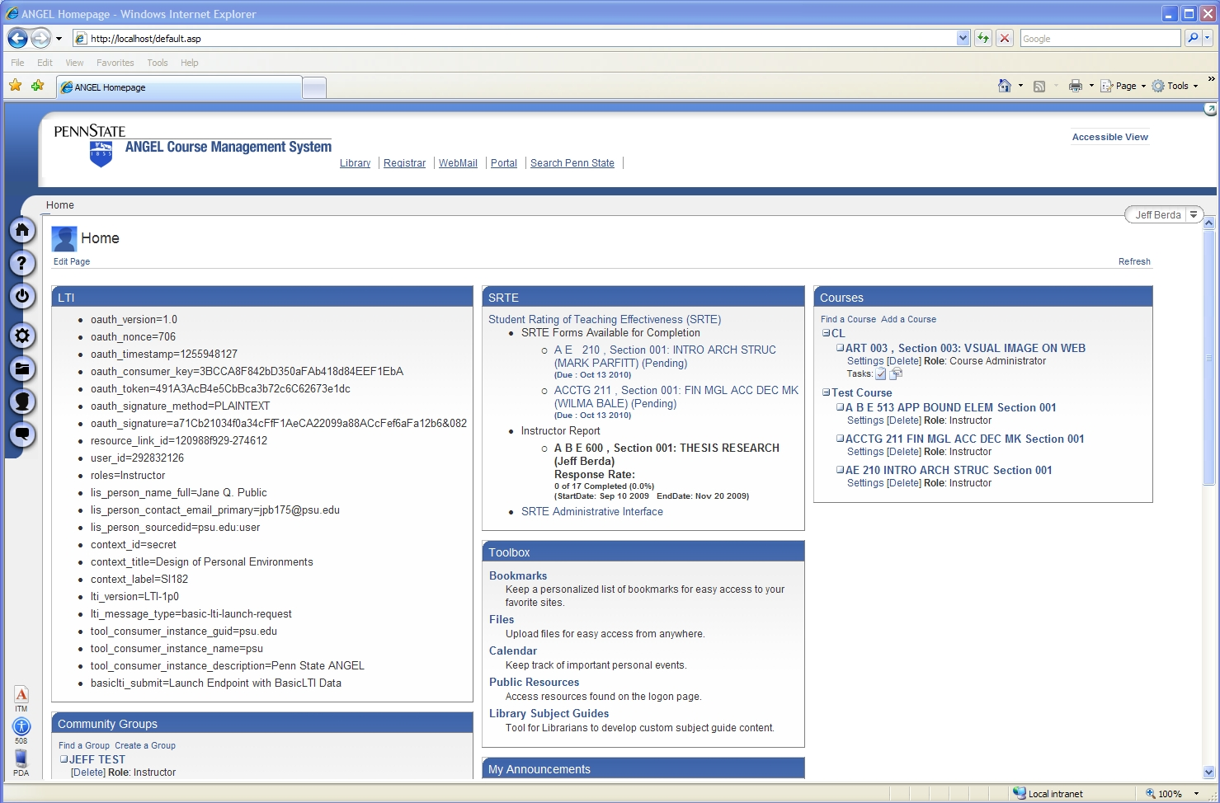

Slide 36
Basic LTI LMS Coverage (approx.)
Shipped
  Desire2Learn 8.4.2
In Progress
  Sakai 2.7, Moodle 1.9
Planned
  Moodle 2.0
Open Source Plugins
  Blackboard 8
  Blackboard 9
  WebCT Vista
Early Work
  ANGEL Learning

Slide 37
Where Do Tools Come From?
Tool Vendors – Write once run anywhere
  As LMS's ship with Basic LTI out of the box, this becomes the low-effort solution for the Wimba's of the world
Focused Free Tools
  LectureTools – www.lecturetools.org
  Interactive Math Assessment – www.imathas.com

Slide 38
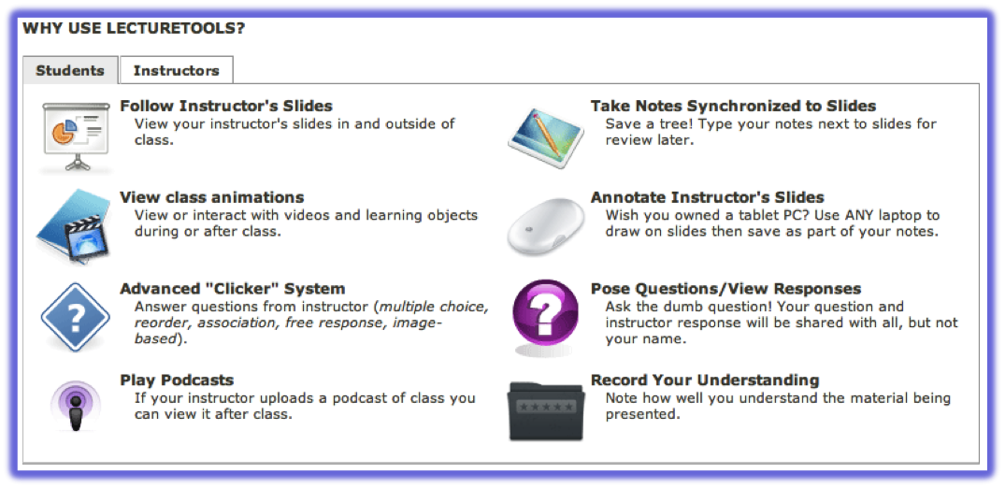
Sakai@
umich.edu
Blackboard@
wcc.edu
Blackboard@
flint.umich.edu
Basic LTI
Case Study: www.lecturetools.org

Slide 39
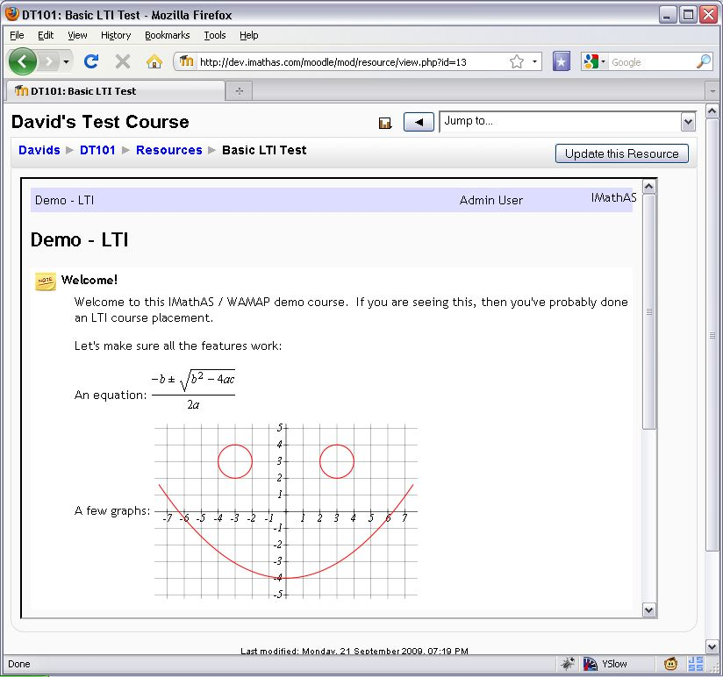
Case Study: www.imathas.com / David Lippman

Slide 40
Where Do Tools Come From?
Perhaps in time, tools will be written by Faculty / Students / Tech Support
  Apache Wookie – Learning Widgets
  Python / Google App Engine Tool Kits

Slide 41
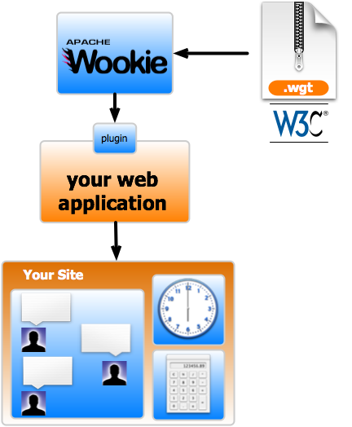
Apache Wookie Project
An Apache project to implement a reference implementation to host W3C Widgets
Adding support for IMS Basic LTI Provider

Slide 42
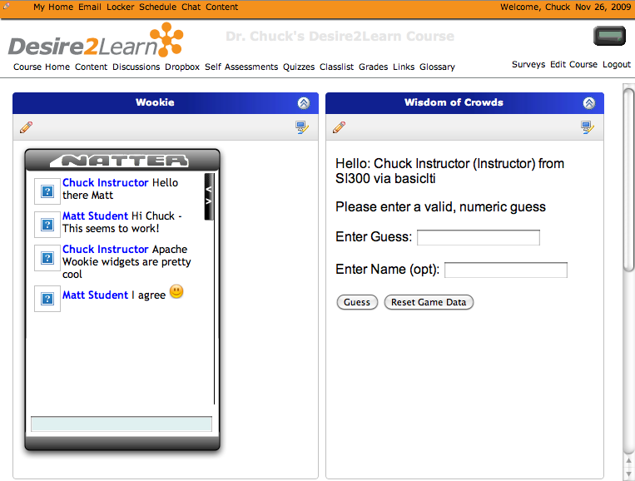
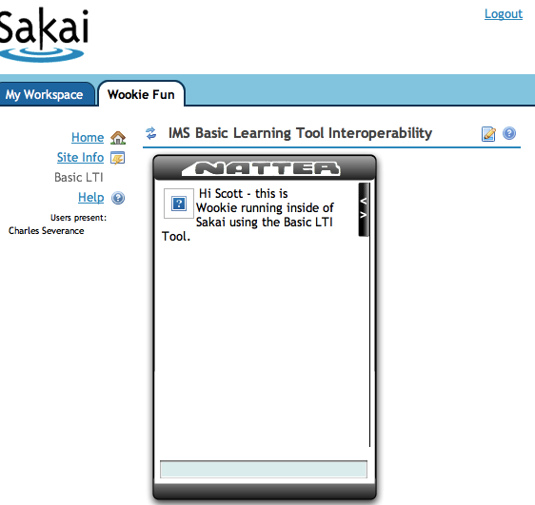
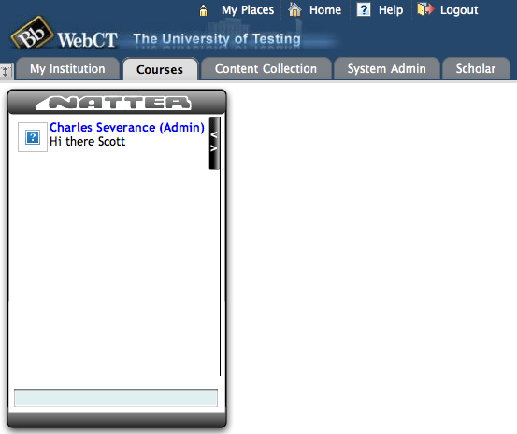
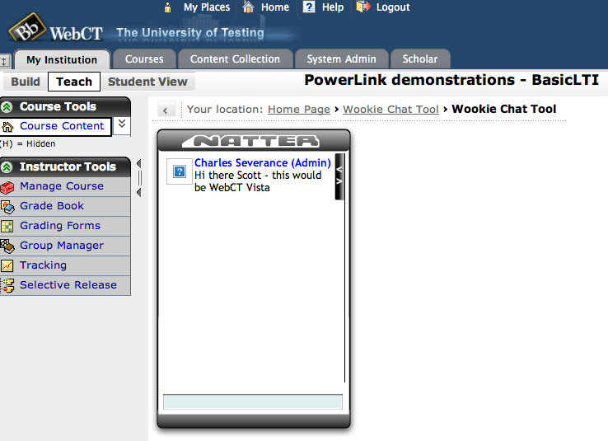
http://incubator.apache.org/wookie/

Slide 43
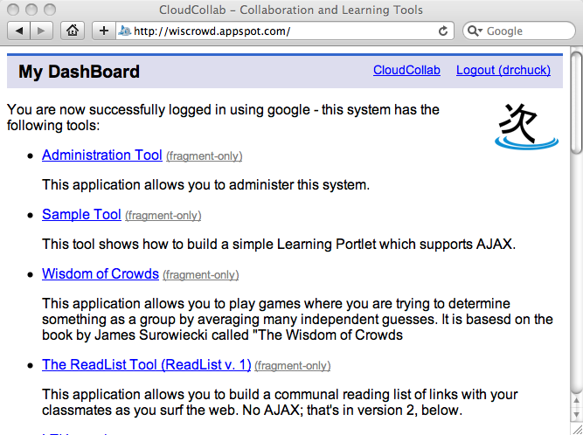
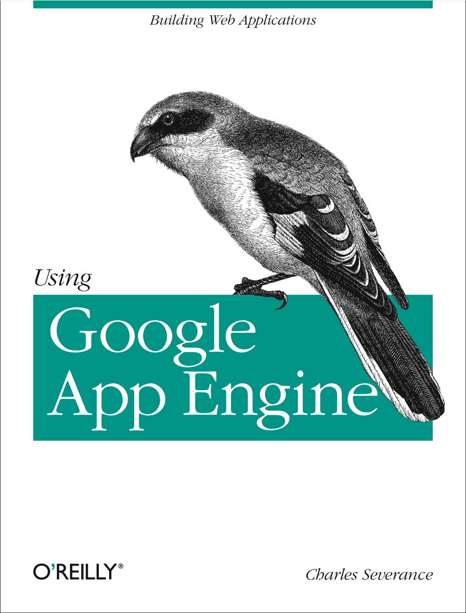
www.tsugiproject.org

Slide 44
Developer Tools
Tool Consumer
  http://developers.imsglobal.org/BLTI/lms.php
Tool Provider
  http://developers.imsglobal.org/BLTI/tool.php
  Key=lmsng.school.edu secret=secret
Source Code
  http://code.google.com/p/ims-dev/

Slide 45
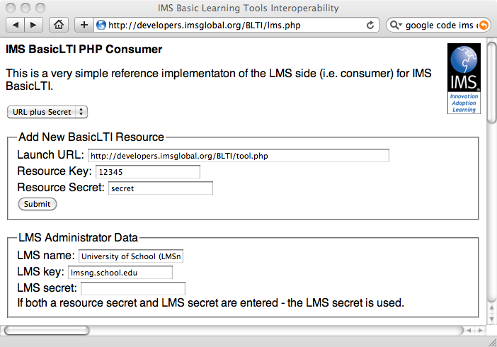

Slide 46
Discussion Forums
CC Alliance Forum – Private / Members Only
  http://www.imsglobal.org/community/forum/index.cfm?forumid=7
Public Developer Forum
  http://www.imsglobal.org/community/forum/index.cfm?forumid=5

Slide 47

















Slide 48
Up Next…
IMS Basic LTI and IMS CC puts unprecedented ability to teach and innovate in new ways in the hands of students and teachers
This is moving quickly into the marketplace
Get involved – www.imsglobal.org
Tell me how I can help: cseverance@imsglobal.org

