Slide 1



IMS Basic Learning Tools Interoperability (Basic LTI)
Charles Severance, Ph.D.
Affiliate Coordinator
IMS Global Learning Consortium (IMS GLC)
http://www.imsglobal.org/

Slide 2
Basic LTI: Executive Summary
Allows an LMS to launch an External Tool and securely provide user identity, course information, and role information to the external tool
Uses a HTTP POST through the browser – secured by the OAuth security (www.oauth.net)

Slide 3
Basic LTI is Included in Full LTI
IMS Learning Tools
Interoperability
Provisioning
Services
Event
Services
Richer
Trust Model
Basic LTI
Run-Time
Services

Slide 4
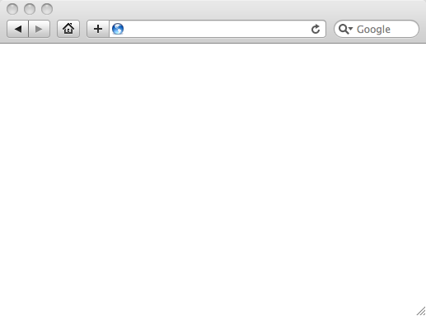
Integrated User Experience
Welcome
Local Resource
Lame iFrame
LTI Tool
Movie
© Copyright 2009 IMS Global Learning Consortium
All Rights Reserved.

Slide 5
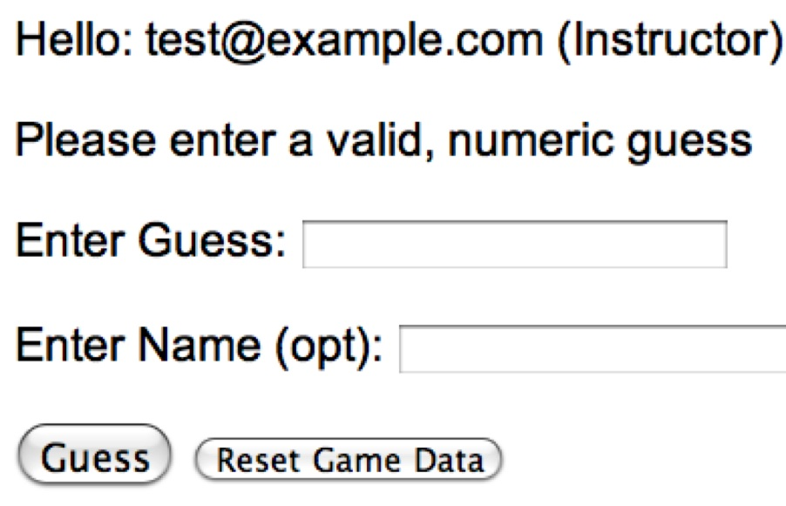
User Experience
Welcome
Local Resource
Lame iFrame
LTI Tool
Movie
© Copyright 2009 IMS Global Learning Consortium
All Rights Reserved.

Slide 6
LMS (LTI Consumer)
Again in Slow Motion
Welcome
Local Resource
Lame iFrame
LTI Tool
Movie
Tool (LTI Provider)
© Copyright 2009 IMS Global Learning Consortium
All Rights Reserved.

Slide 7
LMS (LTI Consumer)
Again in slow motion…
LMS Looks up User and Course Information.
Information is signed using secret and OAuth
Welcome
Local Resource
Lame iFrame
LTI Tool
Movie
Form data sent to Browser
Tool (LTI Provider)
© Copyright 2009 IMS Global Learning Consortium
All Rights Reserved.

Slide 8
LMS (LTI Consumer)
Form is immediately auto-submitted using JavaScript.
<form action=”tool”/>
<input name=”user_id”
value=”2348d8dd” />
<input name=”oauth_token”
value=”abc.edu” />
</form>
Tool (LTI Provider)
Tool looks up secret and validates signature.
Tool provisions user, course, and session.
Tool sends redirect
© Copyright 2009 IMS Global Learning Consortium
All Rights Reserved.

Slide 9
LMS (LTI Consumer)
Browser follows redirect…
<head>
<meta redirect
page=”main.php”>
</head>
Tool (LTI Provider)
Tool produces
first page.
© Copyright 2009 IMS Global Learning Consortium
All Rights Reserved.

Slide 10
LMS (LTI Consumer)
Tool (LTI Provider)
© Copyright 2009 IMS Global Learning Consortium
All Rights Reserved.

Slide 11
Basic LTI Sample Launch Data
lti_version=LTI-1p0
lti_message_type=basic-lti-launch-request
resource_link_id=120988f929-274612
user_id=292832126
roles=Instructor
lis_person_name_full=Charles R. Severance
lis_person_contact_email_primary = csev@umich.edu
context_id=456434513
context_title=SI301 - PHP
tool_consumer_instance_guid=ctools.umich.edu
tool_consumer_instance_description=University of Michigan

Slide 12
REST Message Signing / OAuth
Specification at www.oauth.net is very clear
Signs message using time-stamp, one-use token (nonce)
Message signing – Trust between pairs of servers
“Three-legged-OAuth” – Trust between servers plus user identity (not used in Basic LTI)

Slide 13
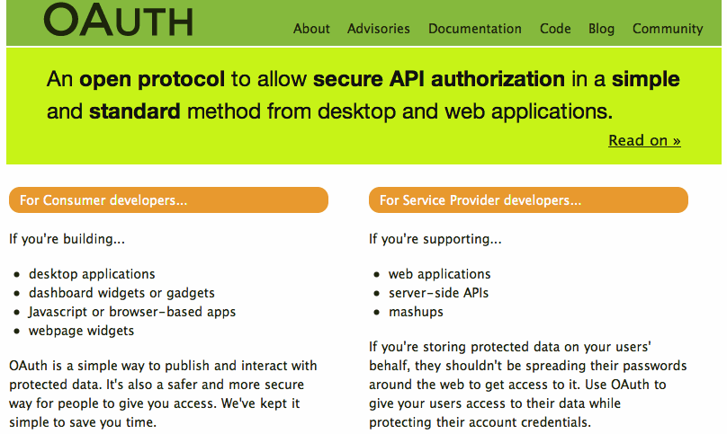

Slide 14
OAuth Base Message String
POST&http%3A%2F%2Flocalhost%2F~user%2Fphp-simple%2Ftool.php&basiclti_submit%3DLaunch%2520Endpoint%2520with%2520BasicLTI%2520Data%26context_id%3D456434513%26context_title%3DSI301%2520-%2520PHP%26lis_person_contact_email_primary%3Duser%2540school.edu%26lis_person_name_full%3DJane%2520Q.%2520Public%26lis_person_sourcedid%3Duser%26lti_message_type%3Dbasiclti-lti-launch-request%26lti_version%3DbasicLTI-1p0%26oauth_consumer_key%3Dlmsng.school.edu%26oauth_nonce%3D0f353c60b12cd5db55ce2bf4cbeb6f8b%26oauth_signature_method%3DHMAC-SHA1%26oauth_timestamp%3D1249621439%26oauth_version%3D1.0%26resource_link_id%3D120988f929-274612%26roles%3DInstructor%26tool_consumer_instance_description%3DUniversity%2520of%2520Michigan%26tool_consumer_instance_guid%3Dschool.edu%26user_id%3D292832126
oauth_signature = kjqD5TpgdhjPOq0gqoPVntJ8yPU=

Slide 15
Basic LTI and IMS Common Cartridge
Welcome
Local Resource
Folder
LTI Tool
Discussion
QTI Pool
Common Cartridge 1.1 includes the ability to define a Basic LTI resource and include that resource in course organizational structures

Slide 16
IMS Learning Information Services
If an LMS supports LIS, the LMS can pass LIS data to the external tool in case the external tool also is configured to use LIS
  lis_person_sourced_id
  lis_course_offering_sourced_id
  lis_course_section_sourced_id
  lis_result_sourcedid

Slide 17
Learning Tools Interoperability
TOOL PROVIDER
TOOL CONSUMER
BasicLTILaunch with LIS pointers
LIS
SERVICES
The TP calls LIS
services, if available.

Slide 18
Pushing Basic LTI Adoption
Sample Java + PHP Basic LTI implementations at
  http://code.google.com/p/ims-dev/
Use/include sample code from oauth.net
Both structured to provide reusable code
  org.imsglobalorg.basiclti.BasicLTIUtil.java
  blti_util.php
Copyright IMS, Apache 2 – Usable anywhere

Slide 19
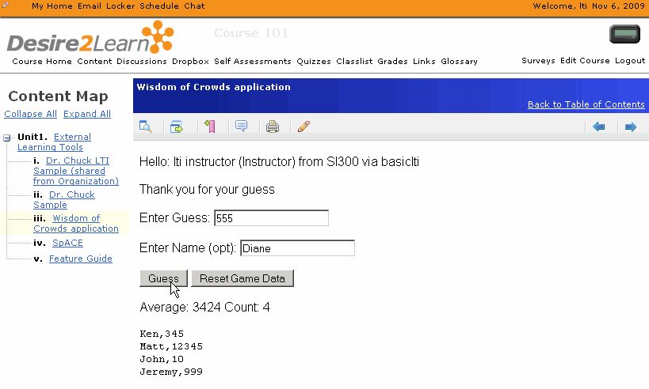
Desire2Learn
IMS Basic LTI Support in 8.4.2 (Released Nov 2009)

Slide 20

Icodeon – Content Player
The Icodeon content player supports IMS Common Cartridge 1.1 which includes live links to premium content using Basic LTI

Slide 21
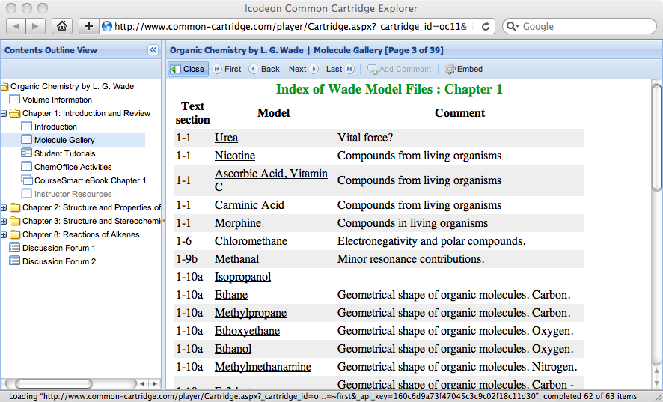
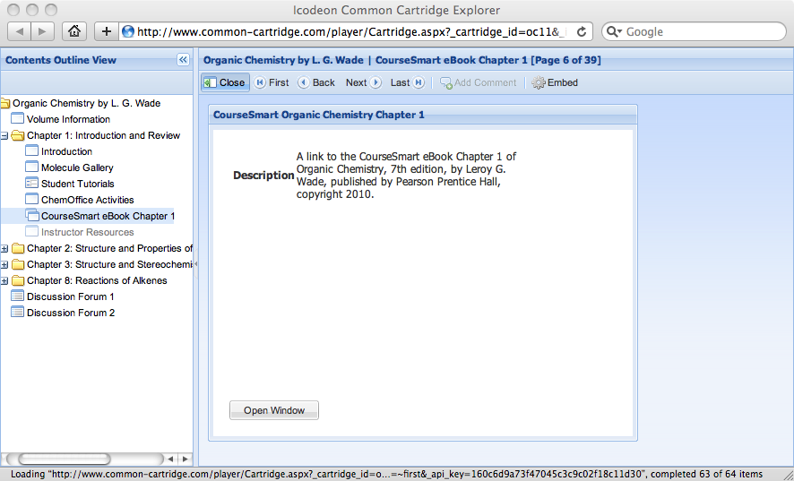
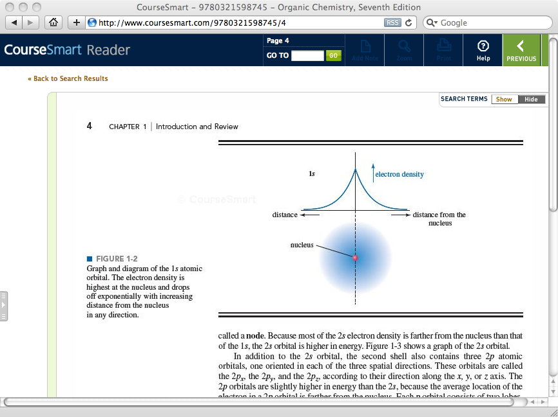



Slide 22
Basic LTI Building Block / PowerLink
Stephen Vickers – U. Edinburgh
  Blackboard Building Block and PowerLink
  http://www.spvsoftwareproducts.com/bb/basiclti/demo.swf
  http://projects.oscelot.org/gf/project/wct-basiclti/
Uses the IMS-Provided utility code
Excellent example of the "Virtual Tool" pattern

Slide 23
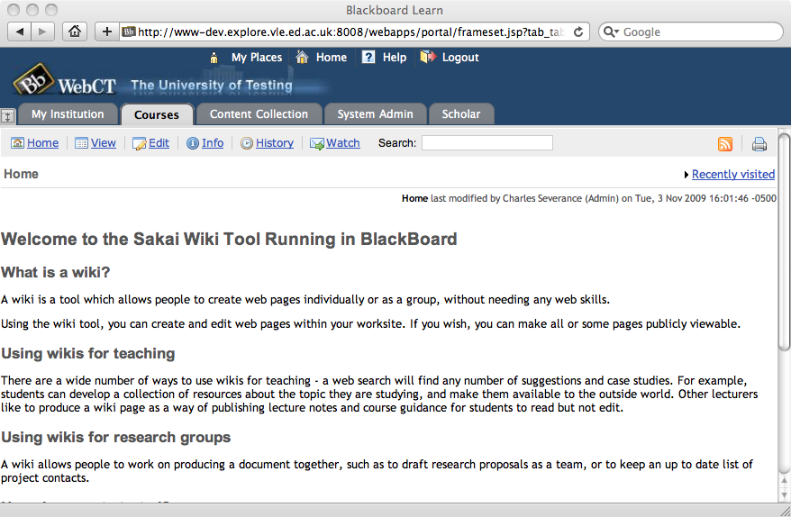
http://www.spvsoftwareproducts.com/bb/basiclti/demo.swf

Slide 24
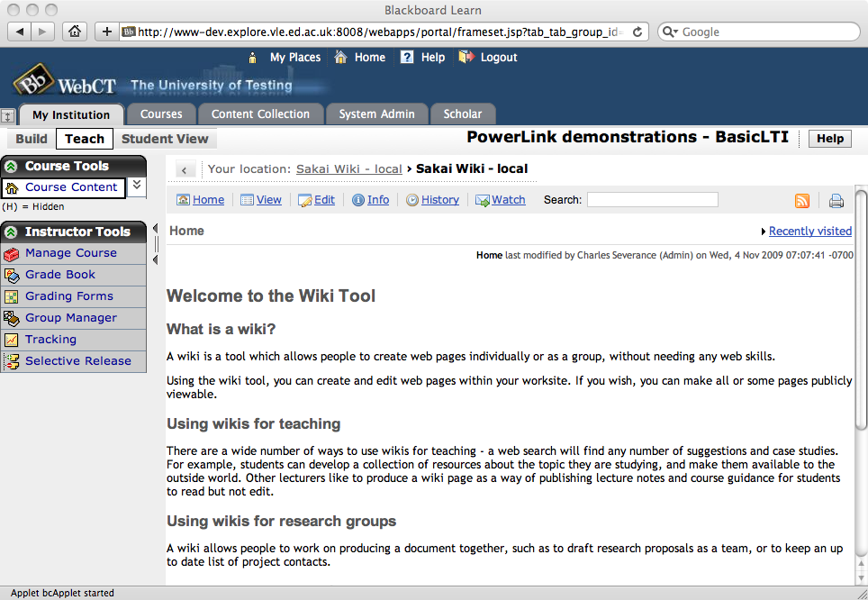
http://www.spvsoftwareproducts.com/bb/basiclti/demo.swf

Slide 25

BasicLTI – Sakai
Sakai BasicLTI Consumer Portlet available (Expected in 2.7)
  https://source.sakaiproject.org/contrib//csev/trunk/basiclti/
  Example of using the IMS Utility code
Support for Basic LTI in Sakai/Melete 2.7
Sakai BasicLTI Tool Provider in Sakai 2.7

Slide 26
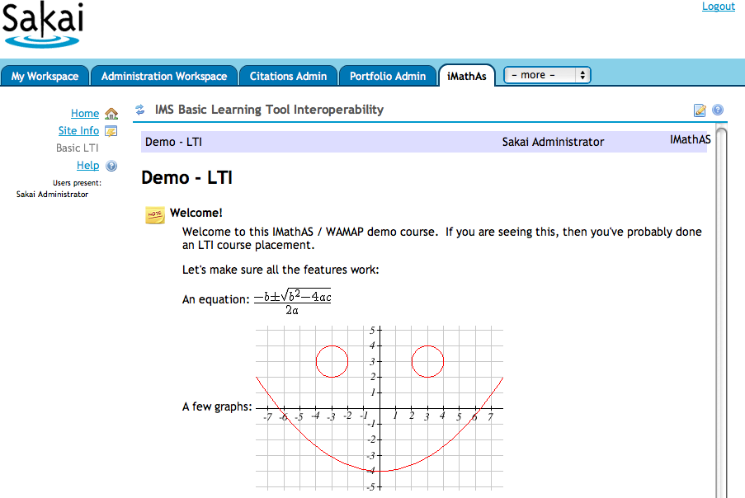
http://www.imathas.com/

Slide 27
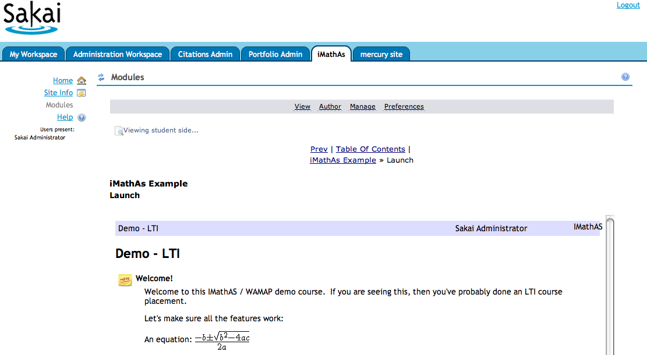

Slide 28
http://www.spvsoftwareproducts.com/bb/basiclti/demo.swf

Slide 29
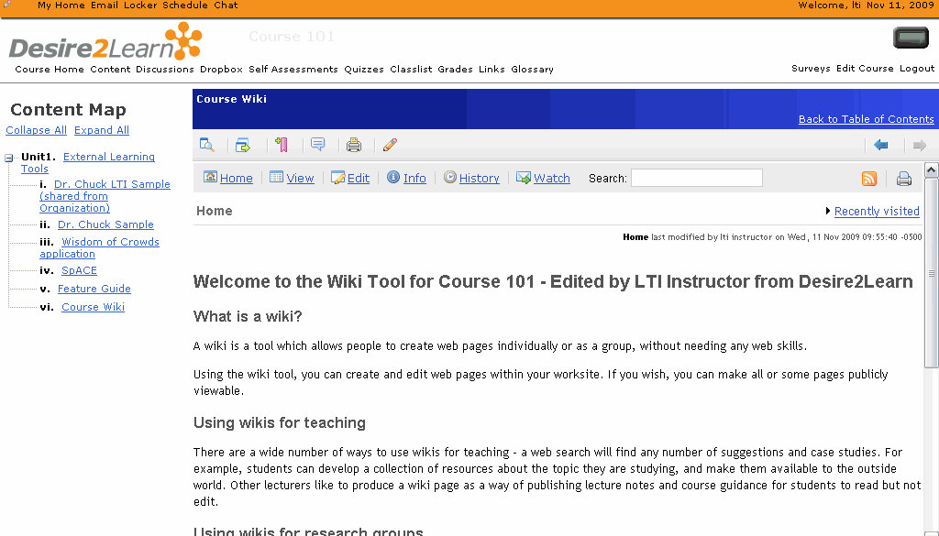

Slide 30

IMS Basic LTI and IMS Common Cartridge are on the roadmap for Moodle and development work has started
  It should appear in Moodle 2.0 out of the box
  Basic LTI should be back ported to 1.9,1.8 for a dot release
http://code.google.com/p/basiclti4moodle/

Slide 31
ANGEL Learning – Penn State
Penn State University is working on building a nugget for ANGEL Learning that supports Basic LTI Consumer
They are also building Basic LTI Tool Provider support for PLONE
Release and license plans and software availability are completely unknown at this point

Slide 32
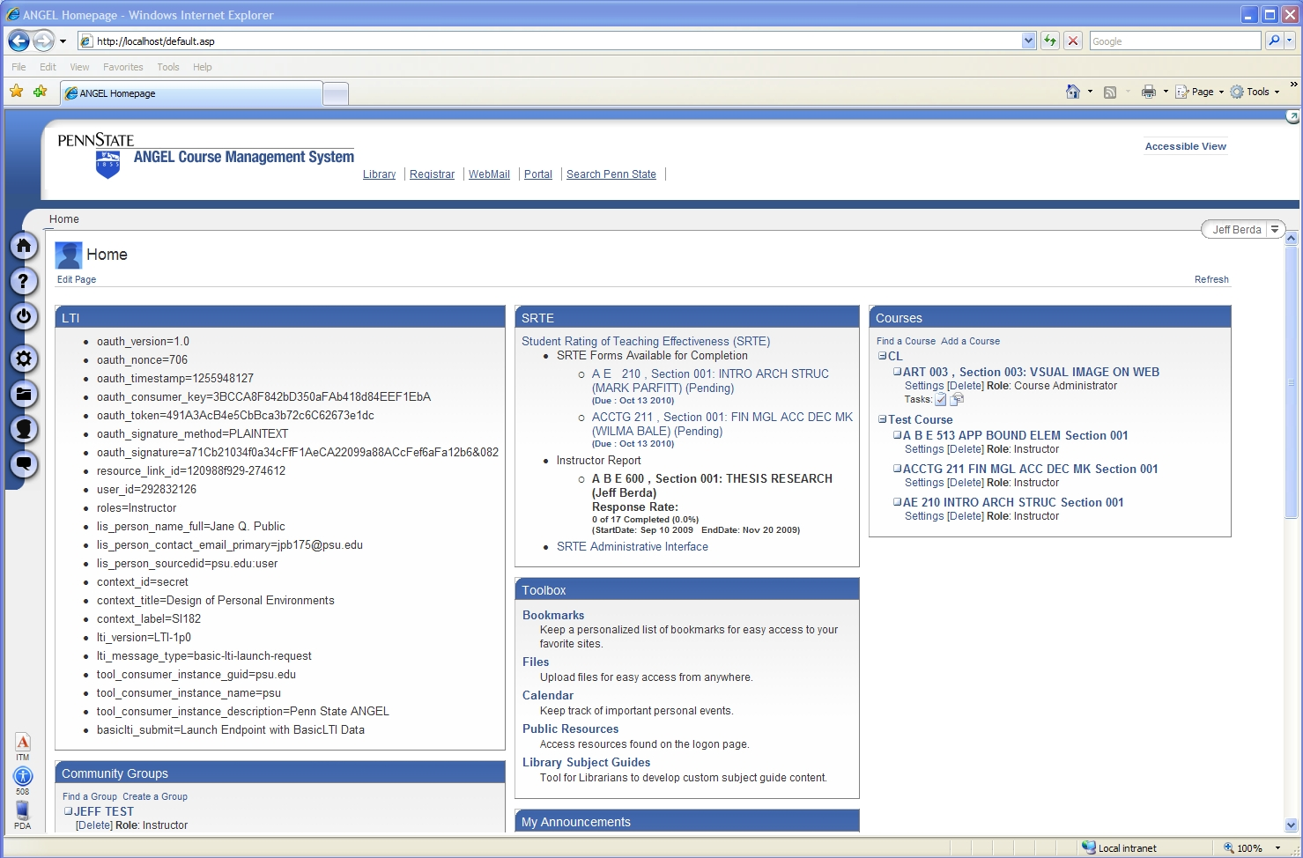

Slide 33
Basic LTI LMS Coverage (approx.)
Shipped
  Desire2Learn 8.4.2
In Progress
  Sakai 2.7, Moodle 1.9
Planned
  Moodle 2.0
Open Source Plugins
  Blackboard 8
  Blackboard 9
  WebCT Vista
Early Work
  ANGEL Learning

Slide 34
Where Do Tools Come From?
Tool Vendors – Write once run anywhere
  As LMS's ship with Basic LTI out of the box, this becomes the low-effort solution for the Wimba's of the world
Focused Free Tools
  LectureTools – www.lecturetools.org
  Interactive Math Assessment – www.imathas.com

Slide 35
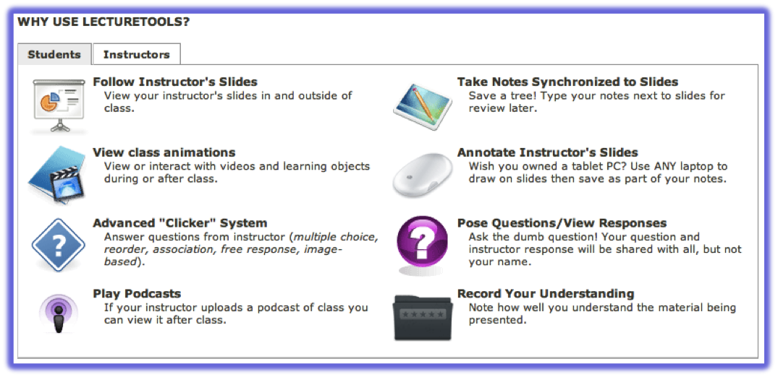
Sakai@
umich.edu
Blackboard@
wcc.edu
Blackboard@
flint.umich.edu
Basic LTI
Case Study: www.lecturetools.org

Slide 36
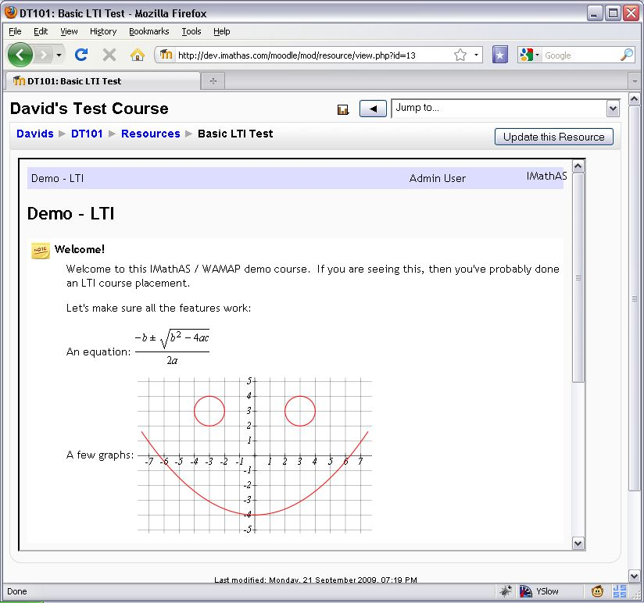
Case Study: www.imathas.com / David Lippman

Slide 37
Developer Tools
Tool Consumer
  http://developers.imsglobal.org/BLTI/lms.php
Tool Provider
  http://developers.imsglobal.org/BLTI/tool.php
  Key=lmsng.school.edu secret=secret
Source Code
  http://code.google.com/p/ims-dev/

Slide 38
Discussion Forums
CC Alliance Forum – Private / Members Only
  http://www.imsglobal.org/community/forum/index.cfm?forumid=7
Public Developer Forum
  http://www.imsglobal.org/community/forum/index.cfm?forumid=5

Slide 39

















Slide 40
Up Next…
IMS Basic LTI and IMS CC puts unprecedented ability to teach and innovate in new ways in the hands of students and teachers
This is moving quickly into the marketplace
Get involved – www.imsglobal.org
Tell me how I can help: cseverance@imsglobal.org

