Slide 1
Author Panel Discussion 2010 Connexions Conference
Charles Severance
University of Michigan, School of Information
February 2, 2010

Slide 2
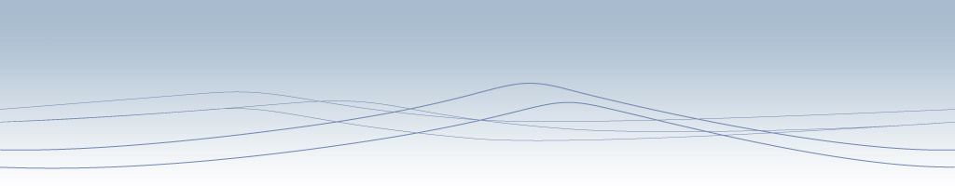




Unless otherwise noted, the content of this material is licensed under a Creative Commons Attribution 3.0 License.
http://creativecommons.org/licenses/by/3.0/.
Copyright 2010, Charles Severance

Slide 3
A Tale of Three Books (in 2009)
Using Google AppEngine
  Published O'Reilly and Associates May 2009
High Performance Computing Second Edition
  Published O'Reilly and Associates – July 1998
  Re-published Connexions – November 2009
Python for Informatics – Exploring Information
  Published on the UM Library – December 2009

Slide 4
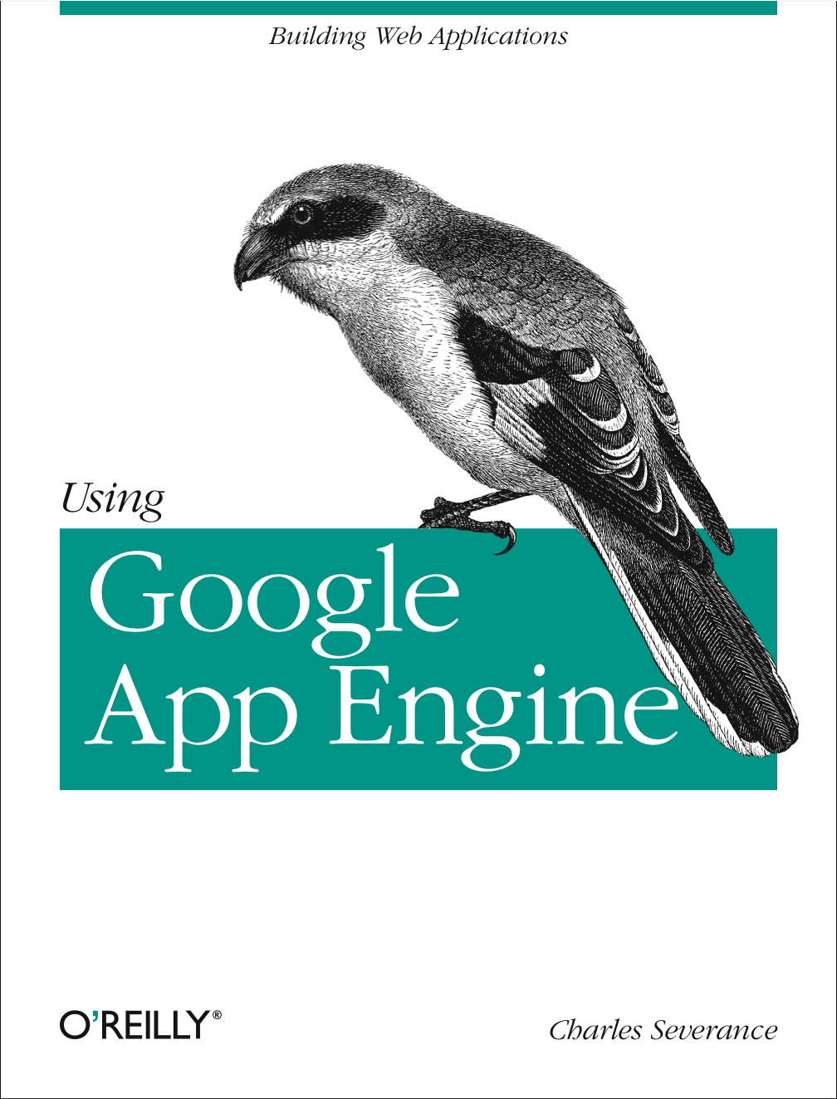
Using Google AppEngine
Used Microsoft Word
Wrote 2/3 of the book while teaching Fall 2008
Wrote the rest of the book 12/15/08 – 01/08/09
Delivered to O'Reilly 01/31/09
Shipped in time for the May 2009 Google I/O conference

Slide 5
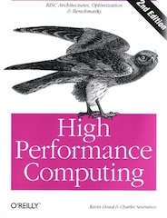
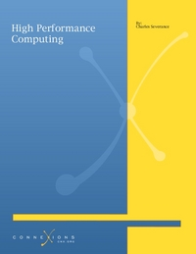
HPC
Published 1998, out-of-print 2001
Got it back CC-BY – October 2009
Re-pubished – November 2009
Thanks to: Jan Odegard, Dan Williamson, Jared Adler, Kathi Fletcher

Slide 6
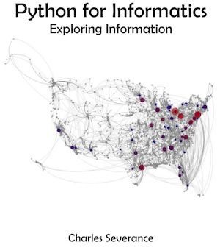
Python for Informatics
Allen B. Downy – 1999 – How to
Think Like a Computer Science (Java)
Jeff Elkner – 2001 – How to Think Like a Computer Scientist: Learning with Python
Allen B. Downey – 2003 – Moves to Olin College teaches Python from his "own" book – revisions
Allen B. Downey – 2008 – Published through Cambridge University Press – Remained GFDL

Slide 7
Python for Informatics
Atul Prakash – 2009 – Adopts "Think
Python" as the required text for
Introductory Python Programming at U. Mich.
Me – December 15, 2009 – Decide to adapt "Think Python" to become "Python for Informatics" (Learning LaTeX)
December 31, 2009 – First draft of Py4Inf is done

Slide 8
Python for Informatics
January 4, 2010 – Py4Inf first
printing
January 7, 2010 – Networked
Computing (SI502) students begin buying their new required textbook for $10.00
January 8, 2010 – Allen B. Downey gives me permission to switch copyright from GFDL to CC-BY-SA

Slide 9
Reflecting on Remixing
This book was 10 years old when I started
My purpose was very different than the original author's purpose
A portable document source format was critical (LaTeX)
"Pay it forward" philosophy for all the authors
Copyleft is a core value of the authors of this book (GFDL / CC-BY-SA)

Slide 10
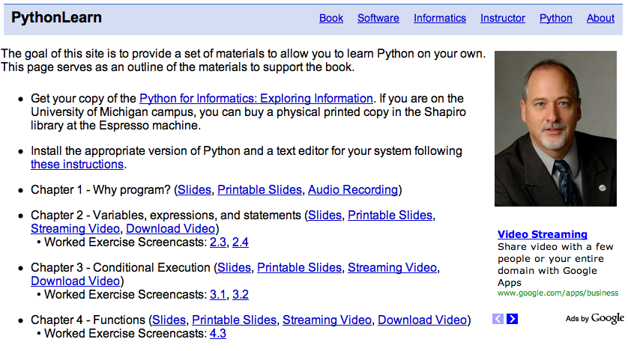
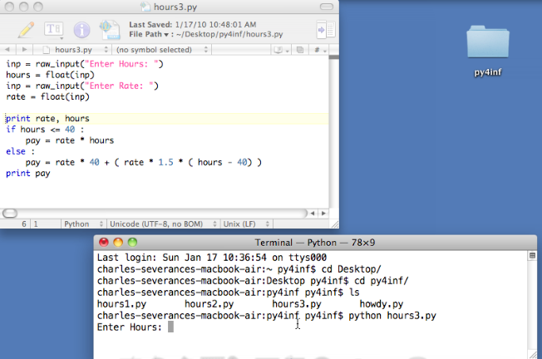
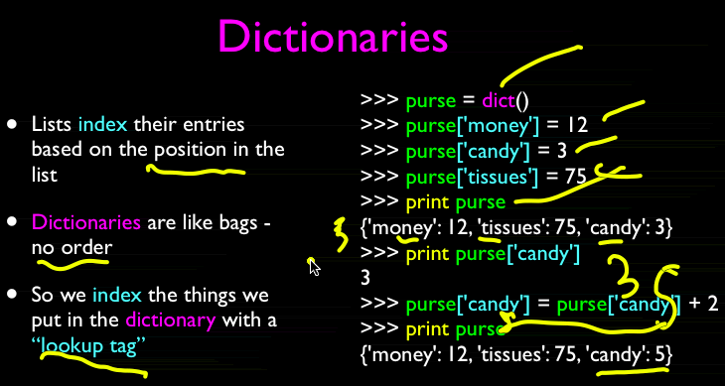
www.pythonlearn.com

Slide 11
Connexions is Awesome
CC-BY is the price of entry
PDF / HTML / Physical book – no extra effort
www.cnx.org - PageRank is a good thing
Wonderful and active Connexions staff
Obsession with copyright provenance
Willingness to play with things like analytics and cloudsocial

Slide 12
My Wish List...
Less than 60 seconds from source to camera ready for a whole book
XML-Free author pipeline to camera ready
Apple iPad and a bunch of other eBook formats – with no more work for me
Engaging interactive experiences on the web – dynamic pathing

Slide 13

My OER Dream for Informatics
People will look at old Dilbert comics in 50 years and will no longer understand why they are funny. The word "nerd" will simply be a "funny arcane word" like the word "flapper". In this presentation we look past the time where technology was the domain of the elite few and instead technology skills become basic skills that all educated people must posses.
This is not Computer Science, this is Informatics. We will need completely new courses, curricula, books and teaching methods are needed to reach the point where we all possess necessary technology skills.
We should build open concepts, open thinking, and open educational resources into the field of Informatics from the very first moment possible.

Slide 14

Conclusion
Connexions is the right place at the right time
Scaling something up is always the hardest challenge
Sometimes a "new approach" ends up too much like the "old approach" with a few tweaks

