Slide 1



IMS Basic Learning Tools Interoperability (Basic LTI)
Charles Severance, Ph.D.
Developer Network Coordinator
IMS Global Learning Consortium (IMS GLC)
http://www.imsglobal.org/
http://www.dr-chuck.com/

Slide 2
Basic LTI: Executive Summary
Allows an CMS to launch an External Tool and securely provide user identity, course information, and role information to the external tool
Uses a HTTP POST through the browser – secured by the OAuth security (www.oauth.net)

Slide 3
Basic LTI is Included in Full LTI
IMS Learning Tools
Interoperability
Provisioning
Services
Event
Services
Richer
Trust Model
Basic LTI
Run-Time
Services

Slide 4
Case Study www.vyew.com
A Collaborative Document Edit/Annotate Tool with Audio for Discussion

Slide 5
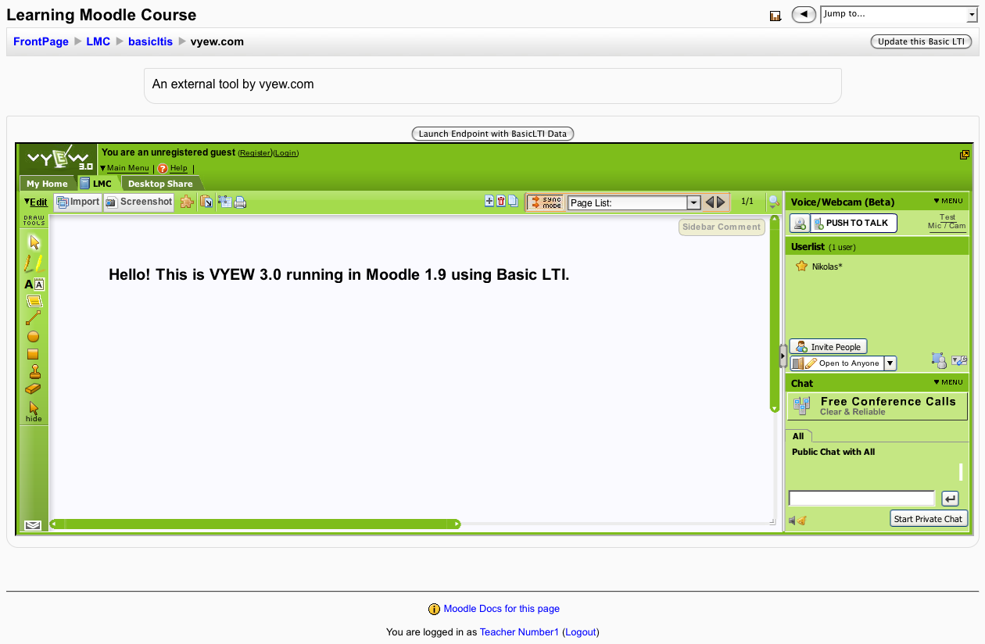

Slide 6
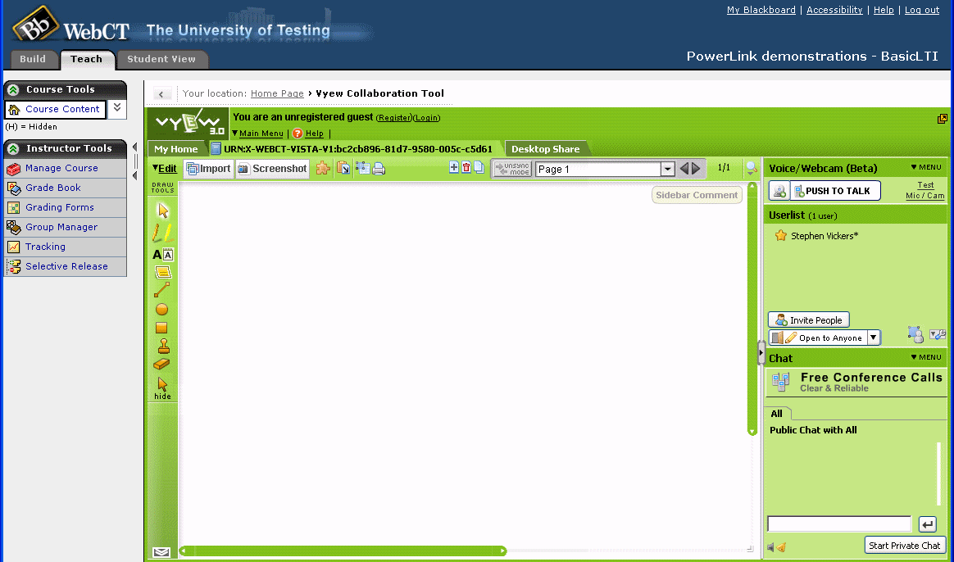

Slide 7
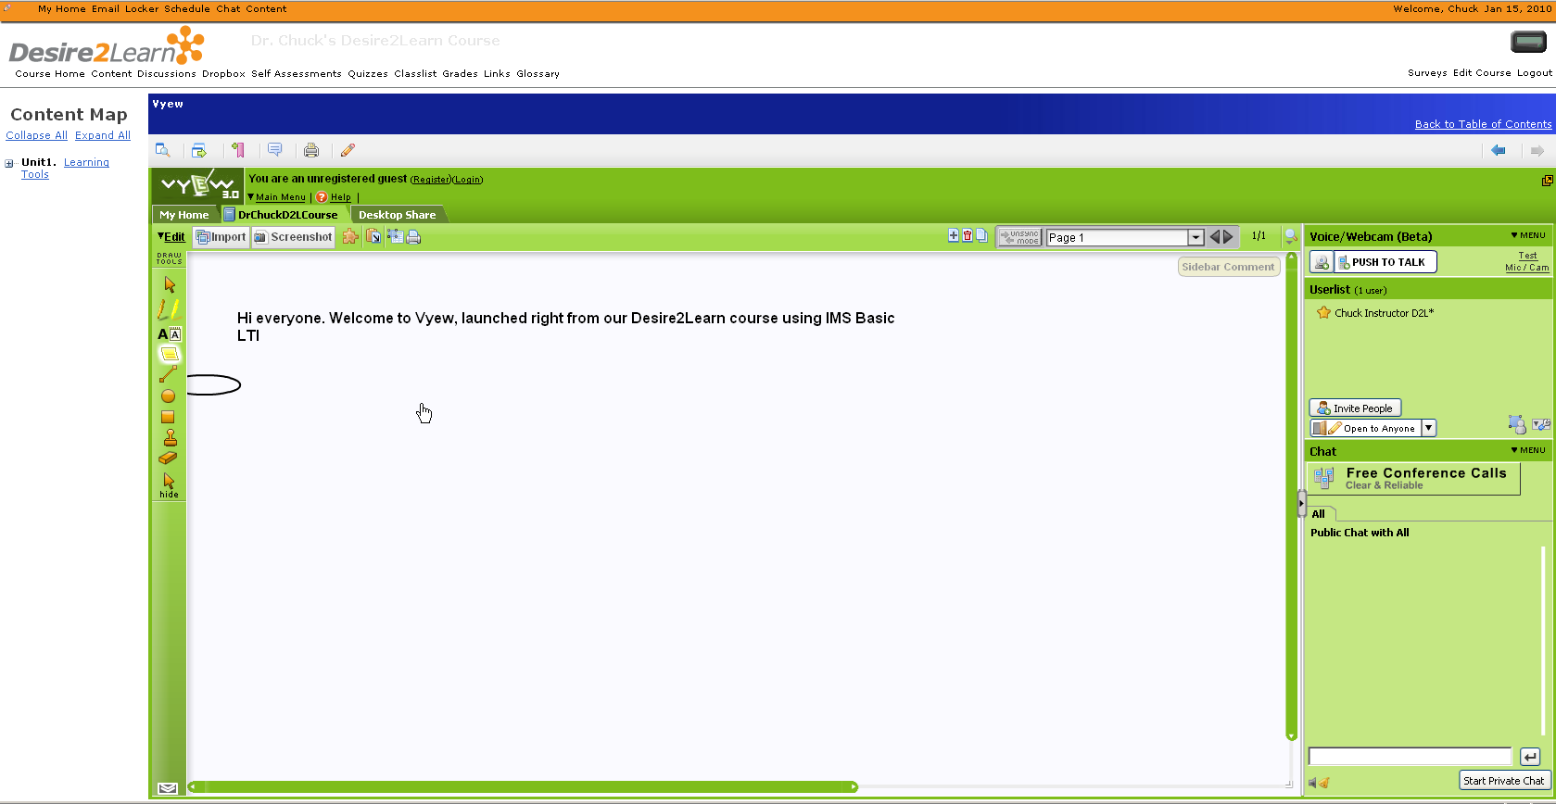

Slide 8
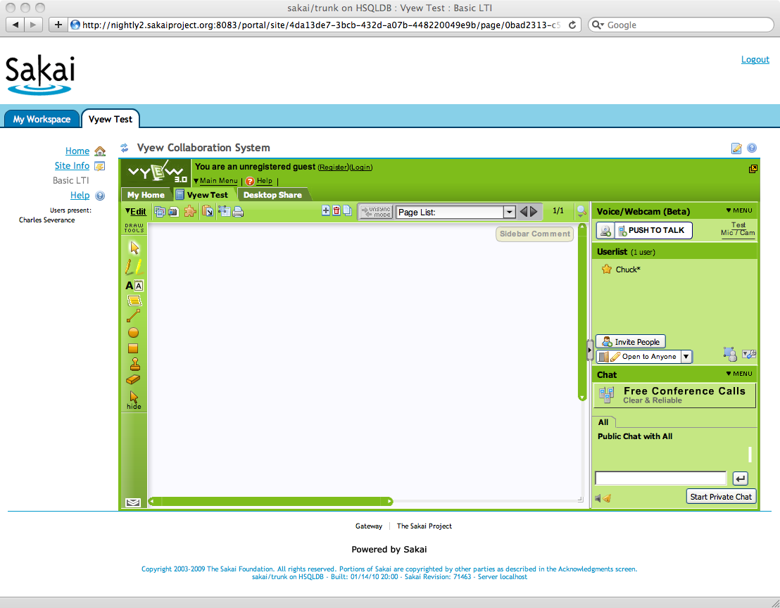

Slide 9
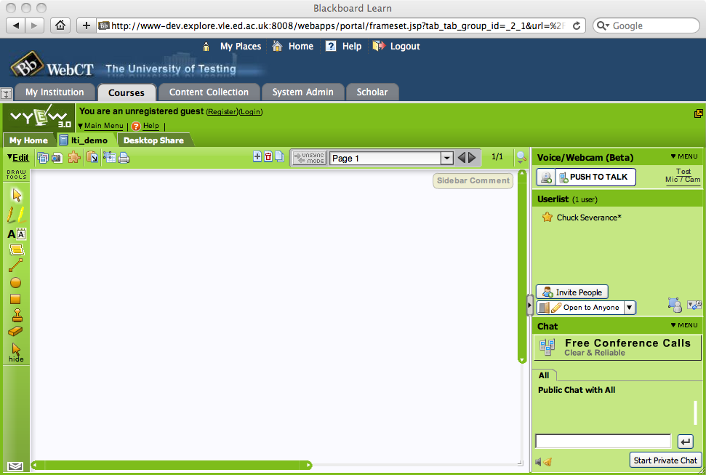

Slide 10
Integrating vyew into 5 CMS systems took < 24 Hours

Slide 11
Developer Support Tools
Tool Consumer
  http://developers.imsglobal.org/BLTI/lms.php
Tool Provider
  http://developers.imsglobal.org/BLTI/tool.php
  Key=lmsng.school.edu secret=secret
Source Code
  http://code.google.com/p/ims-dev/

Slide 12
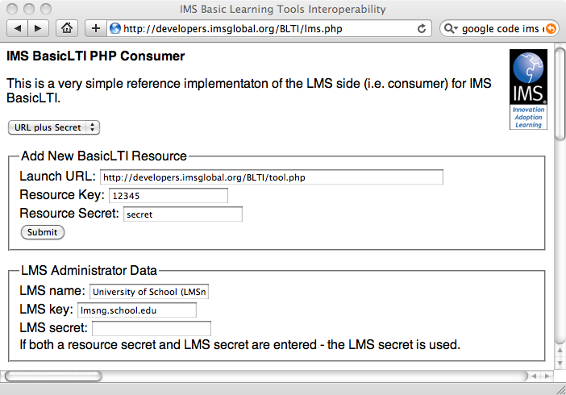

Slide 13
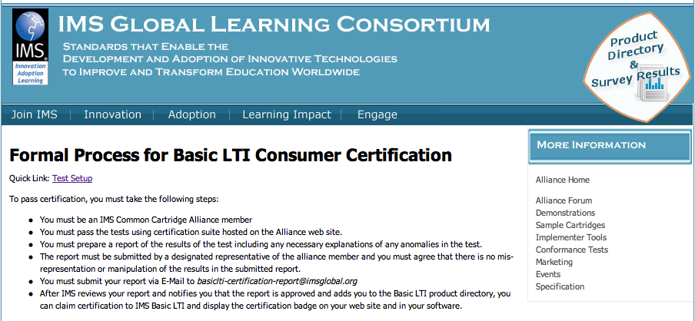
http://www.imsglobal.org/developers/alliance/lti/blti-cert/

Slide 14
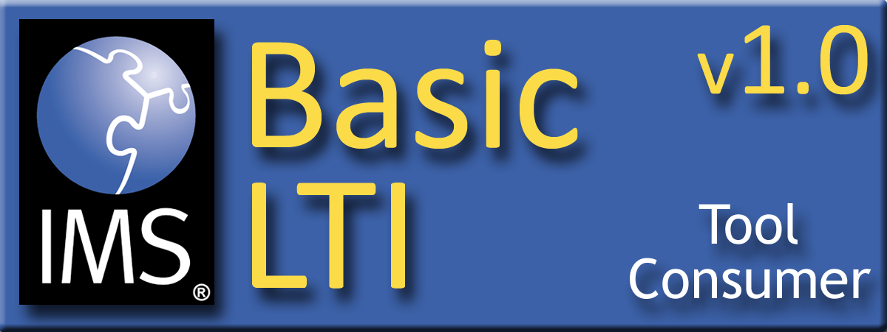
Proposed Rules
IMS Common Cartridge Alliance member
Pass tests on Alliance site
Prepare and submit a report (with contact info)
You get your badge

Slide 15
Basic LTI LMS Coverage
Shipped
  Desire2Learn 8.4.2
In Progress
  Moodle 1.9, Sakai 2.7
Planned
  Moodle 2.0
  Jenzabar
  Learning Objects
Open Source Plugins
  Blackboard 8
  Blackboard 9
  WebCT Vista
Early Work
  ANGEL Learning
  Plone

