Slide 1

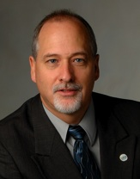

IMS Basic Learning Tools Interoperability (Basic LTI)
Charles Severance, Ph.D.
Developer Network Coordinator
IMS Global Learning Consortium (IMS GLC)
http://www.imsglobal.org/
http://www.dr-chuck.com/

Slide 2
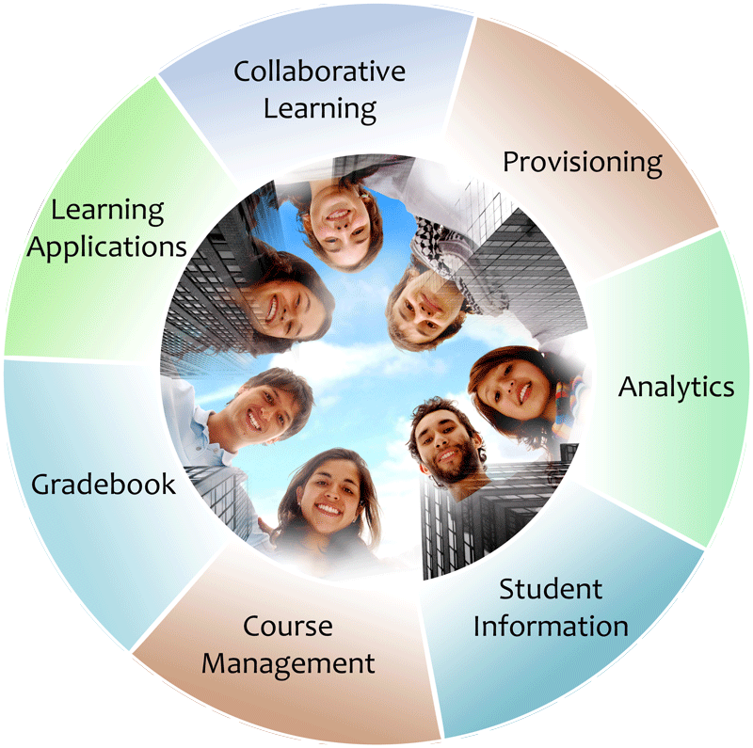


IMS: Digital Learning Standards
The information
architecture for
learning
Seamlessly
connect
to learning
Free the
content
IMS Common Cartridge
IMS Learning Tools
Interoperability (LTI)
IMS Learning Information
Services (LIS)

Slide 3
IMS in a Nutshell
In the past few years IMS has moved from a focus on writing specs and "hoping" to an approach where engineering and experimentation are an integral part of our processes
Years ago, our focus was "Getting lots of specs agreed-to, published, and out the door."

Slide 4
IMS Current Standards Approach
A standard which is not implemented is pointless
How many implementations of the standard in the market?
How well those implementations interoperate?
And do those standards positively impact teaching and learning?

Slide 5
Basic LTI: Executive Summary
Allows an CMS to launch an External Tool and securely provide user identity, course information, and role information to the external tool
Uses a HTTP POST through the browser – secured by the OAuth security (www.oauth.net)

Slide 6

IMS (Simple) LTI Consumer for Moodle – Video From Marc
http://www.vimeo.com/7825070

Slide 7
IMS Learning Tools Interoperability
Problem
  Every CMS has their own very unique "module", "tool" "block", "nugget", "powerlink", etc
  External tools like QuestionMark, Wimba, Elluminate, etc must prioritize which CMS they invest in plugging into
  Tool Providers wait until customers are willing to pay money to start development

Slide 8
IMS Learning Tools Interoperability
Solution
  Build a standard plug-in for all CMS systems
  Tool and Content Providers can build one integration and use it in any CMS that supports the standard
  Note – the standard plug-in will not be as rich as a native plug-in – but it will be simple and universal
  Tool Providers will continue to build native integrations for the parts of the market where they find value

Slide 9
IMS Learning Tools Interoperability
Rational Future
  Evolve the standard integration to support increasingly broad use cases
  At some point the standard plug in will be sufficient for a particular tool provider and they can simply provide a single integration which works for all CMS Systems

Slide 10
IMS Learning Tools Interoperability
Crazy Future
  We make it easy enough to write one of these tools that teachers start writing their own tools and plug them into their CMS without needing to "hack" their production CMS (particularly if their CMSis "hosted")
  Teachers send the URLs for these tools to each other and they plug each other's tools into their courses almost as easy as putting in an iFrame

Slide 11
IMS Learning Tools Interoperability
Extremely Dream-Like Future
  Services like YouTube, Deli.cio.us, Vimeo, Blogger, Google Docs, etc.. provide support as IMS Basic LTI Tool Producers that allow for simple plug in (mash up), automatic roster provisioning, roster exchange, course roles, and properly maintain student privacy when using these services in a course context..

Slide 12
Case Study www.vyew.com
A Collaborative Document Edit/Annotate Tool with Audio for Discussion

Slide 13
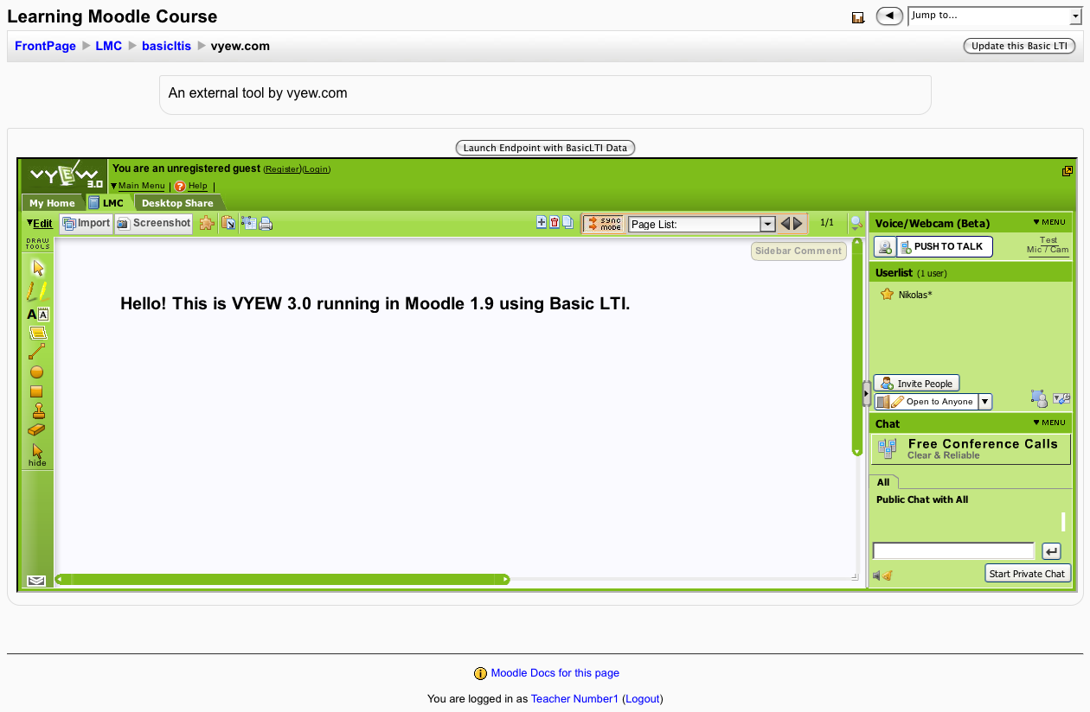

Slide 14
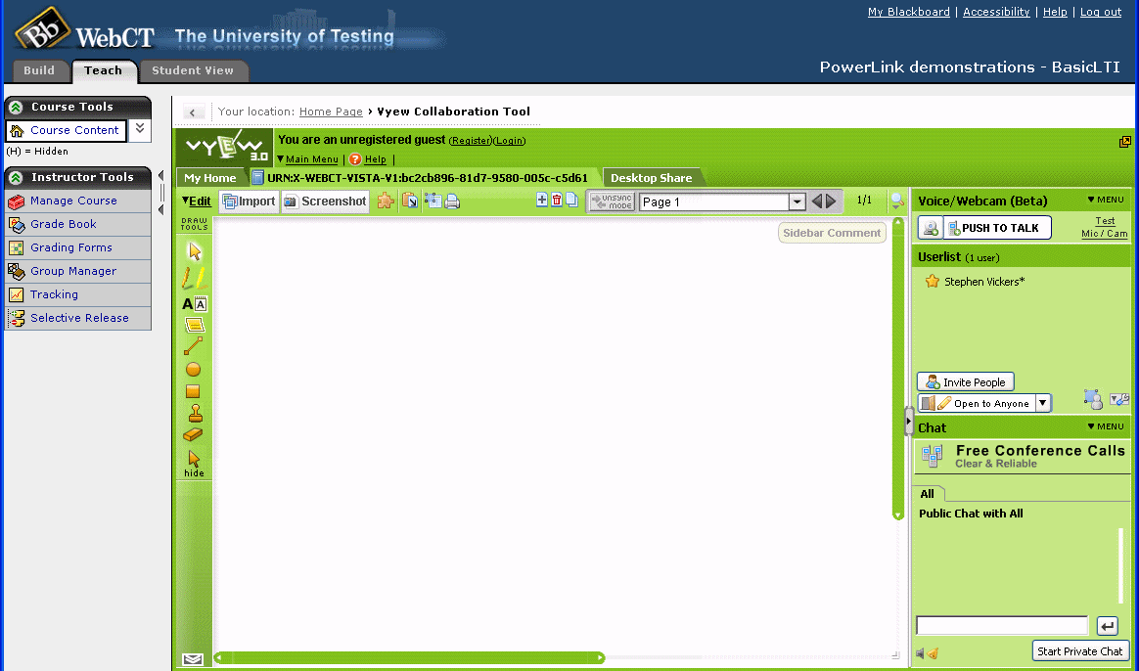

Slide 15
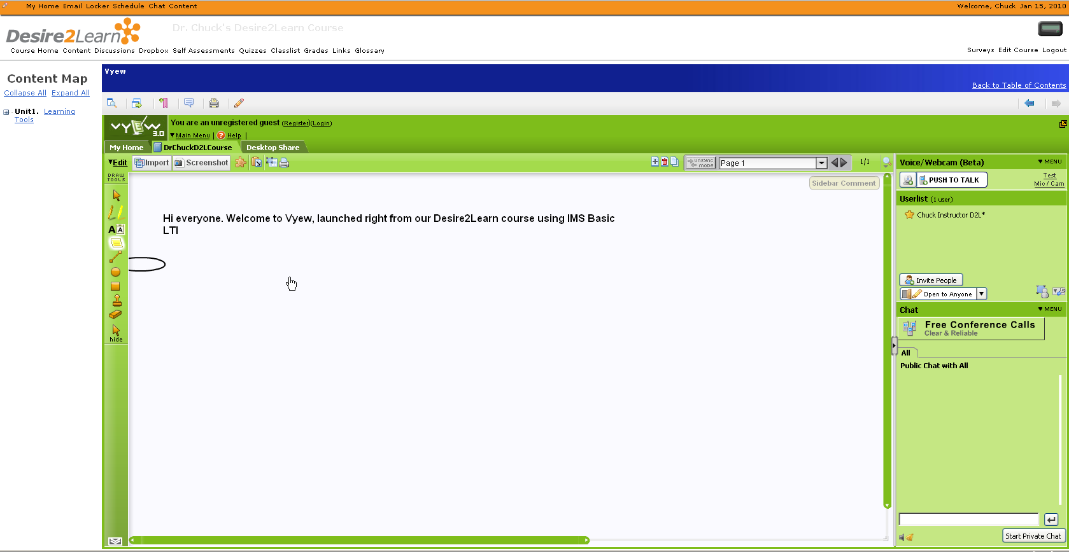

Slide 16
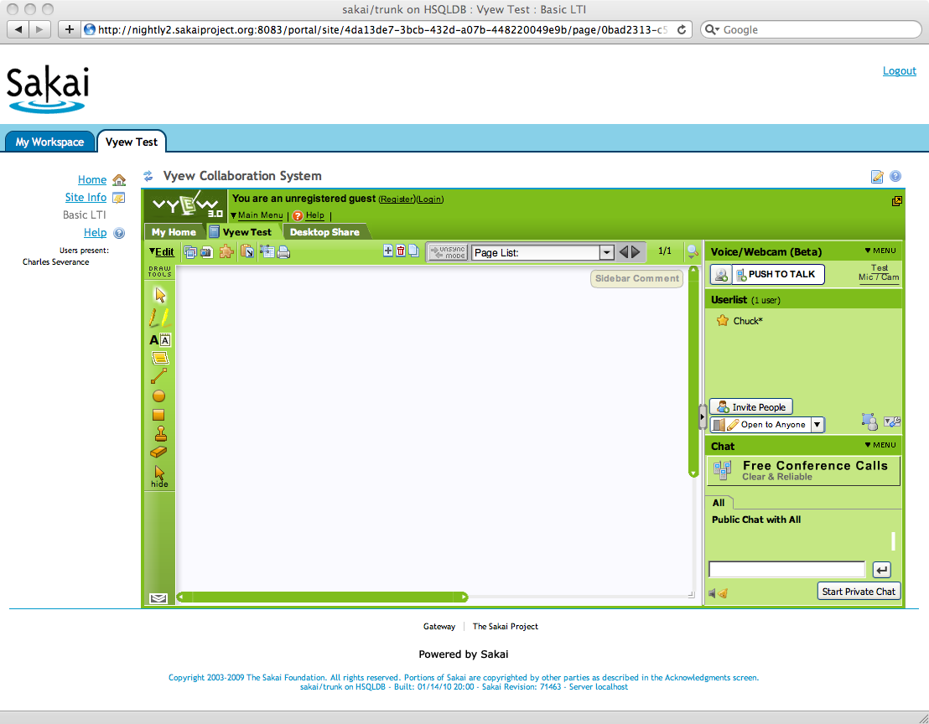

Slide 17
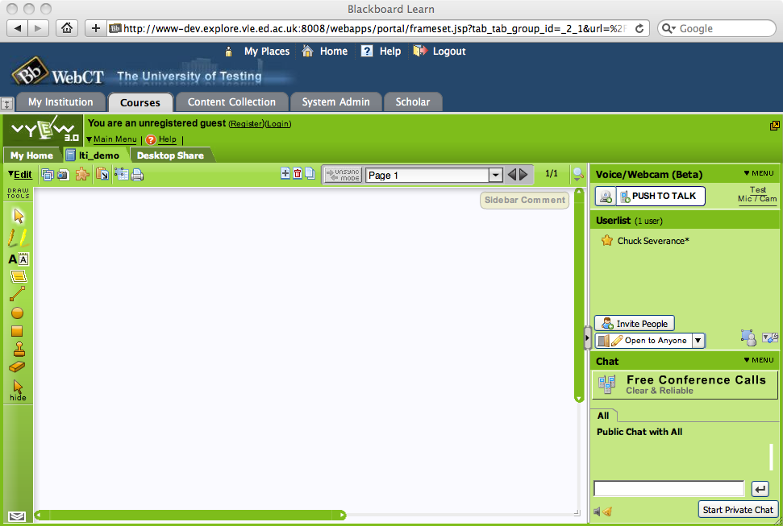

Slide 18
Integrating vyew into 5 CMS systems took < 24 Hours

Slide 19
IMS Learning Tools Interoperability Overview

Slide 20
Basic LTI is Included in Full LTI
IMS Learning Tools
Interoperability
Provisioning
Services
Event
Services
Richer
Trust Model
Basic LTI
Run-Time
Services

Slide 21
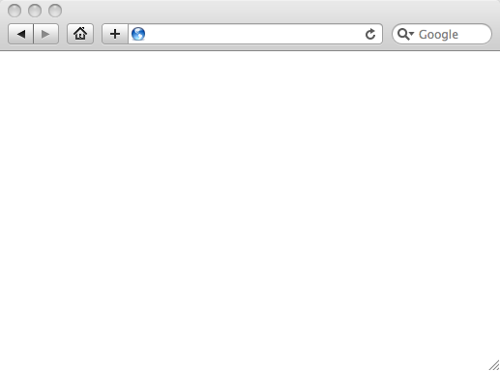
Integrated User Experience
Welcome
Local Resource
Lame iFrame
LTI Tool
Movie
© Copyright 2010 IMS Global Learning Consortium
All Rights Reserved.

Slide 22
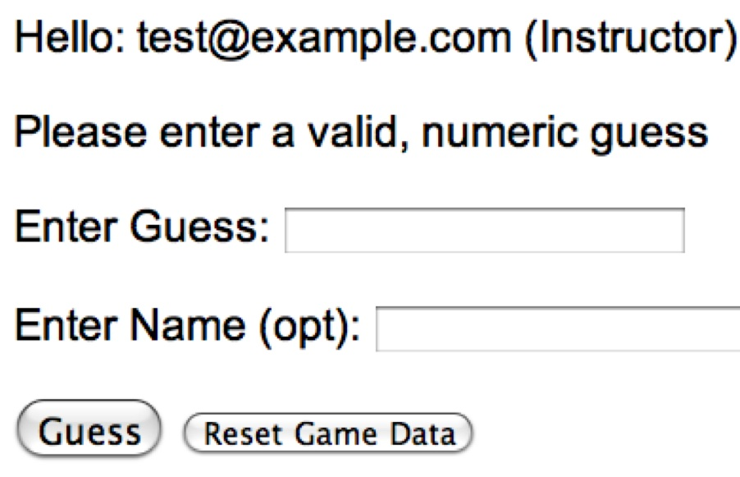
User Experience
Welcome
Local Resource
Lame iFrame
LTI Tool
Movie
© Copyright 2010 IMS Global Learning Consortium
All Rights Reserved.

Slide 23
CMS (LTI Consumer)
User Experience
Welcome
Local Resource
Lame iFrame
LTI Tool
Movie
Tool (LTI Provider)
© Copyright 2010 IMS Global Learning Consortium
All Rights Reserved.

Slide 24
CMS (LTI Consumer)
User Experience
Welcome
Local Resource
Lame iFrame
LTI Tool
Movie
Tool (LTI Provider)
© Copyright 2010 IMS Global Learning Consortium
All Rights Reserved.

Slide 25
CMS (LTI Consumer)
Again in slow motion…
LMS Looks up User and Course Information.
Information is signed using secret and OAuth
Welcome
Local Resource
Lame iFrame
LTI Tool
Movie
Form data sent to Browser
Tool (LTI Provider)
© Copyright 2010 IMS Global Learning Consortium
All Rights Reserved.

Slide 26
CMS (LTI Consumer)
Form is immediately auto-submitted using JavaScript.
<form action=”tool”/>
<input name=”user_id”
value=”2348d8dd” />
<input name=”oauth_token”
value=”abc.edu” />
</form>
Tool (LTI Provider)
Tool looks up secret and validates signature.
Tool provisions user, course, and session.
Tool sends redirect
© Copyright 2010 IMS Global Learning Consortium
All Rights Reserved.

Slide 27
CMS (LTI Consumer)
Browser follows redirect…
<head>
<meta redirect
page=”main.php”>
</head>
Tool (LTI Provider)
Tool produces
first page.
© Copyright 2010 IMS Global Learning Consortium
All Rights Reserved.

Slide 28
CMS (LTI Consumer)
Tool (LTI Provider)
© Copyright 2010 IMS Global Learning Consortium
All Rights Reserved.

Slide 29
Basic LTI Sample Launch Data
lti_version=LTI-1p0
lti_message_type=basic-lti-launch-request
resource_link_id=120988f929-274612
user_id=292832126
roles=Instructor
lis_person_name_full=Charles R. Severance
lis_person_contact_email_primary = csev@umich.edu
context_id=456434513
context_title=SI301 - PHP
tool_consumer_instance_guid=ctools.umich.edu
tool_consumer_instance_description=University of Michigan

Slide 30
REST Message Signing / OAuth
Specification at www.oauth.net is very clear
Signs message using time-stamp, one-use token (nonce)
Message signing – Trust between pairs of servers
“Three-legged-OAuth” – Trust between servers plus user identity (not used in Basic LTI)

Slide 31
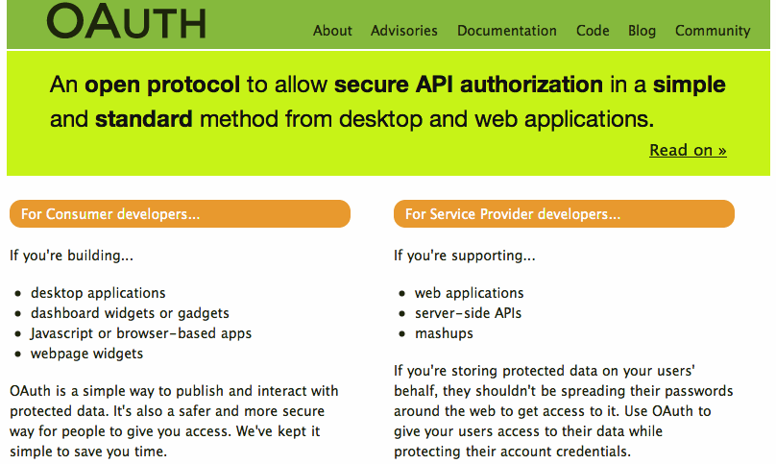

Slide 32
OAuth Base Message String
POST&http%3A%2F%2Flocalhost%2F~user%2Fphp-simple%2Ftool.php&basiclti_submit%3DLaunch%2520Endpoint%2520with%2520BasicLTI%2520Data%26context_id%3D456434513%26context_title%3DSI301%2520-%2520PHP%26lis_person_contact_email_primary%3Duser%2540school.edu%26lis_person_name_full%3DJane%2520Q.%2520Public%26lis_person_sourcedid%3Duser%26lti_message_type%3Dbasiclti-lti-launch-request%26lti_version%3DbasicLTI-1p0%26oauth_consumer_key%3Dlmsng.school.edu%26oauth_nonce%3D0f353c60b12cd5db55ce2bf4cbeb6f8b%26oauth_signature_method%3DHMAC-SHA1%26oauth_timestamp%3D1249621439%26oauth_version%3D1.0%26resource_link_id%3D120988f929-274612%26roles%3DInstructor%26tool_consumer_instance_description%3DUniversity%2520of%2520Michigan%26tool_consumer_instance_guid%3Dschool.edu%26user_id%3D292832126
oauth_signature = kjqD5TpgdhjPOq0gqoPVntJ8yPU=

Slide 33
Basic LTI and IMS Common Cartridge
Welcome
Local Resource
Folder
LTI Tool
Discussion
QTI Pool
Common Cartridge 1.1 will include the ability to define a Basic LTI resource and include that resource in course organizational structures

Slide 34
Pushing Basic LTI Adoption
Sample Java + PHP Basic LTI implementations at
  http://code.google.com/p/ims-dev/
Use/include sample code from oauth.net
Both structured to provide reusable code
  org.imsglobalorg.basiclti.BasicLTIUtil.java
  blti_util.php
Copyright IMS, Apache 2 – Usable anywhere

Slide 35
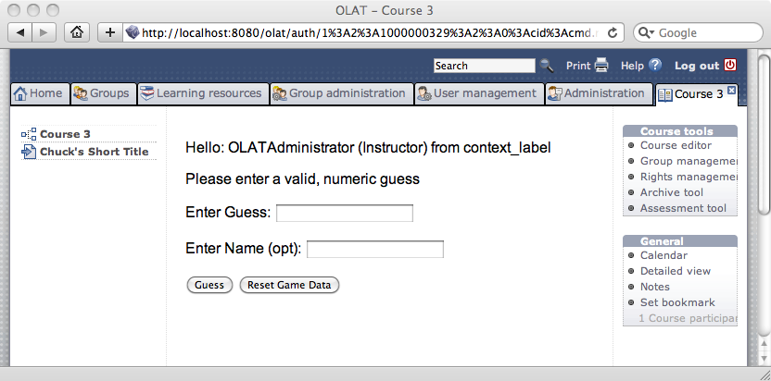

OLAT 6.4

Slide 36

IMS Basic LTI and IMS Common Cartridge are on the roadmap for Moodle and development work has started
  It should appear in Moodle 2.0 out of the box
  Basic LTI should be back ported to 1.9 for a dot release
http://code.google.com/p/basiclti4moodle/

Slide 37
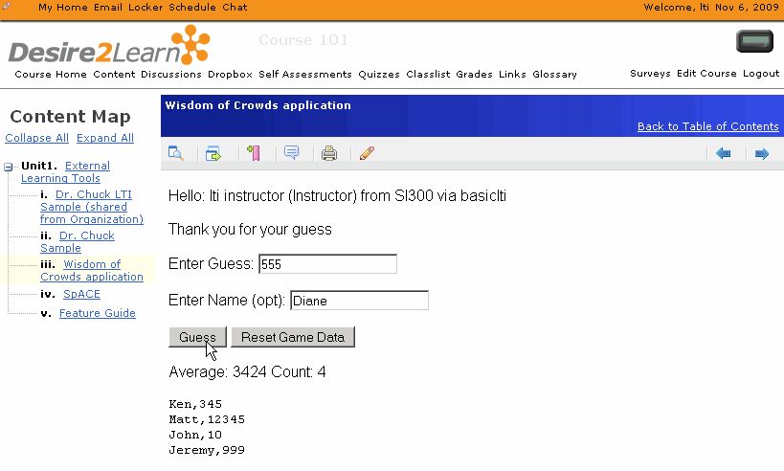
Desire2Learn
IMS Basic LTI Support in 8.4.2 (Released Nov 2009)

Slide 38
Basic LTI Building Block / PowerLink
Stephen Vickers – U. Edinburgh
  Blackboard Building Block and PowerLink
  http://www.spvsoftwareproducts.com/bb/basiclti/demo.swf
  http://projects.oscelot.org/gf/project/wct-basiclti/
Uses the IMS-Provided utility code
Excellent example of the "Virtual Tool" pattern

Slide 39

BasicLTI – Sakai
Sakai BasicLTI Consumer available in 2.7
  Example of using the IMS Utility code
Support for Basic LTI in Sakai/Melete 2.7
Sakai BasicLTI Tool Provider in Sakai 2.7

Slide 40
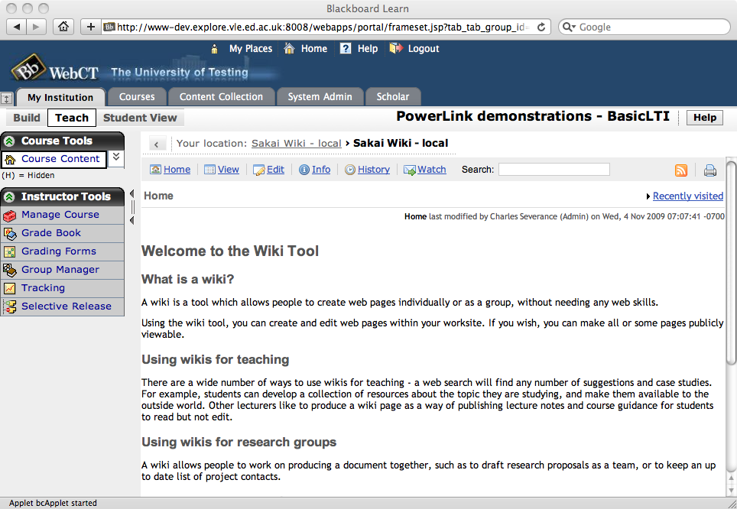
http://www.spvsoftwareproducts.com/bb/basiclti/demo.swf

Slide 41
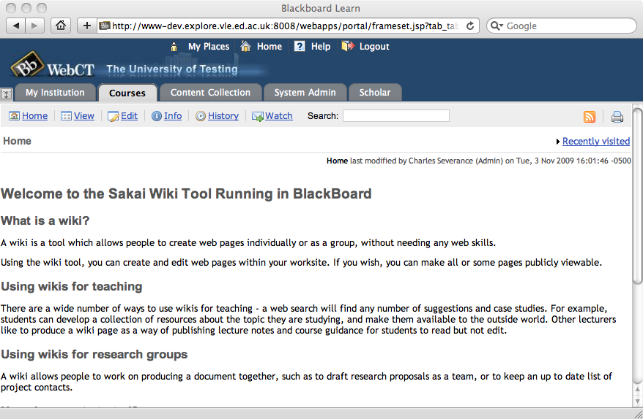
http://www.spvsoftwareproducts.com/bb/basiclti/demo.swf

Slide 42
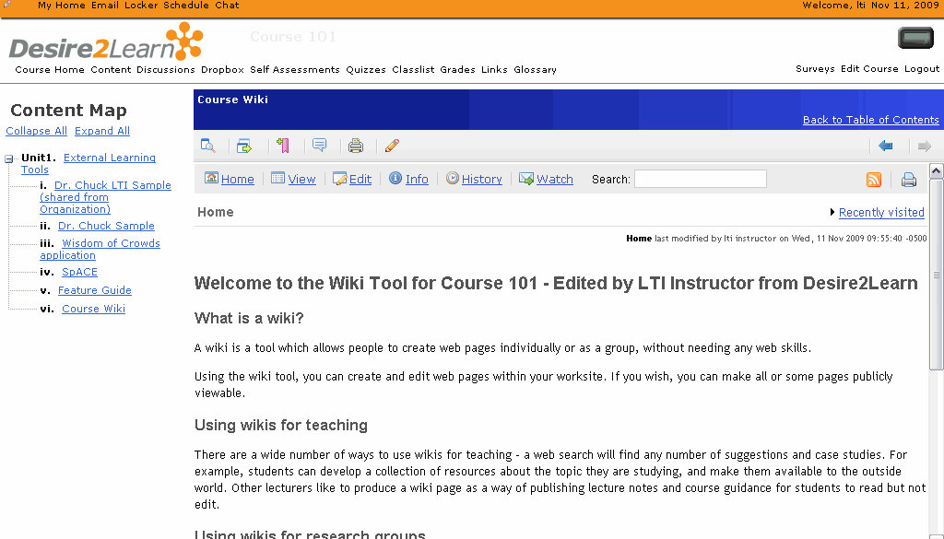

Slide 43
Basic LTI LMS Coverage (approx.)
Shipped
  Desire2Learn 8.4.2
In Progress
  Moodle 1.9, Sakai 2.7, OLAT 6.4
Planned
  Moodle 2.0
Open Source Plugins
  Blackboard 8
  Blackboard 9
  WebCT Vista
Early Work
  ANGEL Learning
  Plone

Slide 44
Developer Tools
Tool Consumer
  http://developers.imsglobal.org/BLTI/lms.php
Tool Provider
  http://developers.imsglobal.org/BLTI/tool.php
  Key=lmsng.school.edu secret=secret
Source Code
  http://code.google.com/p/ims-dev/

Slide 45
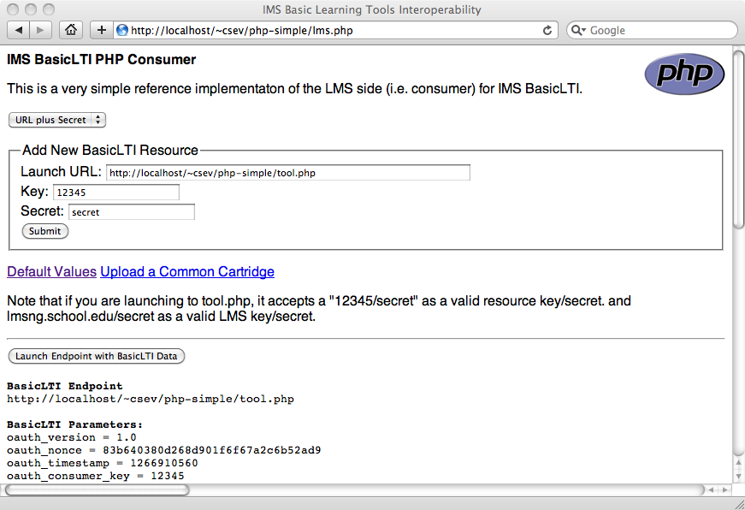

Slide 46
A Sample Basic LTI Tool in PHP
I am developing a workshop and documentation aimed specifically at medium-skill developers so they can learn to write their own tools in PHP
  A "Craigslist" Classified Ad Application
These tools can be very simple because the teachers already have access to a full-featured CMS like Moodle
They only need to write a simple, little gadget

Slide 47
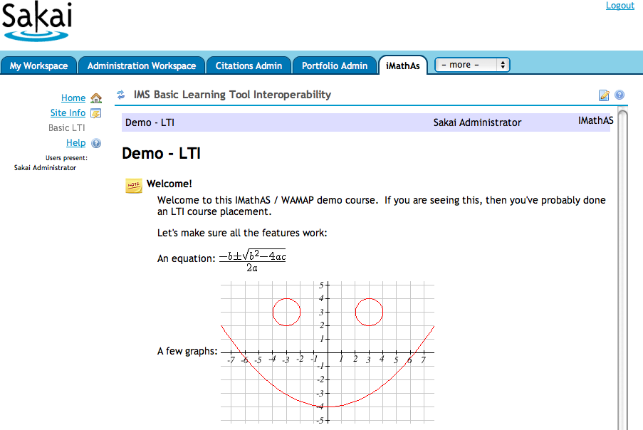
http://www.imathas.com/

Slide 48

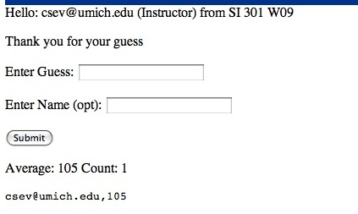
A Simple Guessing Game

Slide 49
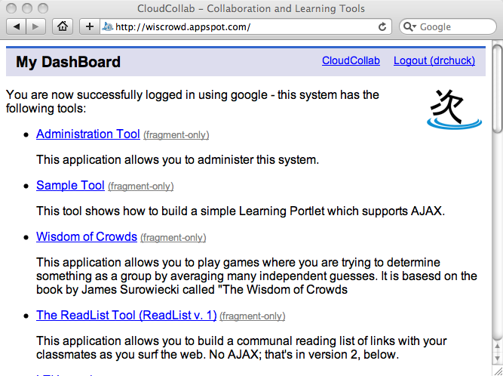

www.tsugiproject.org

Slide 50

Certification
We have developed a certification test for CMS systems to insure interoperability and that tool writers can make some basic assumptions about the behavior of certified CMS systems
Early version of certification was given out for testing and all LMS systems passed the certification

Slide 51
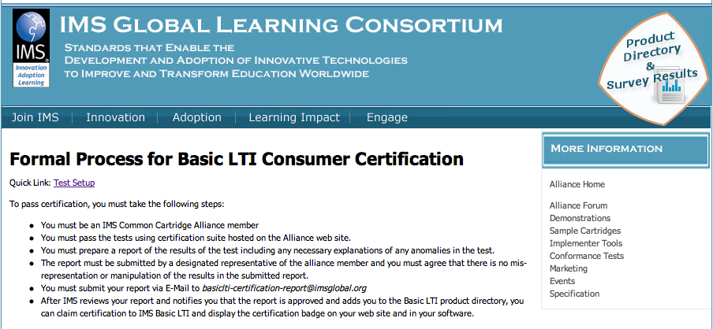
http://www.imsglobal.org/developers/alliance/lti/blti-cert/

Slide 52
Summary..
IMS Basic LTI will increase the number of software vendors and content providers that can be plugged into a CMS
Nearly all CMS Vendors are well along
My Task for 2010: Train Tool Writers
Comments: cseverance@imsglobal.org

Slide 53
Some References
IMS – www.imsglobal.org
IMS Basic LTI Video – www.vimeo.com/8073453
IMS Basic LTI Certification Video - www.vimeo.com/8474727
Marc's Dinosaur Video – www.vimeo.com/7825070

