Slide 1



Building Tools in PHP using
IMS Basic LTI
Charles Severance, Ph.D.
Affiliate Coordinator
IMS Global Learning Consortium (IMS GLC)
http://www.imsglobal.org/
http://www.dr-chuck.com/

Slide 2



IMS: Digital Learning Standards
The information
architecture for
learning
Seamlessly
connect
to learning
Free the
content
IMS Common Cartridge
IMS Learning Tools
Interoperability (LTI)
IMS Learning Information
Services (LIS)

Slide 3

IMS (Simple) LTI Consumer for Moodle – Video From Marc
http://www.vimeo.com/7825070

Slide 4

Learning Tools Interoperability
Photo Credit: Ian Dolphin

Slide 5
IMS Learning Tools Interoperability
Problem
  Every CMS has their own very unique "module", "tool" "block", "nugget", "powerlink", etc
  External tools like QuestionMark, Wimba, Elluminate, etc must prioritize which CMS they invest in plugging into
  Tool Providers wait until customers are willing to pay money to start development

Slide 6
IMS Learning Tools Interoperability
Solution
  Build a standard plug-in for all CMS systems
  Tool and Content Providers can build one integration and use it in any CMS that supports the standard
  Note – the standard plug-in will not be as rich as a native plug-in – but it will be simple and universal
  Tool Providers will continue to build native integrations for the parts of the market where they find value

Slide 7






B
A
S
I
C
L
T
I
LEARNING
TOOL
PHP
Java
App Engine
Wookie...

Slide 8



B
A
S
I
C
L
T
I
LEARNING
TOOL
...
PHP
Java
App Engine
Wookie...

Slide 9
Basic LTI LMS Coverage (approx.)
Shipped
  Desire2Learn 8.4.2
In Progress
  Moodle 1.9, Sakai 2.7, OLAT 6.4, Jenzabar
Planned
  Moodle 2.0
Open Source Plugins
  Blackboard 8
  Blackboard 9
  WebCT Vista
Early Work
  ANGEL Learning
  Plone

Slide 10
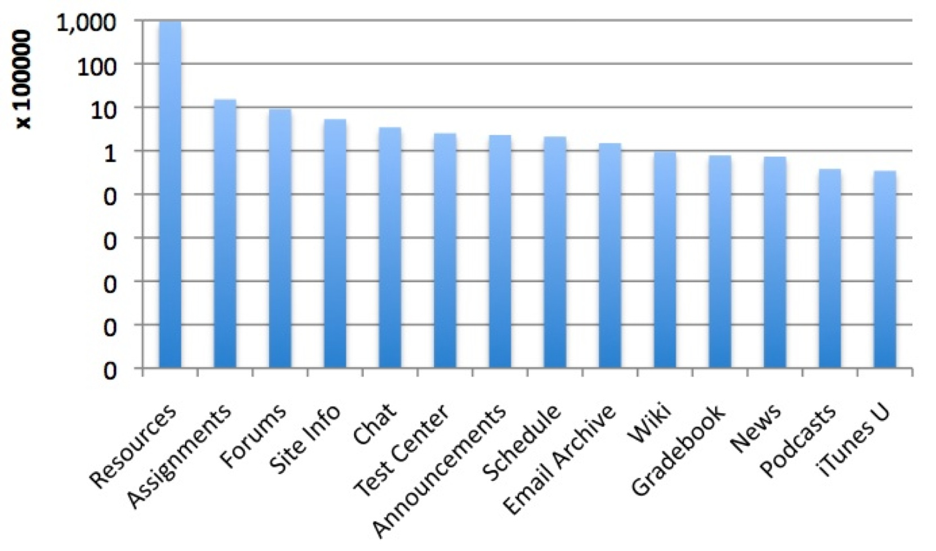
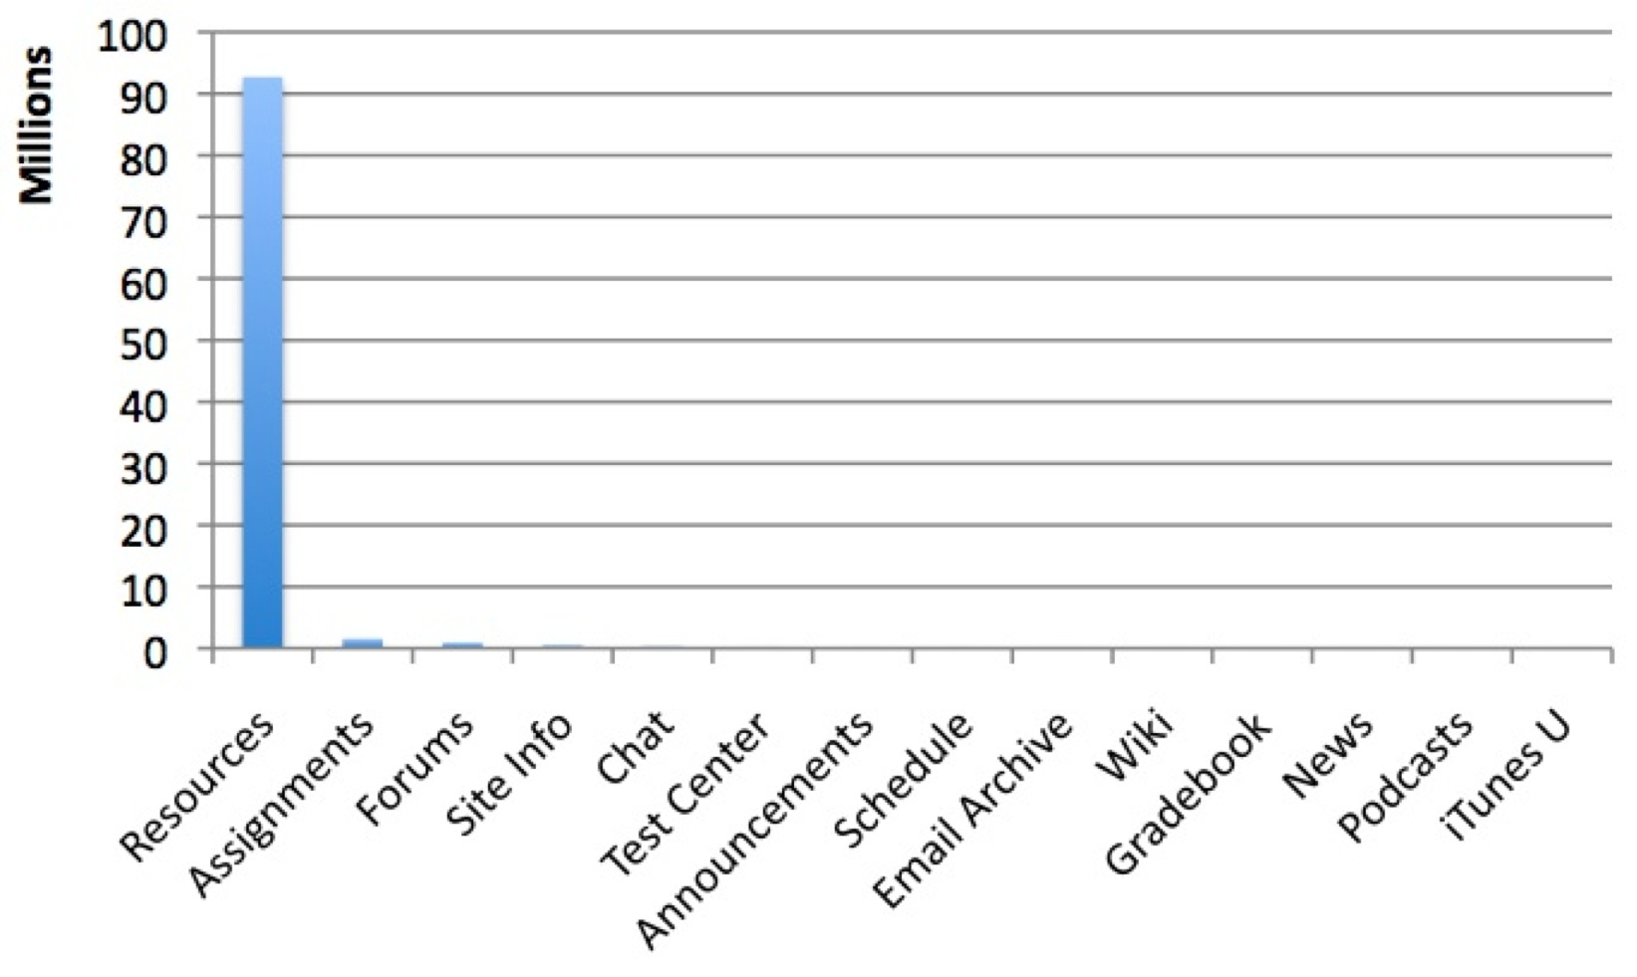

Slide 11


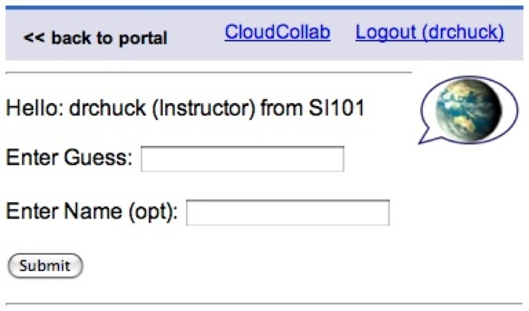
Who writes these learning tools?
There are more than
15 applications

Slide 12
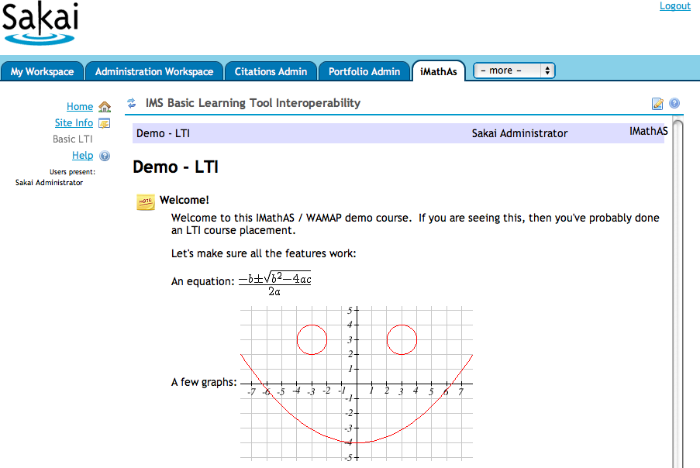
http://www.imathas.com/

Slide 13

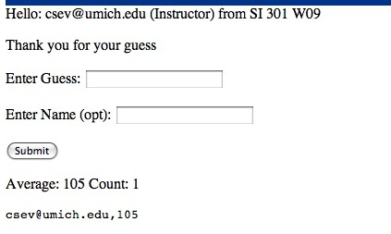
A Simple Guessing Game

Slide 14
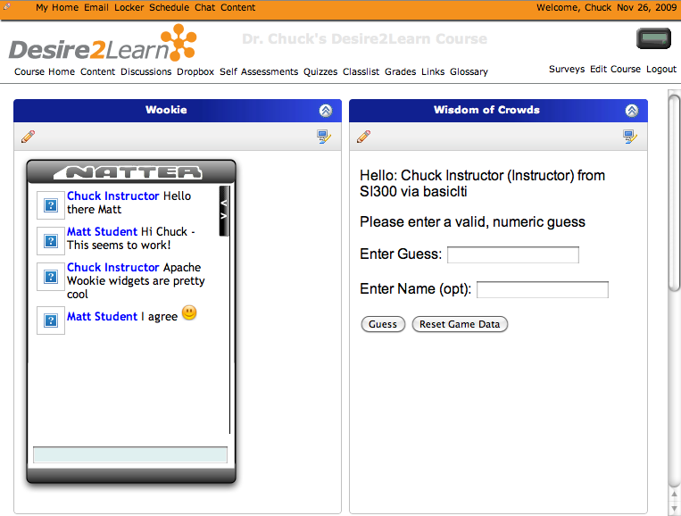
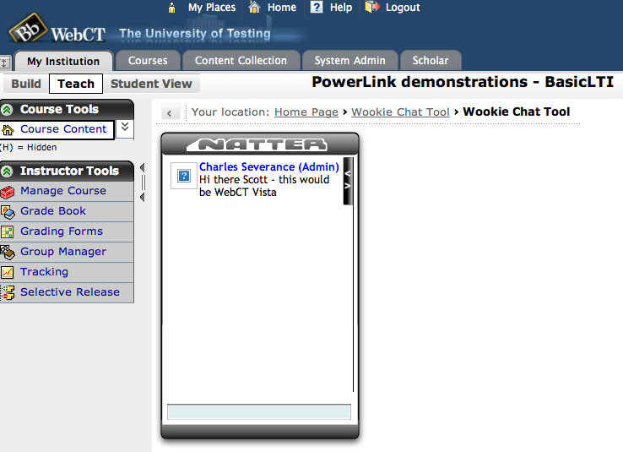
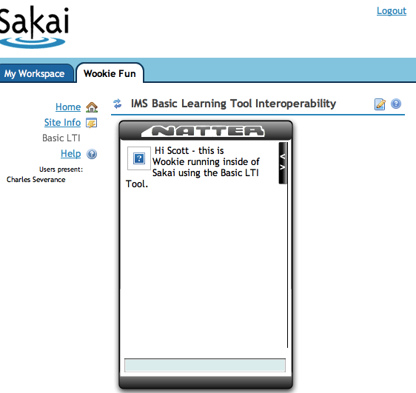
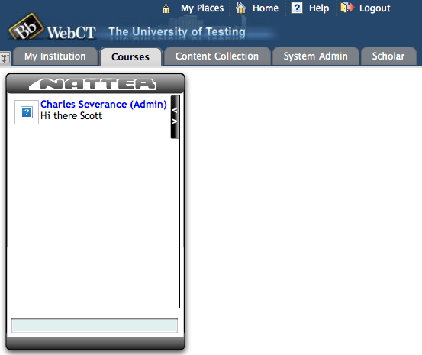
Apache
Wookie

Slide 15
Imagine a Learning App Store...
Imagine that we had a single place to search for learning tools to pull into our course management systems
These could be code or content or services..

Slide 16
IMS Learning Tools Interoperability Technical Overview

Slide 17
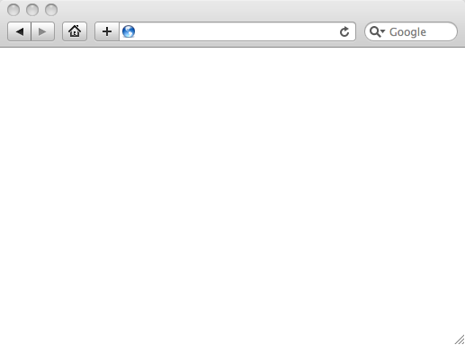
Integrated User Experience
Welcome
Local Resource
Lame iFrame
LTI Tool
Movie
© Copyright 2010 IMS Global Learning Consortium
All Rights Reserved.

Slide 18
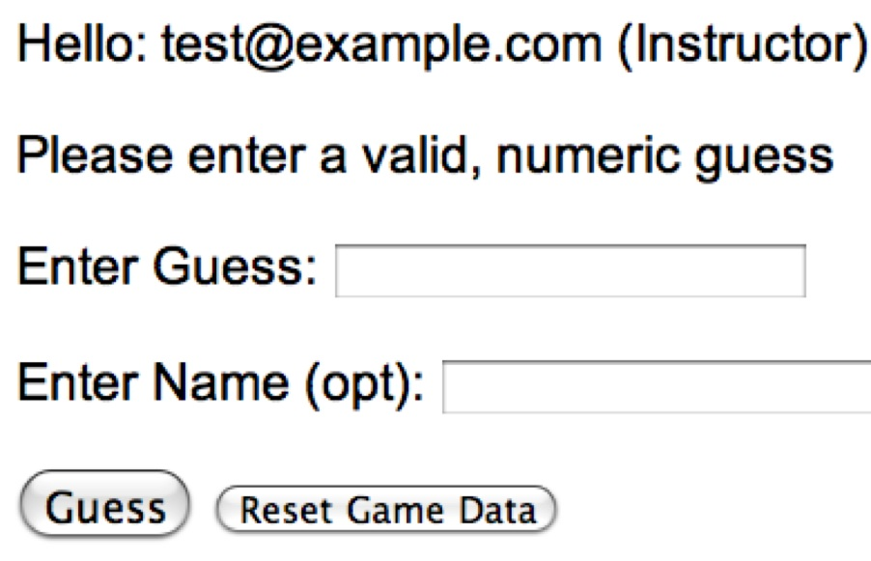
User Experience
Welcome
Local Resource
Lame iFrame
LTI Tool
Movie
© Copyright 2010 IMS Global Learning Consortium
All Rights Reserved.

Slide 19
CMS (LTI Consumer)
Again in slow motion…
LMS Looks up User and Course Information.
Information is signed using secret and OAuth
Welcome
Local Resource
Lame iFrame
LTI Tool
Movie
Form data sent to Browser
Tool (LTI Provider)
© Copyright 2010 IMS Global Learning Consortium
All Rights Reserved.

Slide 20
CMS (LTI Consumer)
Form is immediately auto-submitted using JavaScript.
<form action=”tool”/>
<input name=”user_id”
value=”2348d8dd” />
<input name=”oauth_token”
value=”abc.edu” />
</form>
Tool (LTI Provider)
Tool looks up secret and validates signature.
Tool provisions user, course, and session.
Tool sends redirect
© Copyright 2010 IMS Global Learning Consortium
All Rights Reserved.

Slide 21
CMS (LTI Consumer)
Browser follows redirect…
<head>
<meta redirect
page=”main.php”>
</head>
Tool (LTI Provider)
Tool produces
first page.
© Copyright 2010 IMS Global Learning Consortium
All Rights Reserved.

Slide 22
CMS (LTI Consumer)
Tool (LTI Provider)
© Copyright 2010 IMS Global Learning Consortium
All Rights Reserved.

Slide 23
Basic LTI Sample Launch Data
lti_version=LTI-1p0
lti_message_type=basic-lti-launch-request
oauth_consumer_key=lmsng.school.edu
resource_link_id=120988f929-274612
user_id=292832126
roles=Instructor
lis_person_name_full=Charles R. Severance
lis_person_contact_email_primary = csev@umich.edu
context_id=456434513
context_title=SI301 – PHP
tool_consumer_instance_description=University of School

Slide 24
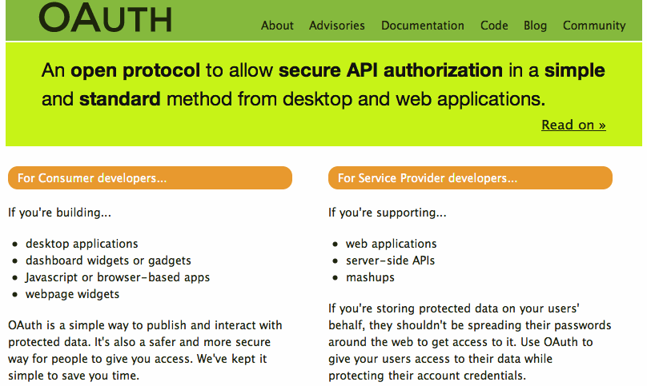

Slide 25
How to Write a Basic LTI Tool in PHP

Slide 26
Source Code - Download
Simple Sample Application – Classified Ads
  Classified Ad Software
  Key / Secret administration
  Basic LTI Utility Code
  Testing harness (simple BLTI Consumer)
  http://www.dr-chuck.com/ims/php-simple/dist.zip

Slide 27
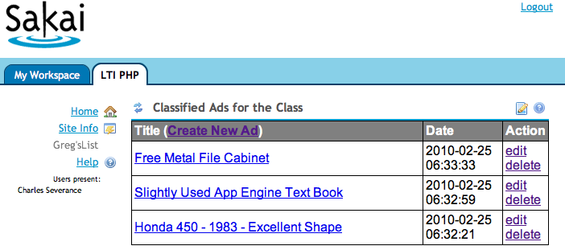
A Sample Tool – Classified Ads

Slide 28
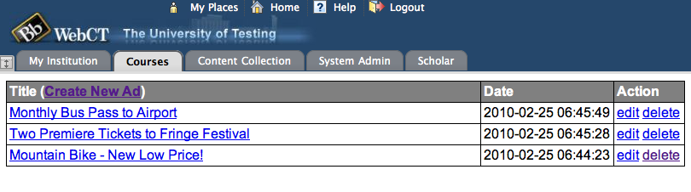
A Sample Tool – Classified Ads

Slide 29
Outline
Solving Multi-Tenancy
Handling the Basic LTI Launch and Context
Patterns for Simple Authorization

Slide 30

Multi-Tenancy
Multitenancy refers to a principle in software architecture where a single instance of the software runs on a server, serving multiple client organizations (tenants). Multitenancy is contrasted with a multi-instance architecture where separate software instances (or hardware systems) are set up for different client organizations. With a multitenant architecture, a software application is designed to virtually partition its data and configuration so that each client organization works with a customized/isolated virtual application instance.
http://en.wikipedia.org/wiki/Multitenancy

Slide 31
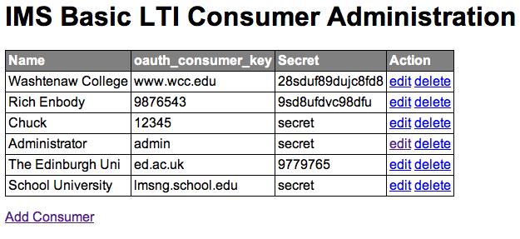
Administration Screen

Slide 32
Multi-Tenancy Data Model
create table blti_keys (
id MEDIUMINT NOT NULL AUTO_INCREMENT,
oauth_consumer_key CHAR(255) NOT NULL,
secret CHAR(255) NULL,
name CHAR(255) NULL,
context_id CHAR(255) NULL,
created_at DATETIME NOT NULL,
updated_at DATETIME NOT NULL,
PRIMARY KEY (id)
);

Slide 33
Advertisement Data Model

Slide 34
Multi-Tenancy Data Model
create table ads (
id MEDIUMINT NOT NULL AUTO_INCREMENT,
course_key CHAR(255) NOT NULL,
user_key CHAR(255) NULL,
user_name CHAR(255) NULL,
title CHAR(255) NULL,
description TEXT(2048) NULL,
created_at DATETIME NOT NULL,
updated_at DATETIME NOT NULL,
PRIMARY KEY (id)
);
Apologies to "3NF"

Slide 35
Multi-Tenancy Data
mysql> select id, left(course_key,25),left(user_key,25),left(title,20) from ads;
+----+---------------------------+---------------------------+----------------------+
| id | left(course_key,25) | left(user_key,25) | left(title,20) |
+----+---------------------------+---------------------------+----------------------+
| 6 | 12345:456434513 | 12345:292832126 | A Totally Sweet Titl |
| 7 | 12345:456434513 | 12345:292832126 | Another Awesome Titl |
| 8 | lmsng.school.edu:45643451 | lmsng.school.edu:29283212 | A TITLE |
| 9 | lmsng.school.edu:7601b0ed | lmsng.school.edu:f315ea76 | Honda 450 - 1983 - E |
| 10 | lmsng.school.edu:7601b0ed | lmsng.school.edu:f315ea76 | Slightly Used App En |
| 11 | lmsng.school.edu:7601b0ed | lmsng.school.edu:f315ea76 | Free Metal File Cabi |
| 12 | ed.ac.uk:lti_demo | ed.ac.uk:URN:X-WEBCT-b98f | Mountain Bike - New |
| 13 | ed.ac.uk:lti_demo | ed.ac.uk:URN:X-WEBCT-b98f | Two Premiere Tickets |
| 14 | ed.ac.uk:lti_demo | ed.ac.uk:URN:X-WEBCT-b98f | Monthly Bus Pass to |
+----+---------------------------+---------------------------+----------------------+
We must namespace the primary keys (user_id, context_id) with the oauth_consumer_key to isolate courses and users

Slide 36
Handling the Basic LTI Launch
A utility library is provided that intercepts and processes launches
require_once '../ims-blti/blti.php';
require_once("db.php");
$context = new BLTI(array('table' => 'blti_keys'));
if ( $context->complete ) exit();
if ( ! $context->valid ) {
print "Could not establish context: ".$context->message."\n";
exit();
}

Slide 37
Handling the Basic LTI Launch
The "context" is either taken from the launch or restored from the PHP session – like a filter
require_once '../ims-blti/blti.php';
require_once("db.php");
$context = new BLTI(array('table' => 'blti_keys'));
if ( $context->complete ) exit();
if ( ! $context->valid ) {
print "Could not establish context: ".$context->message."\n";
exit();
}

Slide 38
The Context
The context contains information from the launch
  Resource information
  User Information
  Course (aka context) information
  Organizational Information
  Launch Authentication Information

Slide 39
The Context – Supplied Methods
$context->getCourseKey() = 12345:456434513
$context->getCourseName() = SI182
$context->getUserKey() = 12345:292832126
$context->isInstructor() = true/false
$context->getUserEmail() = jane@school.edu
$context->getUserShortName() = jane@school.edu
$context->getUserName() = Jane Q. Public
$context->getConsumerKey() = 12345

Slide 40
Simple Authorization
With the data model, we need to know who can edit which ads in our table
mysql> select id, left(course_key,25),left(user_key,25),left(title,20) from ads;
+----+---------------------------+---------------------------+----------------------+
| id | left(course_key,25) | left(user_key,25) | left(title,20) |
+----+---------------------------+---------------------------+----------------------+
| 6 | 12345:456434513 | 12345:292832126 | A Totally Sweet Titl |
| 7 | 12345:456434513 | 12345:292832126 | Another Awesome Titl |
| 8 | lmsng.school.edu:45643451 | lmsng.school.edu:29283212 | A TITLE |
| 9 | lmsng.school.edu:7601b0ed | lmsng.school.edu:f315ea76 | Honda 450 - 1983 - E |
| 10 | lmsng.school.edu:7601b0ed | lmsng.school.edu:f315ea76 | Slightly Used App En |
| 11 | lmsng.school.edu:7601b0ed | lmsng.school.edu:f315ea76 | Free Metal File Cabi |
| 12 | ed.ac.uk:lti_demo | ed.ac.uk:URN:X-WEBCT-b98f | Mountain Bike - New |
| 13 | ed.ac.uk:lti_demo | ed.ac.uk:URN:X-WEBCT-b98f | Two Premiere Tickets |
| 14 | ed.ac.uk:lti_demo | ed.ac.uk:URN:X-WEBCT-b98f | Monthly Bus Pass to |
+----+---------------------------+---------------------------+----------------------+

Slide 41
Instructor:
SELECT * FROM ads WHERE id='7' AND
course_key='12345:456434513'
Student:
SELECT * FROM ads WHERE id='7' AND
course_key='12345:456434513 AND
user_key = '12345:292832126'
mysql> select id, left(course_key,25),left(user_key,25),left(title,20) from ads;
+----+---------------------------+---------------------------+----------------------+
| id | left(course_key,25) | left(user_key,25) | left(title,20) |
+----+---------------------------+---------------------------+----------------------+
| 6 | 12345:456434513 | 12345:292832126 | A Totally Sweet Titl |
| 7 | 12345:456434513 | 12345:292832126 | Another Awesome Titl |
| 8 | lmsng.school.edu:45643451 | lmsng.school.edu:29283212 | A TITLE |
| 9 | lmsng.school.edu:7601b0ed | lmsng.school.edu:f315ea76 | Honda 450 - 1983 - E |
| 10 | lmsng.school.edu:7601b0ed | lmsng.school.edu:f315ea76 | Slightly Used App En |
| 11 | lmsng.school.edu:7601b0ed | lmsng.school.edu:f315ea76 | Free Metal File Cabi |
| 12 | ed.ac.uk:lti_demo | ed.ac.uk:URN:X-WEBCT-b98f | Mountain Bike - New |
| 13 | ed.ac.uk:lti_demo | ed.ac.uk:URN:X-WEBCT-b98f | Two Premiere Tickets |
| 14 | ed.ac.uk:lti_demo | ed.ac.uk:URN:X-WEBCT-b98f | Monthly Bus Pass to |
+----+---------------------------+---------------------------+----------------------+

Slide 42
Show/Hide Buttons

Slide 43
Showing Buttons For Edit/Delete
<php
if ( $context->isInstructor() ||
$row['user_key'] == $context->getUserKey() ) { ?>
<a href="<self?>?action=edit&id=<row[id]?>">edit<a>
<a href="<self?>?action=delete&id=<row[id]?>">delete<a>
<php
}?>

Slide 44
Advanced Topic:
System and Course-Mapped Keys

Slide 45
Use cases
System-scoped key – The Consumer sends us a context_id which allows many different courses to use our tool independently – this is a typical approach
Course-mapped key – in this case, you ignore the consumer-provided context_id and specify the context_id inside of your (Producer) system

Slide 46
System-Scoped
Key=zap
cid=a1d2
cid=1234
cid=654
Producer
zap(sys)
fun(sys)
zap:a1d2
zap:1234
zap:654
fun:a1d2
fun:9876
fun:345
Key=fun
cid=a1d2
cid=9876
cid=345
Consumers

Slide 47
Course-Scoped Keys
Key=zap
cid=a1d2
cid=1234
Producer
zap(sys)
east (c=1555)
west(c=1555)
zap:a1d2
zap:1234
1555
Key=east
cid=a1d2
cid=1234
Key=west
cid=9876
With course-scoped keys, students from multiple contexts in multiple Consumers can meet and collaborate in the producer.
Consumers

Slide 48
Course-Scoped Keys
In the sample application, each key as a context_id field – if it is null, the key is a system-scoped key.
mysql> select id,oauth_consumer_key,secret,context_id from blti_keys;
+----+--------------------+--------+------------+
| id | oauth_consumer_key | secret | context_id |
+----+--------------------+--------+------------+
| 4 | 12345 | secret | NULL |
| 5 | admin | secret | 999999 |
+----+--------------------+--------+------------+

Slide 49
Configuration using resource_link_id

Slide 50
Use Case: Picking a Video
If our Producer is video archive and the purpose of each "placement" in a course is to play a particular video using BLTI to gain access to the video
Problem: How to place BLTI several places in the course but refer to different videos in each placement?

Slide 51
Goal State
Scene
1
Week 1
Video snippet
Discussion board
Week 2
Video snippet
Wiki
Week 3
Video Snippet
Midterm Exam
Scene4
Scene
9

Slide 52
Understanding resource_link_id
Key=987 cid=a1b2
Week 1
Video snippet
Discussion board
Week 2
Video snippet
Wiki
Week 3
Video Snippet
Midterm Exam
rlid=9c45
The resource_link_id is unique for each placement of Basic LTI in a course. When each of the resources is launched you get key, cid, and rlid. Resource_link_id is required on all launches.
rlid=23b5
rlid=1725

Slide 53
Using resource_link_id
Key=987 cid=a1b2
Week 1
Video snippet
Discussion board
rlid=9c45
You need a table in your application which maps from a key:resource_link_id (i.e. 987:9c45) to some local resource identified within your application. Until the Instructor selects a resource within your tool, it is "unconfigured"

Slide 54
Understanding resource_link_id
Key=987 cid=a1b2
Week 1
Video snippet
Discussion board
rlid=9c45
Not
Config
Pick
Video
Scene
1
Scene
1
Learner
Instructor
Learner
Instructor
Not configured
987:9c45 = matrix_scene_01

Slide 55
Custom Field Notes
In a Common Cartridge, Basic LTI Resource Links have a custom field which can be used for this purpose
The custom fields UI varies from LMS to LMS and may not even be available to the Instructor
Using resource_link_id keeps the configuration UX in the Producer and keeps from needing per-LMS documentation
A good practice is to use custom_fields in cartridges and if no custom field is present fall back to resource_link_id provisioning

Slide 56
Adding Basic LTI to an Existing Application

Slide 57
Adding Support for BLTI
Must deal with multi-tenancy gracefully – it will not look nice if your UI shows user names like fbbf213:29938jsha01929
Add a launch-point to provision courses, users, set roles, and provision a session and redirect to tool page
May want to come up with a UI with little or no outer navigation so it looks more like a "tool"

Slide 58
Source Code - Download
Simple Sample Application – Classified Ads
  http://www.dr-chuck.com/ims/php-simple/dist.zip
  Classified Ad Software (adlist/ads.php)
  Key / Secret administration (adlist/admin.php)
  Basic LTI Utility Code (ims-blti/blti.php)
  Testing harness (simple BLTI Consumer) (lms.php)
  Uses MySQL (adlist/setup.sql and adlist/db.php)

Slide 59
Questions....
IMS – www.imsglobal.org
IMS Basic LTI Video – www.vimeo.com/8073453
Marc's Dinosaur Video – www.vimeo.com/7825070
cseverance@imsglobal.org
www.dr-chuck.com

