Slide 1



IMS Basic Learning Tools
Interoperability
Charles Severance, Ph.D.
Affiliate Coordinator
IMS Global Learning Consortium (IMS GLC)
http://www.imsglobal.org/
http://www.dr-chuck.com/

Slide 2
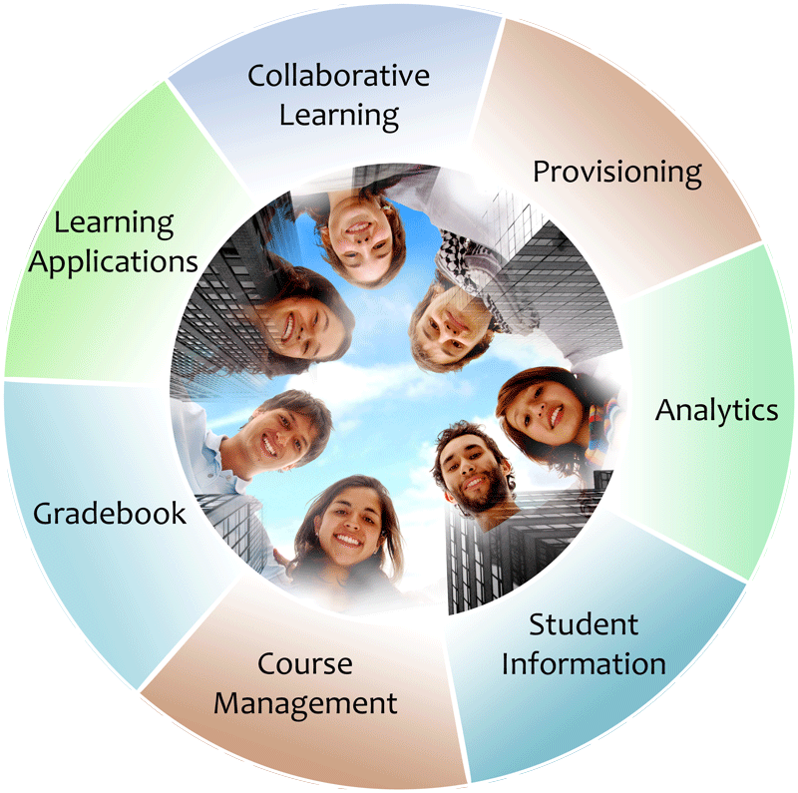


IMS: Digital Learning Standards
The information
architecture for
learning
Seamlessly
connect
to learning
Free the
content
IMS Common Cartridge
IMS Learning Tools
Interoperability (LTI)
IMS Learning Information
Services (LIS)

Slide 3
IMS Learning Tools Interoperability
Problem
  Every CMS has their own very unique "module", "tool" "block", "nugget", "powerlink", etc
  External tools like QuestionMark, Wimba, Elluminate, etc must prioritize which CMS they invest in plugging into
  Tool Providers wait until customers are willing to pay money to start development

Slide 4
IMS Learning Tools Interoperability
Solution
  Build a standard plug-in for all CMS systems
  Tool and Content Providers can build one integration and use it in any CMS that supports the standard
  Note – the standard plug-in will not be as rich as a native plug-in – but it will be simple and universal
  Tool Providers will continue to build native integrations for the parts of the market where they find value

Slide 5









B
A
S
I
C
L
T
I
LEARNING
TOOL
...
PHP
Java
App Engine
Wookie...

Slide 6
B
A
S
I
C
L
T
I
PREMIUM
LEARNING
CONTENT
...

Slide 7
Common
Cartridge
L
M
S
Premium
Learning
Content
L
M
S
When LTI is combined with
the IMS Common Cartridge,
publishers can distribute cartridges containing active, authenticated links back centrally hosted content.

Slide 8
Basic LTI LMS Coverage (approx.)
Shipped
  Desire2Learn 8.4.2
In Progress
  Moodle 1.9, Sakai 2.7, OLAT 6.4
Planned
  Moodle 2.0
Open Source Plugins
  Blackboard 8
  Blackboard 9
  WebCT Vista
Early Work
  ANGEL Learning
  Plone

Slide 9
Imagine a Learning App and Content Store...
Imagine that we had a single place to search for learning tools to pull into our course management systems
These could be code or content or services..

Slide 10
IMS Learning Tools Interoperability Technical Overview

Slide 11
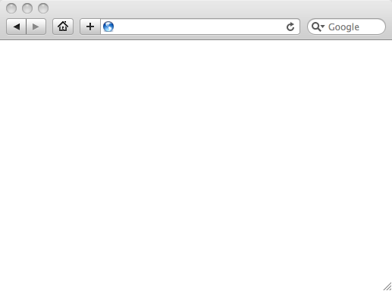
Integrated User Experience
Welcome
Local Resource
Lame iFrame
LTI Tool
Movie
© Copyright 2010 IMS Global Learning Consortium
All Rights Reserved.

Slide 12
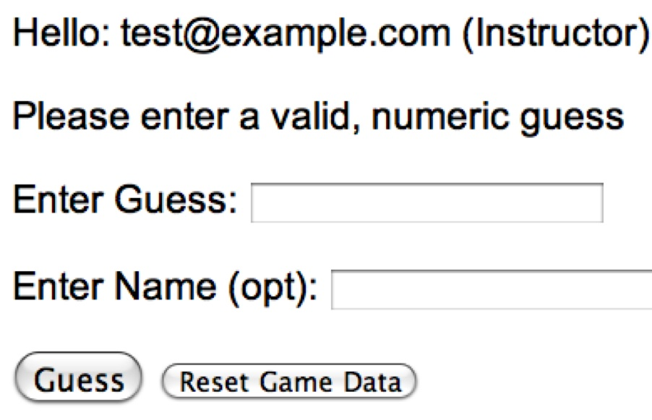
User Experience
Welcome
Local Resource
Lame iFrame
LTI Tool
Movie
© Copyright 2010 IMS Global Learning Consortium
All Rights Reserved.

Slide 13
CMS (LTI Consumer)
Again in slow motion…
LMS Looks up User and Course Information.
Information is signed using secret and OAuth
Welcome
Local Resource
Lame iFrame
LTI Tool
Movie
Form data sent to Browser
Tool (LTI Provider)
© Copyright 2010 IMS Global Learning Consortium
All Rights Reserved.

Slide 14
CMS (LTI Consumer)
Form is immediately auto-submitted using JavaScript.
<form action=”tool”/>
<input name=”user_id”
value=”2348d8dd” />
<input name=”oauth_token”
value=”abc.edu” />
</form>
Tool (LTI Provider)
Tool looks up secret and validates signature.
Tool provisions user, course, and session.
Tool sends redirect
© Copyright 2010 IMS Global Learning Consortium
All Rights Reserved.

Slide 15
CMS (LTI Consumer)
Browser follows redirect…
<head>
<meta redirect
page=”main.php”>
</head>
Tool (LTI Provider)
Tool produces
first page.
© Copyright 2010 IMS Global Learning Consortium
All Rights Reserved.

Slide 16
CMS (LTI Consumer)
Tool (LTI Provider)
© Copyright 2010 IMS Global Learning Consortium
All Rights Reserved.

Slide 17
Basic LTI Sample Launch Data
lti_version=LTI-1p0
lti_message_type=basic-lti-launch-request
oauth_consumer_key=lmsng.school.edu
resource_link_id=120988f929-274612
user_id=292832126
roles=Instructor
lis_person_name_full=Charles R. Severance
lis_person_contact_email_primary = csev@umich.edu
context_id=456434513
context_title=SI301 – PHP
tool_consumer_instance_description=University of School

Slide 18
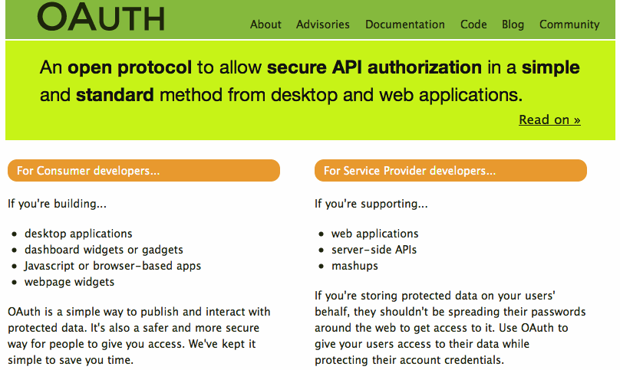

Slide 19
Basic LTI and IMS Common Cartridge
Welcome
Local Resource
Folder
LTI Tool
Discussion
QTI Pool
Common Cartridge 1.1 will include the ability to define a Basic LTI resource and include that resource in course organizational structures

Slide 20
Pushing Basic LTI Adoption
Sample Java + PHP Basic LTI implementations at
  http://code.google.com/p/ims-dev/
Use/include sample code from oauth.net
Both structured to provide reusable code
  org.imsglobalorg.basiclti.BasicLTIUtil.java
  blti_util.php
Copyright IMS, Apache 2 – Usable anywhere

Slide 21

Certification
We have developed a certification test for CMS systems to insure interoperability and that tool writers can make some basic assumptions about the behavior of certified CMS systems
Early version of certification was given out for testing and all LMS systems passed the certification

Slide 22
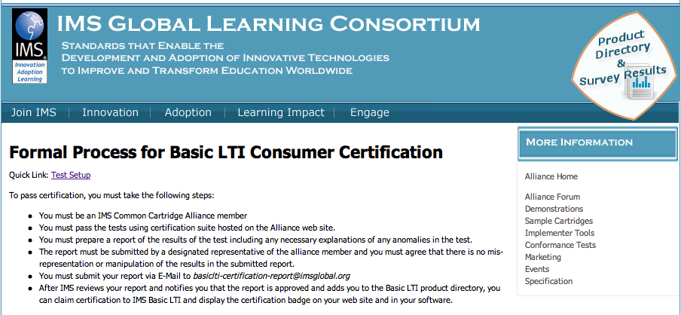
http://www.imsglobal.org/developers/alliance/lti/blti-cert/

Slide 23
Questions
IMS – www.imsglobal.org
IMS Basic LTI Video – www.vimeo.com/8073453

