Slide 1



Building Tools in PHP using
IMS Basic LTI
Charles Severance, Ph.D.
Affiliate Coordinator
IMS Global Learning Consortium (IMS GLC)
http://www.imsglobal.org/
http://www.dr-chuck.com/

Slide 2



IMS: Digital Learning Standards
The information
architecture for
learning
Seamlessly
connect
to learning
Free the
content
IMS Common Cartridge
IMS Learning Tools
Interoperability (LTI)
IMS Learning Information
Services (LIS)

Slide 3
IMS Learning Tools Interoperability
Problem
  Every CMS has their own very unique "module", "tool" "block", "nugget", "powerlink", etc
  External tools like QuestionMark, Wimba, Elluminate, etc must prioritize which CMS they invest in plugging into
  Tool Providers wait until customers are willing to pay money to start development

Slide 4
IMS Learning Tools Interoperability
Solution
  Build a standard plug-in for all CMS systems
  Tool and Content Providers can build one integration and use it in any CMS that supports the standard
  Note – the standard plug-in will not be as rich as a native plug-in – but it will be simple and universal
  Tool Providers will continue to build native integrations for the parts of the market where they find value

Slide 5









B
A
S
I
C
L
T
I
LEARNING
TOOL
...
PHP
Java
App Engine
Wookie...

Slide 6
Basic LTI LMS Coverage (approx.)
Shipped
  Desire2Learn 8.4.2
In Progress
  Moodle 1.9, Sakai 2.7, OLAT 6.4, Jenzabar
Planned
  Moodle 2.0
Open Source Plugins
  Blackboard 8
  Blackboard 9
  WebCT Vista
Early Work
  ANGEL Learning
  Plone

Slide 7
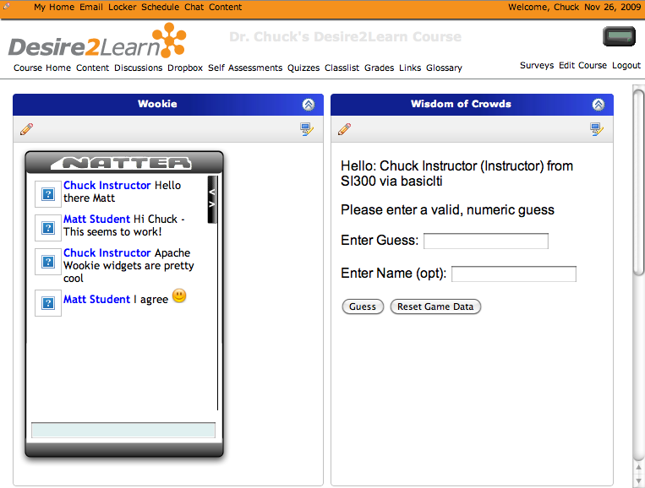
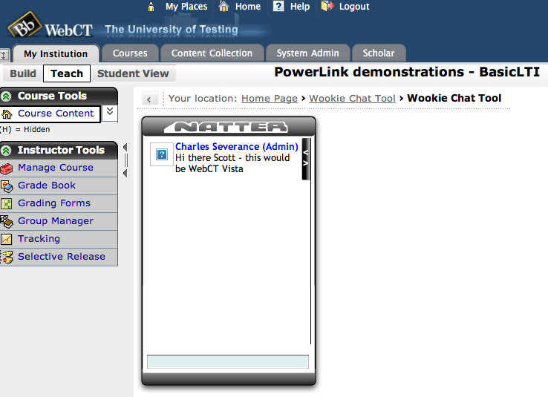
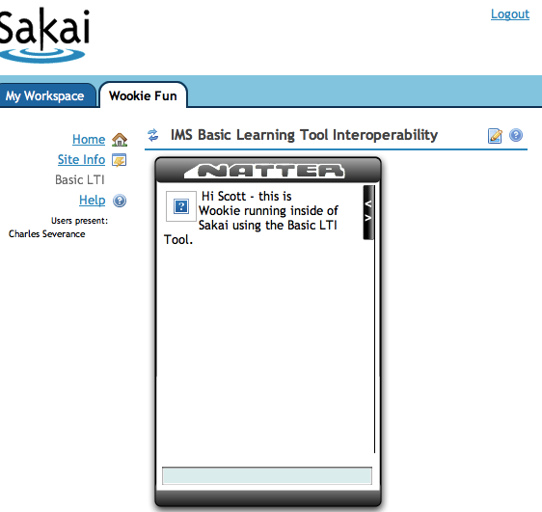
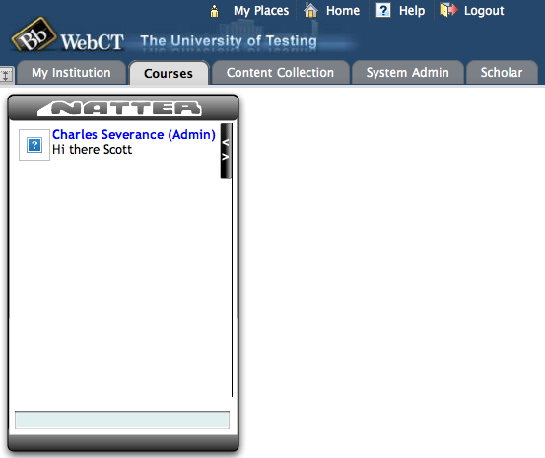
Apache
Wookie

Slide 8
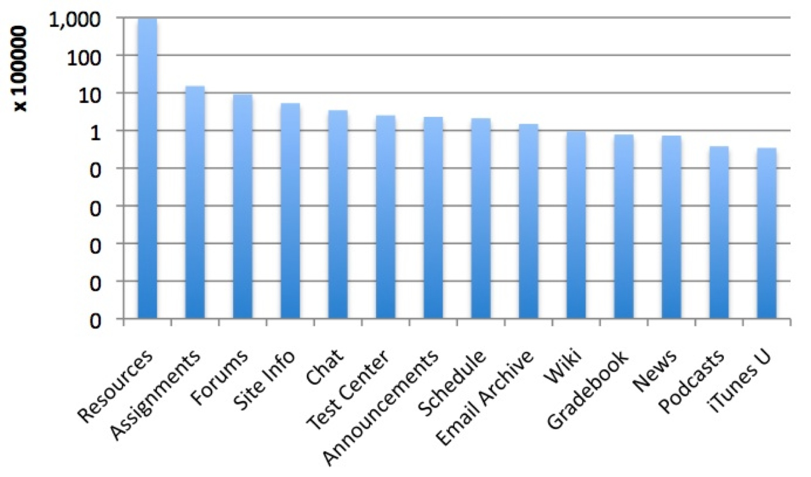
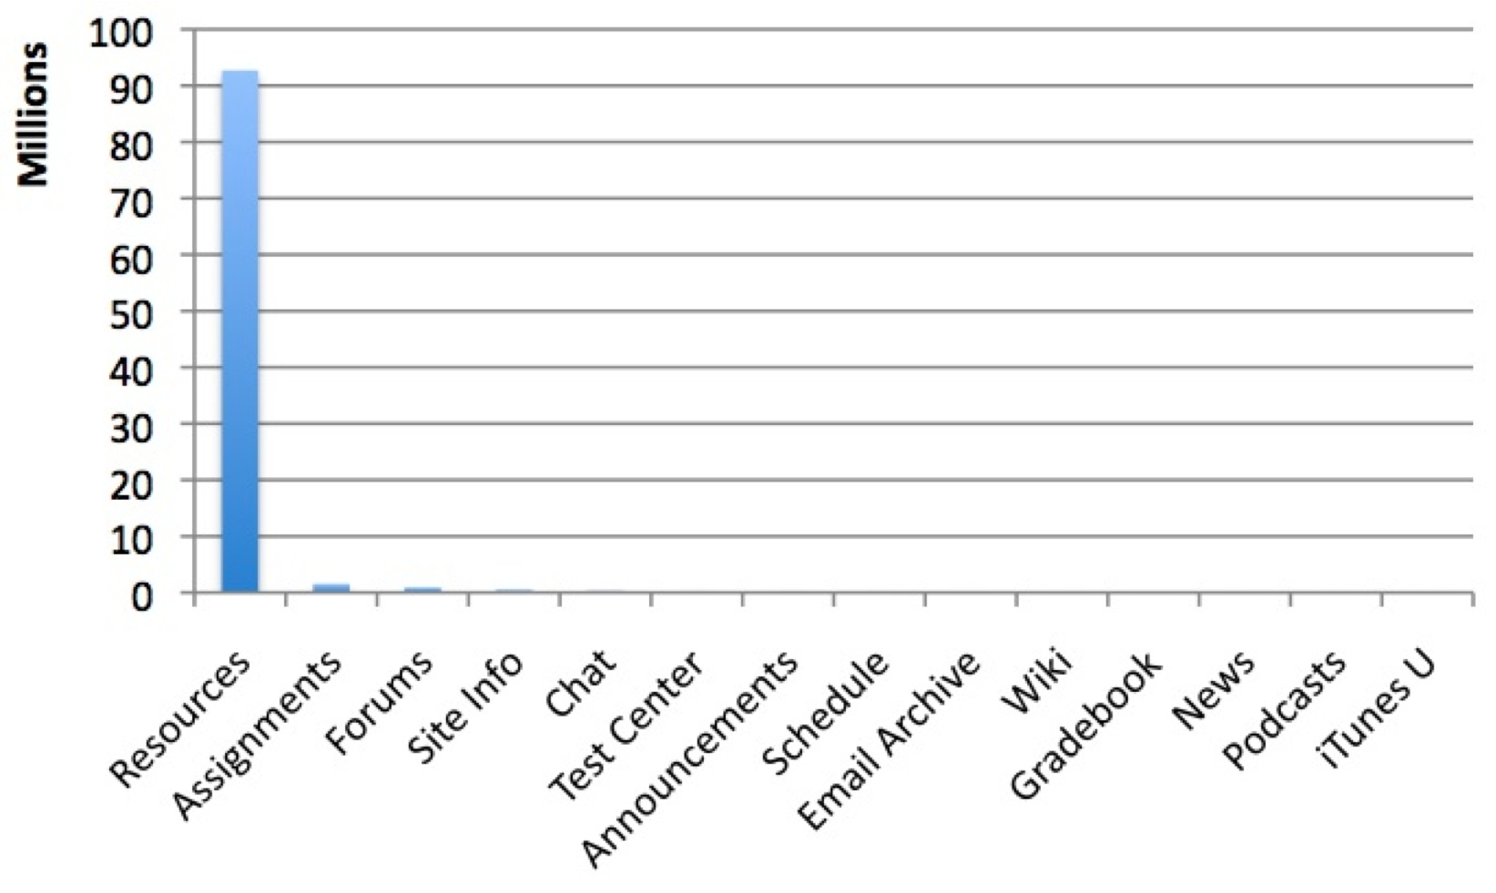

Slide 9


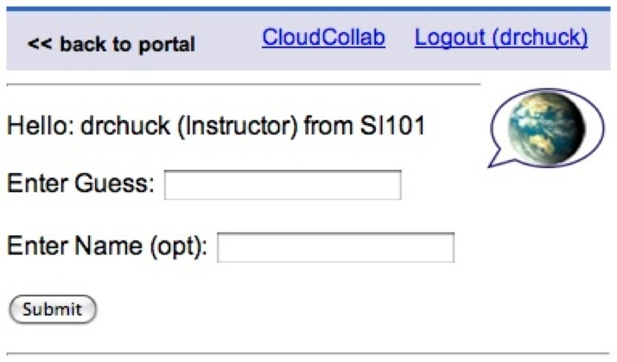
Who writes these learning tools?
There are more than
15 applications

Slide 10

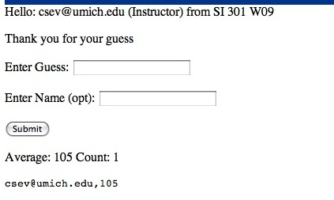
A Simple Guessing Game

Slide 11
How to Write a Basic LTI Tool in PHP

Slide 12
Source Code - Download
Simple Sample Application – Classified Ads
  Classified Ad Software
  Key / Secret administration
  Basic LTI Utility Code
  Testing harness (simple BLTI Consumer)
  http://www.dr-chuck.com/ims/php-simple/dist.zip

Slide 13
Tool Installation and URLs
LMS Tester
  install-dir/lms.php
Installation instructions
  install-dir/adlist/index.htm
Administration functions
  install-dir/adlist/admin.php
Launch URL
  install-dir/adlist/ads.php

Slide 14
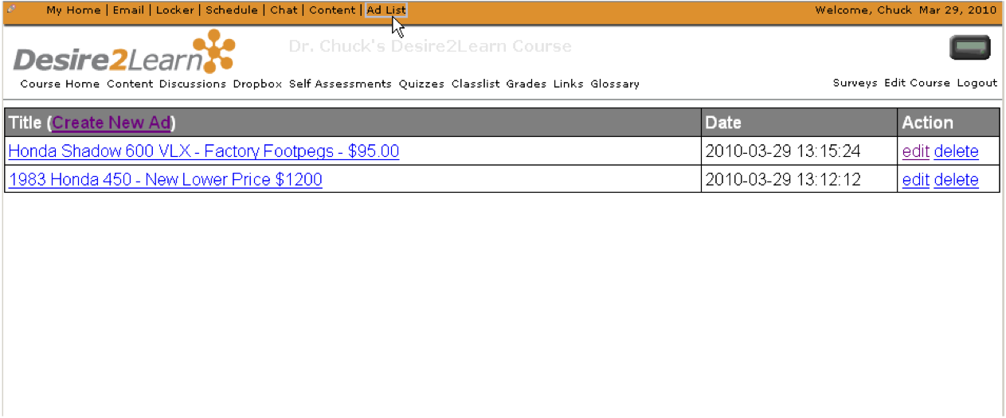
A Sample Tool – Classified Ads

Slide 15
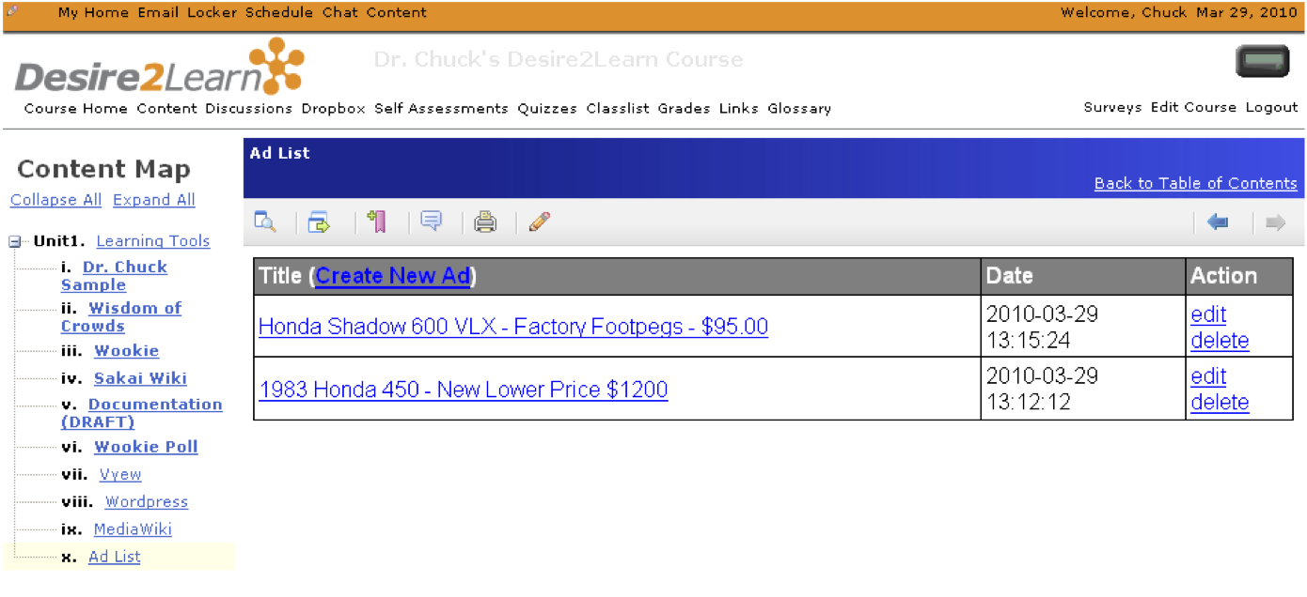
A Sample Tool – Classified Ads

Slide 16
Outline
Solving Multi-Tenancy
Handling the Basic LTI Launch and Context
Patterns for Simple Authorization

Slide 17

Multi-Tenancy
Multitenancy refers to a principle in software architecture where a single instance of the software runs on a server, serving multiple client organizations (tenants). Multitenancy is contrasted with a multi-instance architecture where separate software instances (or hardware systems) are set up for different client organizations. With a multitenant architecture, a software application is designed to virtually partition its data and configuration so that each client organization works with a customized/isolated virtual application instance.
http://en.wikipedia.org/wiki/Multitenancy

Slide 18
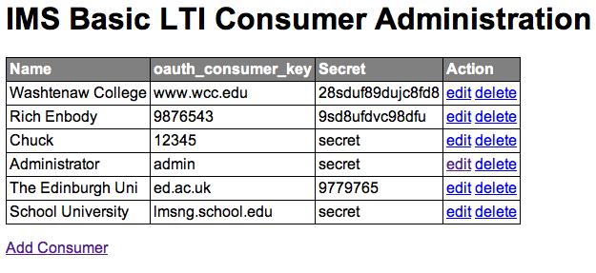
Administration Screen

Slide 19
Multi-Tenancy Data Model
create table blti_keys (
id MEDIUMINT NOT NULL AUTO_INCREMENT,
oauth_consumer_key CHAR(255) NOT NULL,
secret CHAR(255) NULL,
name CHAR(255) NULL,
context_id CHAR(255) NULL,
created_at DATETIME NOT NULL,
updated_at DATETIME NOT NULL,
PRIMARY KEY (id)
);

Slide 20
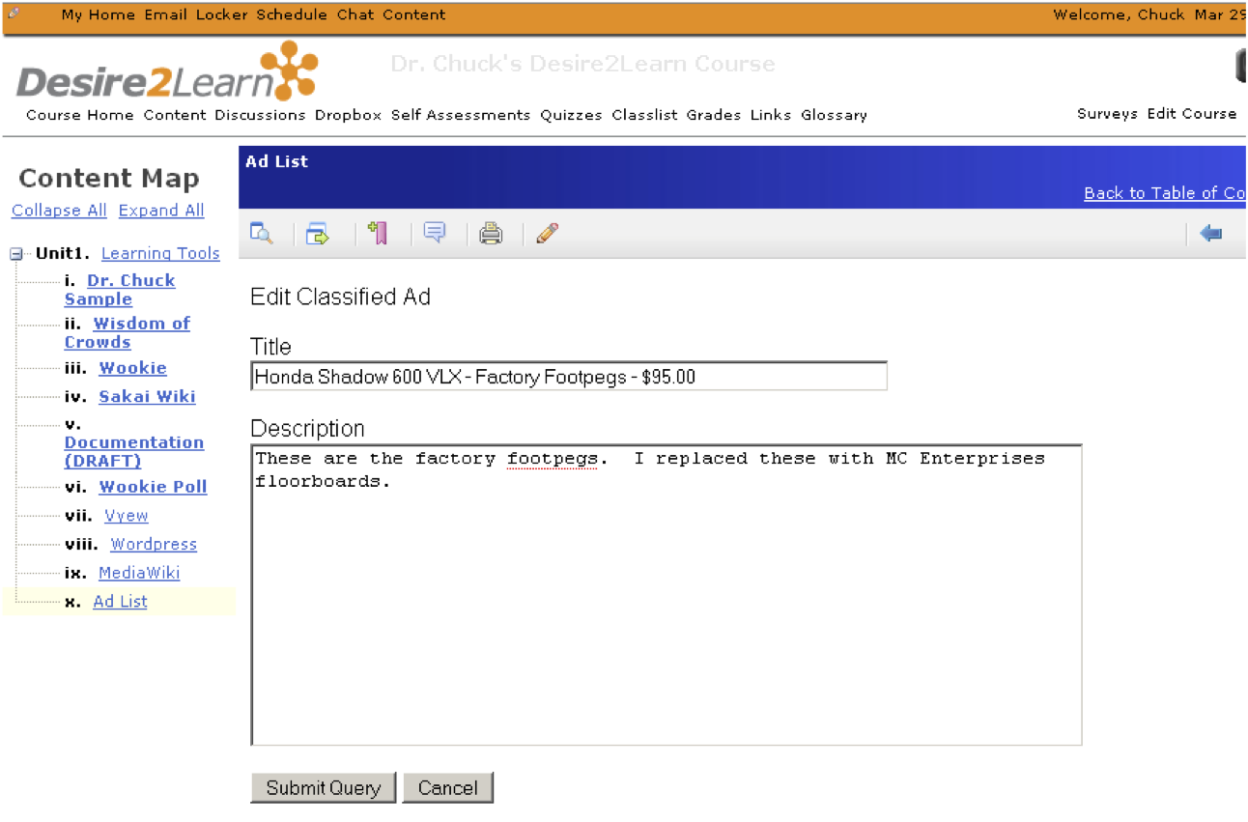
Advertisement Data Model

Slide 21
Multi-Tenancy Data Model
create table ads (
id MEDIUMINT NOT NULL AUTO_INCREMENT,
course_key CHAR(255) NOT NULL,
user_key CHAR(255) NULL,
user_name CHAR(255) NULL,
title CHAR(255) NULL,
description TEXT(2048) NULL,
created_at DATETIME NOT NULL,
updated_at DATETIME NOT NULL,
PRIMARY KEY (id)
);
Apologies to "3NF"

Slide 22
Multi-Tenancy Data
mysql> select id, left(course_key,25),left(user_key,25),left(title,20) from ads;
+----+---------------------------+---------------------------+----------------------+
| id | left(course_key,25) | left(user_key,25) | left(title,20) |
+----+---------------------------+---------------------------+----------------------+
| 6 | 12345:456434513 | 12345:292832126 | A Totally Sweet Titl |
| 7 | 12345:456434513 | 12345:292832126 | Another Awesome Titl |
| 8 | lmsng.school.edu:45643451 | lmsng.school.edu:29283212 | A TITLE |
| 9 | lmsng.school.edu:7601b0ed | lmsng.school.edu:f315ea76 | Honda 450 - 1983 - E |
| 10 | lmsng.school.edu:7601b0ed | lmsng.school.edu:f315ea76 | Slightly Used App En |
| 11 | lmsng.school.edu:7601b0ed | lmsng.school.edu:f315ea76 | Free Metal File Cabi |
| 12 | ed.ac.uk:lti_demo | ed.ac.uk:URN:X-WEBCT-b98f | Mountain Bike - New |
| 13 | ed.ac.uk:lti_demo | ed.ac.uk:URN:X-WEBCT-b98f | Two Premiere Tickets |
| 14 | ed.ac.uk:lti_demo | ed.ac.uk:URN:X-WEBCT-b98f | Monthly Bus Pass to |
+----+---------------------------+---------------------------+----------------------+
We must namespace the primary keys (user_id, context_id) with the oauth_consumer_key to isolate courses and users

Slide 23
Handling the Basic LTI Launch
A utility library is provided that intercepts and processes launches
require_once '../ims-blti/blti.php';
require_once("db.php");
$context = new BLTI(array('table' => 'blti_keys'));
if ( $context->complete ) exit();
if ( ! $context->valid ) {
print "Could not establish context: ".$context->message."\n";
exit();
}
ads.php

Slide 24
Handling the Basic LTI Launch
The "context" is either taken from the launch or restored from the PHP session – like a filter
require_once '../ims-blti/blti.php';
require_once("db.php");
$context = new BLTI(array('table' => 'blti_keys'));
if ( $context->complete ) exit();
if ( ! $context->valid ) {
print "Could not establish context: ".$context->message."\n";
exit();
}
ads.php

Slide 25
The Context
The context contains information from the launch
  Resource information
  User Information
  Course (aka context) information
  Organizational Information
  Launch Authentication Information

Slide 26
The Context – Supplied Methods
$context->getCourseKey() = 12345:456434513
$context->getCourseName() = SI182
$context->getResourceKey() = 12345:9fbbe1230
$context->getResourceTitle() = Week 1 Blog
$context->getUserKey() = 12345:292832126
$context->isInstructor() = true/false
$context->getUserEmail() = jane@school.edu
$context->getUserShortName() = jane@school.edu
$context->getUserName() = Jane Q. Public
$context->getUserImage() = http://www.gravatar...
$context->getConsumerKey() = 12345

Slide 27
Simple Authorization
With the data model, we need to know who can edit which ads in our table
mysql> select id, left(course_key,25),left(user_key,25),left(title,20) from ads;
+----+---------------------------+---------------------------+----------------------+
| id | left(course_key,25) | left(user_key,25) | left(title,20) |
+----+---------------------------+---------------------------+----------------------+
| 6 | 12345:456434513 | 12345:292832126 | A Totally Sweet Titl |
| 7 | 12345:456434513 | 12345:292832126 | Another Awesome Titl |
| 8 | lmsng.school.edu:45643451 | lmsng.school.edu:29283212 | A TITLE |
| 9 | lmsng.school.edu:7601b0ed | lmsng.school.edu:f315ea76 | Honda 450 - 1983 - E |
| 10 | lmsng.school.edu:7601b0ed | lmsng.school.edu:f315ea76 | Slightly Used App En |
| 11 | lmsng.school.edu:7601b0ed | lmsng.school.edu:f315ea76 | Free Metal File Cabi |
| 12 | ed.ac.uk:lti_demo | ed.ac.uk:URN:X-WEBCT-b98f | Mountain Bike - New |
| 13 | ed.ac.uk:lti_demo | ed.ac.uk:URN:X-WEBCT-b98f | Two Premiere Tickets |
| 14 | ed.ac.uk:lti_demo | ed.ac.uk:URN:X-WEBCT-b98f | Monthly Bus Pass to |
+----+---------------------------+---------------------------+----------------------+

Slide 28
Instructor:
SELECT * FROM ads WHERE id='7' AND
course_key='12345:456434513'
Student:
SELECT * FROM ads WHERE id='7' AND
course_key='12345:456434513 AND
user_key = '12345:292832126'
mysql> select id, left(course_key,25),left(user_key,25),left(title,20) from ads;
+----+---------------------------+---------------------------+----------------------+
| id | left(course_key,25) | left(user_key,25) | left(title,20) |
+----+---------------------------+---------------------------+----------------------+
| 6 | 12345:456434513 | 12345:292832126 | A Totally Sweet Titl |
| 7 | 12345:456434513 | 12345:292832126 | Another Awesome Titl |
| 8 | lmsng.school.edu:45643451 | lmsng.school.edu:29283212 | A TITLE |
| 9 | lmsng.school.edu:7601b0ed | lmsng.school.edu:f315ea76 | Honda 450 - 1983 - E |
| 10 | lmsng.school.edu:7601b0ed | lmsng.school.edu:f315ea76 | Slightly Used App En |
| 11 | lmsng.school.edu:7601b0ed | lmsng.school.edu:f315ea76 | Free Metal File Cabi |
| 12 | ed.ac.uk:lti_demo | ed.ac.uk:URN:X-WEBCT-b98f | Mountain Bike - New |
| 13 | ed.ac.uk:lti_demo | ed.ac.uk:URN:X-WEBCT-b98f | Two Premiere Tickets |
| 14 | ed.ac.uk:lti_demo | ed.ac.uk:URN:X-WEBCT-b98f | Monthly Bus Pass to |
+----+---------------------------+---------------------------+----------------------+

Slide 29
Show/Hide Buttons

Slide 30
Showing Buttons For Edit/Delete
<?php
if ( $context->isInstructor() ||
$row['user_key'] == $context->getUserKey() ) { ?>
<a href="<self?>?action=edit&id=<row[id]?>">edit<a>
<a href="<self?>?action=delete&id=<row[id]?>">delete<a>
<?php
}?>
ads.php

Slide 31
Advanced Topic:
System and Course-Mapped Keys

Slide 32
Use cases
System-scoped key – The Consumer sends us a context_id for each course which allows many different courses to use our tool independently – this is a typical approach
Course-mapped key – in this case, you ignore the consumer-provided context_id and specify the context_id inside of your (Provider) system

Slide 33
System-Scoped
Key=zap
cid=a1d2
cid=1234
cid=654
Provider
zap(sys)
fun(sys)
zap:a1d2
zap:1234
zap:654
fun:a1d2
fun:9876
fun:345
Key=fun
cid=a1d2
cid=9876
cid=345
Consumers

Slide 34
Course-Scoped Keys
Key=zap
cid=a1d2
cid=1234
Provider
zap(sys)
east (c=1555)
west(c=1555)
zap:a1d2
zap:1234
1555
Key=east
cid=a1d2
cid=1234
Key=west
cid=9876
With course-scoped keys, students from multiple contexts in multiple Consumers can meet and collaborate in the Provider.
Consumers

Slide 35
Course-Scoped Keys
In the sample application, each key as a context_id field – if it is null, the key is a system-scoped key.
mysql> select id,oauth_consumer_key,secret,context_id from blti_keys;
+----+--------------------+--------+------------+
| id | oauth_consumer_key | secret | context_id |
+----+--------------------+--------+------------+
| 4 | 12345 | secret | NULL |
| 5 | admin | secret | 999999 |
+----+--------------------+--------+------------+

Slide 36
Configuration using resource_link_id

Slide 37
Use Case: Picking a Video
If our Tool Provider is video archive and the purpose of each "placement" in a course is to play a particular video using BLTI to gain access to the video
Problem: How to place BLTI links several places in the course but refer to different videos in each placement?

Slide 38
Goal State
Scene
1
Week 1
Video snippet
Discussion board
Week 2
Video snippet
Wiki
Week 3
Video Snippet
Midterm Exam
Scene4
Scene
9

Slide 39
Understanding resource_link_id
Key=987 cid=a1b2
Week 1
Video snippet
Discussion board
Week 2
Video snippet
Wiki
Week 3
Video Snippet
Midterm Exam
rlid=9c45
The resource_link_id is unique for each placement of Basic LTI in a course. When each of the resources is launched you get key, cid, and rlid. Resource_link_id is required on all launches.
rlid=23b5
rlid=1725

Slide 40
Using resource_link_id
Key=987 cid=a1b2
Week 1
Video snippet
Discussion board
rlid=9c45
You need a table in your application which maps from a key:resource_link_id (i.e. 987:9c45) to some local resource identified within your application. Until the Instructor selects a resource within your tool, it is "unconfigured"

Slide 41
Understanding resource_link_id
Key=987 cid=a1b2
Week 1
Video snippet
Discussion board
rlid=9c45
Not
Config
Pick
Video
Scene
1
Scene
1
Learner
Instructor
Learner
Instructor
Not configured
987:9c45 = matrix_scene_01

Slide 42
Custom Field .vs. Resource Link
In a Common Cartridge, Basic LTI Resource Links have a custom field which could be used for this purpose ... But ...
The custom fields UI varies from LMS to LMS and may not even be available to the Instructor
Using resource_link_id keeps the configuration UX in the Provider and keeps from needing per-LMS documentation
A good practice is to use custom_fields in cartridges and if no custom field is present fall back to resource_link_id provisioning

Slide 43
Advanced Topics
Adding Basic LTI To and Existing Application

Slide 44
Source Code - Download
Simple Sample Application – Classified Ads
  http://www.dr-chuck.com/ims/php-simple/dist.zip
  Classified Ad Software (adlist/ads.php)
  Key / Secret administration (adlist/admin.php)
  Basic LTI Utility Code (ims-blti/blti.php)
  Testing harness (simple BLTI Consumer) (lms.php)
  Uses MySQL (adlist/setup.sql and adlist/db.php)

Slide 45
IMS Alliance Membership
Attend IMS Quarterly Meetings
Attend related Working Group Meetings
Technical support for implementers of IMS Specifications
Certification Program
http://www.imsglobal.org/cc/jointhealliance.cfm

Slide 46

Learning Impact 2010
17-20 May 2010 Long Beach, CA
Learning Impact 2010 and the Learning Impact Award Showcase is an executive level gathering of educational leaders, suppliers, and government organizations to encourage new ways to think and collaborative action via projects facilitated by the IMS Global Learning Consortium.
Learn More About LTI -- Join us at Learning Impact and attend the Implementing and Achieving Conformance with Digital Learning Services Standards Workshop
  This technical workshop will focus on three standards: Learning Tools Interoperability, Learning Information Services and Common Cartridge. Information on how to effectively implement the standards along with details on how to achieve conformance to them will be provided.
Find out more at: http://www.imsglobal.org/learningimpact2010/

Slide 47
Questions
Seamlessly
connect
to learning
IMS – www.imsglobal.org
cseverance@imsglobal.org
IMS Learning Tools
Interoperability (LTI)

