Slide 1
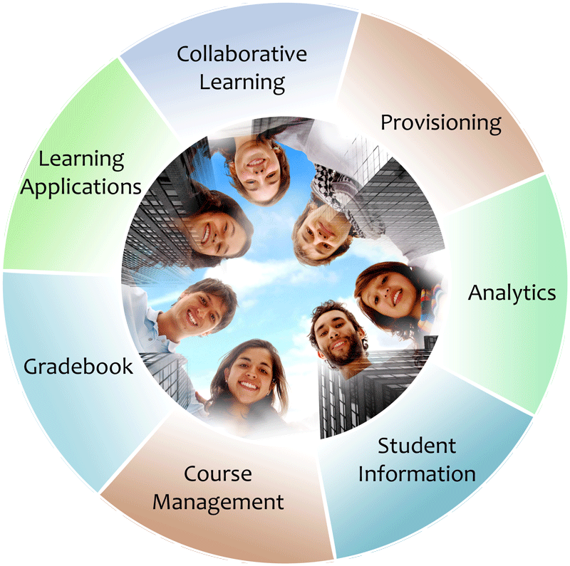

LIS & LTI
The information
architecture for
learning
Seamlessly
connect
to learning
IMS Learning Information
Services (LIS)
IMS Learning Tools
Interoperability (LTI)
Linda Feng (Oracle), John Lewis (Unicon) & Charles Severance (U Michigan)

Slide 2
Agenda
LIS overview (Linda)
LTI overview (Chuck)
Demo (John)
Q&A

Slide 3
LIS Overview

Slide 4
What is LIS 2.0?
A set of services that enable systems, such as SIS/LMS, to exchange information about courses, people, outcomes and groups
LIS v2.0 Public Draft issued – April 2010

Slide 5









Roster Provisioning
Student Admin

Slide 6
IMS LIS 2.0: Logical Architecture
SIS
External Academic System
(LMS, Social Network, Wiki, etc.)
Person
Course
Enrollment
Grades/
Outcomes

Slide 7
Integration Approaches
Three Methods of Integration
  Full Synch Snapshot: initialization/ resynchronization capability
  Incremental Snapshot: Scheduled process to capture effective dated changes and ensure no missed updates
  Event Driven Update: near real time update driven by embedded event triggers

Slide 8
Standards-based Integrations
Existing Today
Oracle SAIP (released Aug 2008)
Sakai (available in all distributions)
Moodle (only via Moodlerooms)
Schools on Facebook
In Progress
Sungard
Desire2Learn
Pearson (eCollege and MyLabs)

Slide 9
LIS Alliance
The Learning Information Services Alliance has been created as a high value community for product and service developers wanting to be compliant with LIS
http://www.imsglobal.org/developers/lisalliance/index.cfm

Slide 10
Alliance Forum and Materials
Forum
  Please participate by posting issues, comments, suggestions, etc.
  http://www.imsglobal.org/community/forum/index.cfm?forumid=13
Resources
  Presentations, guidance documents, support for testing and conformance, etc.

Slide 11
LTI Overview

Slide 12
Learning Tools Interoperability
Problem
  Every CMS has their own very unique "module", "tool" "block", "nugget", "powerlink", etc
  External tools like QuestionMark, Wimba, Elluminate, etc must prioritize which CMS they invest in plugging into
  Tool Providers wait until customers are willing to pay money to start development

Slide 13
Learning Tools Interoperability
Solution
  Build a standard plug-in for all CMS systems
  Tool and Content Providers can build one integration and use it in any CMS that supports the standard
  Start simple and basic and then expand feature sets to allow market to adjust over time and insure that engineering due diligence is being done – phased release

Slide 14









L
T
I
LEARNING
TOOL
...
PHP
Java
App Engine
Wookie...

Slide 15












Tool Consumer
Tool Provider
Launch
Events
Profile
Tool
LTI Services
Profile
Tool Proxy Runtime
Tool
Profile
Tool Proxy
Tool
Deployment
Session
Tool Setting
Outcomes
Data
...
Profile
Tool Proxy
TC
Admin
TP
Admin
User

Slide 16
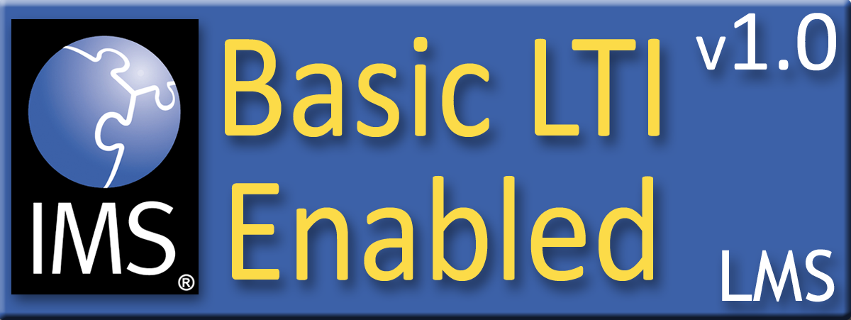

Purpose of Certification
Assure the end-user/purchaser that products will interoperate
Any certified Provider (Tool) should be able to interoperate with any certified Consumer (LMS)

Slide 17



Certified - LMS
PowerLink for Blackboard WebCT v8
Building Block for Blackboard Learn v9
Desire2Learn Learning Environment v8.4
Desire2Learn Learning Environment v9.0
Jenzabar JICS v7.2
Learning Objects Campus Pack v4
Sakai v2.7
Sakai 3 v0.4

Slide 18
Certified - Tool
Learning Objects Campus Pack v4
SpACE v0.5 (Spatial Activities in Course Environments, map application)
WebPA v1 (online peer assessment application)

Slide 19
Demo

Slide 20
Oracle HQ
Unicon HQ
Peoplesoft
Campus Solutions
Sakai CLE
Integration
Broker
SAIP
LIS
Sakora
LIS
BLTI
Portlet
IMS LIS
IMS BLTI
U Michigan
BLTI
BLTI
Wordpress
MediaWiki

Slide 21
Q
&
A

