Slide 1
Thank You !
IMS Global Learning Consortium Announces Public Final Status of Basic Learning Tools Interoperability Standard
Lake Mary, Florida, USA – 17 May 2010 – The IMS Global Learning Consortium (IMS GLC) today announced the achievement of public final status of Basic Learning Tools Interoperability (Basic LTI) enabling open and seamless integration of educational web applications with learning management platforms and portals. Basic LTI addresses the most common roadblocks to achieving a seamless experience for teachers and students.

Slide 2
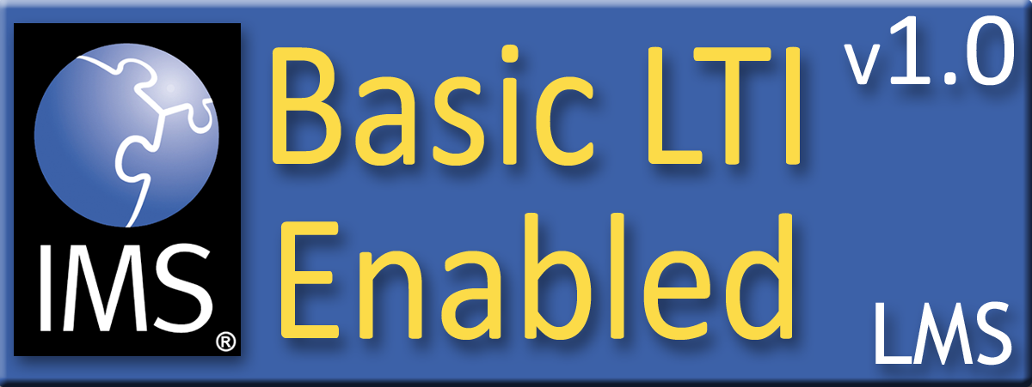

Certification
Assure the end-user/purchaser that products will interoperate
Any certified Provider (Tool) should be able to interoperate with any certified Consumer (LMS)

Slide 3





Certified - LMS
PowerLink for Blackboard WebCT v8
Building Block for Blackboard Learn v9
Desire2Learn Learning Environment v8.4
Desire2Learn Learning Environment v9.0
Jenzabar JICS v7.2
Learning Objects Campus Pack v4
Sakai v2.7
Sakai 3 v0.4

Slide 4
Certified - Tool
Learning Objects Campus Pack v4
SpACE v0.5 (Spatial Activities in Course Environments, map application)
WebPA v1 (online peer assessment application)

Slide 5







Tool Consumer
Tool Provider
Tool Proxy Runtime
TC
User
Tool Proxy Runtime
Tool Proxy
Tool
Secret
Launch
Secret
TC
Admin
TP
Admin
Basic Learning Tools Interoperability

Slide 6










Tool Consumer
Tool Provider
Launch
Events
Profile
Tool
LTI Services
Profile
Tool Proxy Runtime
Tool
Profile
Tool Proxy
Tool
Deployment
Session
Tool Setting
Outcomes
Data
...
Profile
Tool Proxy
TC
Admin
TP
Admin
Learning Tools Interoperability

Slide 7
My Next Steps for LTI
Promote Basic LTI – Focus on tool writers
  Webinar offer / conference talk
Building PHP, Java, C# Reference Implementations for Full LTI (incl. IMS General Web Services)
  Provisioning, Registration, Launch, Outcomes
Would love to have outcomes working for an Educause Demo (October 12-15, Anaheim, CA)

