Slide 1
IMS Global Learning Consortium Announces Public Final Status of Basic Learning Tools Interoperability Standard
Lake Mary, Florida, USA – 17 May 2010 – The IMS Global Learning Consortium (IMS GLC) today announced the achievement of public final status of Basic Learning Tools Interoperability (Basic LTI) enabling open and seamless integration of educational web applications with learning management platforms and portals. Basic LTI addresses the most common roadblocks to achieving a seamless experience for teachers and students.

Slide 2
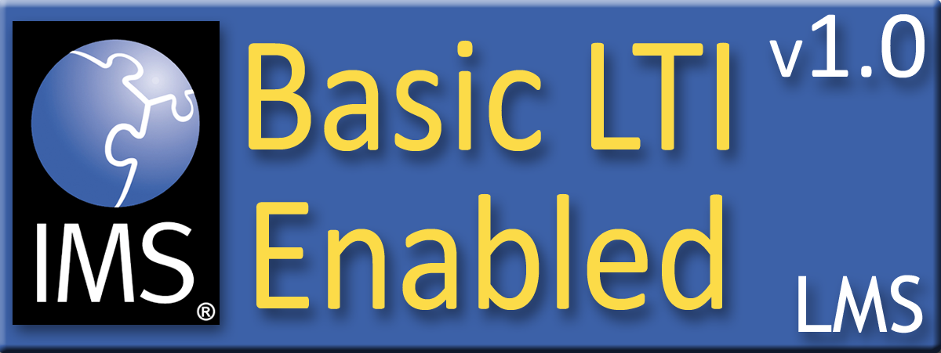





Certified - LMS
PowerLink for Blackboard WebCT v8
Building Block for Blackboard Learn v9
Desire2Learn Learning Environment v8.4
Desire2Learn Learning Environment v9.0
Jenzabar JICS v7.2
Learning Objects Campus Pack v4
Sakai v2.7
Sakai 3 v0.4

Slide 3

Certified - Tool
Learning Objects Campus Pack v4
SpACE v0.5 (Spatial Activities in Course Environments, map application)
WebPA v1 (online peer assessment application)

Slide 4
Workshop
Implementing and Achieving Conformance with Digital Learning Service
  Thursday May 20, 2010 9:00 – 4:00
  Atlantic, I, II

Slide 5

Let the mash up games begin....
Seamlessly
connect
to learning
IMS Learning Tools
Interoperability (LTI)

