Slide 1
Software to Fit T&L Practices
December 6, 2004
Charles Severance
University of Michigan
www.dr-chuck.com

Slide 2
Review: States of Water…
Gas - Freely flows throughout entire space - space is evenly filled
Boiling Point
Temperature -->
Liquid - Fluid flows, but often downhill - cannot fill all of the space - tends to pool at minimum energy - surface tension exists
Melting Point
Frozen - Vibrating and stuck In a Crystal Structure
Time / “Heat” Applied --->

Slide 3
Latent Heat of LMS Innovation
Boiling Point
Better -->
Melting Point
Frozen - Many different “imperfect” CLEs and LMSs
For the past 10 years we have all been all “stuck”, vibrating in place, seemingly with no flexibility, but with plenty of energy.
Time / “Heat” / Money / Energy Applied --->
Notes:
Where are we now?

Slide 4

Latent Heat of LMS Innovation
Building a reference implementation of a conventional CLE…
Boiling Point
Liquid - We can tend toward common CLEs, and/or portability makes the choice of CLE irrelevant
Better -->
Melting Point
Frozen - Many different “imperfect” CLEs and LMSs
Time / “Heat” / Money / Energy Applied --->
Notes:
Where are we now?
During melting, much heat must be applied with no “improvement”. Mellon is supplying part of that heat for two years.
Note that this is a time where we must be careful of hype - because the world wants to think that a project is done the instant it is started.
Also things are not as simple as they appear.

Slide 5
Latent Heat of LMS Innovation
Safe base level functionality empowers new thinking, approaches, and standards, (i.e. good chaos). We enter a period of chaotic freedom.
Boiling Point
Liquid - We can tend toward common CLEs, and/or portability makes the choice of CLE irrelevant
Better -->
Melting Point
Frozen - Many different “imperfect” CLEs and LMSs
Time / “Heat” / Money / Energy Applied --->
Notes:
Where are we now?

Slide 6
Latent Heat of CLE Innovation
Gas - Innovation can spread to cover the space of T & L practices
True change in T & L happens in ways can not anticipate. CLE/LMS’s can take completely new forms and directions…
Boiling Point
Liquid - We can tend toward common CLEs, and/or portability makes the choice of CLE irrelevant
Better -->
Melting Point
Frozen - Many different “imperfect” CLEs and LMSs
Time / “Heat” / Money / Energy Applied --->
Notes:
Where are we now?

Slide 7
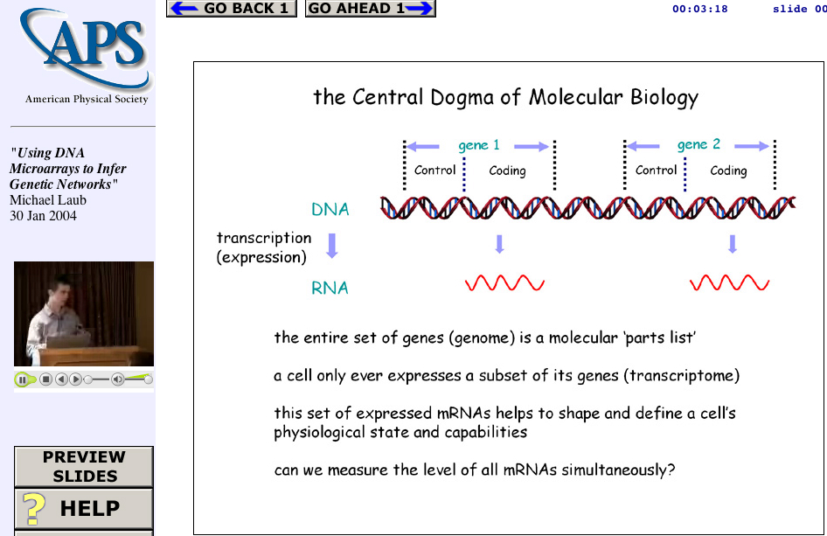
A Sad Story of a Learning Solution
Web Lecture
Archive
Project
www.wlap.org
syncomat.com
Tools
And
Technologies
Tools
And
Technologies
Lecture
Object

Slide 8
Sad Story
1996 - Invented Sync-O-Matic (Real Media)
1997 - 1999 Gave continuous talks / demos at conferences
1998 - Tried to commercialize product through my job (It was the 90’s after all)
1999 - Switched jobs (partially due to bitter experience with intellectual property folks)
1999-2001 Re-Invented the idea in ClipBoard-2000 (Quicktime/Apple)

Slide 9
More Sad Story…
2001 - Switched jobs to the private sector to commercialize technology and deploy into the M.L.T.
2001 - Microsoft dropped M.L.T.
2003 - Switched jobs again to work on open source LMS (CHEF)
2004 - Became part of Sakai (broader open source LMS)

Slide 10
The Future of my Sad Story (?)
2005 - Sakai completes and is installed at 20 universities :)
2006 - I take a few months, reinvent ClipBoard and integrate it into Sakai so people can *finally* truly use it
2007 - Hundreds of people try my idea and it turns out it was a bad idea - so I invent something else…
Moral: I have been waiting 10 years, and changed three jobs to find a framework to deploy my idea so people could use it. Turns out the only way it was going to happen was to help build it myself.

Slide 11
Chuck’s Hierarchy of T & L Needs
We must learn to walk before we fly. And we
must start at the
bottom and work
upwards…
Version ???
The
Future
Version 3.0
Content Management
Version 2.0
Assessment and Gradebook
Version 1.0
Chat Room and Threaded Discussion
Syllabus on an Web site and an E-Mail List

Slide 12
IMS Tool Portability Project
Started as an IMS SIG for Sakai to interact with commercial LMS companies
Approved 11/2004
Blackboard, CETIS, MIT, Sun, Indiana, WebCT, University of Michigan …
Goal: By Alt-I-lab in July 2005 to have demonstrated a single application working in Blackboard, WebCT, and Sakai.

