Slide 1

Adding IMS Basic Learning Tools Interoperability to Cohere
Dr. Charles Severance
OLnet Fellow
University of Michigan
June 8-11, 2010
olnet.org

Slide 2

Visit Details
June 8-11, 2010 in Milton Keynes
Hosted by the Knowledge Media Institute at the Open University
  Simon Buckingham Shum
  Michelle Bachler
  Karen Cropper
Presentation: Integrating External
Tools and Content into Moodle
  July 11, 2010
olnet.org

Slide 3
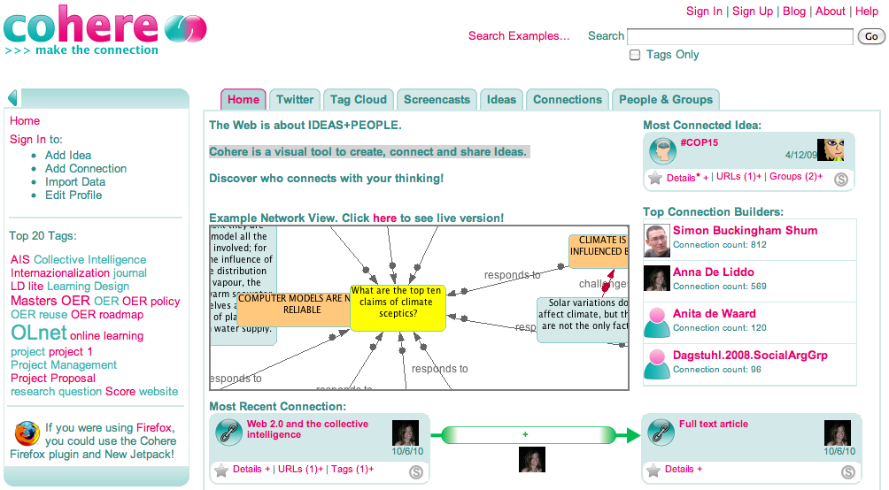
Cohere – Information Mapping and Visualization
olnet.org

Slide 4
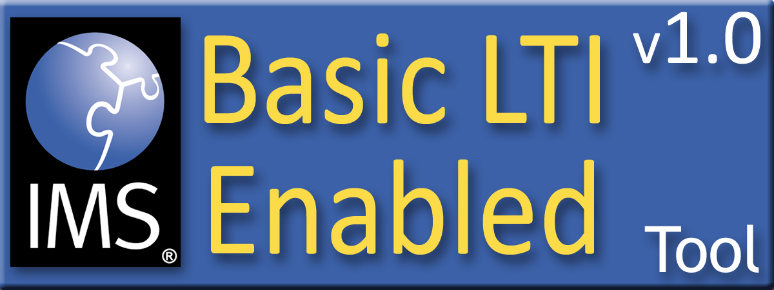
IMS Basic Learning Tools Interoperability
Build a standard plug-in for all CMS systems using REST-style web services
Tool and Content Providers can build one integration and use it in any CMS that supports the standard
IMS certifies Learning Management Systems and Tools as Basic LTI compliant
  http://www.imsglobal.org/developers/BLTI/
olnet.org

Slide 5









L
T
I

Slide 6
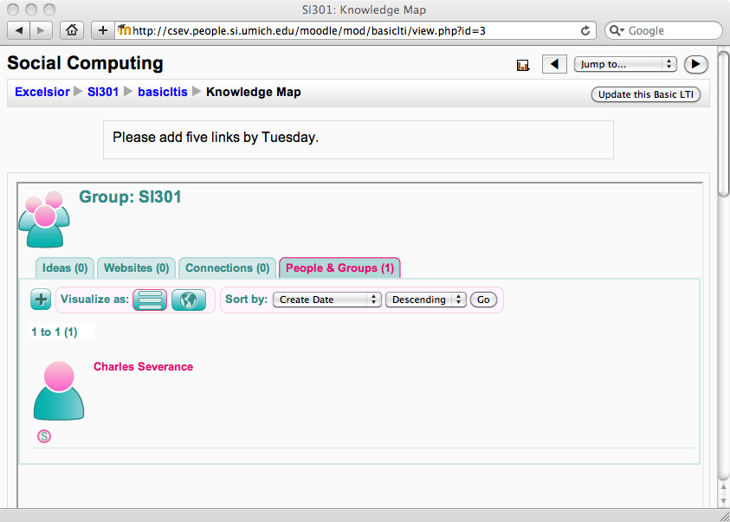
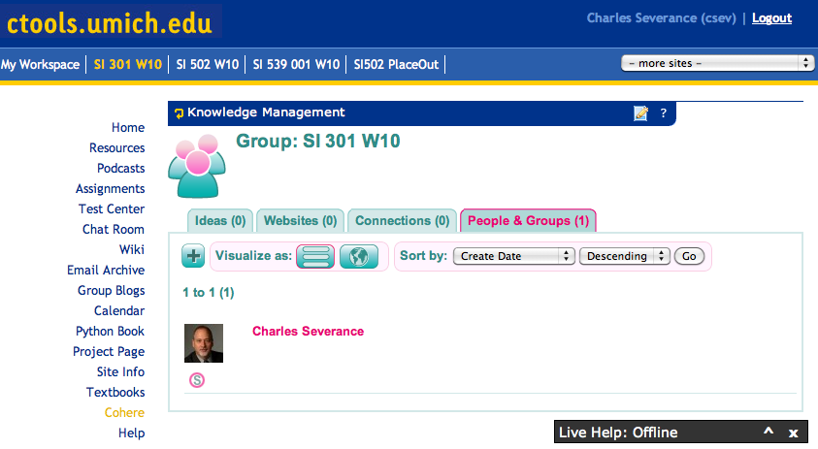
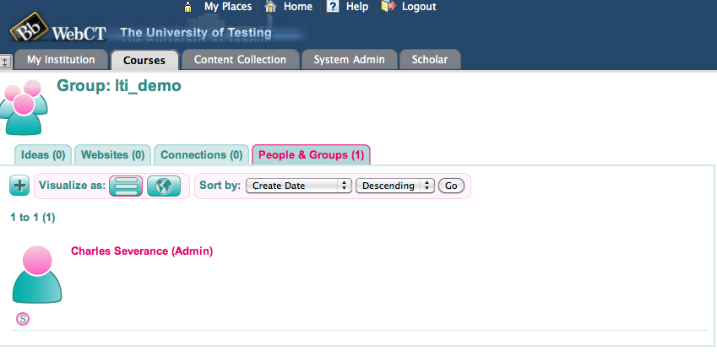
olnet.org

Slide 7
Demo
olnet.org

Slide 8
Visit Results
We built and tested an IMS Basic Learning Tools Interoperability Provider capability for Cohere
  Code review with Michelle
  Design review with Simon
Participated in Cohere workshop and user testing
LTI Workshop on June 11, 2010
SocialLearn briefing with Thanh Le
Next visit planned for late Fall 2010
olnet.org

