Slide 1
IMS Basic Workshop Notes
Dr. Charles Severance
University of Michigan
IMS Global Learning Consortium
www.dr-chuck.com

Slide 2
Home Base
http://www.imsglobal.org/developers/BLTI/
Documentation
Link to the Specification
Software
Pointers to IMS Discussion Forums

Slide 3
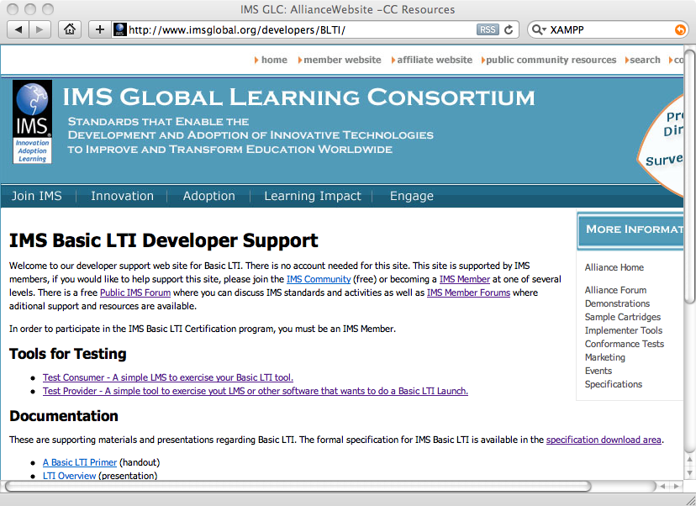

Slide 4
Exercise 1
Lets do some Basic LTI Launching
http://www.imsglobal.org/developers/BLTI/lms.php
Toggle Launch Data
Press Launch

Slide 5
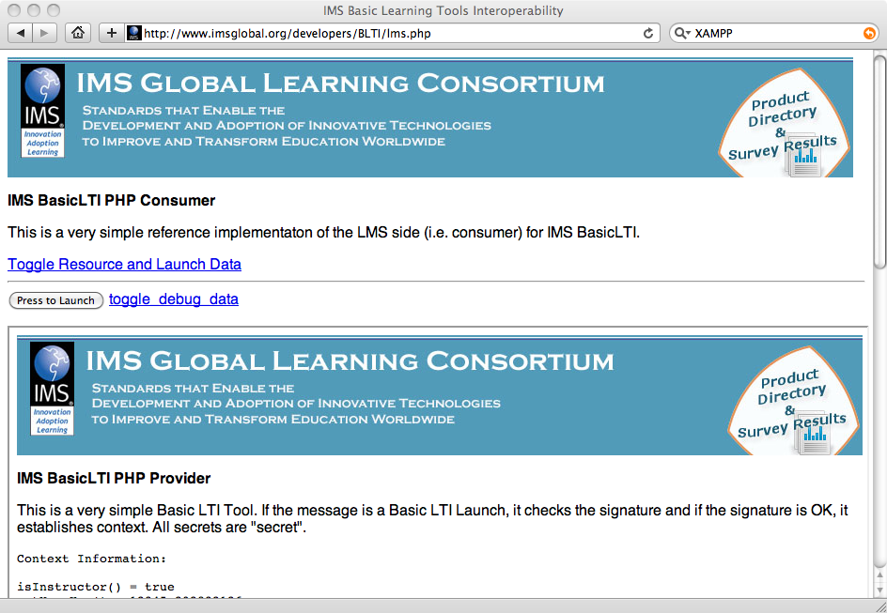

Slide 6
Exercise 2 – Launch Something Else
Toggle Resource Data
Change the data so we are not all the same person
Then launch to
  http://wiscrowd.appspot.com/wiscrowd/12345/
  Key = 12345 secret = secret
We will play a multi-user game and possibly crash my Google Application

Slide 7
Exercise 3
http://nightly2.sakaiproject.org:8085/portal
Make an account – include full name and E-Mail
Make a site – Give it a cool name
Add a Basic LTI Tool to the Site
Go to the Site
Select Basic LTI Tool
Press the "pencil icon"

Slide 8
Configure
http://wiscrowd.appspot.com/wiscrowd/12345/
Key = 12345 secret = secret
Set the Button and Title
Send Email and Name Information
Update Options

Slide 9
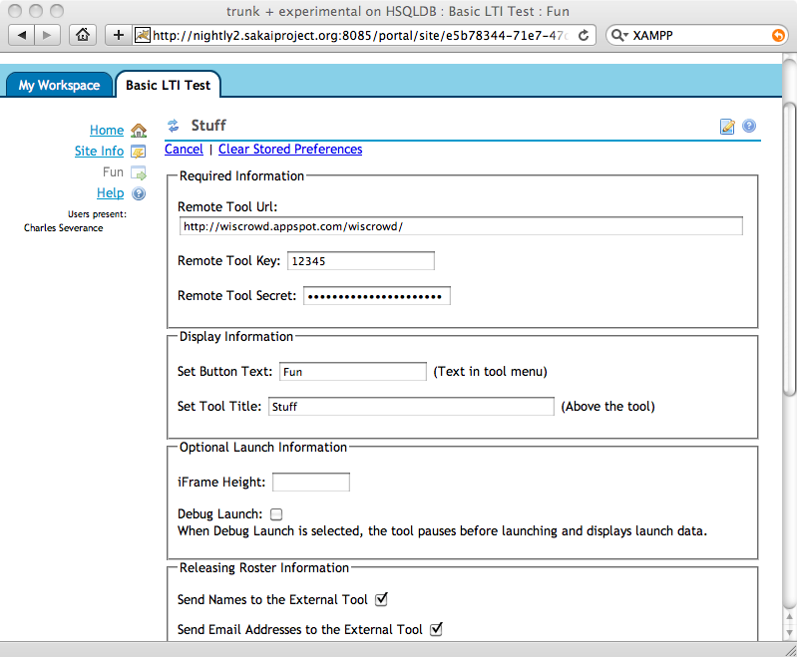

Slide 10
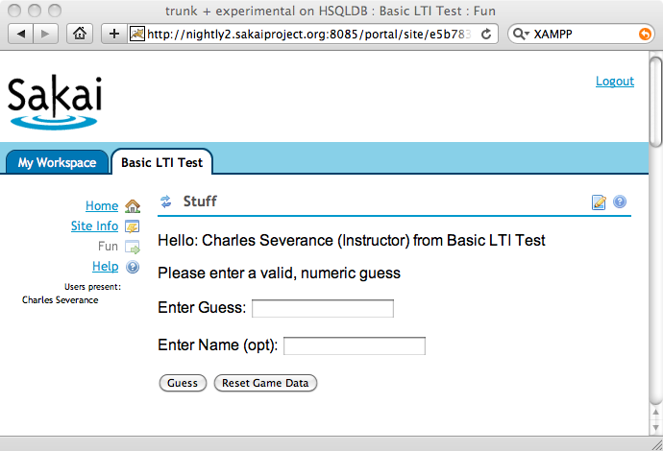

Slide 11
Exercise 4
Here is another tool to play with
  http://www.dr-chuck.com/ims/php-simple/adlist/ads.php
  Key: lmsng.school.edu
  Secret: secret

Slide 12
Exercise 4.a (opt)
Here is another tool to play with
  http://csev.people.si.umich.edu/mediawiki/extensions/Redirect2Course.php
  Key: 12345
  Secret: secret

Slide 13
Preparing to Develop

Slide 14
Text Editor
Make sure you have some kind of plain text editor to edit files. Word will not work. Even Notepad and text edit can mess up file formats when saving. Something like BBEdit, TextMate, TextWrangler, Notepad+, JEdit, Windows command-line edit, VIM, Eclipse, or other editor which can edit text files and not mess them up is fine.

Slide 15
If you don't have PHP + MySql
Install XMAMP
  http://sourceforge.net/projects/xampp/
  Or from a stick/CD being handed out

Slide 16

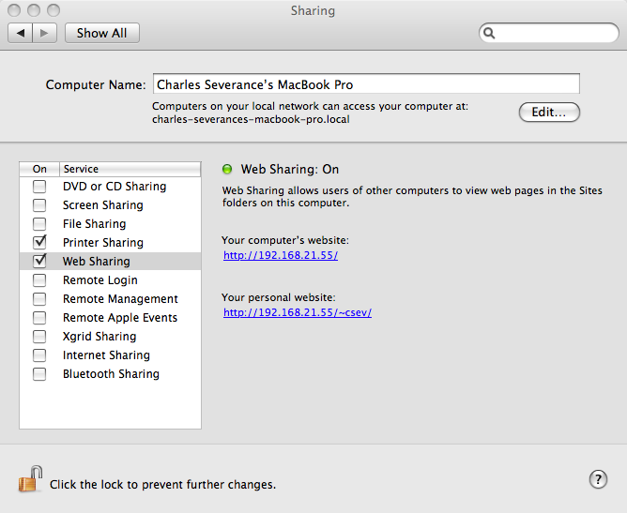
Mac: Disable Web Sharing
The built-in PHP for Mac does not include the unzipping library so we need to turn it off.
System Preferences -> Sharing
Also turn off MySql if you have it running

Slide 17
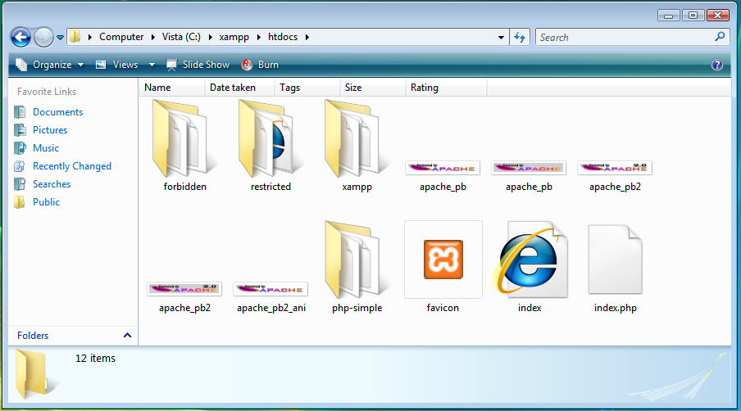
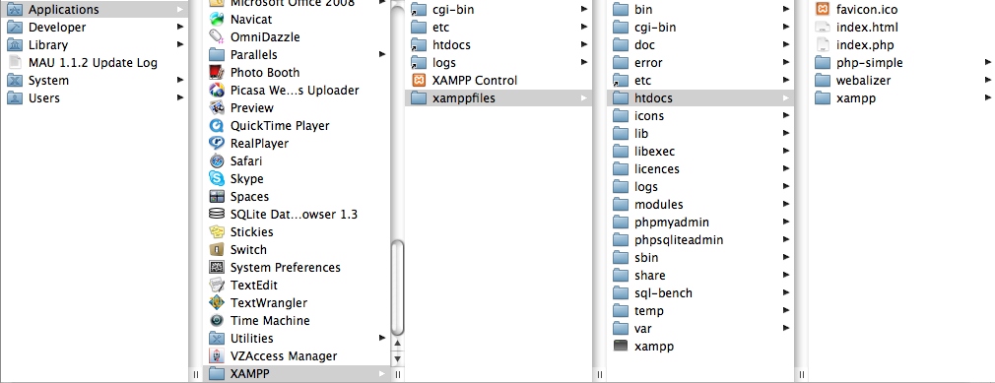

Slide 18
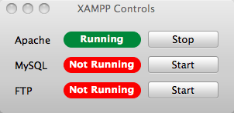
Start XAMP
Windows – Desktop Control Panel
  You may get security dialogs – read carefully and press “allow”
Macintosh
  Applications -> XAMPP -> XAMPP Control

Slide 19
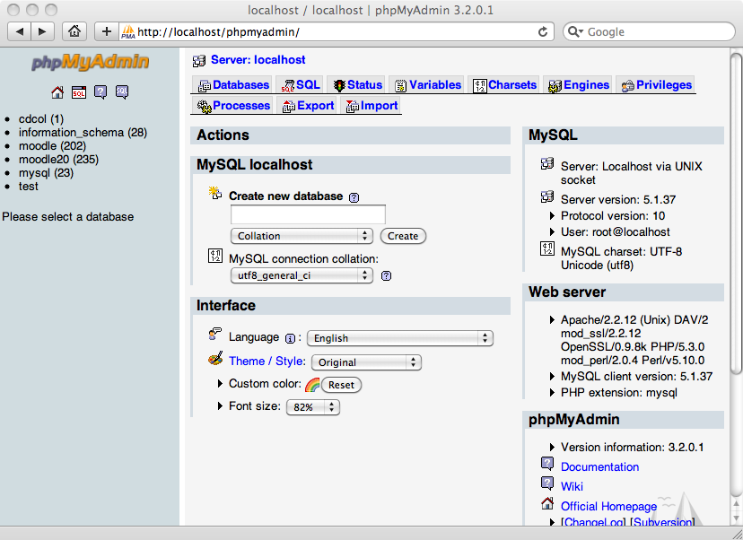
phpMyAdmin
Acct: root
PW: blank

Slide 20
Install IMS PHP Code
Unzip IMS code and move into XAMPP
http://www.imsglobal.org/developers/BLTI/dist.zip
(or from the stick)
Macintosh:
/Applications/XAMPP/htdocs/php-simple
Windows:
C:\xampp\htdocs\php-simple

Slide 21
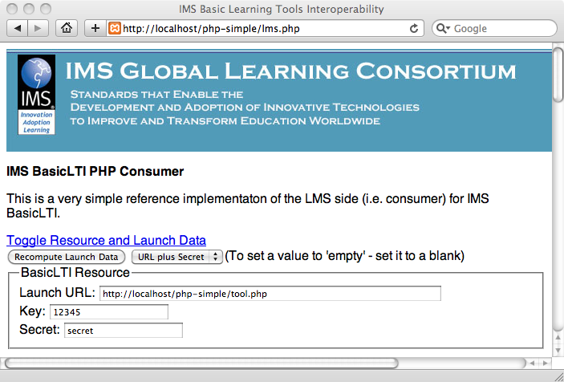
Test your PHP Install

Slide 22
Redo Exercises 1-2 locally
Launch to your “tool.php/tool.jsp” with LMS and Resource secrets – and use right and wrong secrets – verify success and failure

Slide 23
Exercise 5 – Set up MySql
http://localhost/phpmyadmin/
Account: root Password: blank
Go into adlist and find setup.sql
Paste this into phpMyAdmin
  *** remove drop table line if it is there

Slide 24
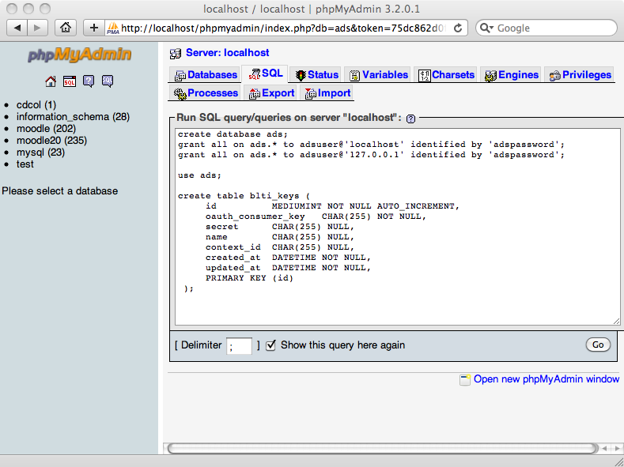

Slide 25
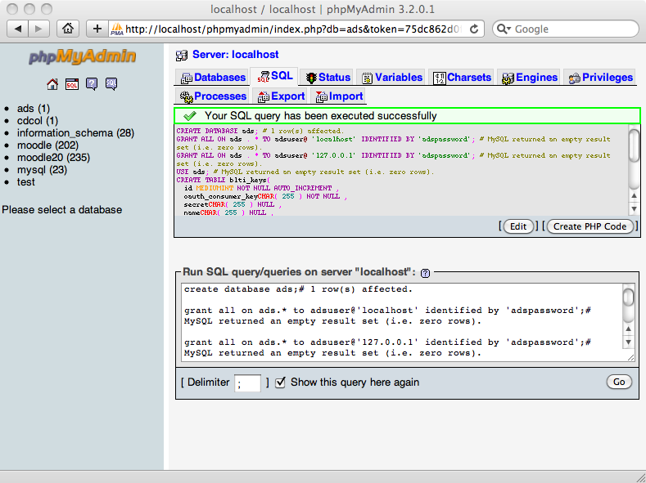

Slide 26
Edit db.sql and Check Database
http://localhost/php-simple/adlist/db.php?dbcheck=yes
Try this on Mac:
$MY_CONNECTION = mysql_connect(":/Applications/XAMPP/xamppfiles/var/mysql/mysql.sock","adsuser","adspassword");

Slide 27
Workshop slides.

Slide 28
Setup Your Adlist Application
http://localhost/php-simple/adlist/
Follow instructions
  SQL Steps are already done
  db.php should be already correct
http://localhost/php-simple/adlist/admin.php
Add a consumer with a key and secret
Don't worry about bootstrapping the admin account unless you really want to.

Slide 29
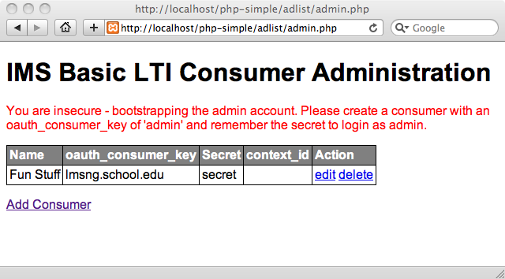

Slide 30
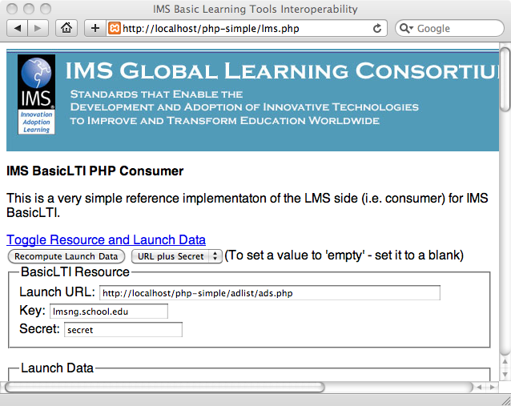

Slide 31
Looking At Source

