Slide 1
Basic LTI At University of Michigan

Slide 2
CTools as "Learning Backbone"
Sakai probably has more "eyeballs per day" than any other application at UMichigan
Writing a Sakai tool is a lot of work
Different stakeholders

Slide 3
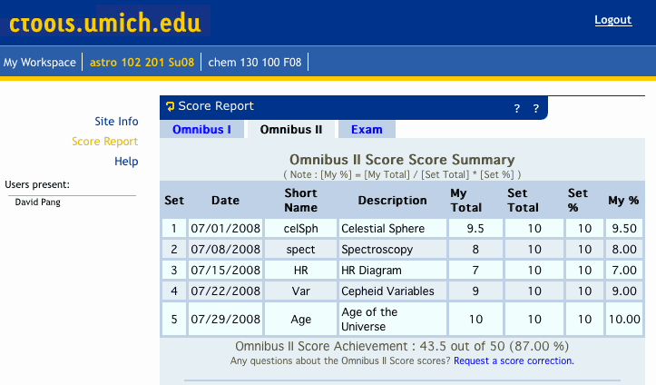
SAMS – Student Assessment

Slide 4
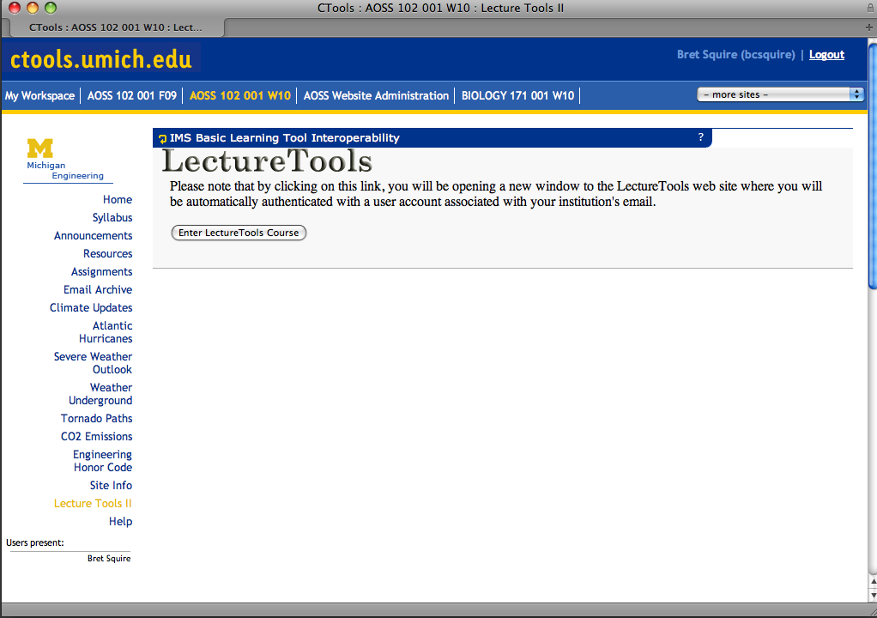
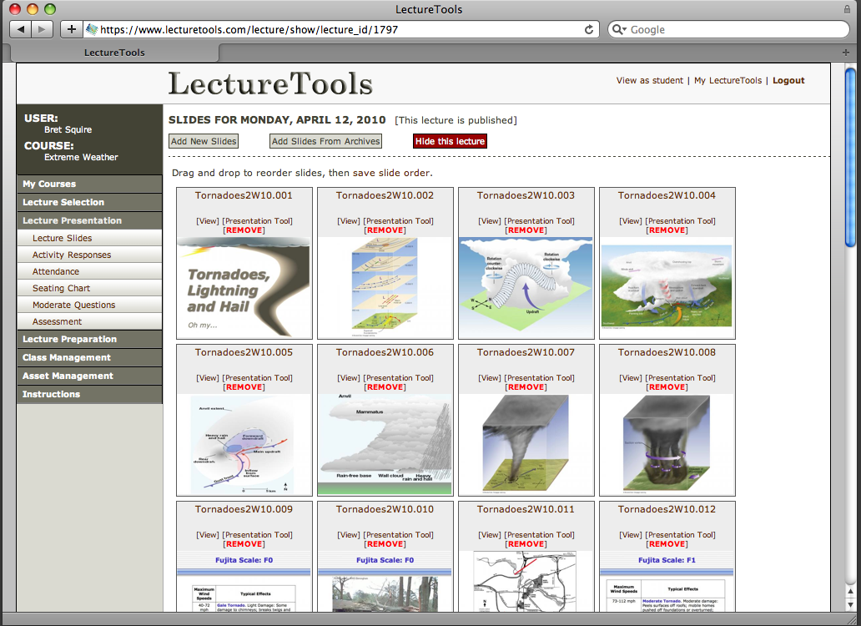
www.lecturetools.com

Slide 5
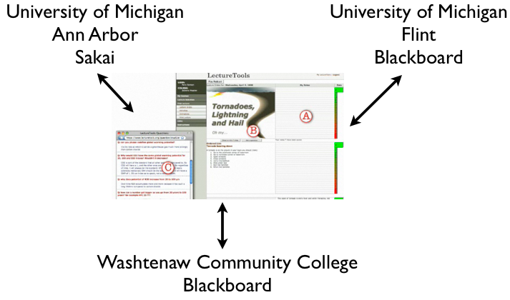

Slide 6
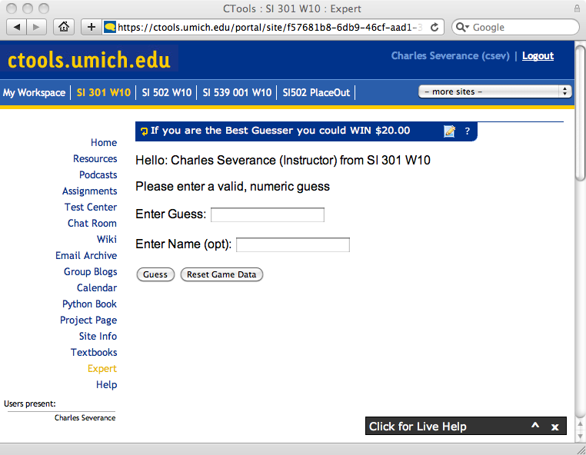

Slide 7
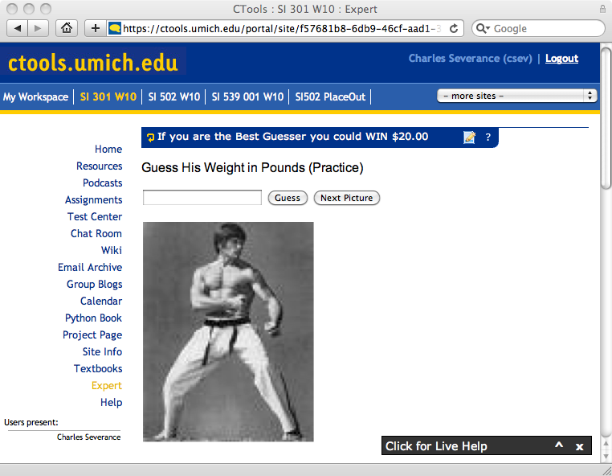

Slide 8
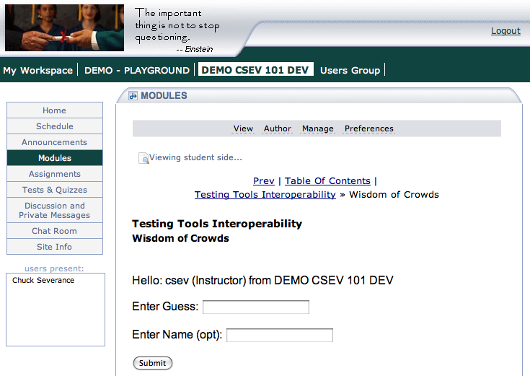

Slide 9
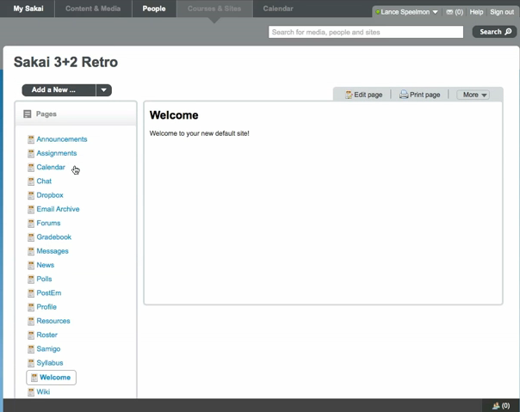
http://www.vimeo.com/11170715

Slide 10
LTI: Enables Innovation
In the next 5 years, LMS systems will become increasingly enterprise critical systems
Reliability, scalability, and consistency will rule
That *could* greatly reduce the pace of innovation
LTI supports a model of a solid and central LMS and enables increased innovation

Slide 11
Developing Sakai Tools
Workshop – June 14, 2010 (in the past)
Materials, sample code, sample application
  http://www.imsglobal.org/developers/BLTI/
I am here to help is you want to write tools – materials, sample code, and answer questions

Slide 12


Questions
Seamlessly
connect
to learning
IMS – www.imsglobal.org
cseverance@imsglobal.org
IMS Learning Tools
Interoperability (LTI)

