Slide 1



IMS Basic Learning Tools
Interoperability
Charles Severance, Ph.D.
Affiliate Coordinator
IMS Global Learning Consortium (IMS GLC)
http://www.imsglobal.org/
http://www.dr-chuck.com/

Slide 2
Learning Tools Interoperability
Problem
  Every CMS has their own very unique "module", "tool" "block", "nugget", "powerlink", etc
  External tools like QuestionMark, Wimba, Elluminate, etc must prioritize which CMS they invest in plugging into
  Tool Providers wait until customers are willing to pay money to start development

Slide 3
Learning Tools Interoperability
Solution
  Build a standard plug-in for all CMS systems
  Tool and Content Providers can build one integration and use it in any CMS that supports the standard
  Start simple and basic and then expand feature sets to allow market to adjust over time and insure that engineering due diligence is being done – phased release

Slide 4


A Six-Year Mission...
August 2004 – Sakai Board suggests
an IMS working group to engage
with commercial vendors
June 2005 – TI 1.0 Demo – Sakai and Samigo
2006 – Learning Tools Interoperability (2.0) starts
June 2008 – I go to work for IMS
June 2010 Basic LTI 1.0 Released

Slide 5
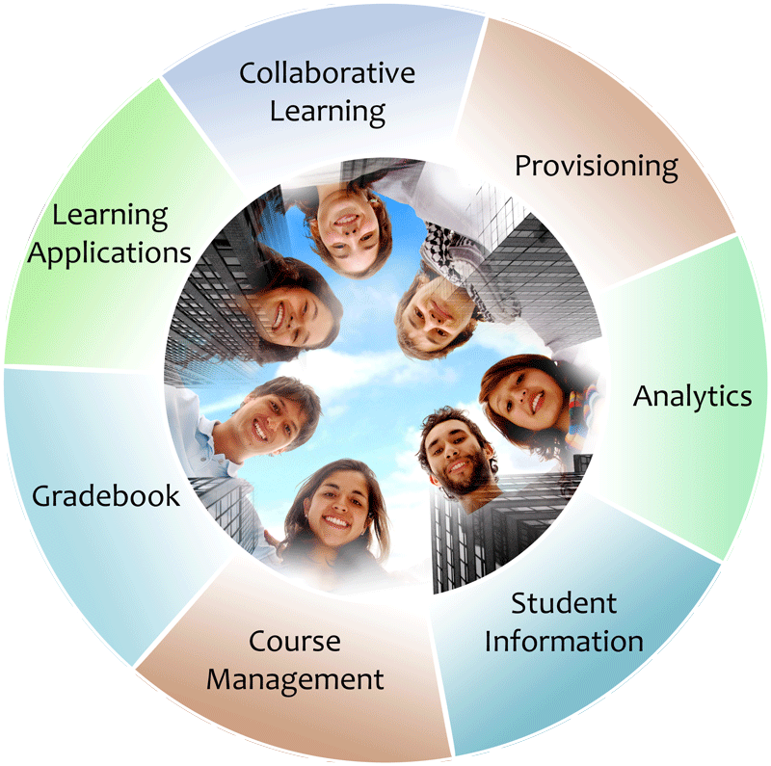


IMS: Digital Learning Standards
The information
architecture for
learning
Seamlessly
connect
to learning
Free the
content
IMS Common Cartridge
IMS Learning Tools
Interoperability (LTI)
IMS Learning Information
Services (LIS)

Slide 6







Certified - LMS
PowerLink for Blackboard WebCT v8
Building Block for Blackboard Learn v9
Desire2Learn Learning Environment v8.4.2
Desire2Learn Learning Environment v9.0
Jenzabar JICS v7.2
Learning Objects Campus Pack v4
Sakai v2.7
Sakai 3 v0.4
OLAT 7.0

Slide 7






L
T
I
LEARNING
TOOL
...
PHP
Java
App Engine
Wookie...

Slide 8
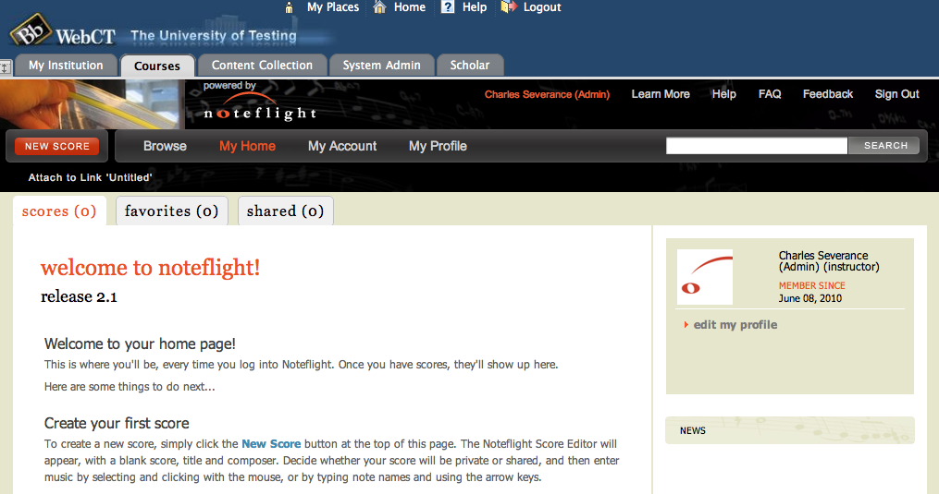
www.noteflight.com

Slide 9
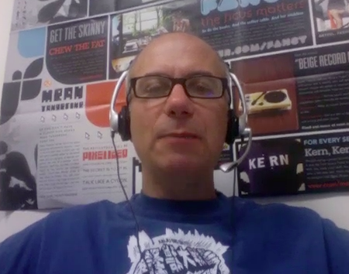
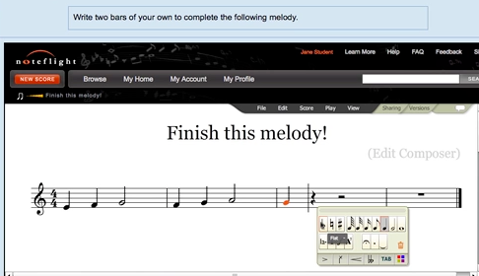
Joseph Berkovitz
<info@noteflight.com>
www.noteflight.com
http://videos.noteflight.com/MoodleBasicLTI.mov

Slide 10
LTI Terminology
Tool Consumer – The system that "consumes" the tool (i.e. the Learning Management System – e.g. Blackboard, Moodle)
Tool Provider – The system that provides the tool (e.g. Wimba, LearningObjects, etc..)

Slide 11











Tool Consumer
REST Services
Tool Provider
Profile
Launch
Events
Tool
Profile
Tool Proxy Runtime
TC
User
Tool Proxy Runtime
Deployment
Session
Tool Setting
Outcomes
Data
...
Tool Proxy
Tool
Secret
Secret
SOAP Services
TC
Admin
TP
Admin
Learning Tools Interoperability

Slide 12
Basic LTI Goals
We decided to roll out Learning Tools Interoperability in a phased series of releases
  These specifications are pretty detailed so we want to get them right
  We want to engineer reference implementations along the way
Basic LTI: "The smallest useful subset of LTI"

Slide 13

Tool Consumer
Tool Provider
Tool Proxy Runtime
TC
User
Tool Proxy Runtime
Tool Proxy
Tool
Secret
Launch
Secret
TC
Admin
TP
Admin
Basic Learning Tools Interoperability

Slide 14

Basic LTI Certification
Assure the end-user/purchaser that products will interoperate
Any certified Provider (Tool) should be able to interoperate with any certified Consumer (LMS)

Slide 15
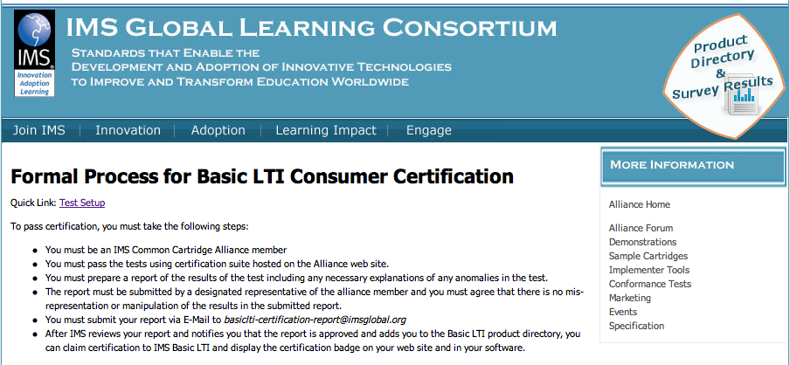
http://www.imsglobal.org/developers/alliance/lti/blti-cert/

Slide 16
IMS Learning Tools Interoperability Technical Overview

Slide 17
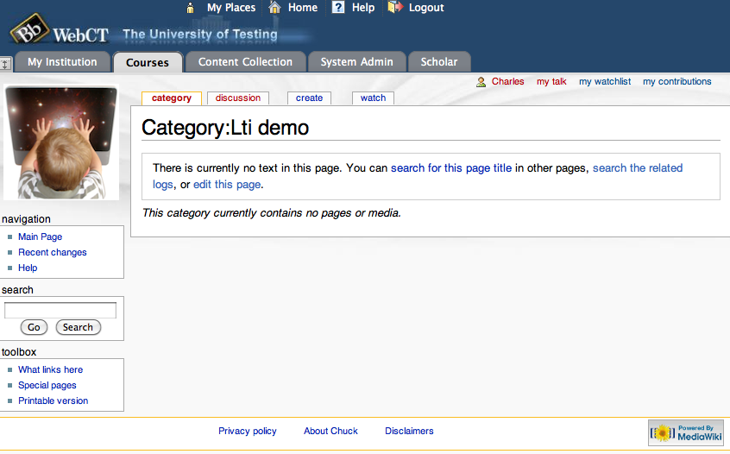

Slide 18
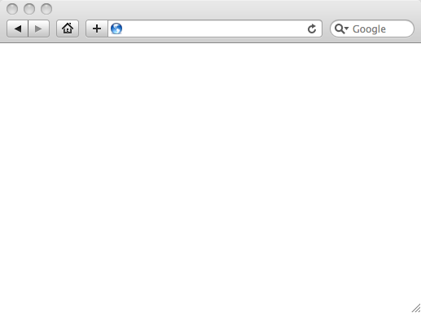
Integrated User Experience
Welcome
Local Resource
Local Resource
LTI Tool
Movie
© Copyright 2010 IMS Global Learning Consortium
All Rights Reserved.

Slide 19
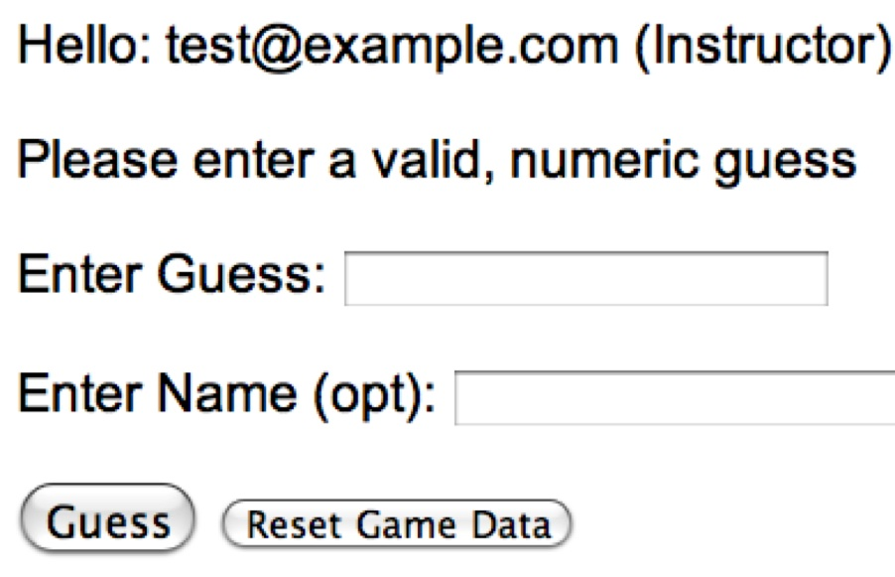
User Experience
Welcome
Local Resource
Lame iFrame
LTI Tool
Movie
© Copyright 2010 IMS Global Learning Consortium
All Rights Reserved.

Slide 20
LMS (LTI Consumer)
Again in slow motion…
LMS Looks up User and Course Information.
Information is signed using secret and OAuth
Week 1
Local Resource
Local Resource
LTI Tool
Movie
Form data sent to Browser
Tool (LTI Provider)
© Copyright 2010 IMS Global Learning Consortium
All Rights Reserved.

Slide 21
LMS (LTI Consumer)
Form is immediately auto-submitted using JavaScript.
<form action=”tool”/>
<input name=”user_id”
value=”2348d8dd” />
<input name=”oauth_token”
value=”abc.edu” />
</form>
Tool (LTI Provider)
Tool looks up secret and validates signature.
Tool provisions user, course, and session.
Tool sends redirect
© Copyright 2010 IMS Global Learning Consortium
All Rights Reserved.

Slide 22
LMS (LTI Consumer)
Browser follows redirect…
<head>
<meta redirect
page=”main.php”>
</head>
Tool (LTI Provider)
Tool produces
first page.
© Copyright 2010 IMS Global Learning Consortium
All Rights Reserved.

Slide 23
LMS (LTI Consumer)
Tool (LTI Provider)
© Copyright 2010 IMS Global Learning Consortium
All Rights Reserved.

Slide 24
Basic LTI Sample Launch Data
lti_version=LTI-1p0
lti_message_type=basic-lti-launch-request
oauth_consumer_key=lmsng.school.edu
resource_link_id=120988f929-274612
user_id=292832126
roles=Instructor
lis_person_name_full=Charles R. Severance
lis_person_contact_email_primary = csev@umich.edu
context_id=456434513
context_title=SI301 – PHP
tool_consumer_instance_description=University of School

Slide 25
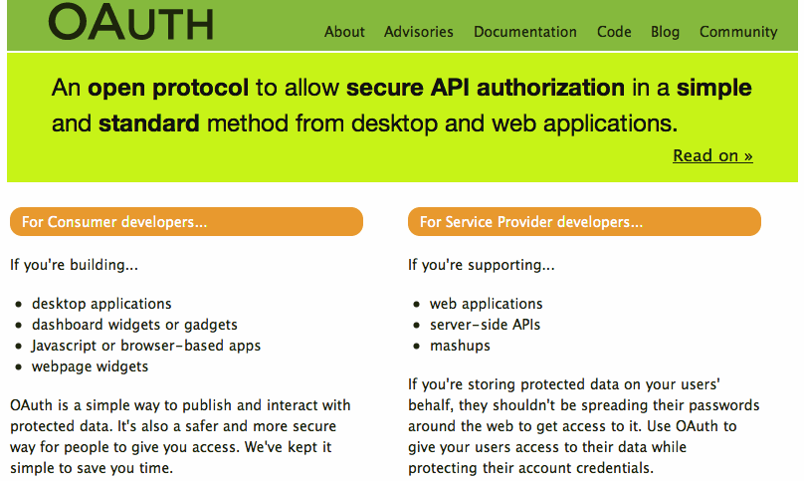

Slide 26
Basic LTI and IMS Common Cartridge
Welcome
HTML Resource
Folder
LTI Tool
Discussion
QTI Pool
Common Cartridge 1.1 will include the ability to define a Basic LTI resource and include that resource in course organizational structures

Slide 27
L
T
I
PREMIUM
LEARNING
CONTENT
...

Slide 28
Common
Cartridge
L
M
S
Premium
Learning
Content
L
M
S
When LTI is combined with
the IMS Common Cartridge,
publishers can distribute cartridges containing active, authenticated links back centrally hosted content.

Slide 29
Coming: Connecting to Learning Information Services (LIS)
TOOL PROVIDER
TOOL CONSUMER
BasicLTI Launch with LIS pointers
LIS
SERVICES
The TP calls LIS
services, if available.
Planned: Educause 2010 Prototype Demo

Slide 30
LTI: Enables Innovation
In the next 5 years, LMS systems will become increasingly enterprise critical systems
Reliability, scalability, and consistency will rule
That *could* greatly reduce the pace of innovation
LTI supports a model of a solid and central LMS and enables increased innovation

Slide 31
Developing Sakai Tools
Materials, sample code, sample application
  http://www.imsglobal.org/developers/BLTI/
I can also do a developer workshop/webinar
I am here to help is you want to write tools – materials, sample code, and answer questions

Slide 32
Questions
Seamlessly
connect
to learning
IMS – www.imsglobal.org
cseverance@imsglobal.org
IMS Learning Tools
Interoperability (LTI)
  http://www.imsglobal.org/developers/BLTI/

