Slide 1



IMS Basic LTI Certification
Charles Severance, Ph.D.
Affiliate Coordinator
IMS Global Learning Consortium (IMS GLC)
http://www.imsglobal.org/
http://www.dr-chuck.com/

Slide 2
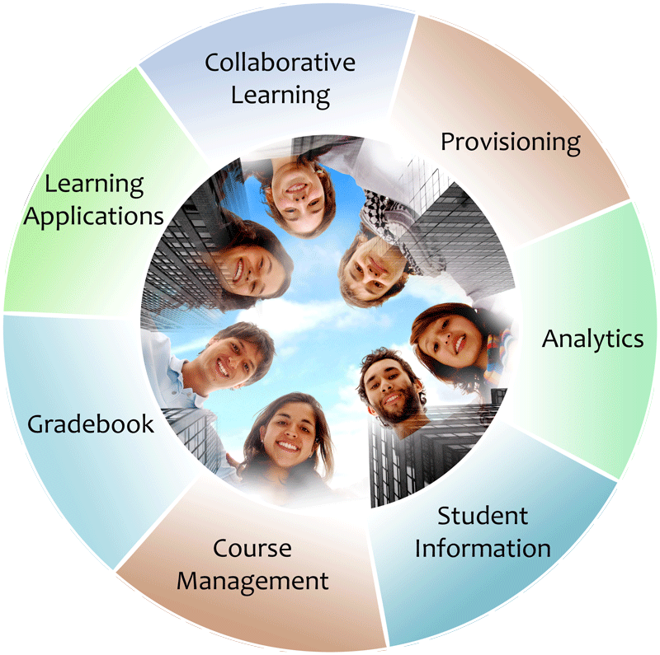


IMS: Digital Learning Standards
The information
architecture for
learning
Seamlessly
connect
to learning
Free the
content
IMS Common Cartridge
IMS Learning Tools
Interoperability (LTI)
IMS Learning Information
Services (LIS)

Slide 3












Tool Consumer
Tool Provider
Launch
Events
Profile
Tool
LTI Services
Profile
Tool Proxy Runtime
Tool
Profile
Tool Proxy
Tool
Deployment
Session
Tool Setting
Outcomes
Data
...
Profile
Tool Proxy
TC
Admin
TP
Admin
User

Slide 4

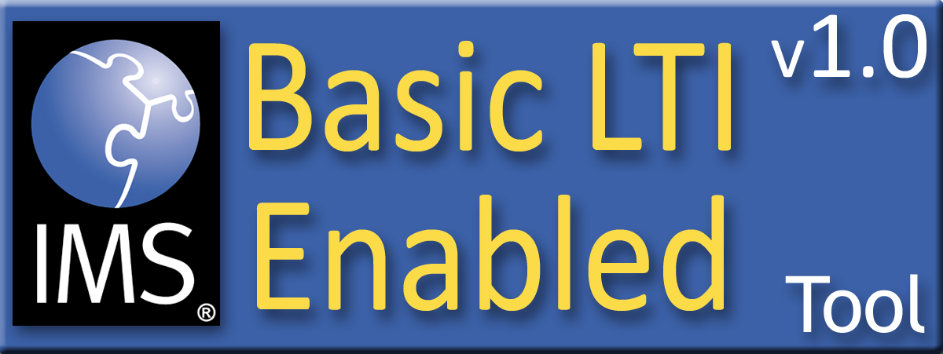
Purpose of Certification
Assure the end-user/purchaser that products will interoperate
Any certified Provider (Tool) should be able to interoperate with any certified Consumer (LMS)

Slide 5
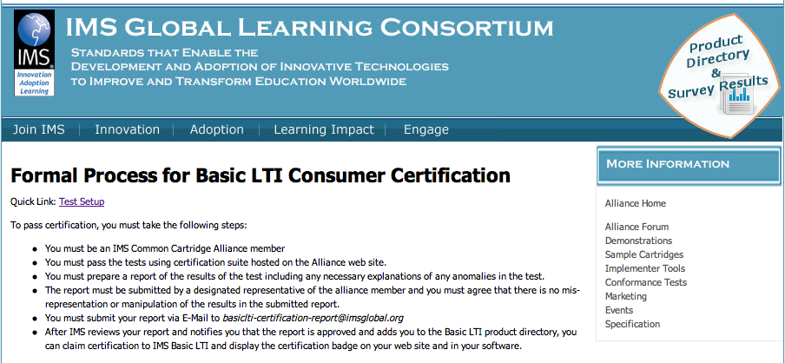
http://www.imsglobal.org/developers/alliance/lti/blti-cert/

Slide 6
Certification is Quite Proscriptive
The IMS Basic LTI specification is very flexible – it could be used for lots of purposes – we did not want to the spec to be so proscriptive that we "outlawed" possible uses we could not imagine
Certification is about the expected / common / typical uses – and is very proscriptive

Slide 7
Certification is not Static
Certification is like a "unit test" that checks a list of expected operations and responses
The current certification test suite is based on interoperability
We will work with the adopters and vendors to work through things that "slip through the cracks"

Slide 8
Two Certifications
Tool Consumer (a.k.a. LMS)
  Very precise test with automated records of tests passed
Tool Provider (a.k.a. Tool)
  Manual verification of proper handling of each of the test cases
Both require contact info and self-assertion

Slide 9
Certification: Members Only
Only IMS Alliance (or higher) members can apply to be certified
No additional cost associated with certification – no third parties to pay
Also, IMS will work with folks when there are disputes – so we may need to contact certifiers

Slide 10
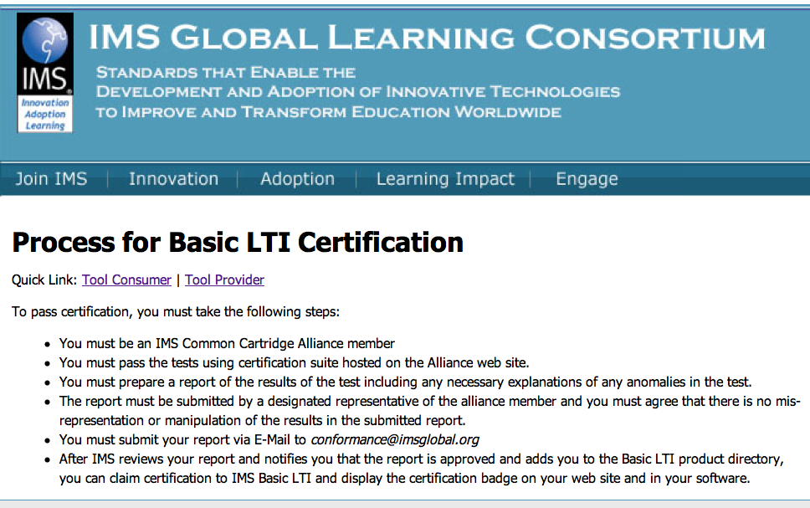
http://www.imsglobal.org/developers/alliance/LTI/blti-cert/index.cfm

Slide 11
Tool Consumer / LMS Certification

Slide 12
Overall Steps
Set up your certification environment at www.imsglobal.org
Set up your LMS with two courses and two users and two Basic LTI resources
Run the certification tests, monitoring your progress

Slide 13
Overall Steps
When all tests are passed..
Fill out the Certification Report
Make a PDF of your Online Test Report from IMS
Send it all to conformance@imsglobal.org
Once it is reviewed and approved – you get your certification badge

Slide 14
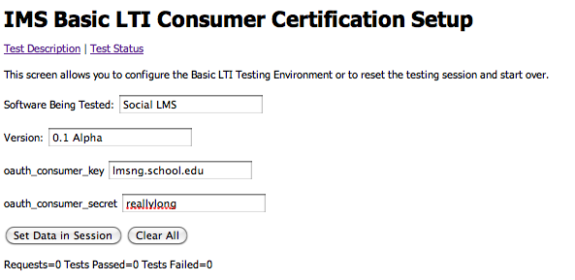
Test Setup
demo

Slide 15
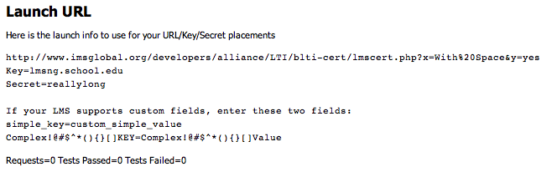
Test Setup - Complete
The test uses cookies so you must setup the test and run the test in the same browser.

Slide 16
Three Kinds of Tests
Normal tests are tests that your code must pass to be certified.
Free Pass tests are optional and depend on design choices in the LMS.
Fail Only tests check for mistakes in every one of your launches. (this is sticky)

Slide 17
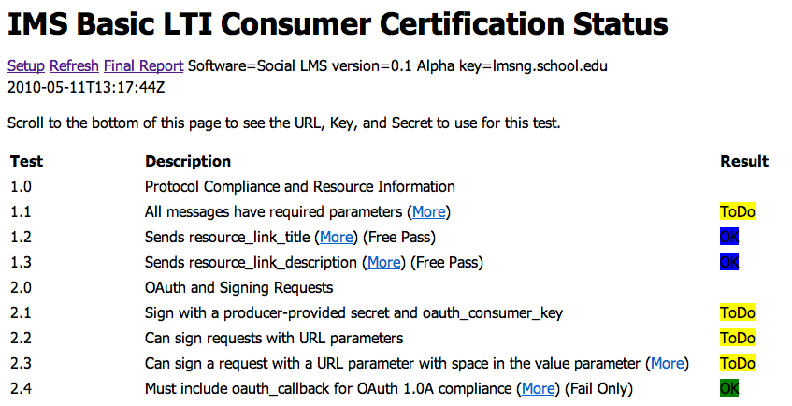
Test Status

Slide 18
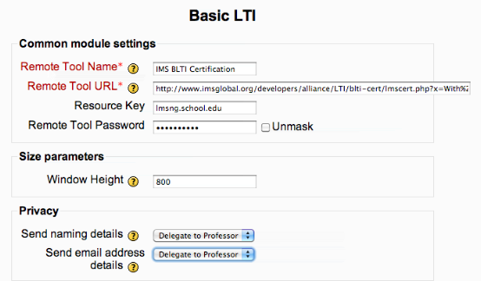
LMS Setup

Slide 19
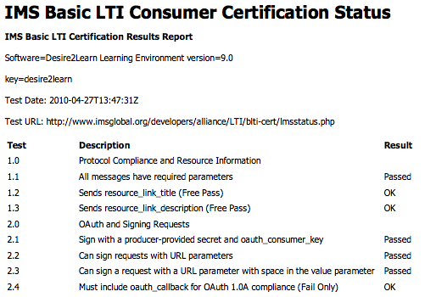

All Tests Passed

Slide 20
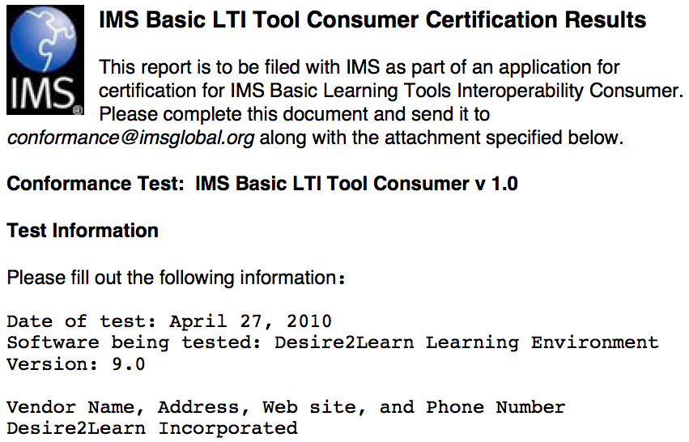

Slide 21






Certified - LMS
PowerLink for Blackboard WebCT v8
Building Block for Blackboard Learn v9
Desire2Learn Learning Environment v8.4.2
Desire2Learn Learning Environment v9.0
Jenzabar JICS v7.2
Learning Objects Campus Pack v4
Sakai v2.7
Sakai 3 v0.4
OLAT 7

Slide 22
Tool Provider/ Tool
Certification

Slide 23
Provider Certification
More of a self-certification
Run a series of launch tests on your Tool and verify proper operation
Very much like formalized unit tests
We are trying to stretch your tool
Emphasize the wide range of launch data sets

Slide 24
Test Themes
Explore privacy levels – insure the tool copes with missing data and makes a good primary key choice
Variations in the valid roles= format
Some dysfunctional/broken launches
Testing the tool's ability to redirect back to the LMS in error conditions

Slide 25
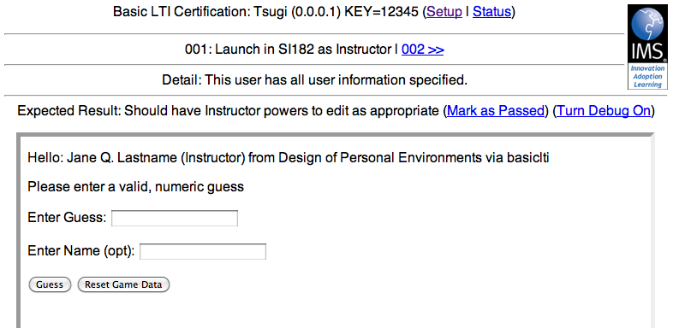
Running a Test

Slide 26
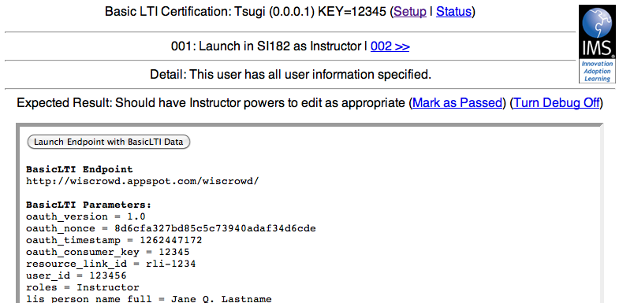
Debug Mode

Slide 27
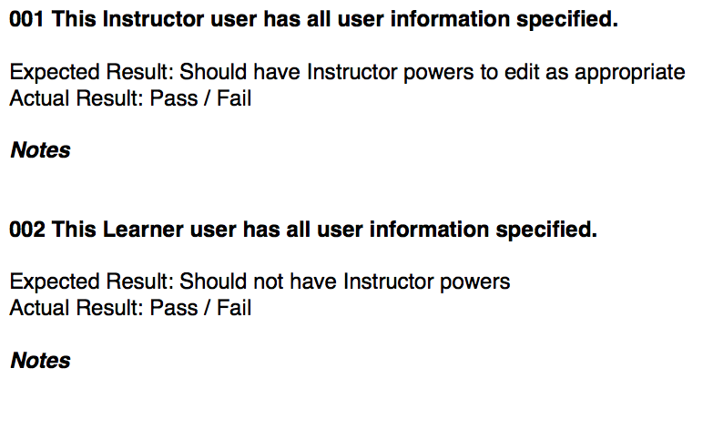
Test (self) Report

Slide 28
Certified - Tool
Learning Objects Campus Pack v4
SpACE v0.5 (Spatial Activities in Course Environments, map application)
WebPA v1 (online peer assessment application)

Slide 29
Basic LTI Community Certification
We are working on a self-certification for Basic LTI Tools that is open to anyone regardless of membership
It will be a self-policing community with ratings, "most popular", etc etc.
Working on a very early prototype

Slide 30
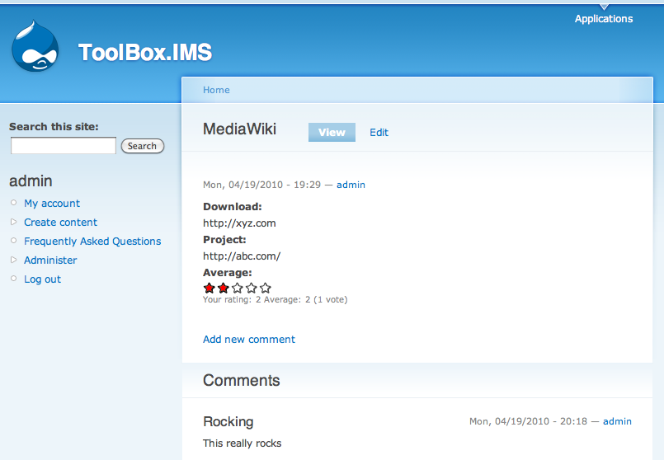
This is just a prototype!

Slide 31
Summary
We have a relatively straightforward Basic LTI certification process in place for LMS and Tools
LMS Certification is well underway for shipping and soon to ship products
These certifications will evolve with experience
We are working on an even lighter social/self-regulated community around Basic LTI Tools

Slide 32
Questions
Seamlessly
connect
to learning
IMS – www.imsglobal.org
cseverance@imsglobal.org
IMS Learning Tools
Interoperability (LTI)

