Slide 1



Building Tools in PHP using
IMS Basic LTI
Charles Severance, Ph.D.
Affiliate Coordinator
IMS Global Learning Consortium (IMS GLC)
http://www.imsglobal.org/
http://www.dr-chuck.com/

Slide 2
Download Materials From Here
http://www.imsglobal.org/developers/BLTI/

Slide 3
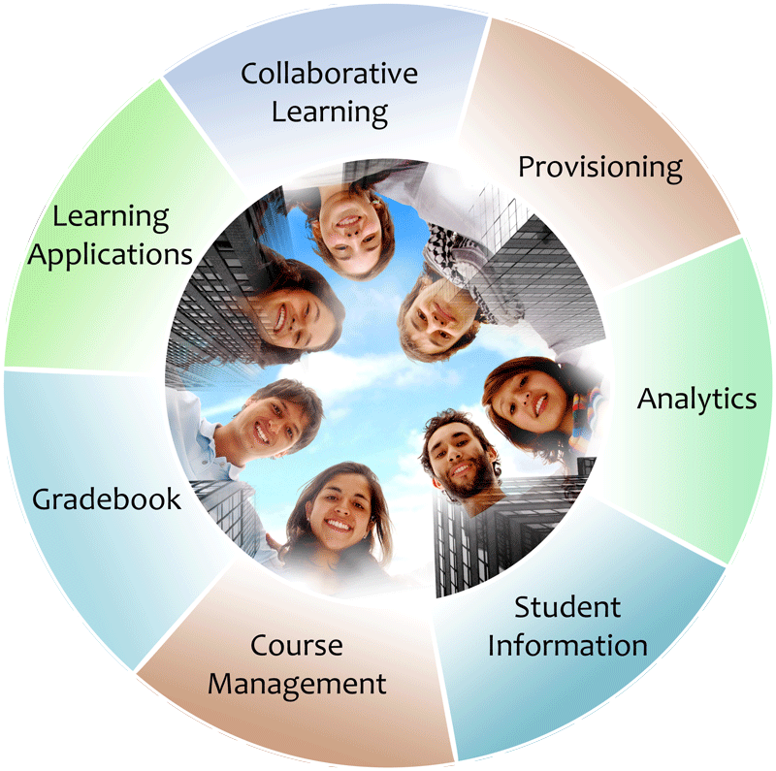


IMS: Digital Learning Standards
The information
architecture for
learning
Seamlessly
connect
to learning
Free the
content
IMS Common Cartridge
IMS Learning Tools
Interoperability (LTI)
IMS Learning Information
Services (LIS)

Slide 4









B
A
S
I
C
L
T
I
LEARNING
TOOL
...
PHP
Java
App Engine
Wookie...

Slide 5
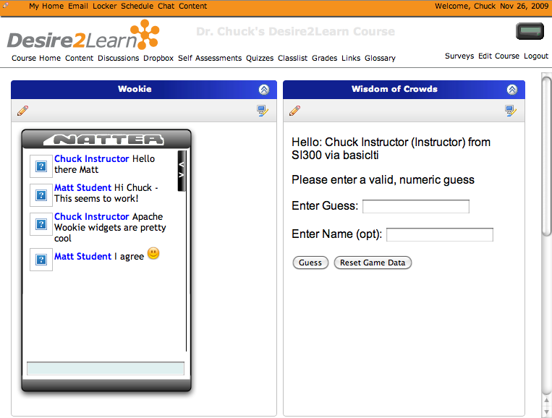
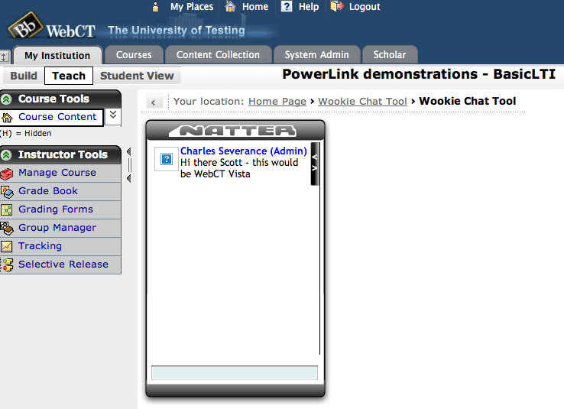
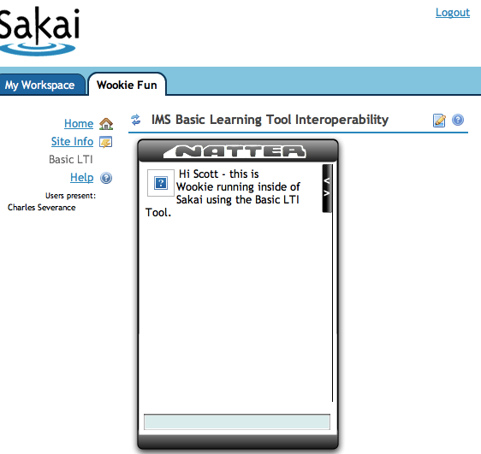
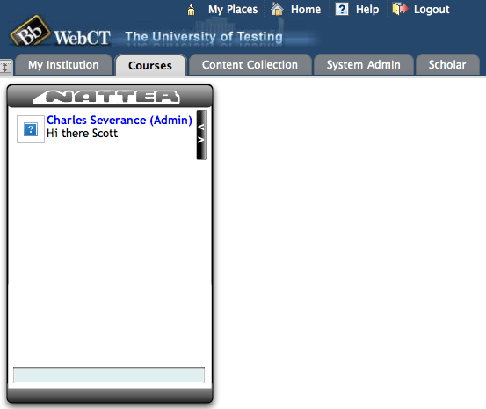
Apache
Wookie

Slide 6







Tool Consumer
Tool Provider
Tool Proxy Runtime
TC
User
Tool Proxy Runtime
Tool Proxy
Tool
Secret
Launch
Secret
TC
Admin
TP
Admin
Basic Learning Tools Interoperability

Slide 7
How to Write a Basic LTI Tool in PHP

Slide 8
Test Harness
We provide a test LMS and test Tool.
No membership is required
http://www.imsglobal.org/developers/BLTI/lms.php
http://www.imsglobal.org/developers/BLTI/tool.php

Slide 9
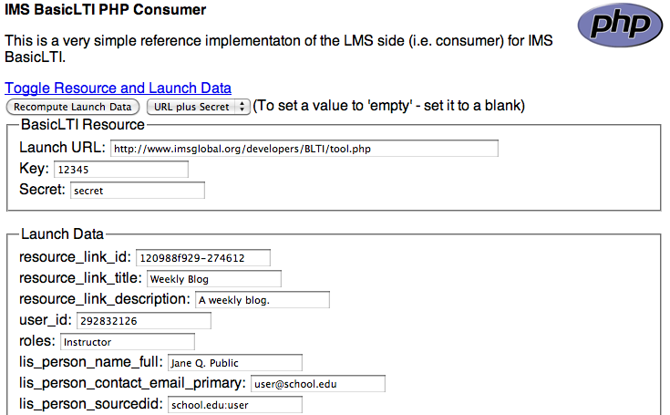
http://www.imsglobal.org/developers/BLTI/lms.php

Slide 10
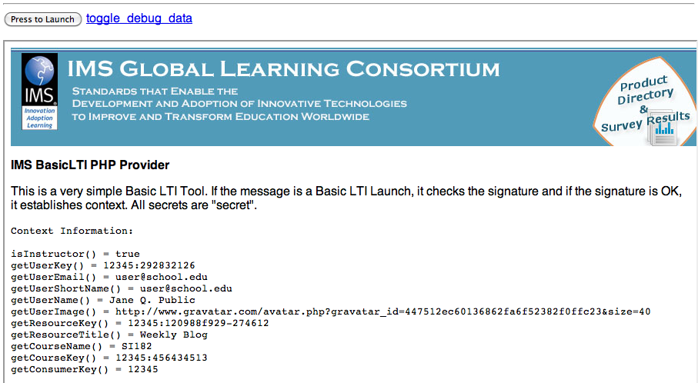
http://www.imsglobal.org/developers/BLTI/tool.php

Slide 11
Source Code - Download
Simple Sample Application – Classified Ads
  Classified Ad Software
  Key / Secret administration
  Basic LTI Utility Code
  Testing harness (simple BLTI Consumer)
  http://www.dr-chuck.com/ims/php-simple/dist.zip

Slide 12
Tool Installation and URLs
LMS Tester
  install-dir/lms.php
Installation instructions
  install-dir/adlist/index.htm
Administration functions
  install-dir/adlist/admin.php
Launch URL
  install-dir/adlist/ads.php

Slide 13
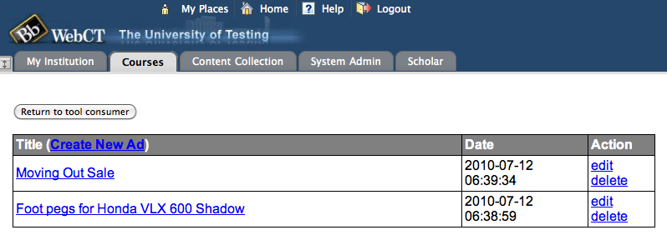
A Sample Tool – Classified Ads

Slide 14
Outline
Secret Management
Solving Multi-Tenancy
Handling the Basic LTI Launch and Context
Patterns for Simple Authorization

Slide 15
Tool Consumer
Tool Provider
Tool Proxy Runtime
TC
User
Tool Proxy Runtime
Tool Proxy
Tool
Secret
Launch
Secret
TC
Admin
TP
Admin
Basic Learning Tools Interoperability

Slide 16
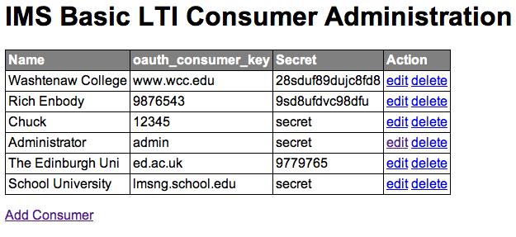
Administration Screen

Slide 17

Multi-Tenancy
Multitenancy refers to a principle in software architecture where a single instance of the software runs on a server, serving multiple client organizations (tenants). Multitenancy is contrasted with a multi-instance architecture where separate software instances (or hardware systems) are set up for different client organizations. With a multitenant architecture, a software application is designed to virtually partition its data and configuration so that each client organization works with a customized/isolated virtual application instance.
http://en.wikipedia.org/wiki/Multitenancy

Slide 18
Basic LTI Sample Launch Data
lti_version=LTI-1p0
lti_message_type=basic-lti-launch-request
oauth_consumer_key=lmsng.school.edu
resource_link_id=120988f929-274612
user_id=292832126
roles=Instructor
lis_person_name_full=Charles R. Severance
lis_person_contact_email_primary = csev@umich.edu
context_id=456434513
context_title=SI301 – PHP
tool_consumer_instance_description=University of School

Slide 19
Administration Screen

Slide 20


Multi-Tenancy Data Model
create table blti_keys (
id MEDIUMINT NOT NULL AUTO_INCREMENT,
oauth_consumer_key CHAR(255) NOT NULL,
secret CHAR(255) NULL,
name CHAR(255) NULL,
created_at DATETIME NOT NULL,
updated_at DATETIME NOT NULL,
PRIMARY KEY (id)
);
Tool
Secret
TP
Admin

Slide 21
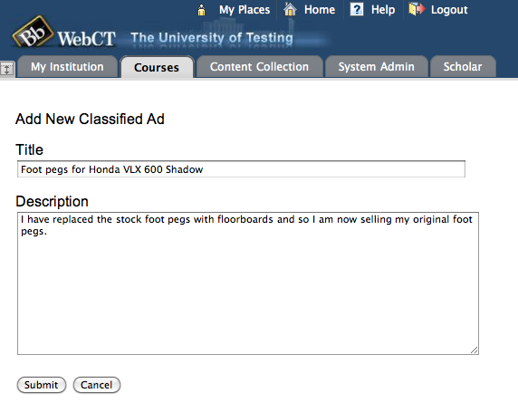
Advertisement Data Model

Slide 22
Multi-Tenancy Data Model
create table ads (
id MEDIUMINT NOT NULL AUTO_INCREMENT,
course_key CHAR(255) NOT NULL,
user_key CHAR(255) NULL,
user_name CHAR(255) NULL,
title CHAR(255) NULL,
description TEXT(2048) NULL,
created_at DATETIME NOT NULL,
updated_at DATETIME NOT NULL,
PRIMARY KEY (id)
);
Apologies to "3NF"

Slide 23
Multi-Tenancy Data
mysql> select id, left(course_key,25),left(user_key,25),left(title,20) from ads;
+----+---------------------------+---------------------------+----------------------+
| id | left(course_key,25) | left(user_key,25) | left(title,20) |
+----+---------------------------+---------------------------+----------------------+
| 6 | 12345:456434513 | 12345:292832126 | A Totally Sweet Titl |
| 7 | 12345:456434513 | 12345:292832126 | Another Awesome Titl |
| 8 | lmsng.school.edu:45643451 | lmsng.school.edu:29283212 | A TITLE |
| 9 | lmsng.school.edu:7601b0ed | lmsng.school.edu:f315ea76 | Honda 450 - 1983 - E |
| 10 | lmsng.school.edu:7601b0ed | lmsng.school.edu:f315ea76 | Slightly Used App En |
| 11 | lmsng.school.edu:7601b0ed | lmsng.school.edu:f315ea76 | Free Metal File Cabi |
| 12 | ed.ac.uk:lti_demo | ed.ac.uk:URN:X-WEBCT-b98f | Mountain Bike - New |
| 13 | ed.ac.uk:lti_demo | ed.ac.uk:URN:X-WEBCT-b98f | Two Premiere Tickets |
| 14 | ed.ac.uk:lti_demo | ed.ac.uk:URN:X-WEBCT-b98f | Monthly Bus Pass to |
+----+---------------------------+---------------------------+----------------------+
We must namespace the primary keys (user_id, context_id) with the oauth_consumer_key to isolate courses and users

Slide 24
Handling the Basic LTI Launch
A utility library is provided that intercepts and processes launches
require_once '../ims-blti/blti.php';
require_once("db.php");
$context = new BLTI(array('table' => 'blti_keys'));
if ( $context->complete ) exit();
if ( ! $context->valid ) {
print "Could not establish context: ".$context->message."\n";
exit();
}
ads.php

Slide 25
Handling the Basic LTI Launch
The "context" is either taken from the launch or restored from the PHP session – like a filter
require_once '../ims-blti/blti.php';
require_once("db.php");
$context = new BLTI(array('table' => 'blti_keys'));
if ( $context->complete ) exit();
if ( ! $context->valid ) {
print "Could not establish context: ".$context->message."\n";
exit();
}
ads.php

Slide 26
The Context
The context contains information from the launch
  Resource information
  User Information
  Course (aka context) information
  Organizational Information
  Launch Authentication Information

Slide 27
The Context – Supplied Methods
$context->getCourseKey() = 12345:456434513
$context->getCourseName() = SI182
$context->getResourceKey() = 12345:9fbbe1230
$context->getResourceTitle() = Week 1 Blog
$context->getUserKey() = 12345:292832126
$context->isInstructor() = true/false
$context->getUserEmail() = jane@school.edu
$context->getUserShortName() = jane@school.edu
$context->getUserName() = Jane Q. Public
$context->getUserImage() = http://www.gravatar...
$context->getConsumerKey() = 12345

Slide 28
Simple Authorization
With the data model, we need to know who can edit which ads in our table
mysql> select id, left(course_key,25),left(user_key,25),left(title,20) from ads;
+----+---------------------------+---------------------------+----------------------+
| id | left(course_key,25) | left(user_key,25) | left(title,20) |
+----+---------------------------+---------------------------+----------------------+
| 6 | 12345:456434513 | 12345:292832126 | A Totally Sweet Titl |
| 7 | 12345:456434513 | 12345:292832126 | Another Awesome Titl |
| 8 | lmsng.school.edu:45643451 | lmsng.school.edu:29283212 | A TITLE |
| 9 | lmsng.school.edu:7601b0ed | lmsng.school.edu:f315ea76 | Honda 450 - 1983 - E |
| 10 | lmsng.school.edu:7601b0ed | lmsng.school.edu:f315ea76 | Slightly Used App En |
| 11 | lmsng.school.edu:7601b0ed | lmsng.school.edu:f315ea76 | Free Metal File Cabi |
| 12 | ed.ac.uk:lti_demo | ed.ac.uk:URN:X-WEBCT-b98f | Mountain Bike - New |
| 13 | ed.ac.uk:lti_demo | ed.ac.uk:URN:X-WEBCT-b98f | Two Premiere Tickets |
| 14 | ed.ac.uk:lti_demo | ed.ac.uk:URN:X-WEBCT-b98f | Monthly Bus Pass to |
+----+---------------------------+---------------------------+----------------------+

Slide 29
Instructor:
SELECT * FROM ads WHERE id='7' AND
course_key='12345:456434513'
Student:
SELECT * FROM ads WHERE id='7' AND
course_key='12345:456434513 AND
user_key = '12345:292832126'
mysql> select id, left(course_key,25),left(user_key,25),left(title,20) from ads;
+----+---------------------------+---------------------------+----------------------+
| id | left(course_key,25) | left(user_key,25) | left(title,20) |
+----+---------------------------+---------------------------+----------------------+
| 6 | 12345:456434513 | 12345:292832126 | A Totally Sweet Titl |
| 7 | 12345:456434513 | 12345:292832126 | Another Awesome Titl |
| 8 | lmsng.school.edu:45643451 | lmsng.school.edu:29283212 | A TITLE |
| 9 | lmsng.school.edu:7601b0ed | lmsng.school.edu:f315ea76 | Honda 450 - 1983 - E |
| 10 | lmsng.school.edu:7601b0ed | lmsng.school.edu:f315ea76 | Slightly Used App En |
| 11 | lmsng.school.edu:7601b0ed | lmsng.school.edu:f315ea76 | Free Metal File Cabi |
| 12 | ed.ac.uk:lti_demo | ed.ac.uk:URN:X-WEBCT-b98f | Mountain Bike - New |
| 13 | ed.ac.uk:lti_demo | ed.ac.uk:URN:X-WEBCT-b98f | Two Premiere Tickets |
| 14 | ed.ac.uk:lti_demo | ed.ac.uk:URN:X-WEBCT-b98f | Monthly Bus Pass to |
+----+---------------------------+---------------------------+----------------------+

Slide 30
Show/Hide Buttons

Slide 31
Showing Buttons For Edit/Delete
<?php
if ( $context->isInstructor() ||
$row['user_key'] == $context->getUserKey() ) {
?>
<a href="<self?>?action=edit&id=<row[id]?>">edit<a>
<a href="<self?>?action=delete&id=<row[id]?>">delete<a>
<?php
}
?>
ads.php

Slide 32
Advanced Topic:
System and Course-Mapped Keys

Slide 33
Use cases
System-scoped key – The Consumer sends us a context_id for each course which allows many different courses to use our tool independently – this is a typical approach
Course-mapped key – in this case, you ignore the consumer-provided context_id and specify the context_id inside of your (Provider) system

Slide 34
System-Scoped
Key=zap
cid=a1d2
cid=1234
cid=654
Provider
zap(sys)
fun(sys)
zap:a1d2
zap:1234
zap:654
fun:a1d2
fun:9876
fun:345
Key=fun
cid=a1d2
cid=9876
cid=345
Consumers

Slide 35
Course-Scoped Keys
Key=zap
cid=a1d2
cid=1234
Provider
zap(sys)
east (c=1555)
west(c=1555)
zap:a1d2
zap:1234
1555
Key=east
cid=a1d2
cid=1234
Key=west
cid=9876
With course-scoped keys, students from multiple contexts in multiple Consumers can meet and collaborate in the Provider.
Consumers

Slide 36
Data Model Changes
create table blti_keys (
id MEDIUMINT NOT NULL AUTO_INCREMENT,
oauth_consumer_key CHAR(255) NOT NULL,
secret CHAR(255) NULL,
name CHAR(255) NULL,
context_id CHAR(255) NULL,
created_at DATETIME NOT NULL,
updated_at DATETIME NOT NULL,
PRIMARY KEY (id)
);
context_id is used to optionally override context_id from launches

Slide 37
Course-Scoped Keys
In the sample application, each key as a context_id field – if it is null, the key is a system-scoped key.
mysql> select id,oauth_consumer_key,secret,context_id from blti_keys;
+----+--------------------+--------+------------+
| id | oauth_consumer_key | secret | context_id |
+----+--------------------+--------+------------+
| 4 | 12345 | secret | NULL |
| 5 | bob.smith.lcc.edu | secret | 999999 |
+----+--------------------+--------+------------+

Slide 38
Basic LTI Sample Launch Data
lti_version=LTI-1p0
lti_message_type=basic-lti-launch-request
oauth_consumer_key=bob.smith.lcc.edu
resource_link_id=120988f929-274612
user_id=292832126
roles=Instructor
lis_person_name_full=Charles R. Severance
lis_person_contact_email_primary = csev@umich.edu
context_id=4598634513
context_title=SI301 – PHP
tool_consumer_instance_description=University of School
ignore

Slide 39
Configuration using resource_link_id

Slide 40
Use Case: Picking a Video
If our Tool Provider is video archive and the purpose of each "placement" in a course is to play a particular video using BLTI to gain access to the video
Problem: How to place BLTI resource links several places in the course map but refer to different videos in each placement?

Slide 41
Goal State
Scene
1
Week 1
Video snippet
Discussion board
Week 2
Video snippet
Wiki
Week 3
Video Snippet
Midterm Exam
Scene4
Scene
9

Slide 42
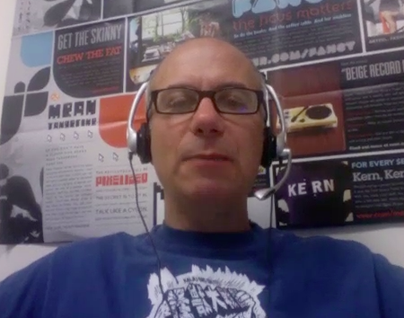
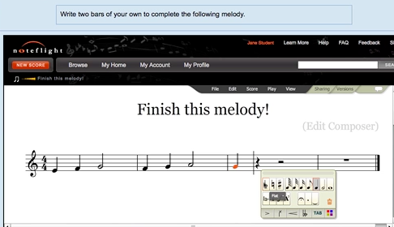
Joseph Berkovitz
<info@noteflight.com>
www.noteflight.com
http://videos.noteflight.com/MoodleBasicLTI.mov

Slide 43
Basic LTI Sample Launch Data
lti_version=LTI-1p0
lti_message_type=basic-lti-launch-request
oauth_consumer_key=lmsng.school.edu
resource_link_id=120988f929-274612
user_id=292832126
roles=Instructor
lis_person_name_full=Charles R. Severance
lis_person_contact_email_primary = csev@umich.edu
context_id=456434513
context_title=SI301 – PHP
tool_consumer_instance_description=University of School

Slide 44
Understanding resource_link_id
Key=987 cid=a1b2
Week 1
Video snippet
Discussion board
Week 2
Video snippet
Wiki
Week 3
Video Snippet
Midterm Exam
rlid=9c45
The resource_link_id is unique for each placement of Basic LTI in a course within a Toll Consumer. When each of the resources is launched from within a context, you get key, cid, and rlid.
rlid=23b5
rlid=1725

Slide 45
Using resource_link_id
Key=987 cid=a1b2
Week 1
Video snippet
Discussion board
rlid=9c45
You need a table in your application which maps from a consumer_key:resource_link_id (i.e. 987:9c45) to some local resource identified within your application. Until the Instructor selects a resource within your tool, it is "unconfigured".
Some tools apply an MD5 or SHA1 hash to the resulting concatenated key to bound the length of their internal key.

Slide 46
Understanding resource_link_id
Key=987 cid=a1b2
Week 1
Video snippet
Discussion board
rlid=9c45
Not
Config
Pick
Video
Scene
1
Scene
1
Learner
Instructor
Learner
Instructor
Not configured
987:9c45 = matrix_01

Slide 47
Uniqueness of resource_link_id
According to the spec recource_link_id is to be unique within an instance of an LMS
  oauth_consumer_key:resource_link_id
A Tool Provider may decide to be less trusting of the resource_link_id uniqueness and choose to use
  oauth_consumer_key:context_id:resource_link_id
Also note that not all launches are not guaranteed to include a context_id (i.e. if the tool is launched from a system-wide portal drop down)

Slide 48
Redirect and Multiple Instances
Once you have stored or retrieved the mapping between the LMS resource_link_id and your own internal resource id, you should redirect the browser to a URL that includes your internal resource id as a parameter or in the path
You should not depend on session for either the resource_link_id or your own internal resource id to deal with the cases of multiple launches embedded in a single page, or launches running simultaneously in multiple browser windows at the same time.

Slide 49
Custom Field .vs. Resource Link
In a Common Cartridge, Basic LTI Resource Links have a custom field which could be used for this purpose ... But ...
The custom fields UI varies from LMS to LMS and may not even be available to the Instructor
Using resource_link_id keeps the configuration UX in the Provider and keeps from needing per-LMS documentation
A good practice is to use custom_fields in cartridges and if no custom field is present fall back to resource_link_id provisioning

Slide 50
Source Code - Download
Simple Sample Application – Classified Ads
  http://www.imglobal.org/developers/BLTI/dist.zip
  Classified Ad Software (adlist/ads.php)
  Key / Secret administration (adlist/admin.php)
  Basic LTI Utility Code (ims-blti/blti.php)
  Testing harness (simple BLTI Consumer) (lms.php)
  Uses MySQL (adlist/setup.sql and adlist/db.php)

Slide 51
IMS Alliance Membership
Attend IMS Quarterly Meetings
Attend related Working Group Meetings
Technical support for implementers of IMS Specifications
Certification Program
http://www.imsglobal.org/cc/jointhealliance.cfm

Slide 52
Questions
Seamlessly
connect
to learning
IMS – www.imsglobal.org
cseverance@imsglobal.org
IMS Learning Tools
Interoperability (LTI)

