Slide 1
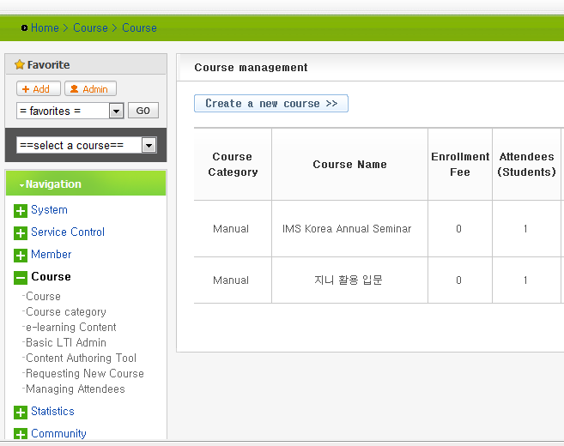
Login to genie (demo2.ongenie.org) with the admin account - id (admin), pass (genie120)
“Basic LTI Admin” for tool registration

Slide 2
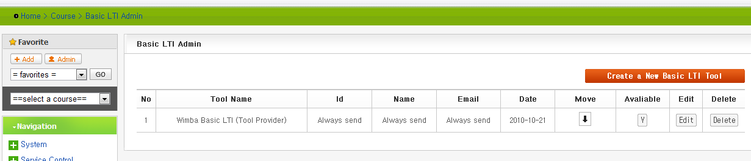
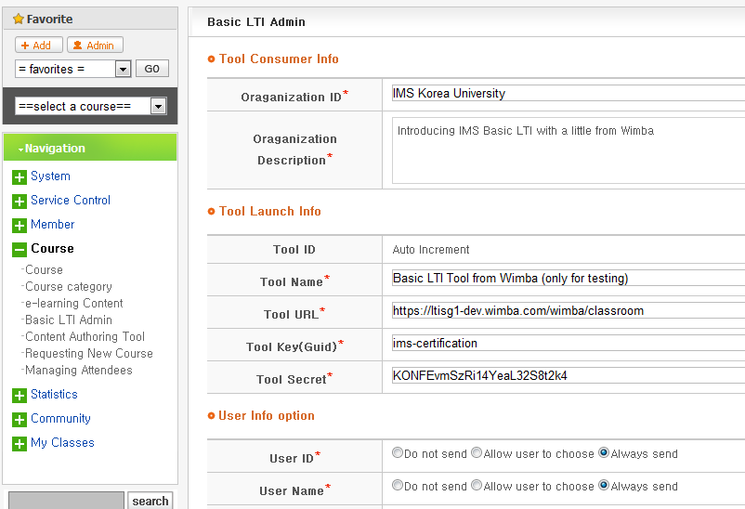
“Create a new ~” for tool registration
Enter tool registration details

Slide 3
Enter tool registration details

Slide 4
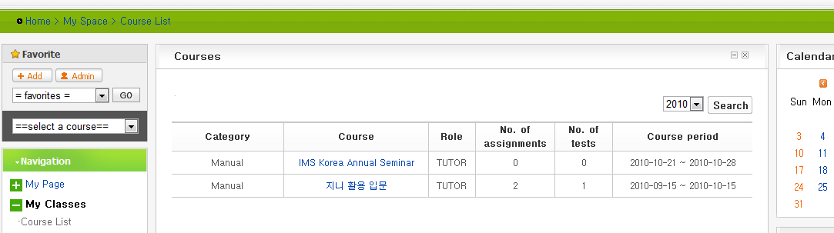
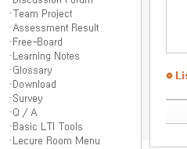
Log back in to genie (demo2.ongenie.org) with the teacher account - id (teacher), pass (genie120)
Select “IMS Korea Annual Seminar” course from the course list
Click “Basic LTI Tools” to view the list of tools available & in next screen press the button “choice tools”

Slide 5
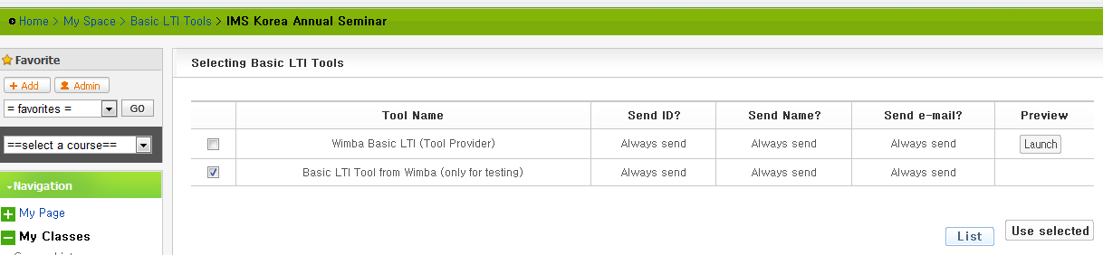
Select “Basic LTI Tool ~~” from the list and press the button “Use selected”

Slide 6
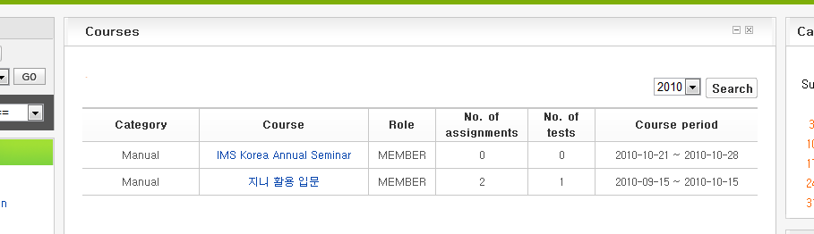
Log back in to genie (demo2.ongenie.org) with the student account - id (student), pass (genie120)
Select “IMS Korea Annual Seminar” course from the course list (“My Classes”)
Click “Basic LTI Tools” to view the list of tools available for the student

Slide 7
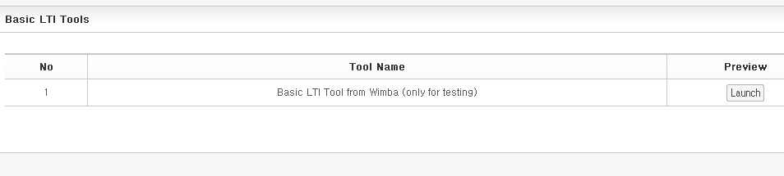

then..
button to launch the tool selected

Slide 8
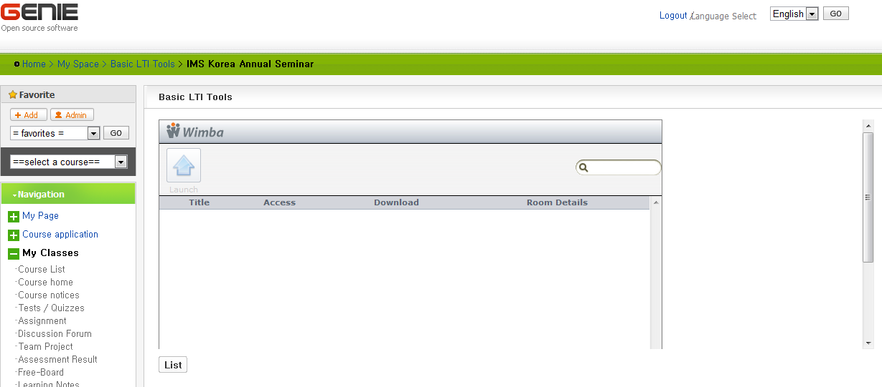
Hooray …

