Slide 1
Functionality Mash Up – Evolving to the Next Generation of Learning Management Systems
Dr. Charles Severance
IMS Global Learning Consortium
www.imsglobal.org
www-dr-chuck.com
October 22, 2010

Slide 2
Learning and Web 2.0
The reality is that Web 2.0 is difficult to use at scale in classrooms
Frustrating for students
  Different software for each class
  Many different accounts
  Privacy concerns about work in progress

Slide 3










Case Study: Amanda Severance
Senior in Special Education
Technology in the Classroom Course
Eleven different accounts
Setup required technical support

Slide 4
Functionality Mash Up
Functionality Mash up is the ability to pull a program into another program under end-user control
Functionality Mash up is not just read-only - the mashed up application will need sufficient access to services in the aggregating system to be able to provide rich and dynamic features.
Functionality mash up includes identity, context, roles, and data interchange

Slide 5
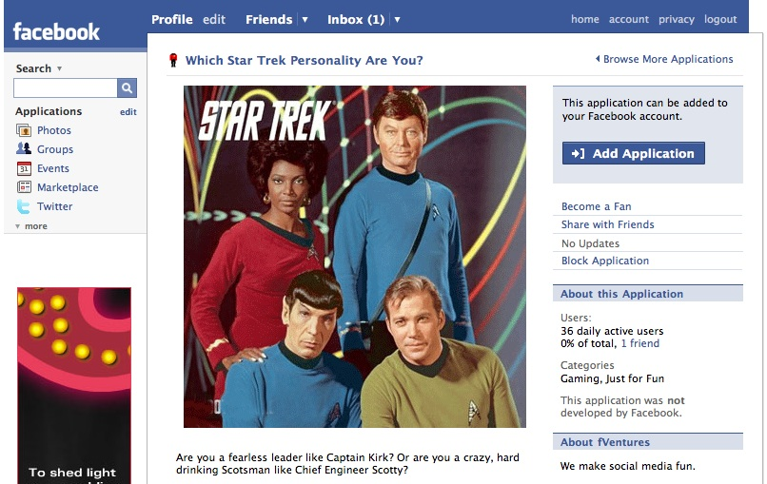

Slide 6
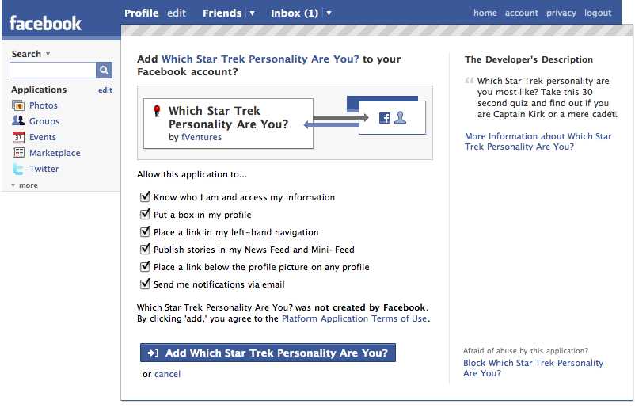

Slide 7
Too Many LMS Extension Points
Blackboard Building Blocks
Moodle Modules
Sakai Tools
WebCT PowerLinks
....

Slide 8









LEARNING
TOOL
...
?????
http://www.flickr.com/photos/lauradye/4917754427/

Slide 9
S
T
A
N
D
A
R
D
LEARNING
TOOL
...
PHP
Java
C#
App Engine
?????

Slide 10
Why not use existing mash-up Spec?
OpenSocial API
FaceBook API
W3C Widget Spec
Yahoo Application Protocol
All of these protocols focus on an individual’s identity and a set of “friends” that surround a person

Slide 11
Learning Tools Mash-up
In Learning, the same person can have many roles in many “courses” – some of which they control / own and other “courses” where they are participants
It is actually very simple – we need to add “which context” and “the current user’s role within that context” to these social / mash-up protocols

Slide 12
Must Be Easy Like Facebook

Slide 13
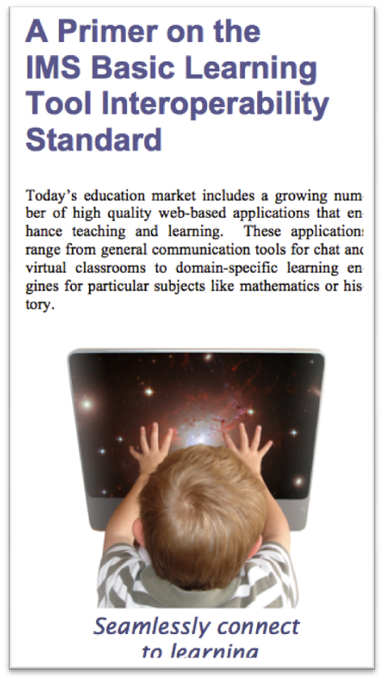
Like FaceBook...
IMS Basic Learning Tools Interoperability
Simple REST-based protocol
Use Industry Standard OAuth for Security
Documentation should be simple

Slide 14
A Growth Path
IMS Basic LTI – Very simple REST-style launch from and LMS to a tool using OAuth security
IMS Basic Outcomes – Simple grades returned to the LMS
IMS Full LTI – Includes a set of rich run-time services (content, grading, provisioning, etc)

Slide 15

B
L
T
I
LEARNING
TOOL
...
PHP
Java
C#
App Engine
?????

Slide 16
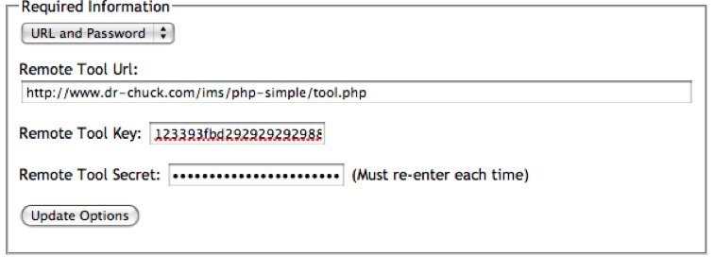
IMS Basic LTI Data Model
An IMS Basic LTI Link is (1) a URL, (2) a key, and (3) a secret

Slide 17
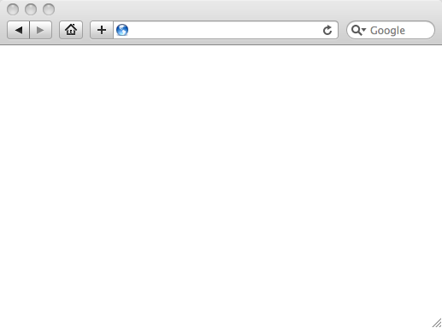
Integrated User Experience
Welcome
Local Resource
Local Resource
LTI Tool
Movie
© Copyright 2010 IMS Global Learning Consortium
All Rights Reserved.

Slide 18
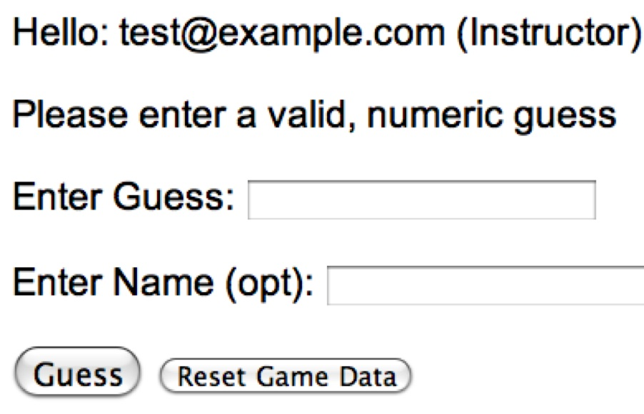
User Experience
Welcome
Local Resource
Lame iFrame
LTI Tool
Movie
© Copyright 2010 IMS Global Learning Consortium
All Rights Reserved.

Slide 19
LMS (LTI Consumer)
Again in slow motion…
LMS Looks up User and Course Information.
Information is signed using secret and OAuth
Week 1
Local Resource
Local Resource
LTI Tool
Movie
Form data sent to Browser
Tool (LTI Provider)
© Copyright 2010 IMS Global Learning Consortium
All Rights Reserved.

Slide 20
LMS (LTI Consumer)
Form is immediately auto-submitted using JavaScript.
<form action=”tool”/>
<input name=”user_id”
value=”2348d8dd” />
<input name=”oauth_token”
value=”abc.edu” />
</form>
Tool (LTI Provider)
Tool looks up secret and validates signature.
Tool provisions user, course, and session.
Tool sends redirect
© Copyright 2010 IMS Global Learning Consortium
All Rights Reserved.

Slide 21
LMS (LTI Consumer)
Browser follows redirect…
<head>
<meta redirect
page=”main.php”>
</head>
Tool (LTI Provider)
Tool produces
first page.
© Copyright 2010 IMS Global Learning Consortium
All Rights Reserved.

Slide 22
LMS (LTI Consumer)
Tool (LTI Provider)
© Copyright 2010 IMS Global Learning Consortium
All Rights Reserved.

Slide 23
Basic LTI Sample Launch Data
lti_version=LTI-1p0
lti_message_type=basic-lti-launch-request
oauth_consumer_key=lmsng.school.edu
resource_link_id=120988f929-274612
user_id=292832126
roles=Instructor
lis_person_name_full=Charles R. Severance
lis_person_contact_email_primary = csev@umich.edu
context_id=456434513
context_title=SI301 – PHP
tool_consumer_instance_description=University of School

Slide 24


Basic LTI Certification
Assure the end-user/purchaser that products will interoperate
Any certified Provider (Tool) should be able to interoperate with any certified Consumer (LMS)

Slide 25
Basic LTI Certification
Must be an IMS member to gain certification
IMS will assist in discussions if there is an interoperability concern between vendors
Long-term relationship

Slide 26




Certified - LMS
PowerLink for Blackboard WebCT v8
Building Block for Blackboard Learn v9
Desire2Learn Learning Environment v8.4.2 and v9.0
Jenzabar JICS v7.2 and e-Racer v1.2
Learning Objects Campus Pack v4.2
Sakai v2.7
Sakai 3 v0.4
Moodle 1.9 Basic LTI Module
OLAT 7.0
GeNIE, Open-Source LMS v1.0
http://www.imsglobal.org/cc/statuschart.html

Slide 27





Certified - Tool
CourseSmart ServiceHub 2.0
CafeScribe Building Block for Blackboard
Learning Objects Campus Pak v4.2
NoteFlight 2.1
Wimba Basic LTI Components v1.0.2
http://www.imsglobal.org/cc/statuschart.html

Slide 28
B
L
T
I
LEARNING
TOOL
...
PHP
Java
App Engine
?????

Slide 29
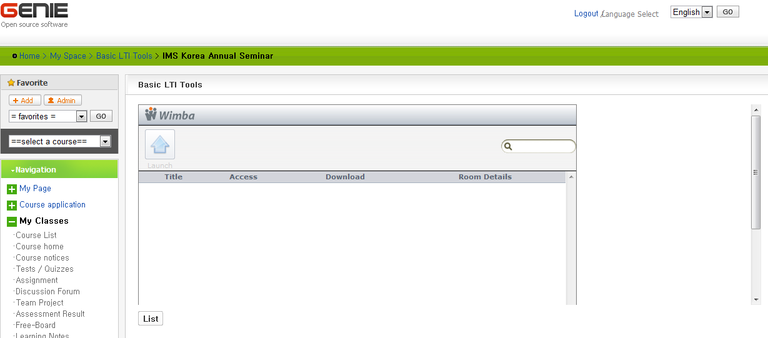
??????

Slide 30
Engaging open source, creating standards, engaging proprietary vendors, promoting ideas, giving lectures, doing demonstrations, all are important activities...

Slide 31
The real reason for this activity is to empower teachers and learners as to how they select and use tools and content to help themselves teach and learn...

Slide 32
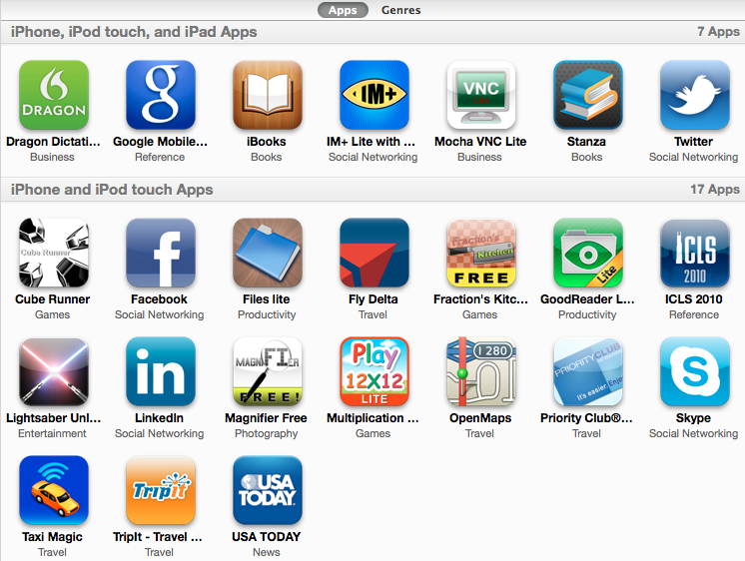
An App Store for Education

Slide 33
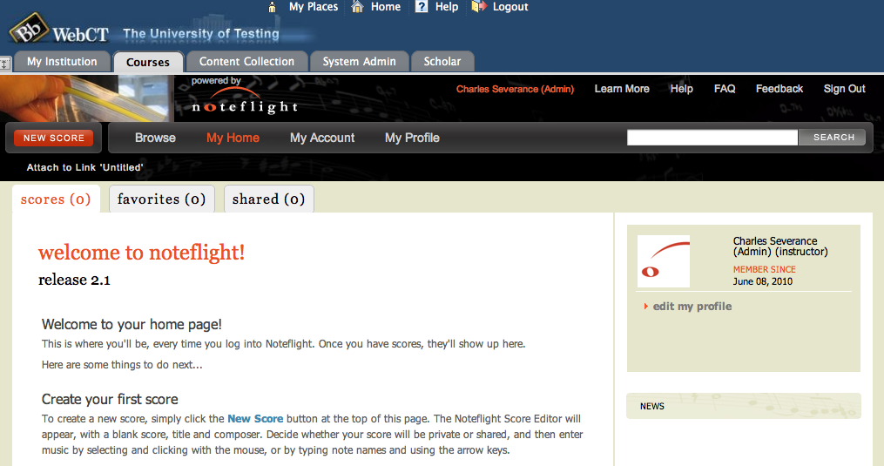
www.noteflight.com

Slide 34
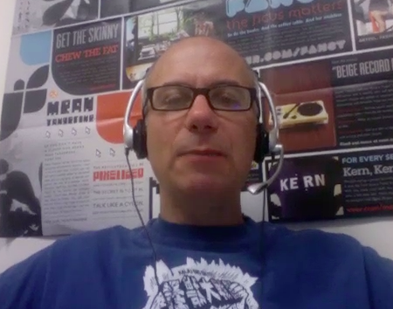
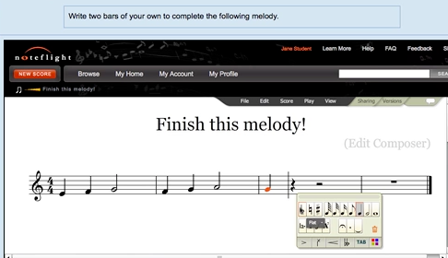
Joseph Berkovitz
<info@noteflight.com>
www.noteflight.com
http://videos.noteflight.com/MoodleBasicLTI.mov

Slide 35
IMS Implementation Support
Materials, sample code, sample application
  http://www.imsglobal.org/developers/BLTI/
Additional support and certification
  http://www.imsglobal.org/joinims.html

Slide 36


Questions
Seamlessly
connect
to learning
IMS – www.imsglobal.org
cseverance@imsglobal.org
IMS Learning Tools
Interoperability (LTI)
  http://www.imsglobal.org/developers/BLTI/

