Slide 1



IMS Basic LTI and LIS Simple Outcomes
Charles Severance, Ph.D.
Affiliate Coordinator
IMS Global Learning Consortium (IMS GLC)
http://www.imsglobal.org/
http://www.dr-chuck.com/

Slide 2
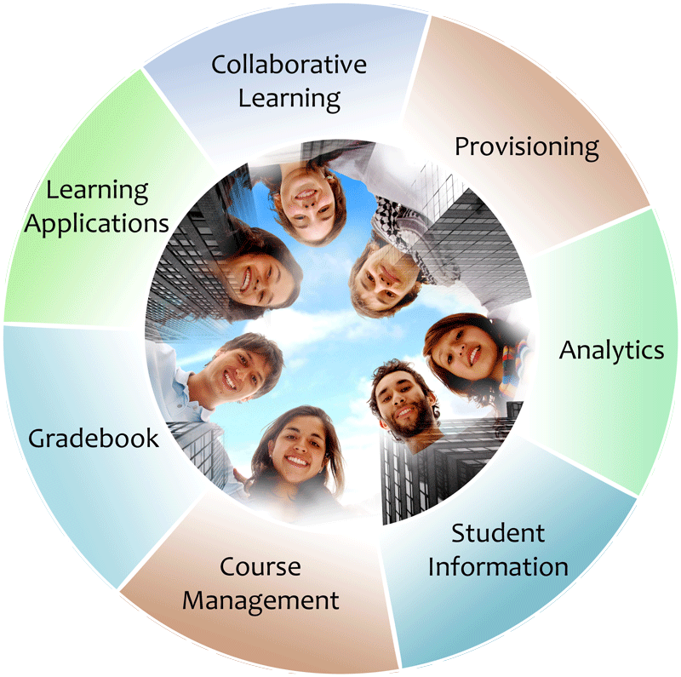


IMS: Digital Learning Standards
The information
architecture for
learning
Seamlessly
connect
to learning
Free the
content
IMS Common Cartridge
IMS Learning Tools
Interoperability (LTI)
IMS Learning Information
Services (LIS)

Slide 3








B
L
T
I
LEARNING
TOOL
...
PHP
Java
C#
App Engine
?????

Slide 4





Certified - LMS
PowerLink for Blackboard WebCT v8
Building Block for Blackboard Learn v9
Desire2Learn Learning Environment v8.4.2 and v9.0
Jenzabar JICS v7.2 and e-Racer v1.2
Learning Objects Campus Pack v4.2
Sakai v2.7
Sakai 3 v0.4
Moodle 1.9 Basic LTI Module
OLAT 7.0
GeNIE, Open-Source LMS v1.0
http://www.imsglobal.org/cc/statuschart.html

Slide 5





Certified - Tool
CourseSmart ServiceHub 2.0
CafeScribe Building Block for Blackboard
Learning Objects Campus Pak v4.2
NoteFlight 2.1
Wimba Basic LTI Components v1.0.2
http://www.imsglobal.org/cc/statuschart.html

Slide 6
The real reason for this activity is to empower teachers and learners as to how they select and use tools and content to help themselves teach and learn...

Slide 7
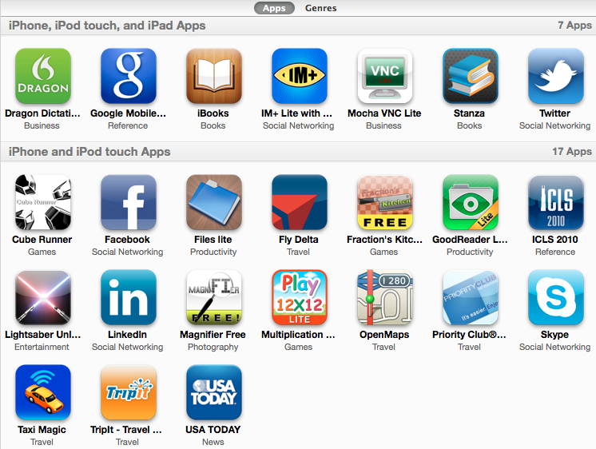
An App Store for Education

Slide 8
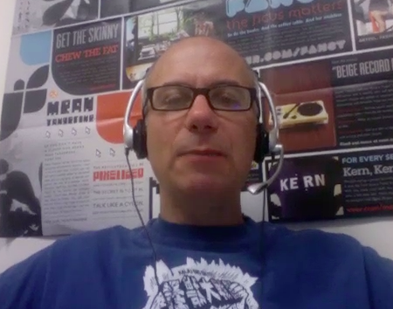
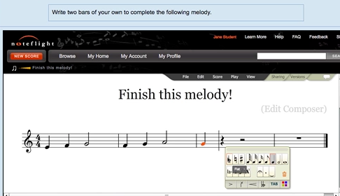
Joseph Berkovitz
<info@noteflight.com>
www.noteflight.com
http://videos.noteflight.com/MoodleBasicLTI.mov

Slide 9











Tool Consumer
REST Services
Tool Provider
Profile
Launch
Events
Tool
Profile
Tool Proxy Runtime
TC
User
Tool Proxy Runtime
Deployment
Session
Tool Setting
Outcomes
Data
...
Tool Proxy
Tool
Secret
Secret
SOAP Services
TC
Admin
TP
Admin
Learning Tools Interoperability

Slide 10

Tool Consumer
Tool Provider
Tool Proxy Runtime
TC
User
Tool Proxy Runtime
Tool Proxy
Tool
Secret
Launch
Secret
TC
Admin
TP
Admin
Basic Learning Tools Interoperability

Slide 11
Basic LTI Sample Launch Data
lti_version=LTI-1p0
lti_message_type=basic-lti-launch-request
oauth_consumer_key=lmsng.school.edu
resource_link_id=120988f929-274612
user_id=292832126
roles=Instructor
lis_person_name_full=Charles R. Severance
lis_person_contact_email_primary = csev@umich.edu
context_id=456434513
context_title=SI301 – PHP
tool_consumer_instance_description=University of School

Slide 12
Basic LTI Support for LIS
TOOL CONSUMER
TOOL PROVIDER
BasicLTI Launch with LIS pointers
LIS
SERVICES
The TP calls Learning Information Services
services, if available.

Slide 13
SimpleOutcome Launch
Add fields to launch if grades are supported
  lis_result_sourcedid – represents course, resource, gradebook, user in one id – opaque to tool (part of the IMS Basic LTI Specification)
  ext_ims_lis_simple_outcome_url – Service URL
  ext_ims_lis_resultvalue_sourcedids – a list of types of outcomes accepted (decimal, percentage, passfail ..)

Slide 14
Basic LTI Sample Launch Data
lti_version=LTI-1p0
lti_message_type=basic-lti-launch-request
oauth_consumer_key=lmsng.school.edu
resource_link_id=120988f929-274612
user_id=292832126
roles=Instructor
context_id=456434513
lis_result_sourcedid=123-9299d9f9a-20233-02939393
ext_ims_lis_simple_outcome_url=http://localhost/outcome.php
ext_ims_lis_resultvalue_sourcedids=percentage,decimal,passfail

Slide 15
Important Disclaimer...
Simple Outcomes is not a formal standard – it is only an engineering exercise to explore use cases and applications of the IMS Learning Information Services in an IMS Basic Learning Tools Interoperability environment. Since Simple Outcomes is not a standard, it is not appropriate to publically claim compliance to it.

Slide 16





User, Course, Resource, Callback info
Tool Provider
Tool Consumer
Tool Proxy Runtime
Tool Proxy Runtime
Tool Proxy
Launch
Tool
Secret
SimpleOutcome
TC
User
Secret
Result-ID
Grade
Grade Book
TC
Admin
TP
Admin
Simple Outcomes

Slide 17
SimpleOutcome Service
Service can be called asynchronously (i.e. no session needed)
Tool sends outcome to service as form-encoded POST data, signed by OAuth shared-secret

Slide 18
IMS Learning Information Services – Outcomes
IMS Learning Information Services is in public draft
  http://www.imsglobal.org/lis/lisv2p0pd/OMSinfoModelv1p0pd.html
This work is based on a REST binding to the LIS data model
  Sections 2.3, 3.3.1, 3.3.3, 3.3.4, 3.3.15, 2.2.16, 5.2, 5.5, 5.14, and Appendix B

Slide 19
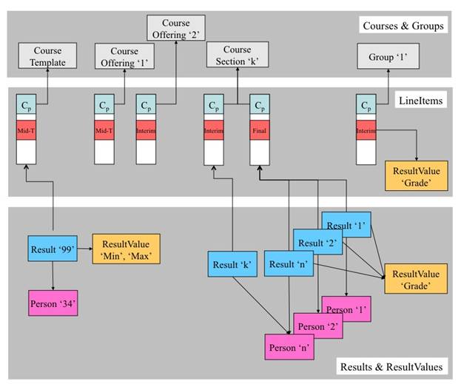
lis_result_sourcedid

Slide 20
SimpleOutcome Message Data
lti_version=LTI-1p0
lti_message_type=simple-lis-replaceresult
sourcedid=123-9299d9f9a-20233-02939393
result_resultscore_textstring=95
result_statusofresult=final
result_resulttvaluesourcedid=percentage
result_personsourcedid=292832126
result_resultscore_language=en_US
result_datasource=1783837472
result_date=2010-08-01T16:43Z

Slide 21
<simpleoutcome>
<lti_message_type>simple-lis-readresult</lti_message_type>
<statusinfo>
<codemajor>Success</codemajor>
<severity>Status</severity>
<codeminor>fullsuccess</codeminor>
</statusinfo>
<result>
<sourcedid>123-9299d9f9a-20233-02939393</sourcedid>
<personsourcedid>292832126</personsourcedid>
<statusofresult>interim</statusofresult>
<date>2010-07-18T10:55Z</date>
<resultscore>
<resultvaluesourcedid>percentage</resultvaluesourdedid>
<textstring>90</textstring>
<language>en_US</language>
<resultscore>
<datasource>1783837472</datasource>
</result>
</simpleoutcome>
May Be Changed..
XML Response

Slide 22
lis_result_sourcedid

Slide 23
lis_result_sourcedid issues
Must securely and uniquely identify a course, section, grade book column, and user
We want to keep the authorization for the setting of a particular grade in the LMS (i.e. the tool should not be allowed to set any grade for any person simply knowing the Launch secret)
We also want to be able to revoke the right for a tool to set grades.

Slide 24
Constructing lis_result_sourcedid
Inside the LMS, a distinct grade_secret is associated with each resource which is used to message-sign each lis_result_sourcedid
signature = SHA1(grade_secret::resource-id::user-id)
lis_result_sourcedid=signature::resource-id::user-id

Slide 25






Tool Consumer
Tool Provider
Tool Proxy Runtime
Tool Proxy
Launch
Secret
TC
User
Tool Proxy Runtime
Tool
Launch
Grade
Secret
Launch
Secret
SimpleOutcome
TC
Admin
TP
Admin
lis_result_sourcedid
signature::resource-id::user-id

Slide 26


Educause DEMO – October 2010

Slide 27






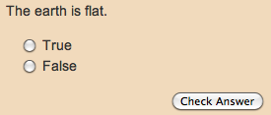
Tool Consumer
Tracker
Launch
SimpleOutcome
Content
JavaScript
Flash
...

Slide 28
Where is this going?
Want to formalize SimpleOutcomes into BasicOutcomes and release at least a "best practice document"
Need to balance extending Basic LTI with implementing Full LTI

Slide 29
Questions
Seamlessly
connect
to learning
IMS – www.imsglobal.org
cseverance@imsglobal.org
IMS Learning Tools
Interoperability (LTI)
  http://www.imsglobal.org/developers/BLTI/

