Slide 1
Why Apereo Analytics

Slide 2
Canvas View of Analytics
Canvas
Tool
Canvas
LRS
Tool
Viewer
LTI Tool
LTI Tool

Slide 3
Sakai Current View of Analytics
Sakai
External
LRS
Tool
Tool
Viewer
LTI Tool
LTI Tool

Slide 4
Tsugi View of Analytics
Tsugi
LRS
Tool
Mini
LRS
Tool
LRS
Viewer
LRS
LTI
Viewer
The mini LRS has a data model that is well suited for a relational database.

Slide 5
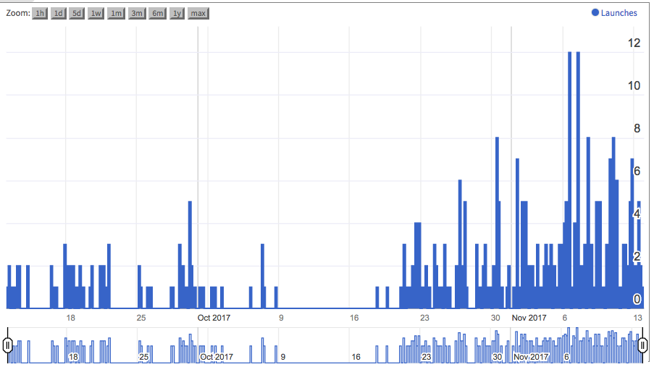
Launches by Time
Virtually all of this UI is a web component

Slide 6
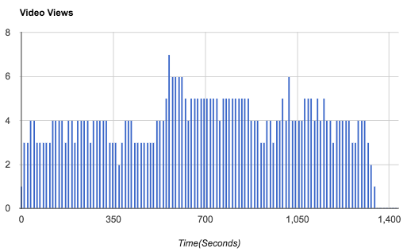

Slide 7
Chucks "Maybe" view of OpenLRW
Tsugi
LTI Tool
Tool
Mini
LRS
LRW
"Data Fixer"
Tool
LRW
Viewer
Viewer
LRW
LTI
ODash
LTI

Slide 8
Chuck "Maybe" View of Sakai Analytics
Sakai
LRS
Tool
Mini
LRS
Tool
LRS
Viewer
LRS
LTI
Viewer
The mini LRS has a data model that is well suited for a relational database.

Slide 9
Apereo View of Analytics
Sakai
OpenLRS
Tsugi
OpenLRW
OpenCast
Fixer
OpenLRW
Xerte
Learning
Locker
OAE

Slide 10

Apereo will not take the easy path
April 2015

