Slide 1
Tsugi Marketing Tour

Slide 2

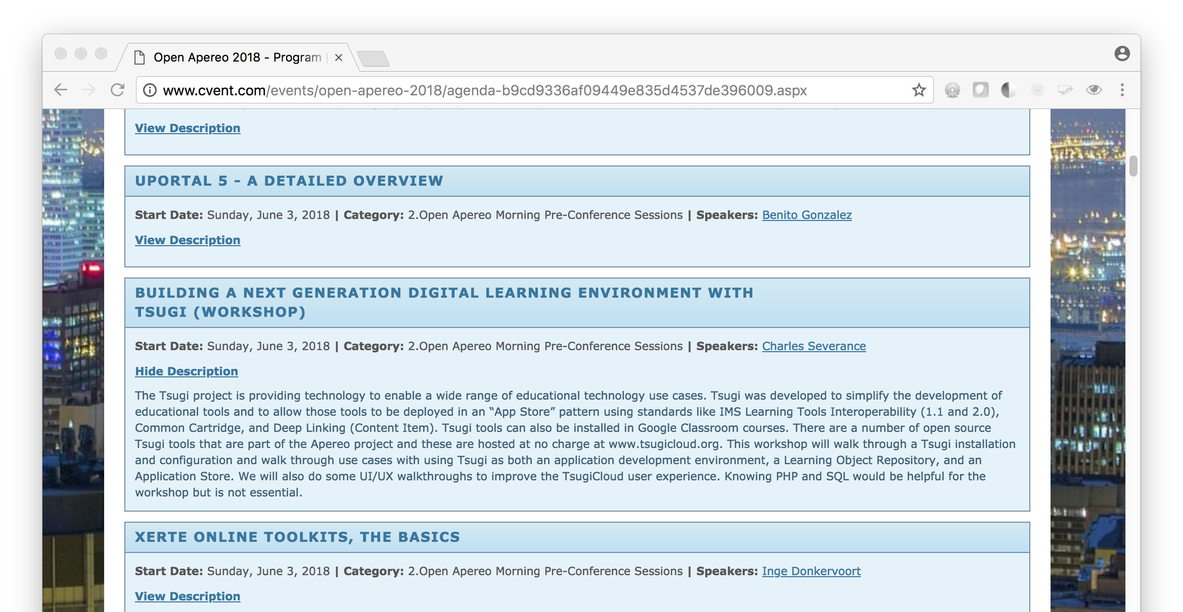

Slide 3


Slide 4
