Slide 1

Introducing SakaiPlus
Dr. Charles Severance
Sakai PMC Chair
www.sakailms.org/plus
plus@sakailms.org

Slide 2


Slide 3
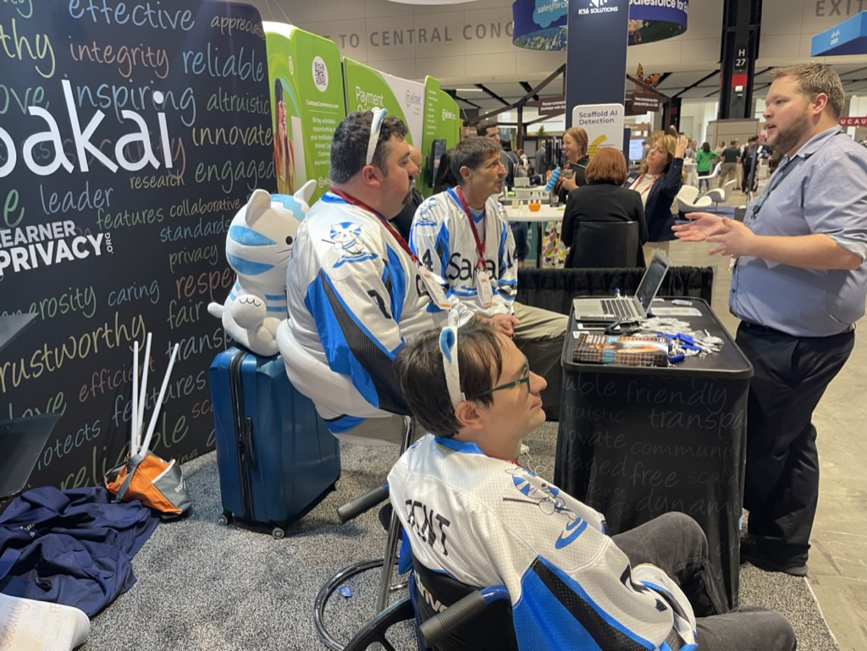
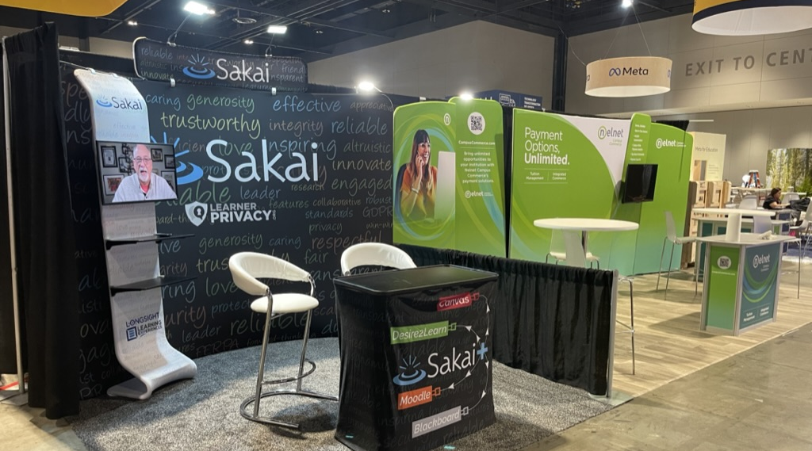
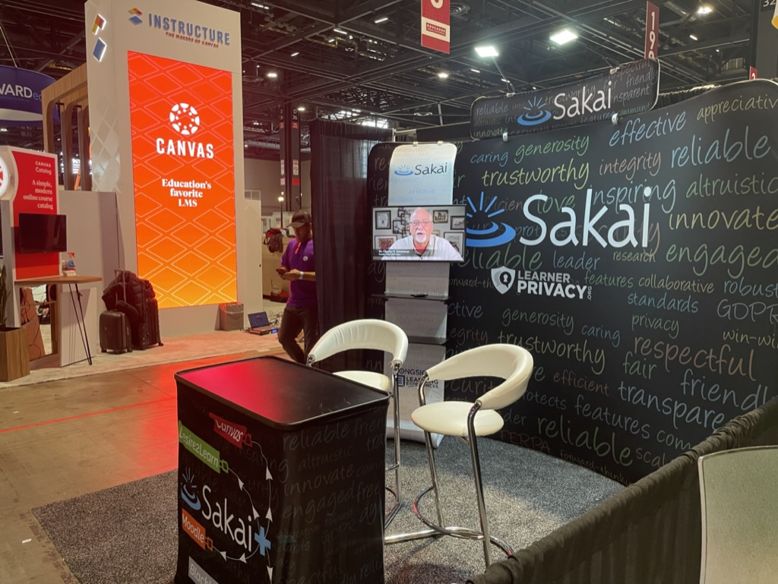

Slide 4
The Trends We See…
LMS Innovation is slowing
LMS Satisfaction is "meh" – no system makes everyone happy
Switching to a new LMS is a lot of work and then … "meh"
Faculty and Instructional Designers are looking to LTI tools that lets them create meaningful content and engage students
The LMS is evolving to be a learning portal with a basic, unexciting, content sequencing experience

Slide 5
Looking at SakaiLMS..
Faculty and instructional designers love Sakai
Sakai continues to innovate
Sakai wants to make life better for
Innovative Instructors
Instructional designers
The IT organization (don't add a lot to their plate)

Slide 6
Demo: Sakai Advantages
Wilma Hodges

Slide 7
Innovative learning experiences are happening outside the LMS using LTI 1.3…

Slide 8
Innovative learning experiences are happening outside the LMS using LTI 1.3… Make all of Sakai an LTI 1.3 tool

Slide 10
SakaiPlus – LMS Multiverse
Part of Sakai 23
Sakai can plug into any LMS using LTI Advantage (1.3)
Retrieves and synchronizes roster data
Synchronizes all grade book activity
Launch / grades / notifications from campus LMS

Slide 11
Demo: Using SakaiPlus in Canvas
Charles Severance

Slide 12
Use Cases
SakaiPlus as "second lms" for the "cool kids"
Build course once in SakaiPlus – provide high fidelity experience in any LMS
Pulling a single tool into Campus LMS as part of a course - just an LTI tool

Slide 13
Benefit: An Active Community
You can be part of an active and engaged community
Participation
Support
Innovation
In Sakai, you can talk to the people doing the work
You can also *be* the people doing the work if you want

Slide 14
Timeline
Beta customers 1Q24
2-6 schools, 1-4 instructors per school
Weekly meetings between Beta testers and dev team during the Beta
Production 3Q24
Beta servers will be funded by LearnXP

Slide 15
Pricing
Pricing will be influenced by
Number of seats
Expected load and growth
Hosting choice
Support options
Initial set up efforts
We need to be sustainable
We won't discount to get business
No venture capital or private equity

Slide 16
Hosting Type | Services | Planning Cost(*, **, ***)
Testing | Multi-Tenant, Shared DB, Not Upgradable or Transferable, < 200 seats | Free
Small | Multi-Tenant, Dedicated Database, Upgradable, Transferrable, < 1000 seats | $5K / year
Local Hosting | Your Server, Your Database, Your AWS bill, Upgradable, < 3000 seats | Subscription, $5K / year
Cloud Hosting | Hosting, support, growth, monitoring, capacity planning… | $20/seat, min $20K / year
(*) These numbers are only shown as examples, for rough budgeting and to help understand the hosting choices that are possible for SakaiPlus. The pricing will be informed by Beta experiences and usage patterns of SakaiPlus versus SakaiLMS (Enterprise-wide)
(**) These numbers do not include the cost of setup which can be as low as zero, but can also be non-trivial and are often determined by institutional requirements
(***) These are planning numbers only, We are happy to chat about your particular situation.

Slide 17
Let's Schedule a Meeting
Introduce SakaiPlus more broadly to your team
Explore benefits to your organization
Instructional Designers
Innovative Faculty
Privacy Concerns
Install Free SakaiPlus into your sandbox or test server
Discuss pain points that SakaiPlus might address
More detailed discussion about hosting options / costs
Make a plan for your Beta
plus@sakailms.org

