Slide 1
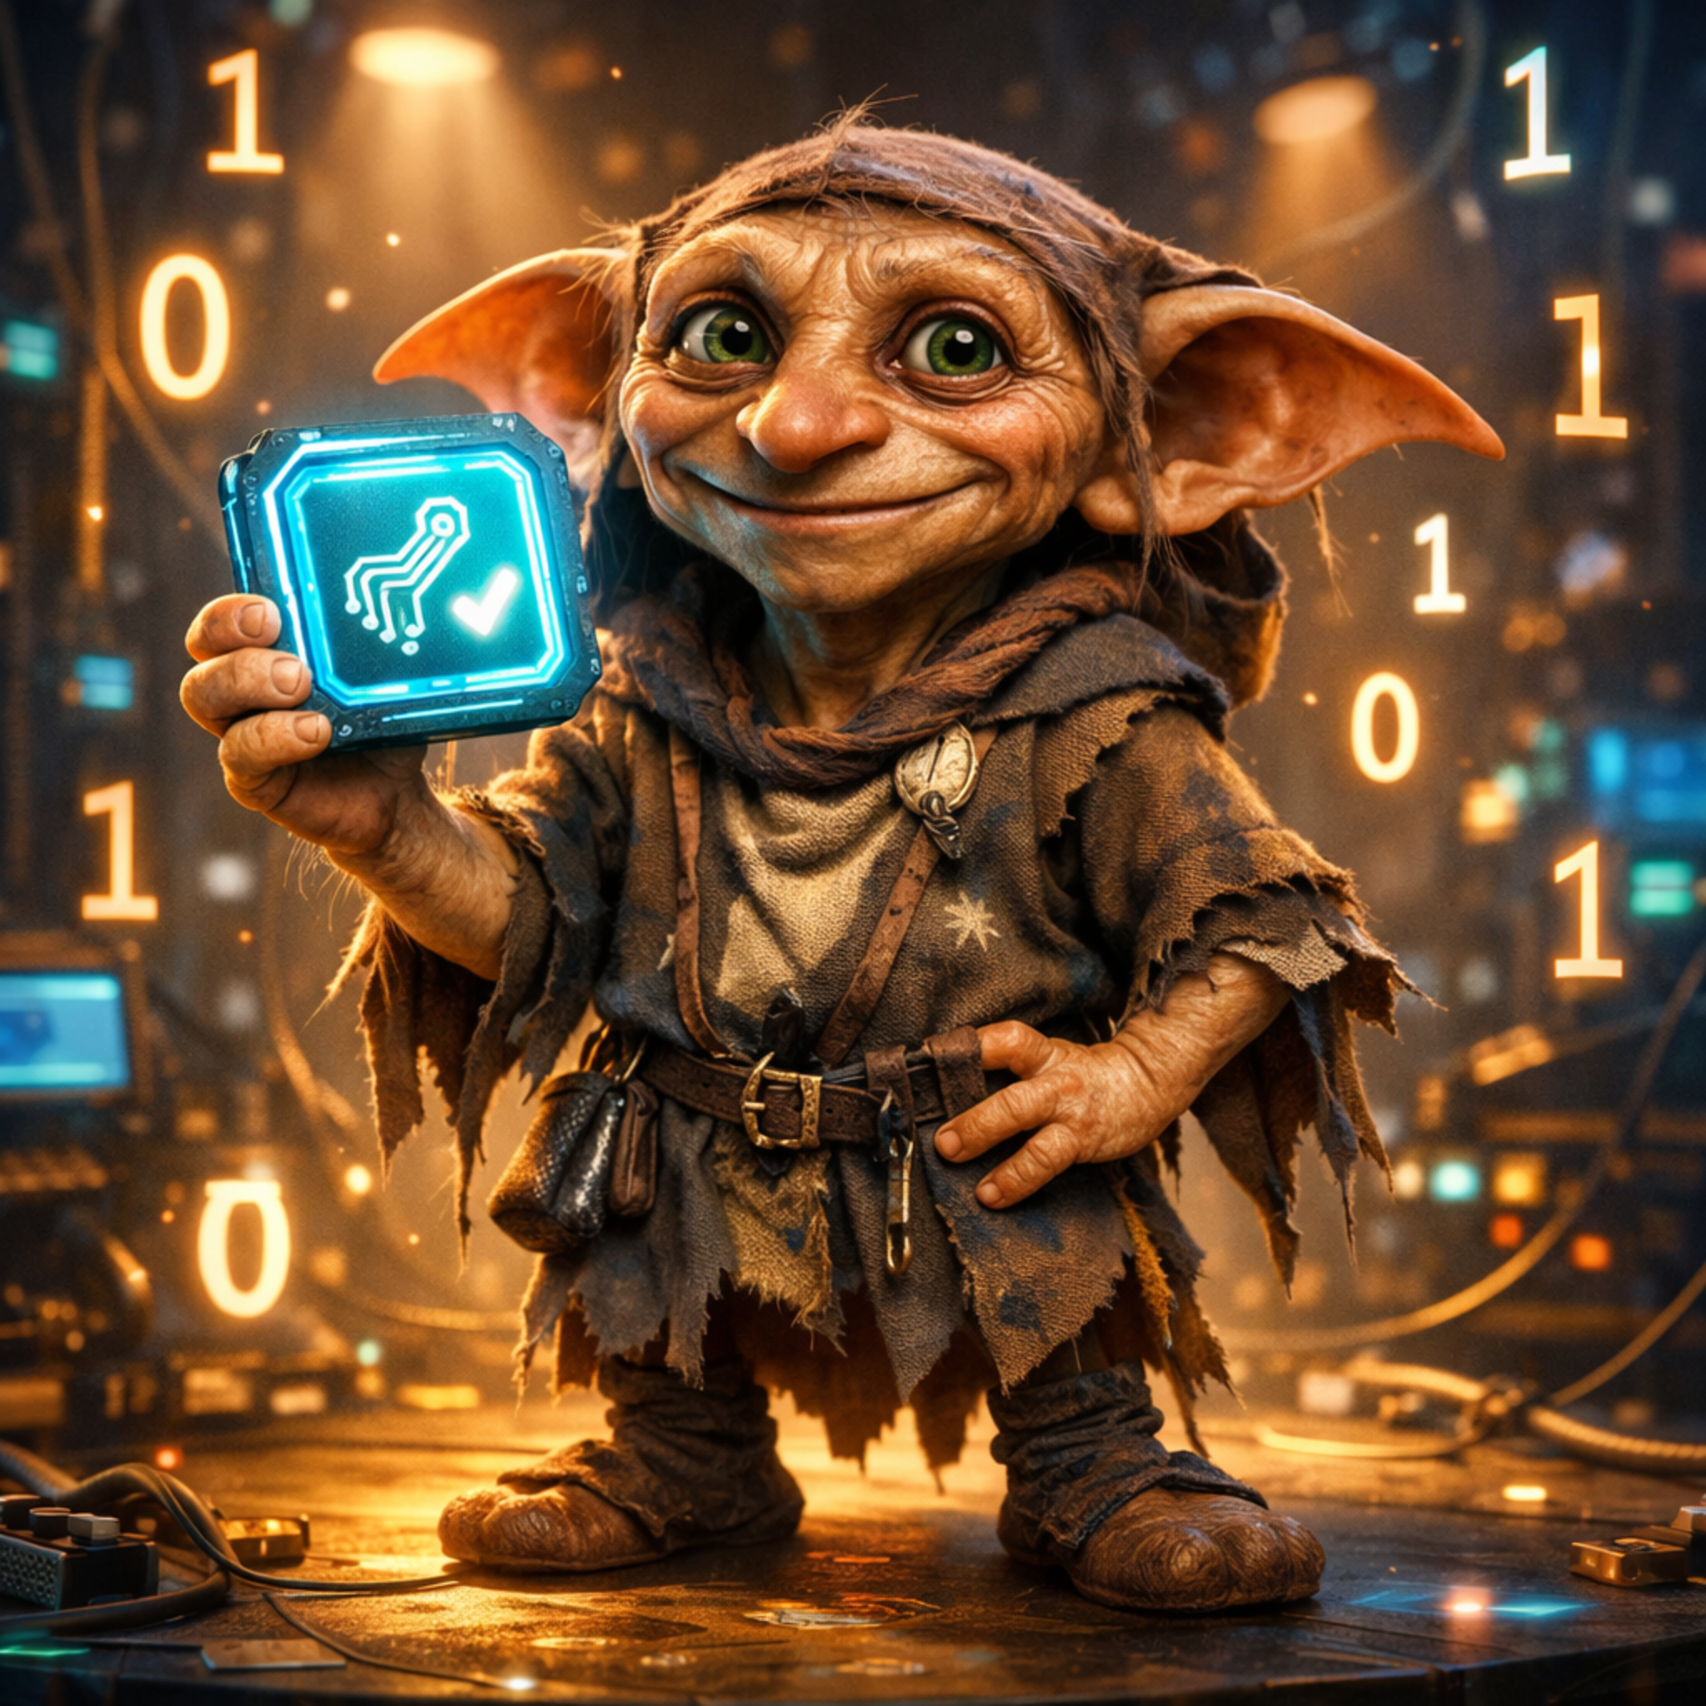
Badge Vendors Are Chaotic Goblins
An OB2/OB3 Field Report
Charles R. Severance + ChatGPT + OpenAI + Cursor.AI
Notes:
Introduce yourself and frame the talk as light-hearted but serious about standards.

Slide 2
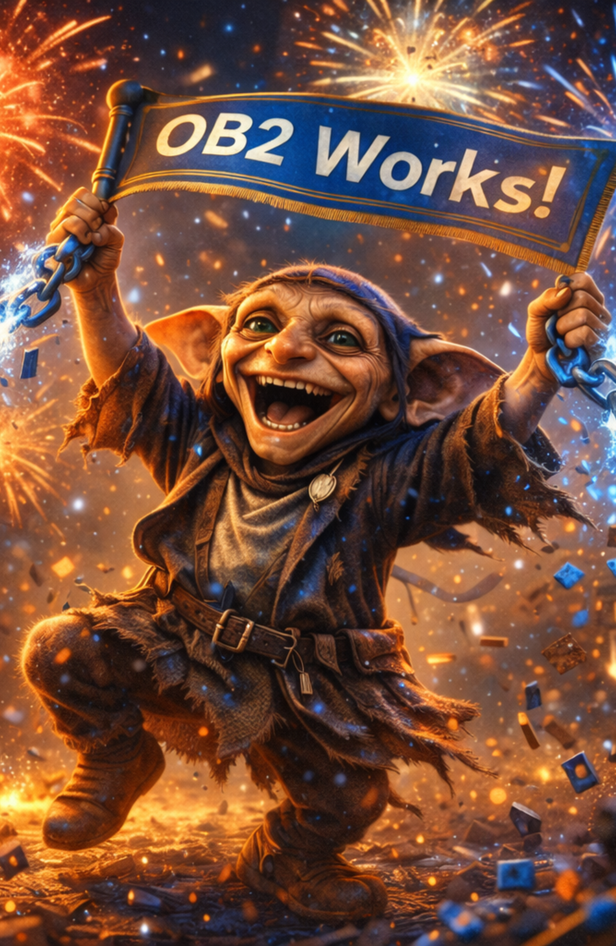
How This Deck Came to Be
• Built from weeks of deep conversations
• We wandered through OB1, OB2, OB3, and vendor chaos
• Many detours, dead ends, and breakthroughs
Dr. Chuck wanted quick hacks that worked
• ChatGPT kept redirecting Dr. Chuck toward clarity & standards
• The deck itself was auto-generated by ChatGPT
Notes:
Tell the story of how this deck emerged through conversation with ChatGPT.

Slide 3
What was the tension
• Open Badges specs evolved faster than adoption
• Vendors drifted into proprietary territory
• Real-world interop ≠ promised interop
Notes:
Explain why badges matter and why the audience should care.

Slide 4
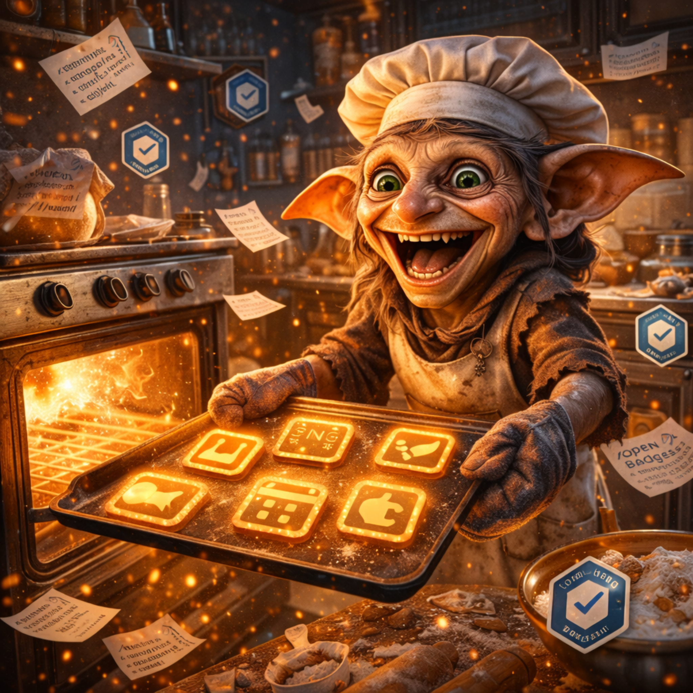
Timeline Chaos
• OB1: baked PNG era
• OB2: hosted JSON era
• OB3: VC era launched before OB2 stabilized
Notes:
Describe the evolution from OB1 to OB3 and emphasize instability.

Slide 5

Vendor Behavior
• Credly: import lock-in, special schemas
• Badgr: validator loves PNG ghosts
• LMS platforms: assume vendor ecosystems
Notes:
Give concrete vendor examples of divergence and lock-in.

Slide 6
Interoperability Myth
• Claim: vendors follow OB2/OB3
• Reality: they follow each other
• IMS validator passes; vendors reject
Notes:
Show how 'interop' often means vendor-to-vendor, not spec.

Slide 7
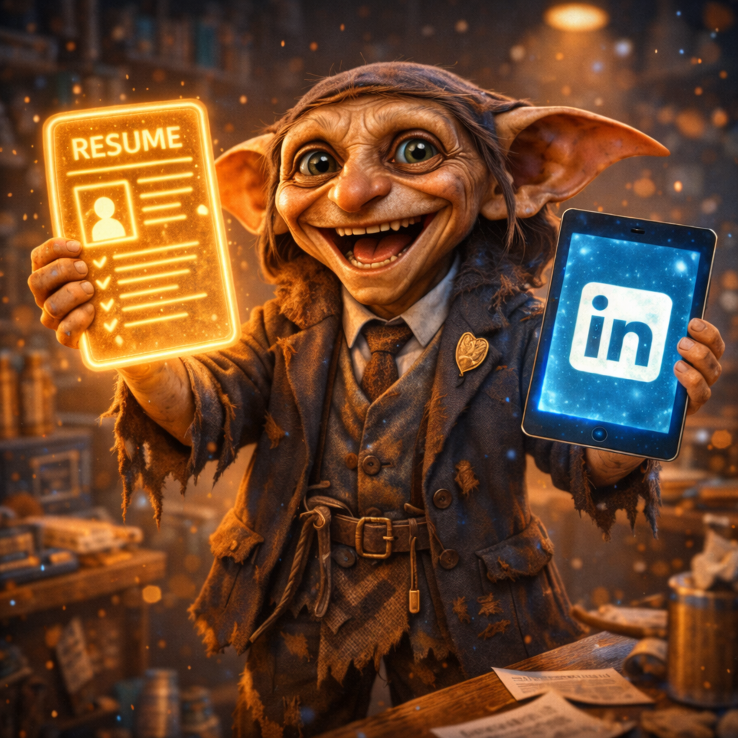
Working Reference Implementation
• Hosted OB2 + OB3
• Independent badge landing pages
• Direct LinkedIn add-to-profile
Notes:
Explain your working reference implementation and why it matters.

Slide 8

Conclusion
• Vendors = goblins
• Standards = good
• Reference implementations matter
• Discuss over beers 🍻
Notes:
Wrap with humor; invite discussion and critique.

Slide 9
ChatGPT ↔ Cursor.ai Dynamic
• Iterated between ChatGPT guidance and Cursor.ai execution
• Frequent frustration with tooling and validation quirks
• ChatGPT helped keep Cursor.ai aligned with standards
• Demonstrates real-world AI pair programming value
Notes:
Talk about how the workflow involved bouncing ideas between ChatGPT and Cursor.ai. Describe frustrations when Cursor drifted or produced invalid output. Highlight how ChatGPT acted as the conceptual guardrail, keeping the implementation aligned with OB2/OB3 goals and preventing vendor-driven detours.

Slide 10
Comedy Roast: OB1 Baked PNGs
• PNGs with JSON hidden like a cursed treasure map
• Debugging? Hope you like hex editors
• 'Spec compliant' if you squint hard enough
• Still haunting modern tools like undead formats
Notes:
Lean into humor: describe OB1 baked PNGs as relics from an ancient civilization. Mention how JSON lived inside PNG chunks like ghosts in the machine. Talk about the absurdity of needing image parsers for credential metadata, and how this architecture still causes real-world chaos.

Slide 11
Our OB2 Baking Temptation
• Tried to resurrect OB1-style baked PNGs for OB2
• Looked at Credly demo PNG: no metadata at all
• Realized baking OB2 would create vendor-specific artifacts
• Decided to stay clean: hosted JSON + landing pages
Notes:
Explain how we desperately wanted PNG baking to solve vendor imports.
Describe looking at Credly's demo PNG and finding no embedded metadata.
Mention how OB2 baking would likely lead to non-standard, vendor-flavored hacks.
Conclude that sticking to hosted JSON and spec purity was the right call.

Slide 12
The Payoff: No Credly Needed for LinkedIn
• Realized LinkedIn accepts direct credential URLs
• No need for Credly/Badgr intermediaries
• Add-to-LinkedIn link: no API, no lock‑in
• Host our own OB2/OB3 → plug into LinkedIn cleanly
Notes:
Explain how the breakthrough came from learning that LinkedIn doesn't parse OB2/OB3 directly; it just needs a credential URL. Mention the built-in profile/add endpoint, removing the need for any third‑party vendor. Emphasize the empowerment: full control, no dependency, and a cleaner system.

Slide 13
Triumphant Escape from the Badge Matrix
• Independent OB2/OB3 issuer with verifiable badges
• LinkedIn integration without vendor lock‑in
• IMS‑validated, standards‑based implementation
• The future: clean, open, portable credentials
Notes:
End with energy: highlight how the project proves a full standards‑aligned pipeline. Celebrate independence from proprietary vendors and reliance on open standards. Invite the audience to imagine a future ecosystem built on this pattern.

Slide 14
Goblin Image Prompts
• Title: proud tech goblin with badge
• Vendor Chaos: goblin ripping wires & papers
• Baked PNG: goblin baker pulling PNG cookies
• LinkedIn: goblin with resume & tablet
• OB3 Future: wizard goblin with VC scroll
• Triumph: goblin breaking chains under fireworks
Notes:
Full Prompts:
1. Proud goblin with badge on stage.
2. Chaotic hacker goblin ripping vendor docs.
3. Goblin baker pulling PNG cookies from oven.
4. Goblin with resume and LinkedIn tablet.
5. Wizard goblin with holographic VC scroll.
6. Triumphant goblin breaking chains.

