Slide 1
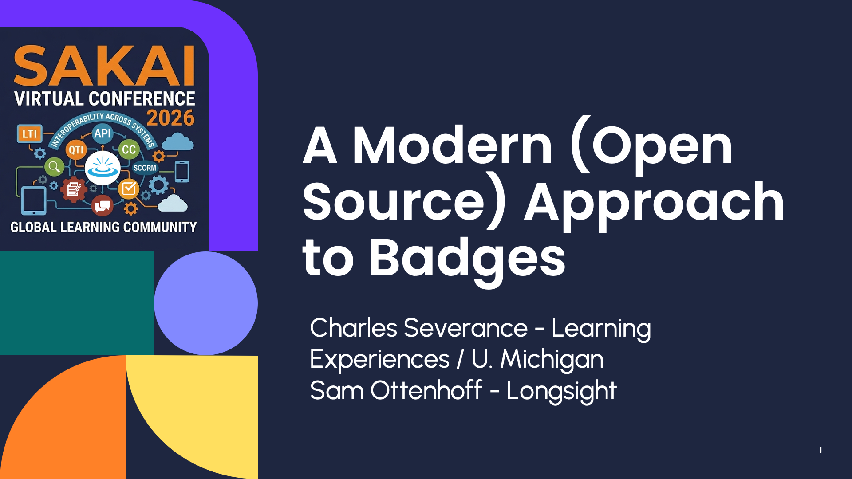
A Modern Approach to Badges ^{(open source)}
Dr. Charles Severance, Learning Experiences, University of Michigan
Sam Ottenhoff, Longsight, Inc.

Slide 2
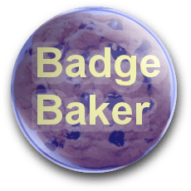
Badge Standards History
2012 Mozilla Open Badges 1.0 – Baked PNGS
2016 IMS OBI 1.0 – Baked PNGs
  https://www.dr-chuck.com/obi-sample/
2018 IMS OBI 2.0 – Signed JSON
2026 1EdTech OBI 3.0 W3C Verifyiable Credentials – JSON-LD
  https://www.w3.org/TR/vc-overview/
Give me a brief history of Open Badges from the original work in Mozilla through IMS to 1EdTech and OBI3

Slide 3
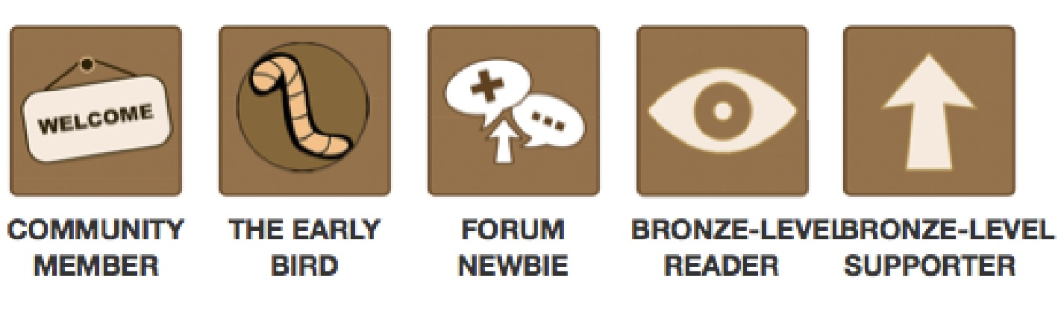
Serious Badge Research Circa 2013
Coursera: Engaging with Massive Online Courses
  https://www.cs.cornell.edu/home/kleinber/www14-courses.pdf
Research Coursera’s 2013 internal forum badge system by Pam Fox, including Badgeville, Andrew Ng’s ML course, badge types, UI experiments, and engagement findings.

Slide 4
Big Money Badges (LinkedIn Credentials)
A reasonable estimate is that the University of Michigan has earned about $50 million in gross non-degree Coursera revenue from 2012 to the present, with a plausible range of $35M–$75M.
This excludes online degrees and represents estimated cash to U-M before internal production/support costs. The estimate is based on U-M’s large Coursera scale: 6.5M enrollments by 2018, continued growth since then, and several unusually large evergreen courses and specializations such as Python for Everybody, Successful Negotiation, Applied Data Science with Python, and Web/Web Applications for Everybody.
About how much gross revenue has the University of Michigan made from Coursera between 2012 and present? Do not include online degrees.

Slide 5
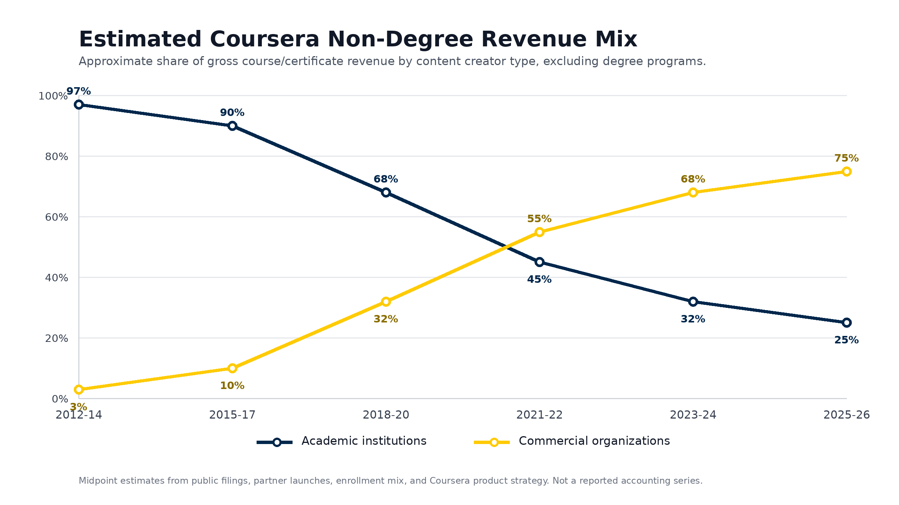
Coursera Academic -> Commercial Shift
Can you track the relative revenue share of Coursera courses over time that are from Academic institutions versus commercial organizations like Google, Facebook, and DeepLearning. Ignore degree programs.
Notes:
The story is: Coursera started as overwhelmingly academic, probably 95%+ university revenue in the 2012-2014 MOOC era. The commercial shift starts in earnest around 2018, when Google launched the IT Support Professional Certificate on Coursera. It accelerates in 2021, when Google launched major career certificates in Data Analytics, Project Management, and UX Design.
By 2025, Coursera describes its non-degree catalog as heavily career-oriented: 95+ entry-level Professional Certificates, 60+ non-entry Professional Certificates, and 6.0M Professional Certificate enrollments in 2025, up 22%. It specifically names IBM, Microsoft, Google, Meta, Amazon, and DeepLearning.AI as major industry certificate creators.

Slide 6
Maybe UMich should prepare to host our own courses and create our own branded badges for students to put into LinkedIn
We like the money and there appears to be a market. AI makes research and solving this much easier.

Slide 7
Badges / Credentials -> LinkedIn
Learner Completes Requirement
Mint a real credential (OB2 / OB3)
  recipient, issuer, badge name, criteria, issue date, credential ID, verification URL, image, and optional expiration, evidence, skills, revocation/status.
Create a durable public verification page
Expose machine readable metadata
Offer "Add to LinkedIn"
Keep the issuer identity consistent
What would you say the best practice is for a learning system to mint a credential / badge and link it into a LinkedIn profile?

Slide 8
Broken LinkedIn Credentials (student paid $3000)
The credential entry stays on the user’s LinkedIn profile
If someone clicks on the link – they get a 404
The credential becomes less trustworthy, because viewers cannot confirm it.
Best practice is to make credential URLs boringly permanent: stable domain, no session required, redirects preserved forever, and no URLs tied to course semesters or internal database paths that might change. For serious credentials, the URL should outlive the platform implementation.
What does LinkedIn do if the durable public verification page goes away or changes slightly.

Slide 9
The Commercial Badge Market
Parchment / Badgr / Canvas
Credly / Pearson
Accredible
Moodle built-in
Open Badge Factory (not open source)
All of these are closed source, proprietary, and are putting their permanent verification URLs in your LinkedIn Certificates.
What are the leading badge / credential minting software products in use in higher education.

Slide 10
UM Online Non-Credit Strategy
We need to award our own University of Michigan branded credentials going forward.

Slide 11
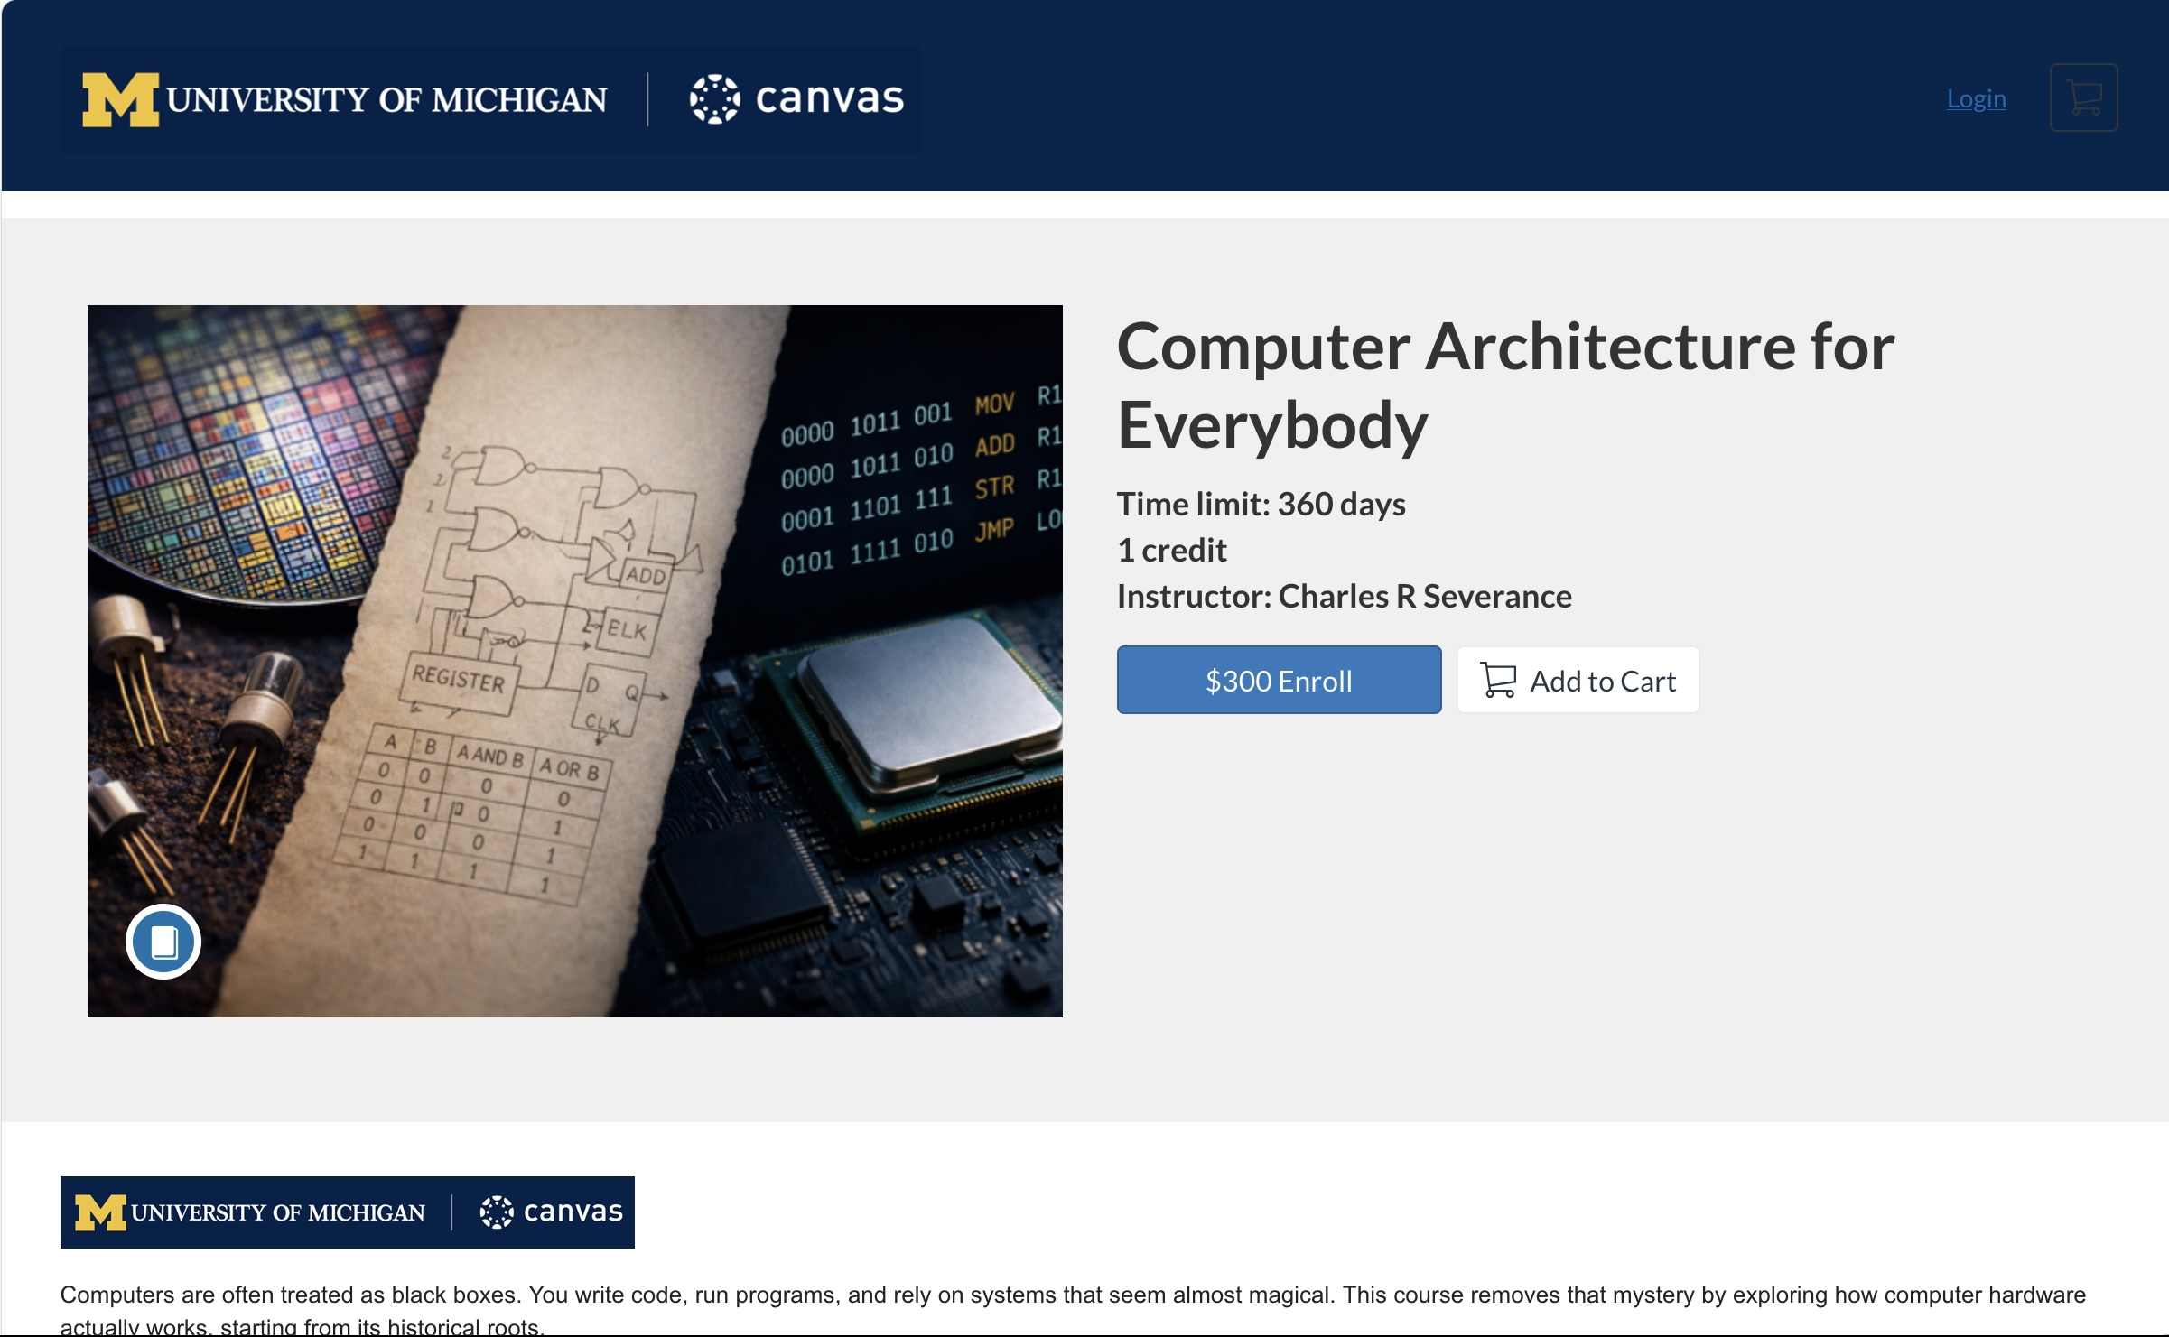

Slide 12
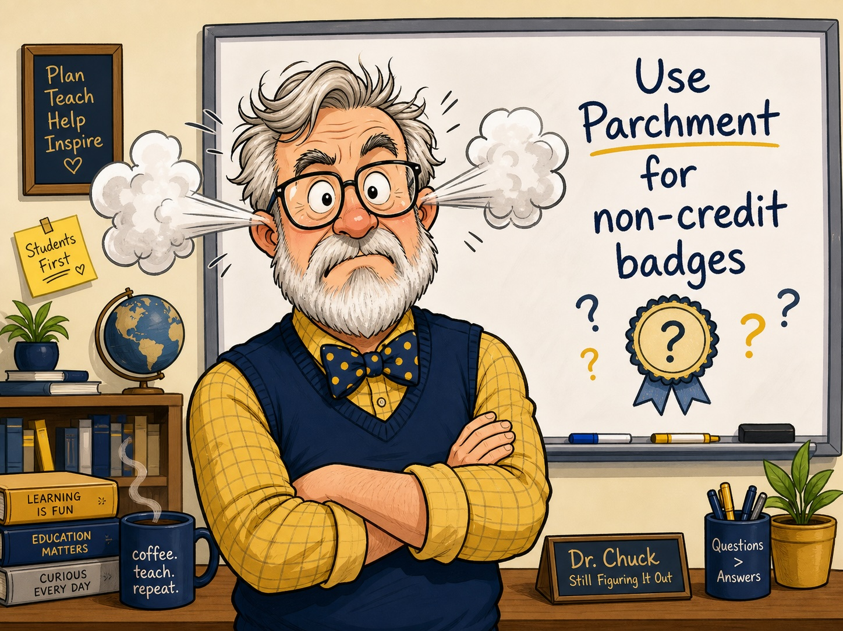
How can I give LinkedIn Badges from My Course?
They said:
  In Canvas – we will use Parchment, right?
  Each badge costs $4
How hard could it be to write a badging system…
Can you create a picture of Dr. Chuck (cartoonish) with steam coming out of my ears after I was told I had to use Parchment as a badging system for my UM non-credit courses.

Slide 13
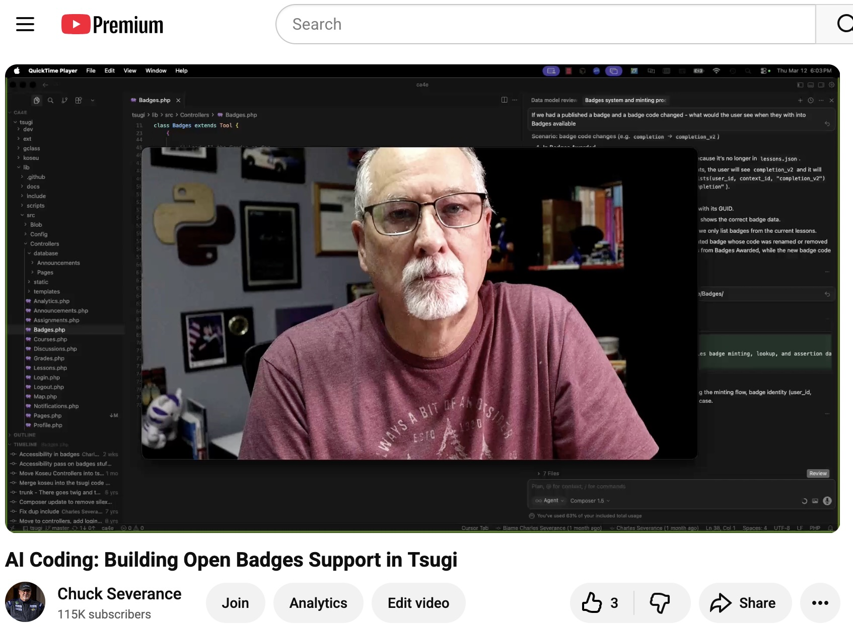
Using AI to Add OBI to Tsugi
It took about six hours – I recorded much of the coding
The LinkedIn bits were slow because they are not well documented
About 6 hours of work
https://ai.dr-chuck.com/
Can you find YouTube videos where Dr. Chuck added Open Badges support to Tsugi.

Slide 14
Tsugi Badge Demo
Including showing some sweet JSON data…

Slide 15
Coupling Portfolio to the LMS -> Bad Idea
Open Source Portfolio (OSP) Sakai 2003-2016 (retired Sakai 11)
Blackboard Built In
Anthology Portfolio (Chalk and Wire)
Moodle / Mahara
Canvas native portfolio (2009 – 2026?) Portfolium (2019-?)
Briefly summarise the history of portfolios in LMS systems - talk about the OSP project in Sakai Mahara in Moodle and any other widely adopted systems
Notes:
I knew badges in Tsugi were bad architecture – but it was easy.

Slide 16
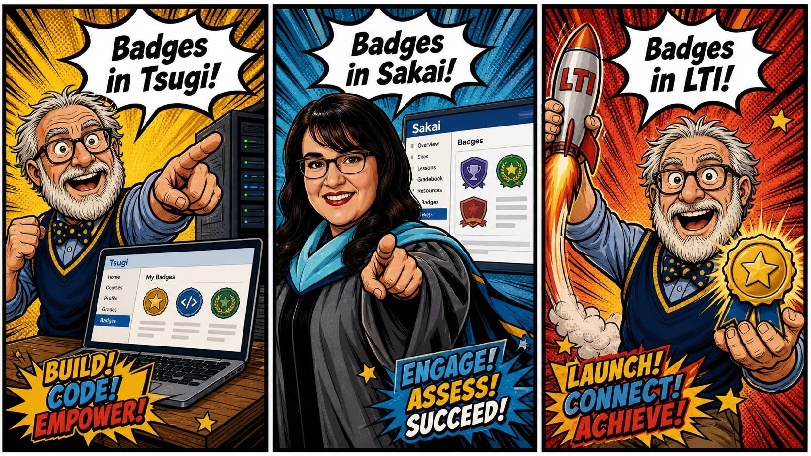
Three-panel comic showing what happened in the Sakai T/L call when Wilma saw the badges feature in Tsugi.
Notes:
Demo to Sakai teaching and Learning
Dr. Chuck – Look at the cool badges in Tsugi it took 6 hours with AI
Wilma – Lets do the exact same thing in Sakai – should be 6 hours, right
Dr. Chuck – It would be about six hours – especially with the Tsugi code – but that would be the wrong architecture! We need (wait for it) LTI ☺

Slide 17
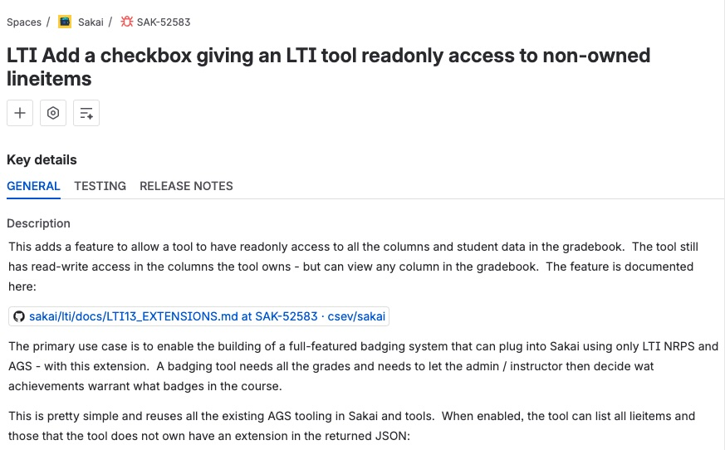
Could you briefly summarize the Sakai JIRA SAK-52583
Notes:
The primary use case is to enable the building of a full-featured badging system that can plug into Sakai using only LTI NRPS and AGS - with this extension. A badging tool needs all the grades and needs to let the admin / instructor then decide wat achievements warrant what badges in the course.

Slide 18
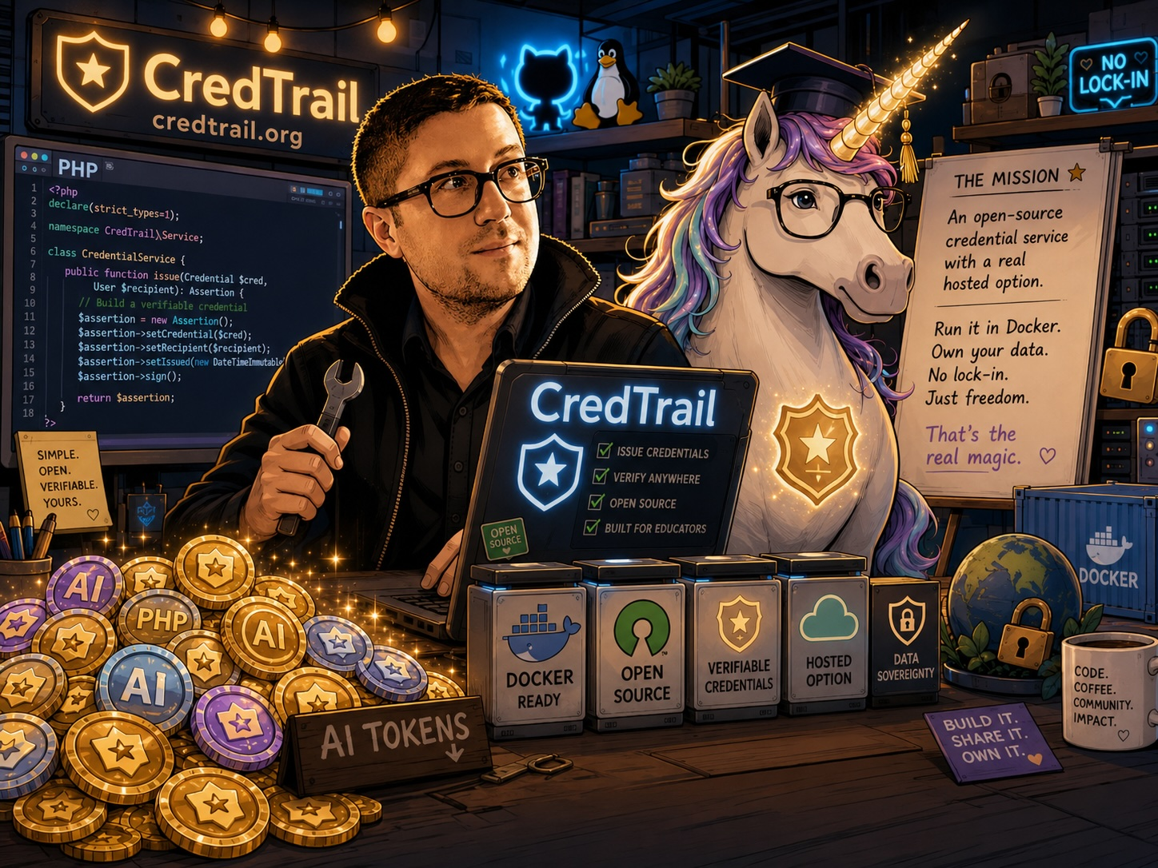
Let's Call Sam …
You get something dangerously close to an EdTech unicorn: The thing EdTech keeps saying it wants but somehow never quite builds: an open-source badge service with a real hosted commercial option, still runnable in Docker by anyone who wants sovereignty instead of lock-in.
What happens when you give Sam Ottenhoff, working badge code in PHP, a bunch of AI tokens, and ask for an open source online commercial LTI-based service that is both hosted and available in docker?

Slide 19
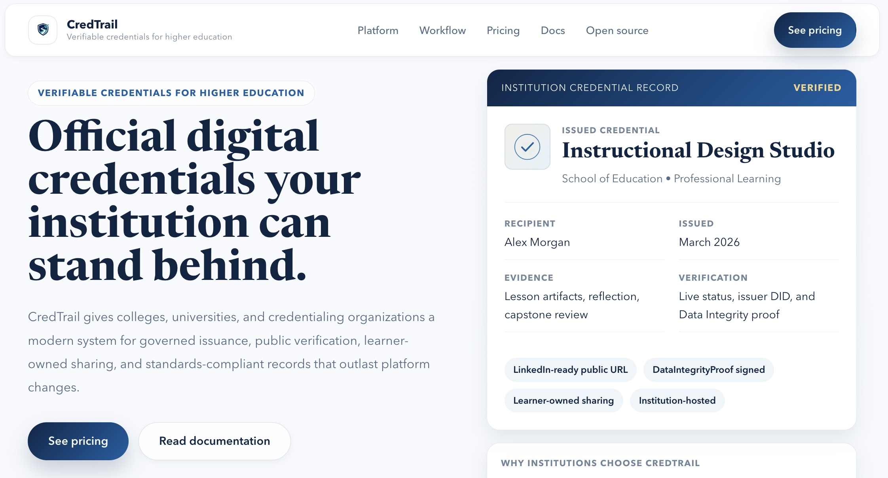
credtrail.org
Tell me about www.credtrail.org
Notes:
CredTrail looks like exactly the “EdTech unicorn” framing: an open-source Open Badges 3.0 / Verifiable Credentials service for higher ed, with both a hosted commercial path and a self-hosted Docker path.
The public site pitches it as institutional badge infrastructure: governed issuance, approval workflows, public verification pages, learner-owned sharing, LinkedIn-ready URLs, and records that survive LMS migrations. It specifically says it supports Open Badges 3.0 with W3C Data Integrity proofs, Docker deployment, Canvas/Sakai-style LMS integration, Postgres/S3-style infrastructure, SAML, branding, and institution-owned verification URLs.
The GitHub repo is under LongsightGroup/credtrail-app, AGPL-3.0 licensed, and describes itself as an “Open-source Open Badges 3.0 platform with Cloudflare SaaS and Docker self-host runtime profiles.” The README lists badge templates, manual issuance, Ed25519 signing, did:web issuer identities, revocation, learner dashboards, public badge pages, LinkedIn sharing, OB3 APIs, OAuth/PKCE, tenant RBAC, audit logs, and Docker self-host commands.
My read: CredTrail is positioning itself as the anti-Credly-for-higher-ed play: commercial enough that a university can buy support, open enough that a university can run it, and standards-focused enough that the badge record does not depend on a vendor profile page staying alive forever. That is a very nice fit with your “wants but never builds” line.

Slide 20
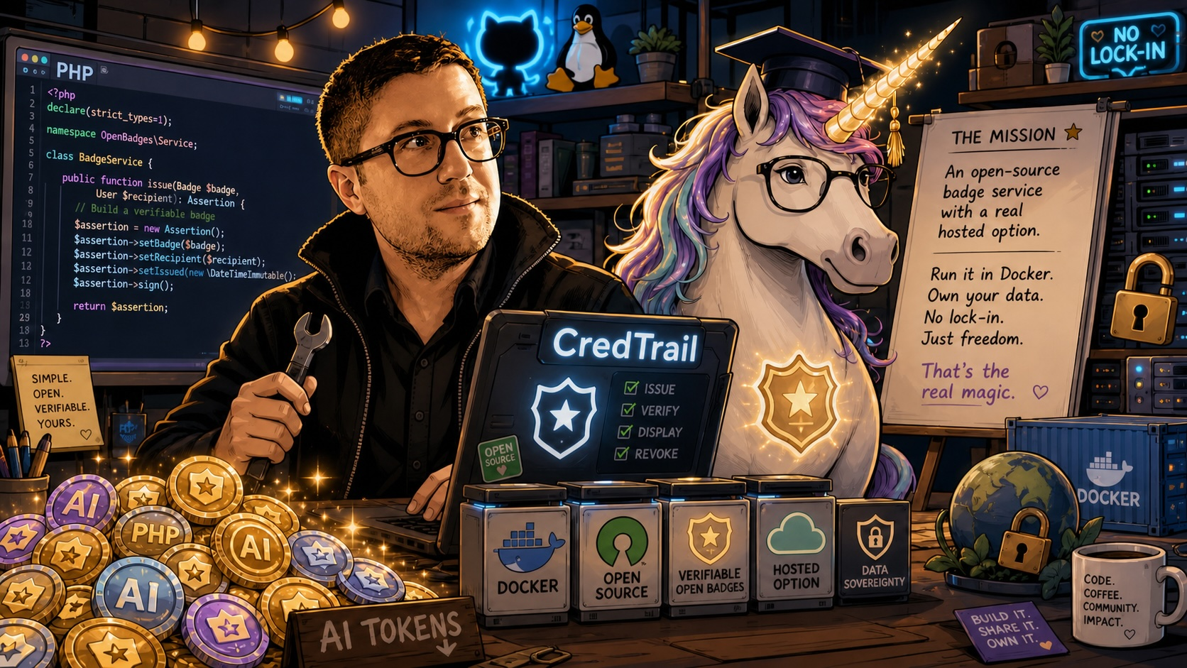
Demo Time

Slide 21

Thank you for your time
Any questions.

