Slide 1
Technical Aspects of Tsugi

Slide 2
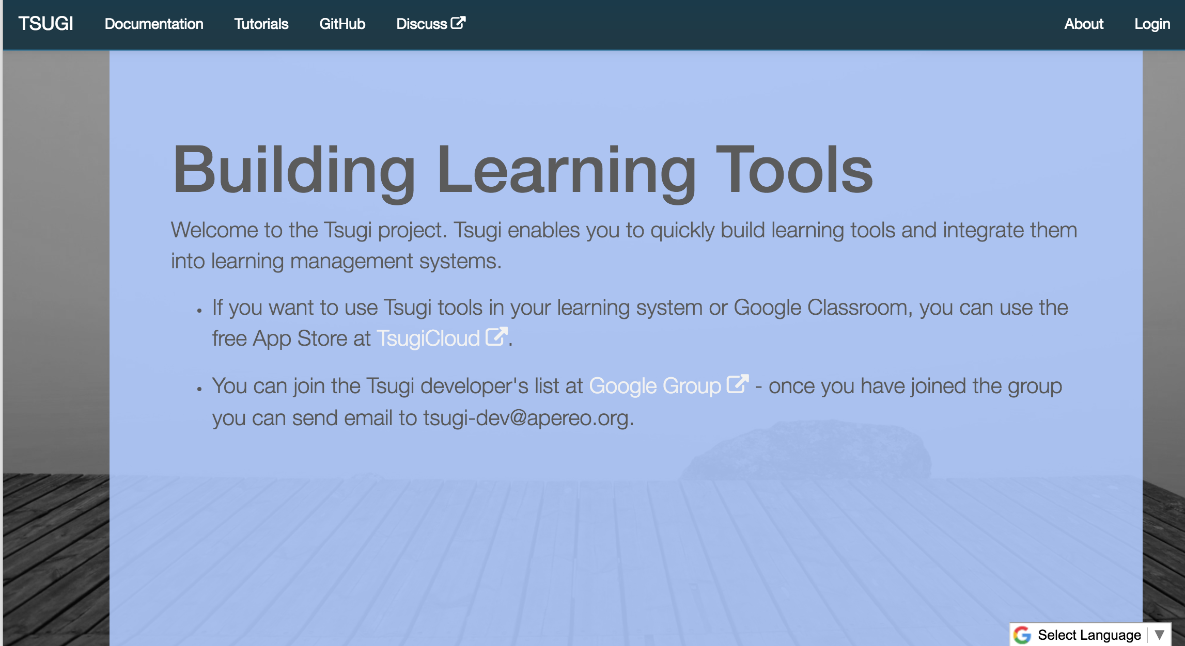
www.tsugi.org

Slide 3
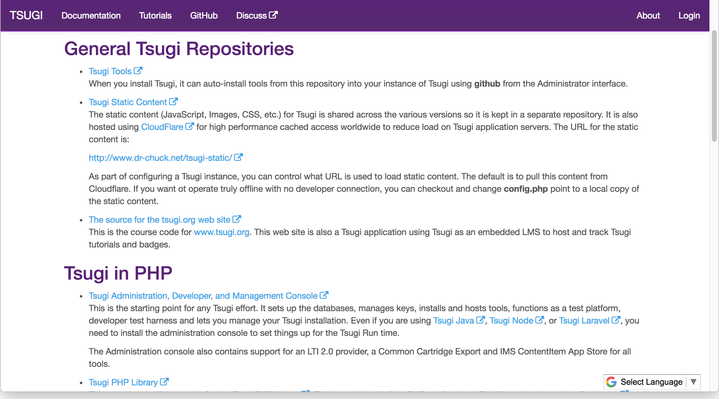

Slide 4
Why Build an LTI App With A Library?
LTI 1.0, LTI 1.1, LTI 2.0, Caliper, Common Cartridge, LTI Advantage …
Do you use user email as logical key in the user table? How long? Indexed?
Session Management / Expiry
Offline Grading – Peer grading Applications
Coping with unreliable Tool Consumers – Grade resend
Building Thin Cartridges From LTI Links
Handling Settings on URL, Custom parameters, etc.
Cross-LMS Setting Dialogs
Does your tool work behind CloudFlare CDN / Proxy?
Do you make use of windows.post messages to resize iframes?

Slide 5
Why use Tsugi's Library Code for your App
How many different LMS's have you actually tested with? Which versions?
Do you set cookies in iframes?
Multiple courses or roles in multiple tabs?
Storing tool settings when LMS does not support it.
Does your navigation vanish in an iframe?
How long is the column lis_sourcedid? Unique / Index / Logical Key
Does your data model support connecting LTI accounts with direct logins?
Do you issue keys by editing a text file or DB Table? Do you have a UI?
Can you figure out Google Classroom integration?

Slide 6
Do you really want to build all this?
You can deploy an on-campus app store
Admin interface / key management / data management
Designed for 100% uptime in the cloud - auto upgrade code/database
Like a WordPress for your learning tools
You can contribute your tool to an open app store like tsugicloud
You can make money submitting your tool from a commercial app store
What if you are building more of a stand alone site than a tool?

Slide 7
Tsugi Tool
Tsugi App
???
UI/UX APIs
Look / Feel
UI Widgets
\Tsugi\UI
\Tsugi\Settings
Opinionated APIs
Convention / Database Model / Session
Easy for App Developer to Use
\Tsugi\Core
Utility APIs
Implement Standards
Portable / Reusable outside Tsugi
\Tsugi\Util

Slide 8
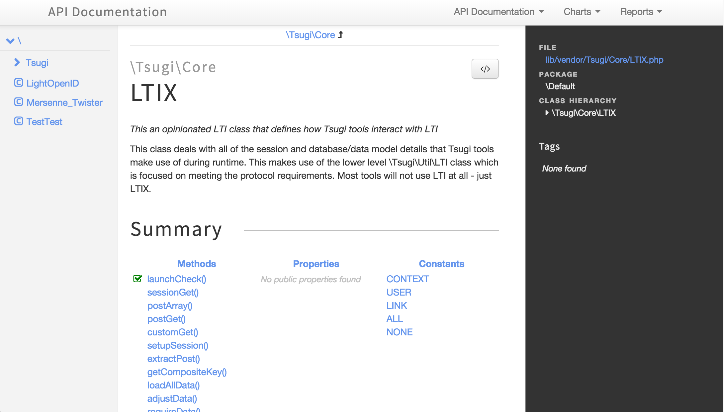
http://do1.dr-chuck.com/tsugi/phpdoc/classes/Tsugi.Core.LTIX.html

Slide 9
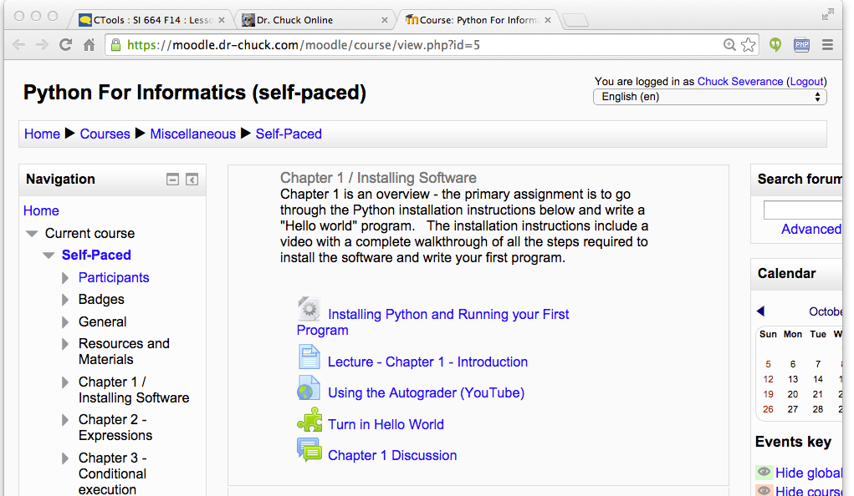
Tenant
Context
User
Link (Many)
Data Model

Slide 10
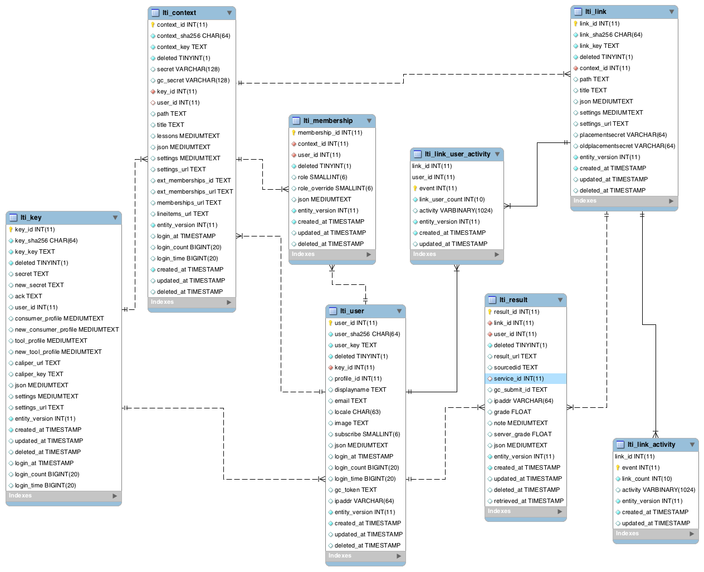

Slide 15
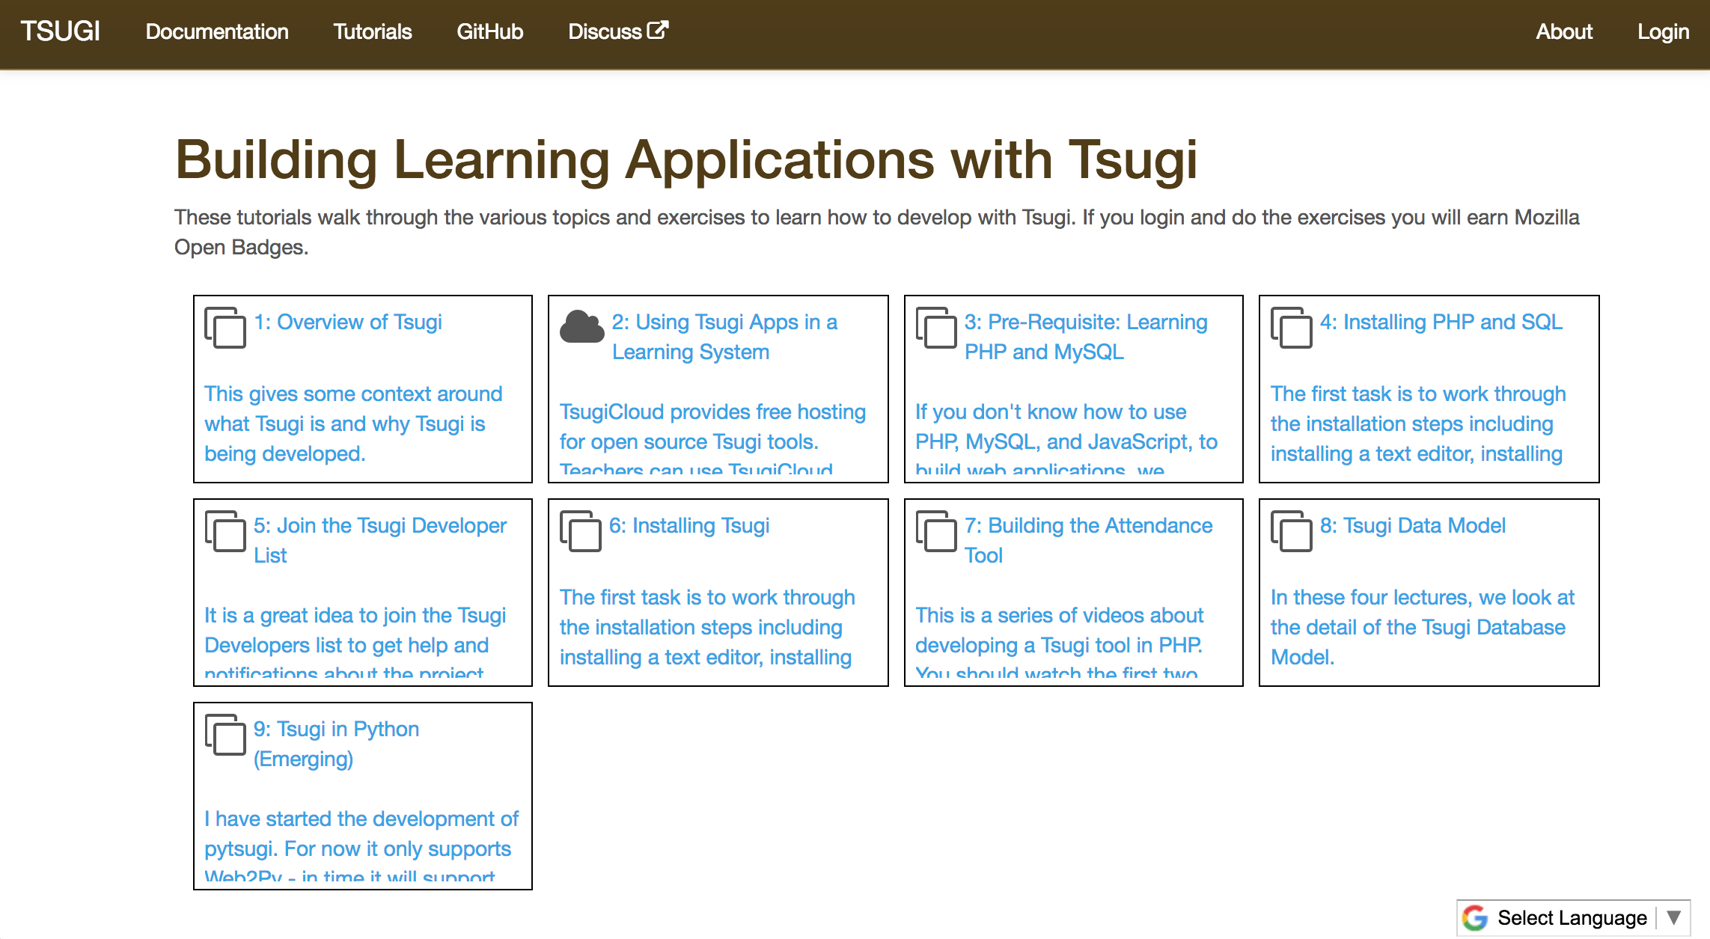

Slide 16
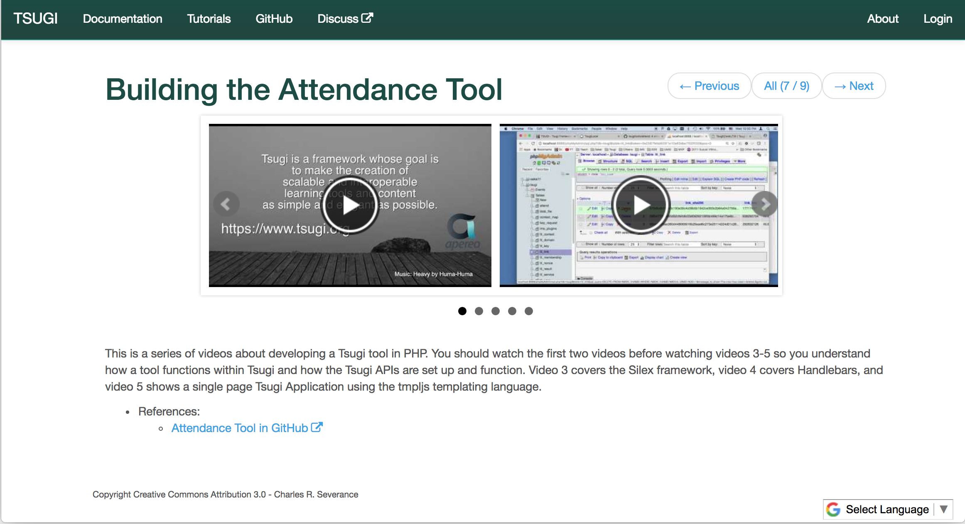

Slide 17
C
l
o
u
d
f
l
a
r
e
Amazon – www.tsugicloud.org
F
I
r
e
w
a
l
l
Application
Load
Balancer
EC2
Aurora
EC2
EFS
…
EC2
DynamoDB
Google – dev.tsugicloud.org
Kubernetes
CloudSQL
Ingress
Service
Load
Balancer
Docker
NFS
…
Docker
DataStore
https://github.com/tsugicloud

Slide 18
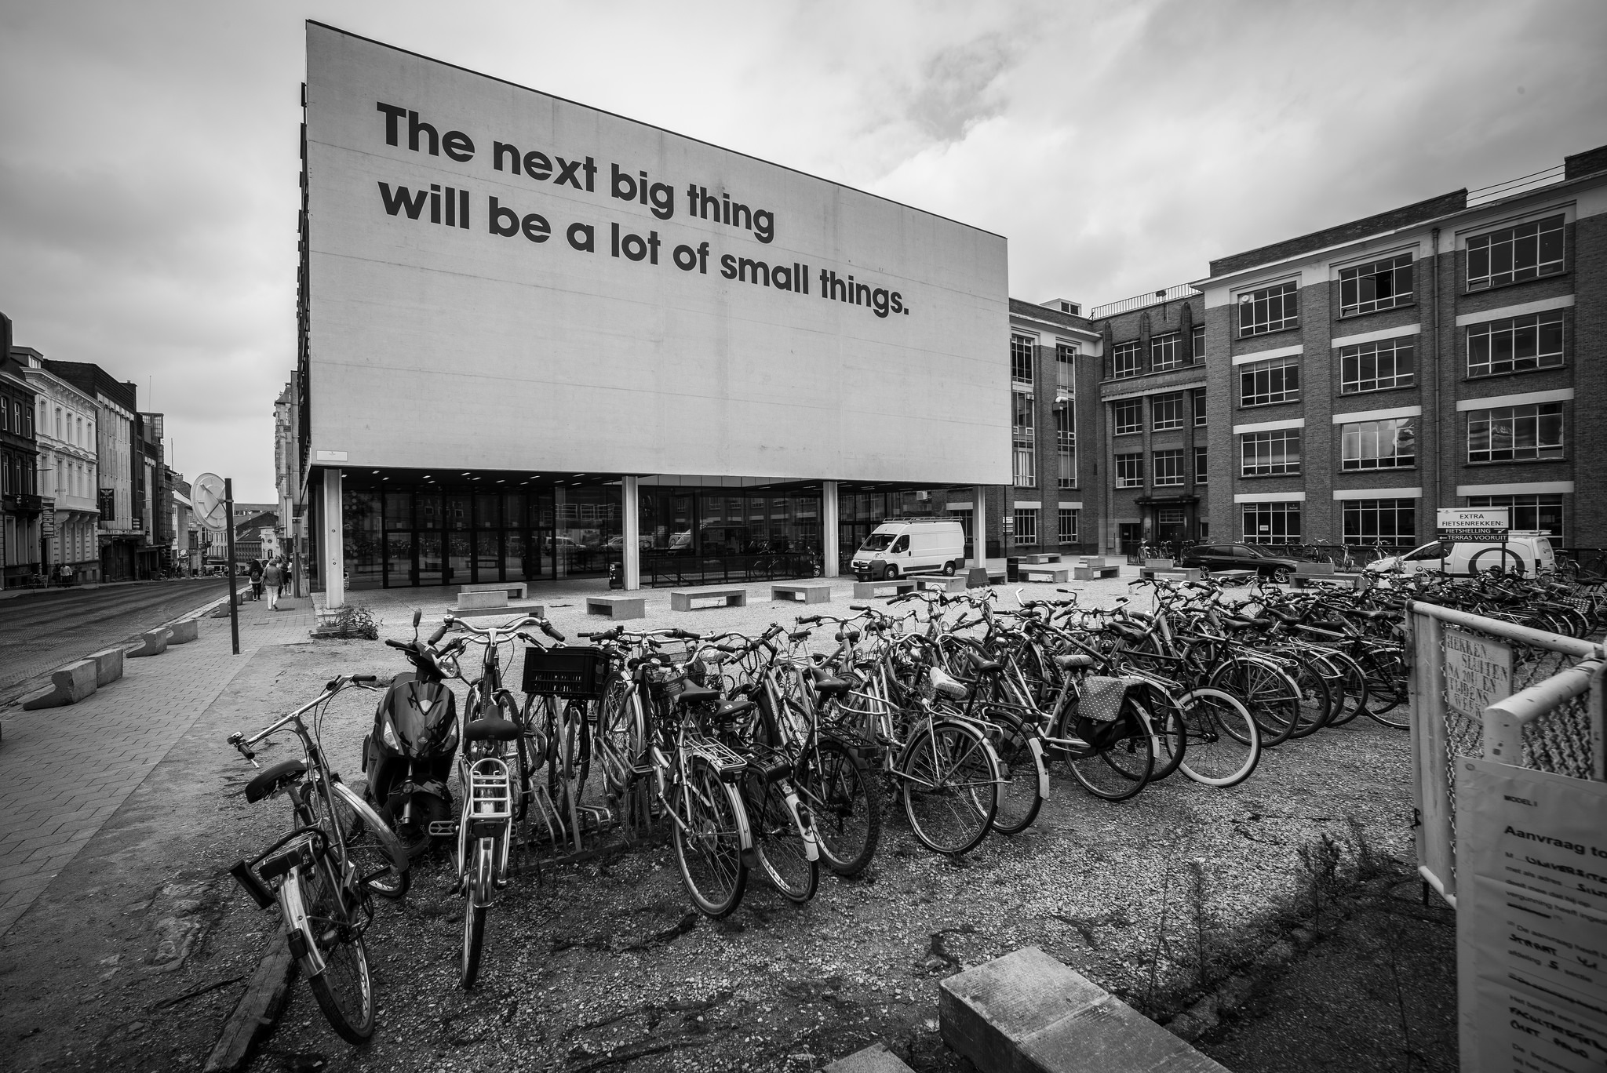

Source: Ian Dolphin

Slide 19
