Slide 1

+
February 3/7, 2022 BRIEFING

Slide 2


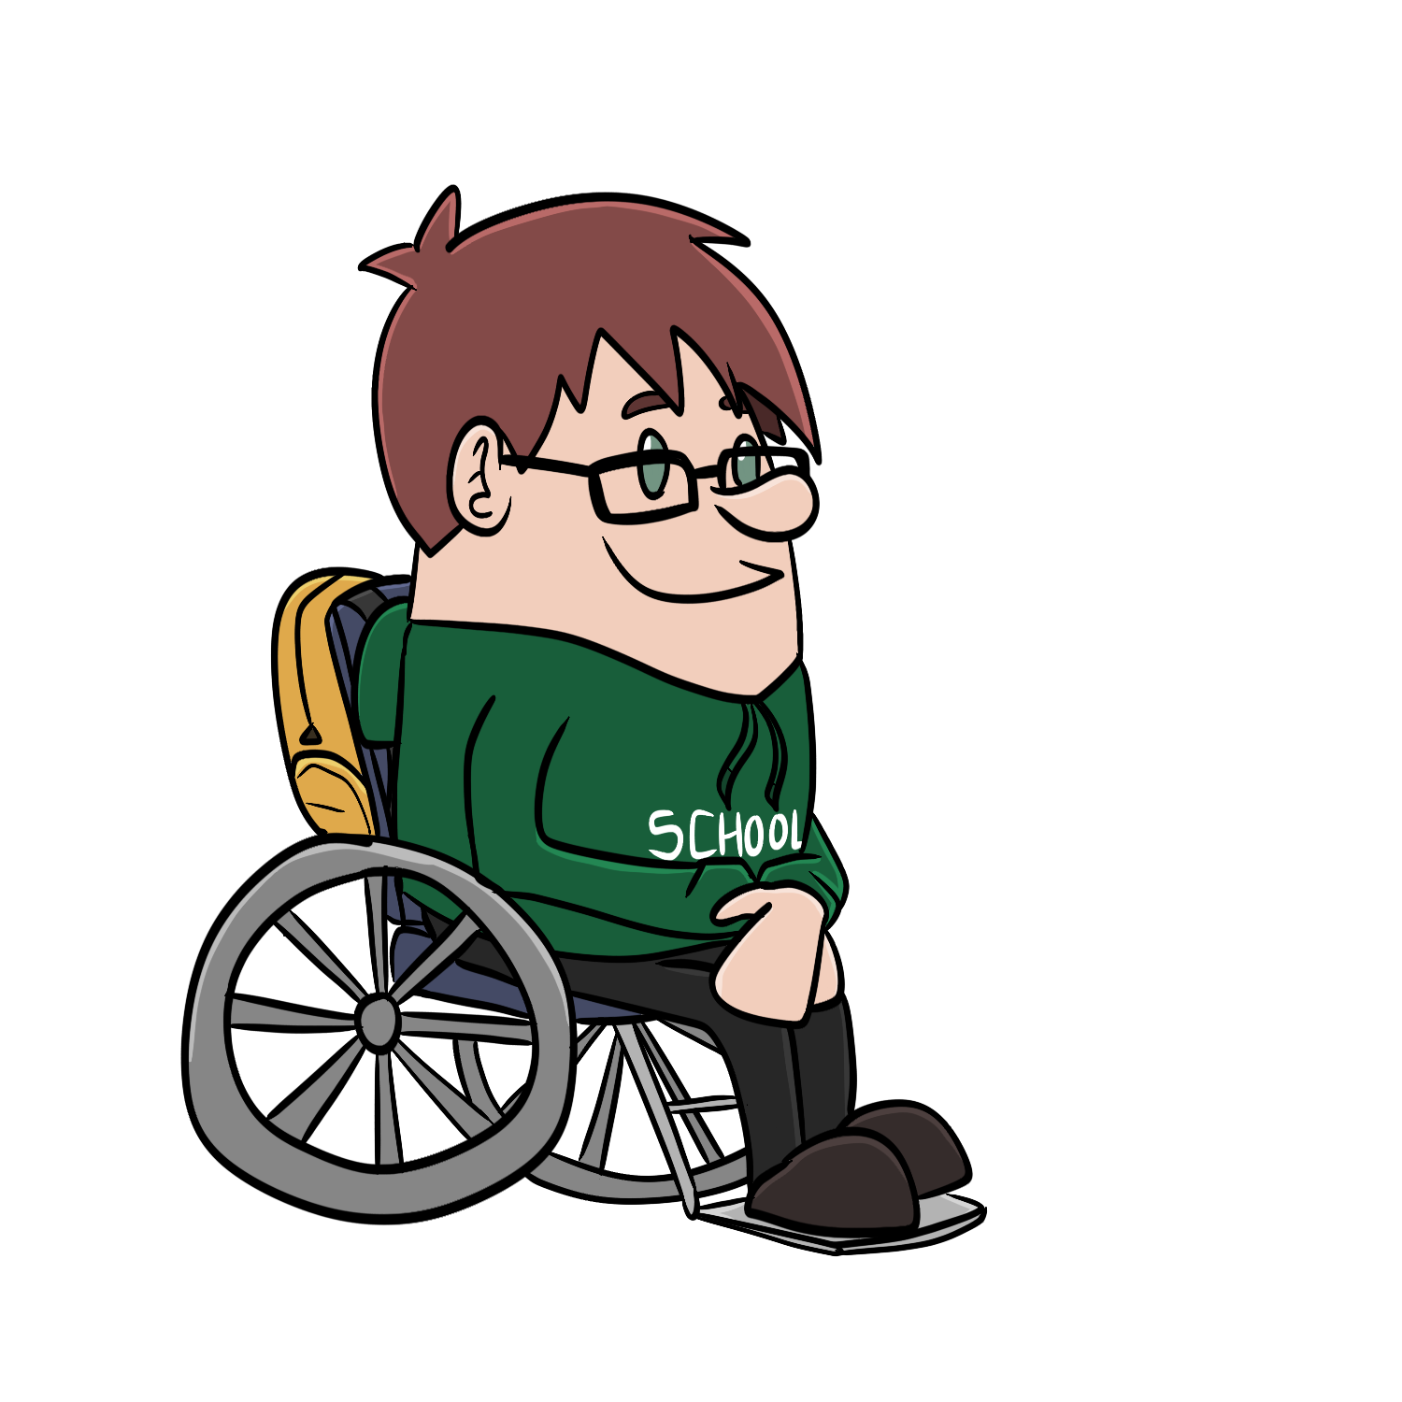




Campus
Information
System
Enterprise
Wide LMS
LTI Advantage
Synchronized grades
Synchronized roster

Slide 3
Big Picture
Sakai Plus makes Sakai an LTI Advantage "Provider"
LTI 1.3 Launch (Receiving)
Names and Roles (NRPS) to retrieve / sync rosters
Assignments and Grades (AGS) to create grade columns and sync scores
Deep Linking to install tool links in the content / modules / rich text editor in the LMS
Dynamic Registration for one-click installs
Canvas one-click JSON install (proprietary but important in the market)

Slide 4
Integration
Canvas
Blackboard
Moodle
Sakai (inception mode for testing)
D2L (TBD)
Note – with an SSO – students can log straight into the Sakai if email addresses are trusted and provide by the launching LMS

Slide 5
Use Cases
Second "boutique" LMS
Sakai is the best LMS for Learning
Better learner privacy
Engaged community for active faculty
Some Sakai tools are well liked and not in other LMS systems
Samigo
Lessons
Roster
Mail Archive
Postem

Slide 6
Alpha Test Goals
Blackboard Schools
US / UK / NL / Spain
Schools with 3+ years of Canvas experience
Likely small pilot with University of Michigan – Dog Food
Long time D2L schools
MSU / Wisconsin
Possible ideas
Schools that explored Sakai in the mid-2000's but never adopted
Schools that left Sakai > 3 years ago

Slide 7
Technical Ideas
We need a more "cloud-like" experience for IT staff
Released quarterly
Automatic upgrades
No forking!!!
Great deployment documentation for local IT folks
Opportunities / Pricing
Free cloud for experiments provided by LearnXP
Small cloud provided instance
Run on amazon hardware under university control
On campus hardware / consortia hardware (like Unizin)

Slide 8
LETS DEMO!!!

