Slide 1
Improving Standards and Integration in Sakai 12
Dr. Charles R Severance
University of Michigan, School of Information
Sakai Virtual Conference 2017

Slide 2
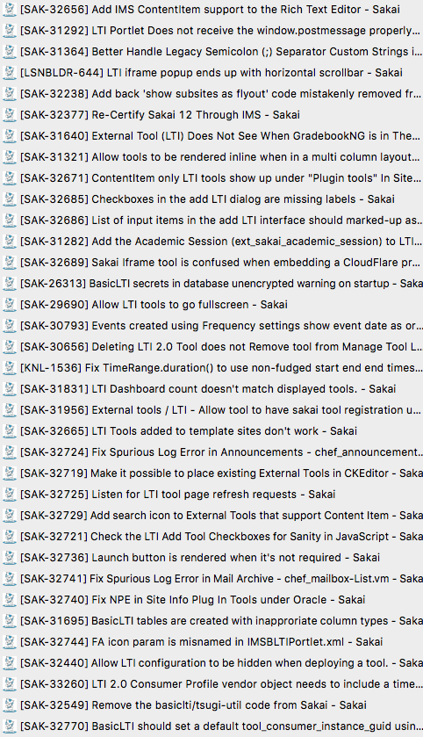
Lots of detail fixes in Sakai 12

Slide 3
New Features in Sakai 12
Support for Content Item in the Rich Text Editor
Simpler Workflow of Content Item in Lessons (two fewer clicks)
Improved Configuration – Sanity Check

Slide 4
To Test
Login on nightly as admin and add an LTI 1.x tool
URL: https://www.tsugicloud.org/tsugi/lti/store/
Key: 12345
Secret: secret
Tick "Allow tool to configure itself"
Tick "Allow tool to be used from the rich text editor"

Slide 5
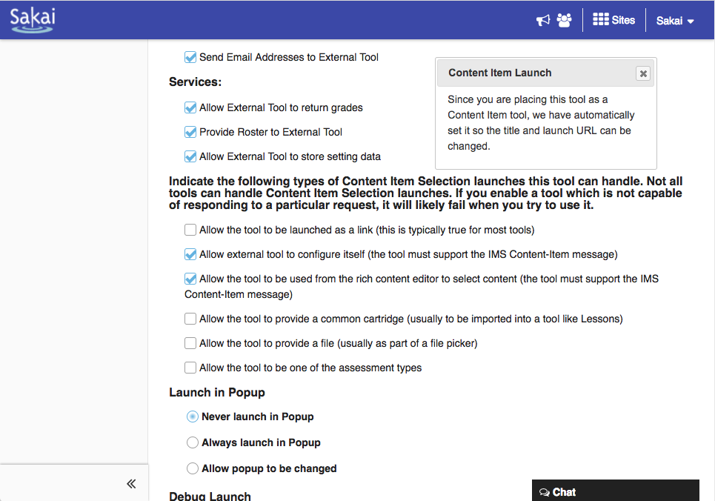

Slide 6
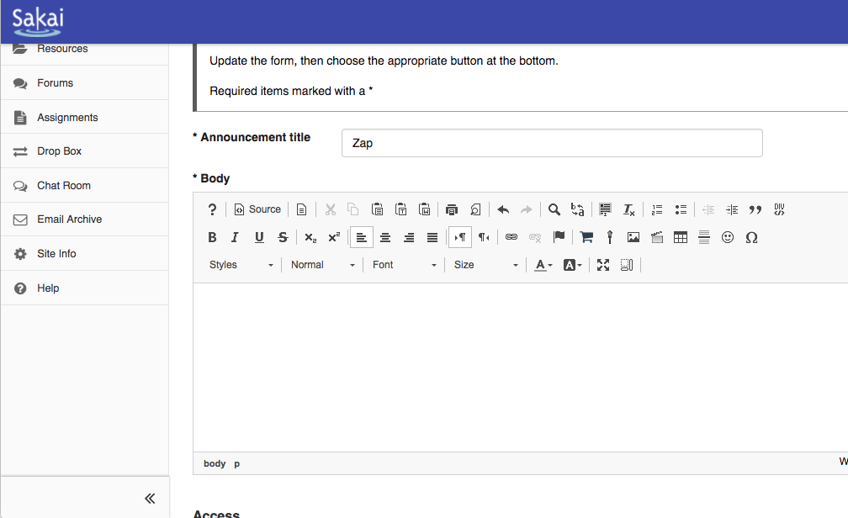

Slide 7
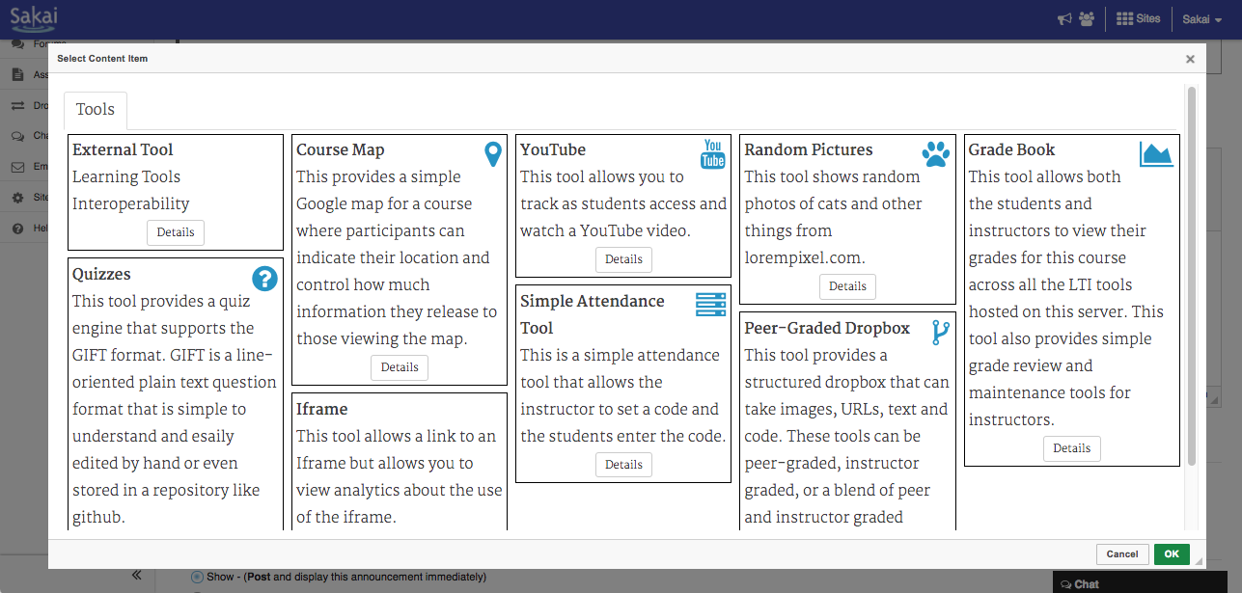

Slide 8
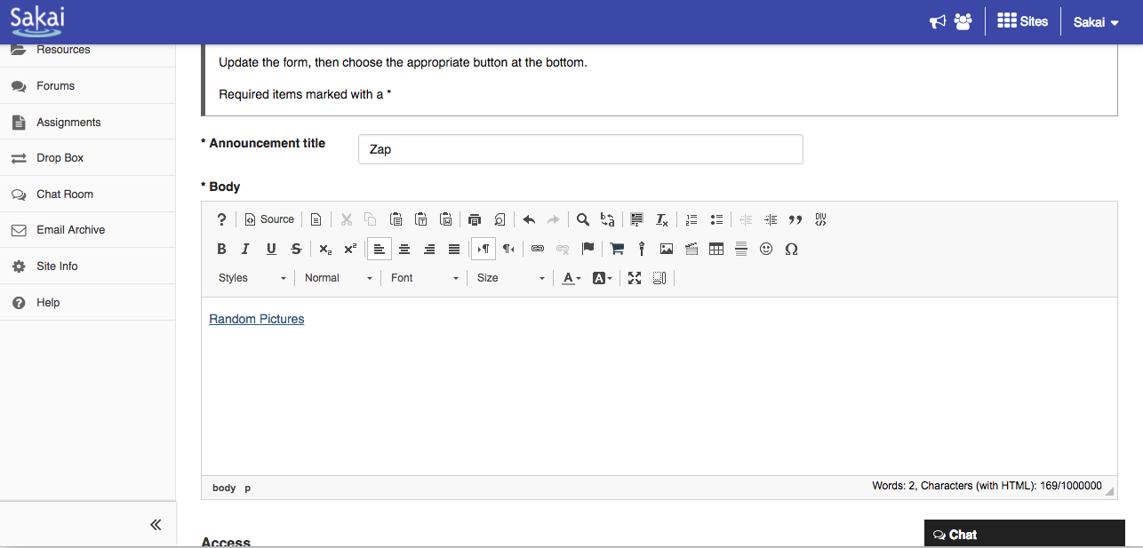
Don't test click here which editing – you will edit the link

Slide 9
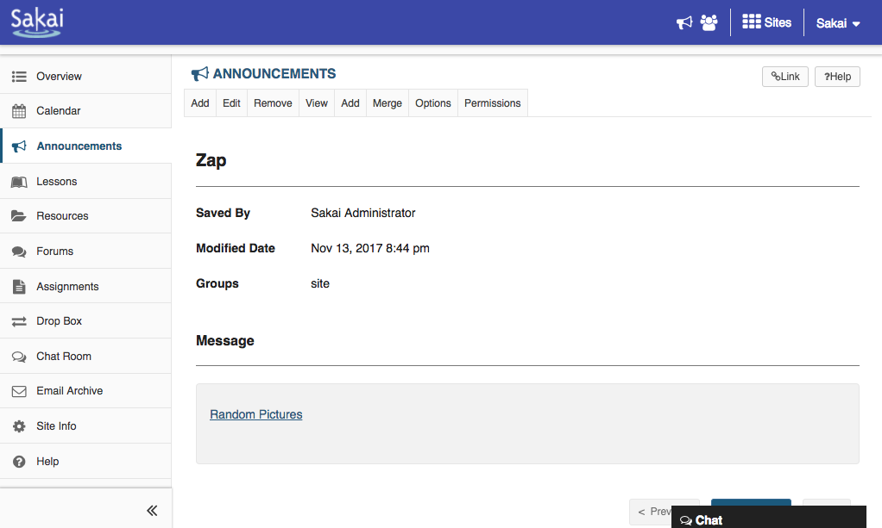

Slide 10
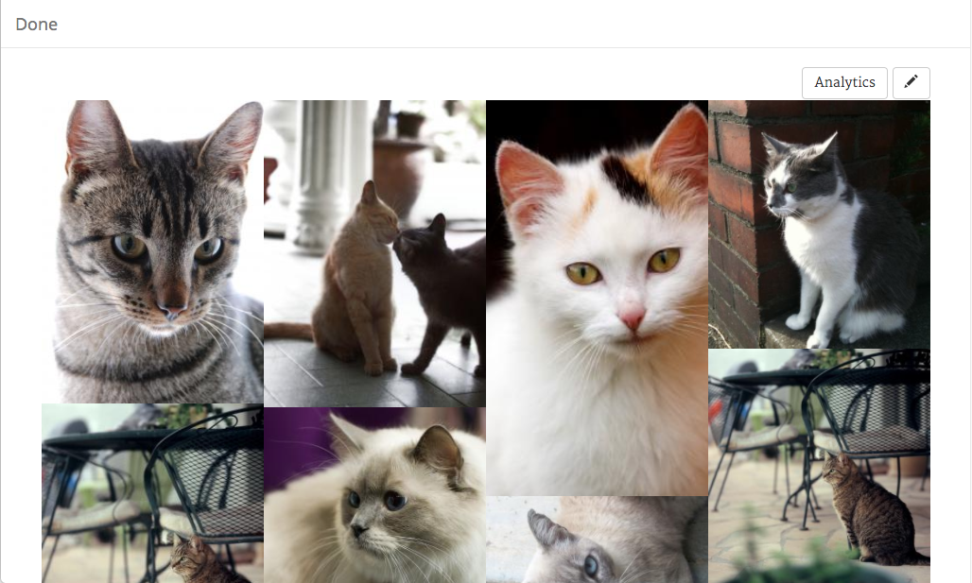

Slide 11
Next Steps for Sakai Standards
Support for Content Item in the Assignments
IMS Advantage:
IMS Membership Service
IMS Gradebook Service
LTI 1.3 – JWTs for launch and OAuth 2.0 for services

Slide 12
Step back from LTI 2.x (Unofficial)
Sakai 12 is re-certified with LTI 2.0
Blackboard also passed certification
Canvas has 85% of LTI 2.0 but is not certified
LTI 2.1
Sakai has 80% done – not certified
Canvas has 90% done – not certified
Is no longer being pushed forward
LTI Advantage is the new plan
LTI 1.3 – JWTs and OAuth 2.0
Gradebook and Membership Services

Slide 13
Blackboard
Complete: LTI 1.1, LTI 2.0
In Progress: Content Item and Membership
D2L
Complete: LTI 1.1, Content Item
In Progress: Membership and Gradebook
Canvas
Complete: LTI 1.1, Content Item
Stalled: LTI 2.0, LTI 2.1
Prototyping: LTI 1.3
Moodle
Complete: LTI 1.1, LTI 2.0, Content Item
??

Slide 14
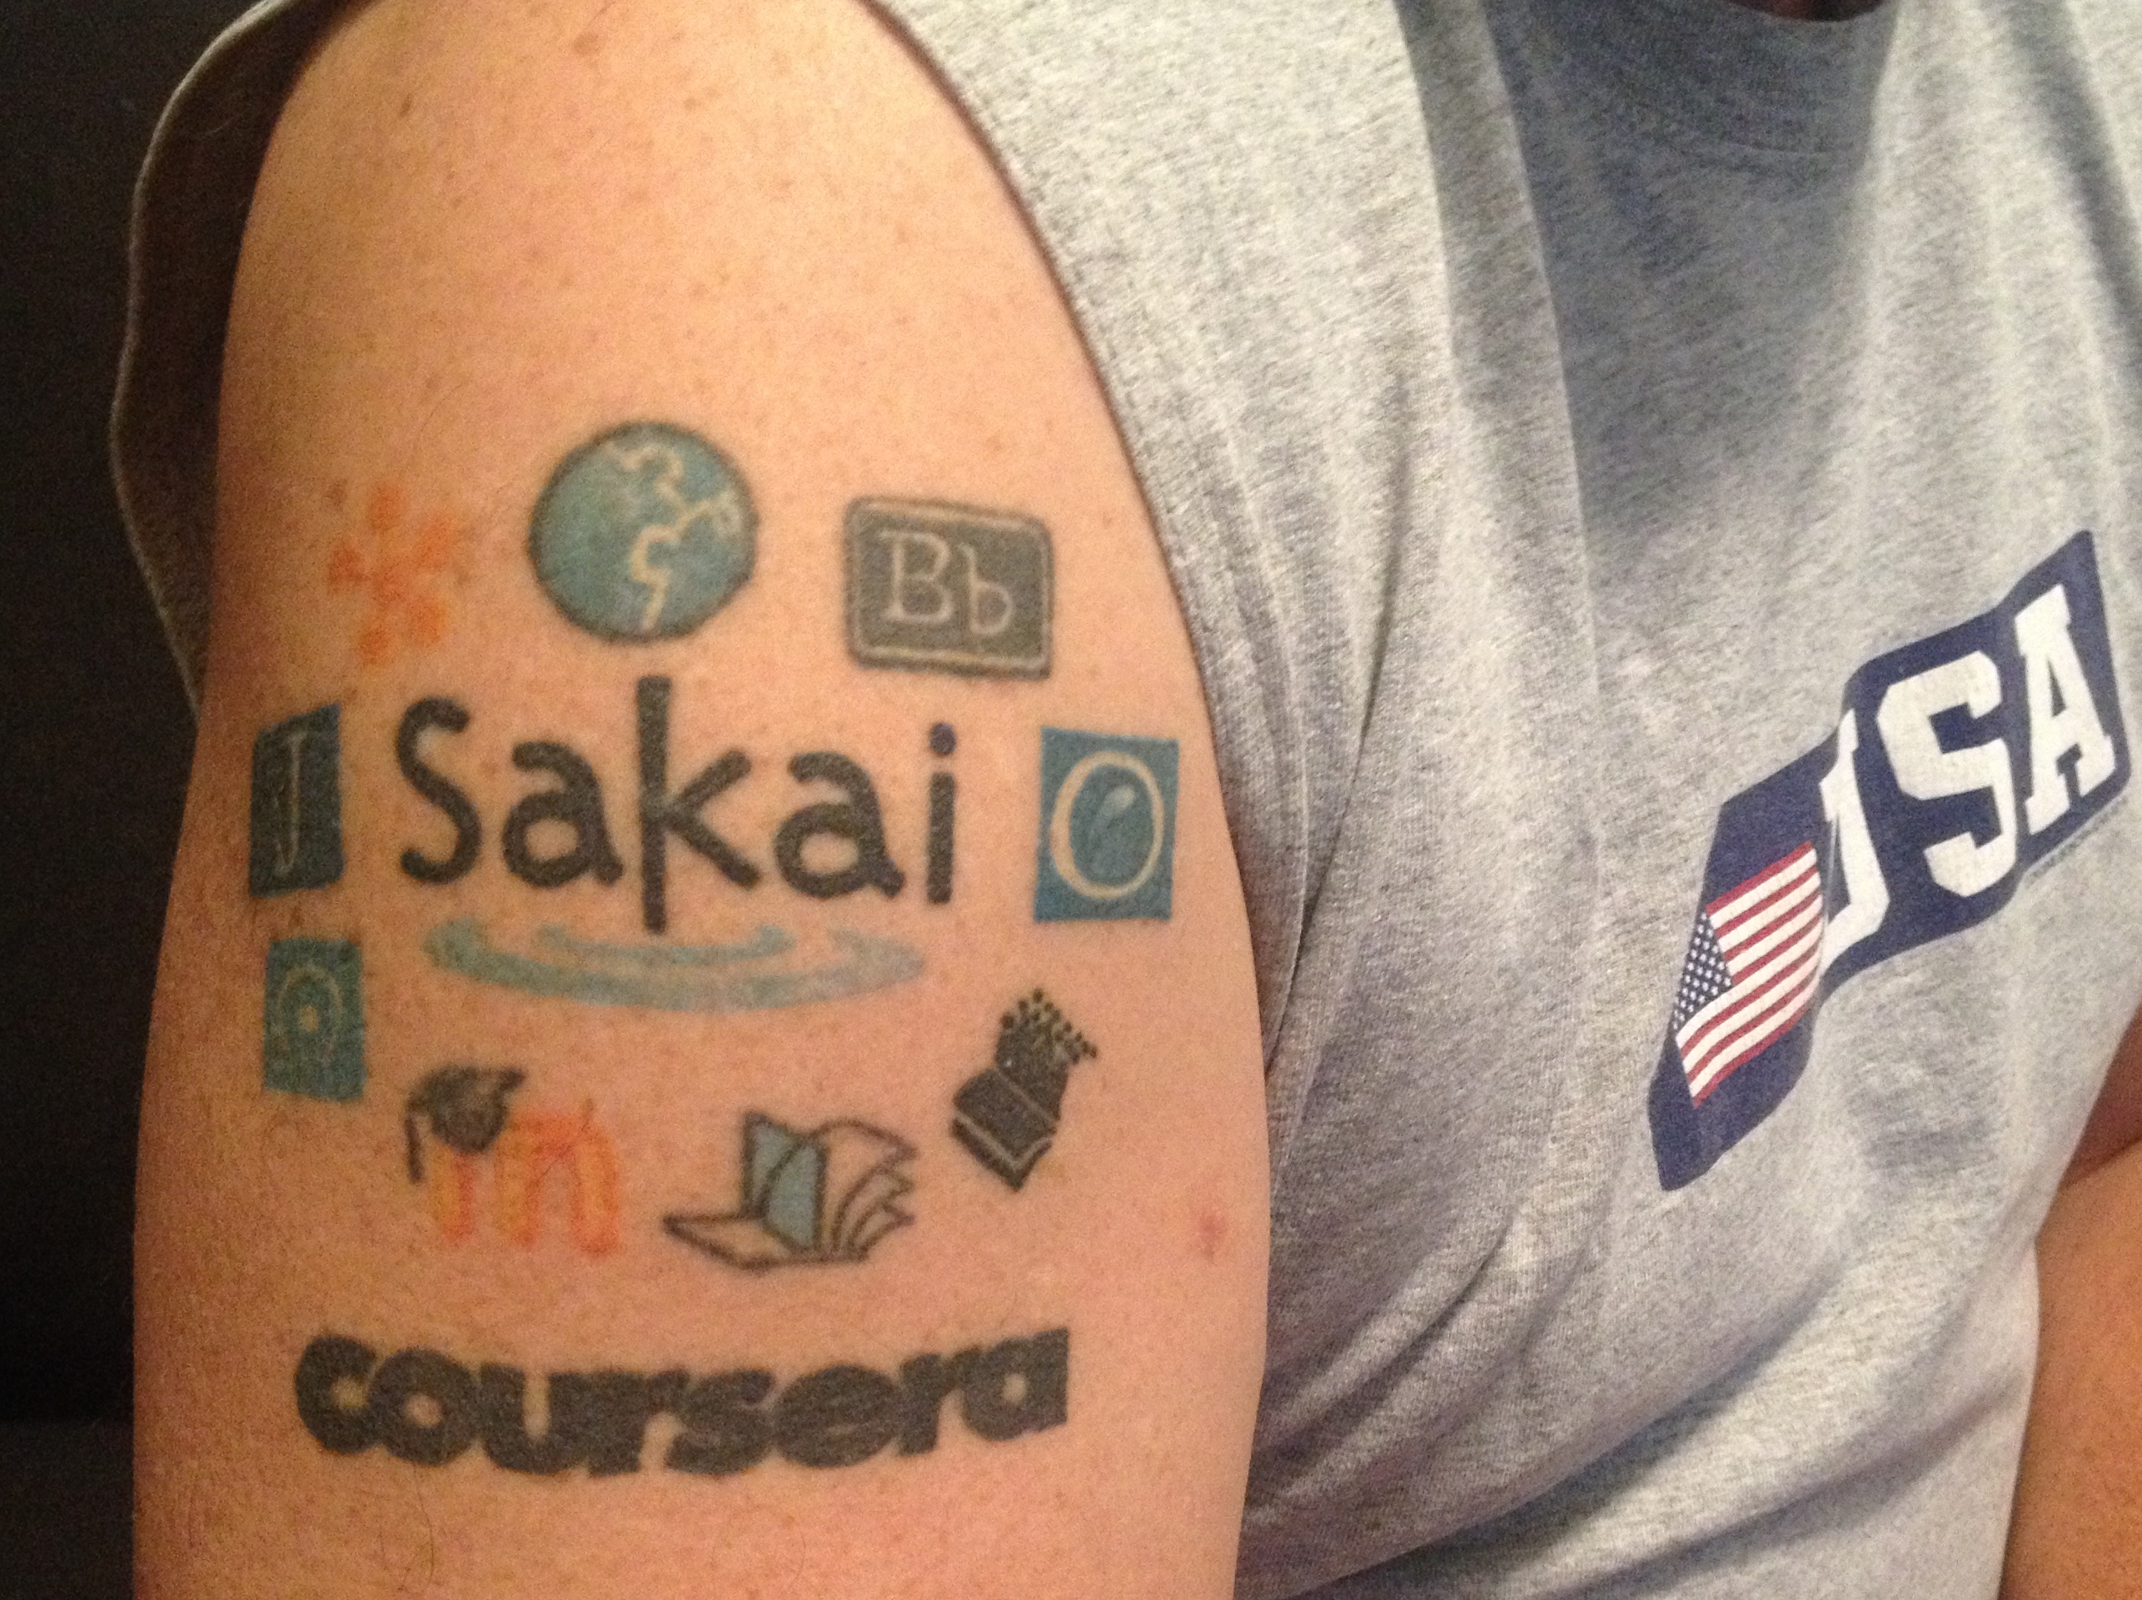
Thanks
Sakai 12 LTI Content Item is much smoother
LTI Advantage will be 2-3 months of work

