Slide 1

Chris Knapp
Accessibility Consultant/Tester
Voluntarily Excellent When It Comes To Accessibility: A Reviewer-Friendly VPAT
FOSSY 2024 August 1-4, 2024 Portland, Oregon
www.SakaiLMS.org
Notes:
Good afternoon, my name is Chris Knapp.
I’m an accessibility consultant and tester, and today I’m going to be talking to you about what I’m describing as a new reviewer-friendly VPAT, or Voluntary Product Accessibility Template.
I’m here today representing Sakai, which is an open-source Learning Management System, and over the next 20 minutes or so, I’ll be talking about our multi-year effort to develop and implement a community-sourced accessibility strategy, that eventually led to us being able to produce our own VPAT.
More specifically, I’ll be walking you through some of the steps we took to reimagine and reinvent our VPAT process and report with the VPAT reviewer audience in mind.
And hopefully, by the end of my presentation, you’ll have some high level concepts that you’ll be able to apply to your respective free and open source software projects, if any of you are interested in trying to replicate our approach to this work.

Slide 2



About the Presenter…
Tales of the Reluctant Blind
https://www.knappstrategic.com/accessiversity-blog
Chris Knapp
Notes:
This is my not-so subliminal advertising slide for my consulting business, accessibility testing service, and blog…
Of course I’m kidding, but for purposes of this presentation, there are just a few things that I think are important for you to know about me…
First of all, I should mention that I am statutorily blind. I have a prosthetic left eye and 8/200 vision in the lower periphery of my right eye. We don’t have time to go into the circumstances that led to me becoming disabled, but I just wanted to point out that for my entire adult life I have had to rely on screen readers and other assistive technology to interact with the web, which I think provides some important context and hopefully speaks to the practical, real-world experience I bring to my role as an embedded accessibility resource.
Second, I’m not a technologist by trade. I spent the first 15+ years of my professional career in workforce development, and only recently got into doing accessibility consulting and testing, when I launched my Accessiversity accessibility testing service in 2019.

Slide 3
VPATs 101
Stands for “Voluntary Product Accessibility Template”
Tool for performing an accessibility assessment of an Information or Communication Technology (ICT) product
End result is creation of an “Accessibility Conformance Report” that describes the extent to which the product complies with various accessibility standards
VPAT name & template are registered service marks of the Information Technology Industry Council
Notes:
For those of you who might not be familiar with VPATs, I thought I would just spend a couple of minutes explaining what those are.
VPAT stands for Voluntary Product Accessibility Template.
Basically, it’s a tool for performing an accessibility assessment of an information or communication technology product, with the end goal being an “Accessibility Conformance Report” that describes the extent to which the product complies with various accessibility standards.
The VPAT template was developed by the Information Technology Industry Council and is free to use as long as you adhere to their usage guidelines, so its proprietary, but only from the standpoint of promoting accurate and consistent reporting, while also protecting the VPAT name and template which are registered service marks of ITIC.
The “V” in VPAT stands for “Voluntary” which suggests that this tool is designed to allow for self attestation, however, many organizations will choose to contract with outside vendors to produce their VPATs.
There are different versions of the VPAT depending on which specific accessibility standards you are wanting to assess for, which I’ll talk about a little further on in my presentation.

Slide 4
Sakai’s Accessibility Journey 2020 - Present
2020
Joins Sakai community as an embedded resource with the Sakai QA Team
First substantive, stand-alone accessibility test script developed
Sakai begins partnership with Vision-Aid and adds several more blind/low-vision testers
2021
Concerted effort is made to bulk up accessibility testing of “high stakes” tools
Sakai 21.0 released
Sakai Accessibility Team assists with user testing/analysis for Sakai 21 VPAT
2022
Sakai 22 testing performed across total of 23 tools/features
Students from Marist College recruited to help with “Accessibility LITE” keyboard testing
Sakai 22.0 released
2023
Decision is made to utilize internal resources to create our own VPAT
Work commences to align accessibility strategy with the VPAT creation process
Sakai 23.0 released
2024
Sakai 23 testing performed across total of 29 tools/features
Sakai community creates/issues its own VPAT
Notes:
Before we get into the specifics of the VPAT work, we need to back up a bit to set the stage…
This slide depicts several key milestones that occurred over the past 4 years that have been critical getting us to this point.
I know that there is a lot of content here, and there’s no way you will be able to read all of this small text, so I’m just going to try and quickly summarize what’s here.
My involvement with Sakai started in 2020.
That’s when Chuck Severance, who is Sakai’s Chief Architect and currently serves as the Sakai PMC Chair, had approached me about getting involved with Sakai.
Chuck’s approach, which proved to be genius, was to embed me with Sakai’s QA team, where I was to begin evaluating the current state of accessibility for Sakai – not just the accessibility of the Sakai LMS product itself, but accessibility across every facet of the open source Sakai community.
So I started working as a member of the Sakai QA team, and began making recommendations about how to make the different tools and processes we were using more accessible.
I created our first, real substantive accessibility test script, and began performing screen reader/keyboard testing to supplement the efforts of our other QA testers.
Then about 3 months into our little experiment, we established a partnership with Vision-Aid, which provides IT training to blind/low-vision individuals in India, and suddenly tripled the number of blind/low-vision testers working on Sakai.
Around that same time, we began piloting a new initiative we call “Accessibility LITE” which involves having some sighted users go through and perform keyboard testing on an adapted version of our accessibility test script.
When the time came for us to create a VPAT for Sakai 21, our expanding Sakai Accessibility Team had plenty to contribute, based on the extensive user testing that we had performed over the prior six months. And while our work was used to supplement (and definitely improve) the VPAT analysis/authoring process, we ultimately decided to utilize an outside contractor to create the Sakai 21 VPAT.
But by the time of the Sakai 22 release, we had built up enough of the accessibility resources within our community, that we made the decision to try and utilize internal resources to create our own VPAT, which is ultimately what we did.

Slide 5
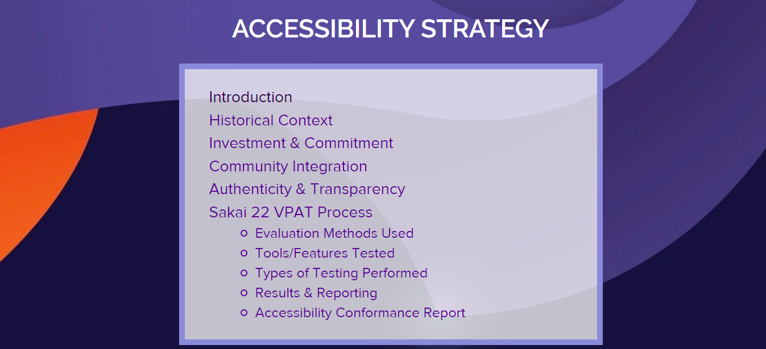
https://www.sakailms.org/accessibility/accessibility-strategy
Notes:
Throughout my presentation, I will be jumping back and forth between two key resources, the Sakai 22 VPAT, and the “Sakai Accessibility Strategy” page on our Sakai LMS web site which is shown here.
On this page you can find all of the information about our Sakai Accessibility Strategy, including the Sakai 22 VPAT, which you can access here in the “Accessibility Conformance Report” section down at the bottom.

Slide 6
Spoiler Alert:
The Underlying Strategy Is More Important Than the Actual VPAT
Notes:
Here I have a copy of the Sakai 22 VPAT. While the goal was to be able to produce our own VPAT, at the end of the day, these 30 or so pages of paper are not as important as the underlying strategy that is helping to drive all of this work.
If you don’t retain anything else from my talk today, at least remember to go to that page on the Sakai LMS web site and read about the Sakai Accessibility Strategy, because it is an absolutely critical component of this work.
While its technically possible to have one without the other, having first developed and implemented a robust accessibility strategy, meant that we already had all of the key ingredients we needed to produce our own VPAT, which definitely made the entire process go more smoothly.
But it also meant that it was harder to separate the strategy from the VPAT, and vice versa, which you’ll notice is a reoccurring theme throughout this presentation.
Another theme that will be repeatedly brought up, is that the VPAT report template has certain limitations, so we had to continually come up with creative ways to tell the Sakai accessibility story, namely, create this separate page to house all of the information about our accessibility strategy.
In fact, many of the things that I am going to highlight today would be considered supplemental materials, and don’t show up in the actual VPAT, but that doesn’t make them any less important.
A VPAT is a point in time, your accessibility strategy is what has real staying power.
Regardless of where you’re at in the process, being able to substantiate that you’re taking the necessary steps to maintain/improve the accessibility of your product, can provide you with much needed air cover – before, during, and after your VPAT project.

Slide 7
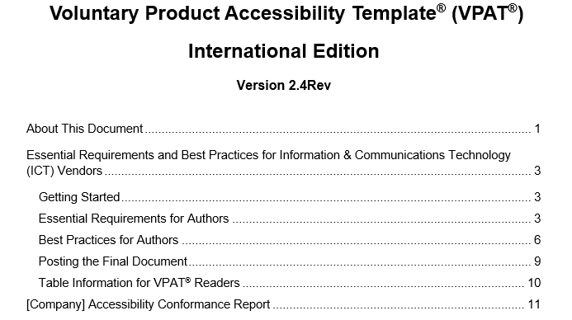
Determining What Version of the VPAT Report To Use
Notes:
Prior to beginning your assessment, you will first need to determine which version of the VPAT report you will want to use.
There are several options to choose from…
There are specific versions for the Web Content Accessibility Guidelines, Revised Section 508 standards, and EN 301 549 European Harmonised standards, and then there is an International version which incorporates all of these standards into a single report template.
Beyond that, the Information Technology Industry Council regularly releases updated versions of the VPAT to try and keep pace with the ever changing landscape of accessibility standards.
For example, when we created the VPAT for Sakai 22, we used VPAT version 2.4 INT which is based on WCAG 2.1 level A & AA, but for the Sakai 23 VPAT, we will be switching to using the latest VPAT version 2.5 INT which is based on WCAG 2.2 level A & AA.
Ultimately, the decision on which version of the VPAT to use comes down to your target audience, and what specific industries and markets are priorities to you.

Slide 8
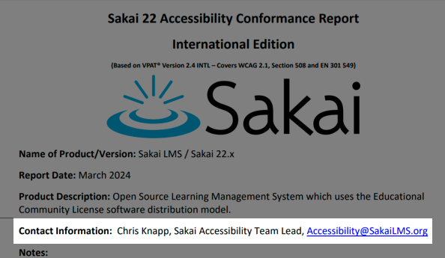
Simplifying Single Point of Contact
Notes:
So, as we start going through some of the specific changes we implemented to make our VPAT more reviewer-friendly, the first thing I want to talk about is this “Contact Information” area at the beginning of the VPAT report template.
This is all pretty straightforward, but I’ll just stress that you will really want to think about who to list here, as you would prefer that its someone who can serve as that single point of contact for fielding questions about the VPAT, as well as providing technical assistance regarding any accessibility-related issues users may be experiencing with your product.
For us, this meant listing me, but we felt it would be too confusing or tacky to use my business email, so we created a shared email using the Sakai LMS domain, choosing to go with Accessibility@SakaiLMS.org to keep it simple and so it would be easy for people to remember.

Slide 9
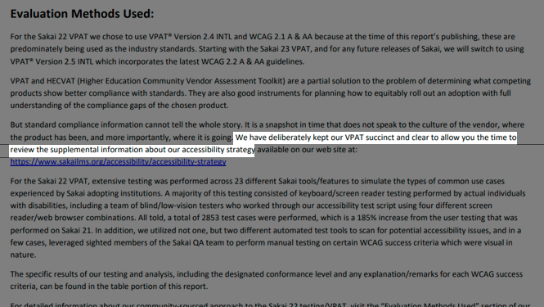
Setting the Tone with a “Succinct” Statement
Notes:
These next two examples are somewhat related, in the sense that the first thing I’m going to be talking about sort of precipitated the need for the next thing I’ll be covering.
This first one comes to us courtesy of Gonzalo Silverio from the University Of Michigan who has been serving as our informal VPAT advisor.
Gonzalo, who regularly reviews VPATs as part of his day job at U of M, was the person who had convinced us to cut down on the amount of supporting materials we were trying to cram into our report, saying that the reviewers would thank us for keeping things as succinct and clear as possible.
He then took it a step further, and suggested including an actual statement about deliberately keeping the VPAT succinct and clear, To signal to the reviewer that we’re on their side, like this language we ended up adopting for our Sakai 22 VPAT.
While we come right out and say that we’re doing this to allow folks more time to review our other materials, we’re also implying that they will need to review this supplemental information to get the full picture, so we’ve technically added to the VPAT report, not by altering the standard report template, but rather by extension.

Slide 10
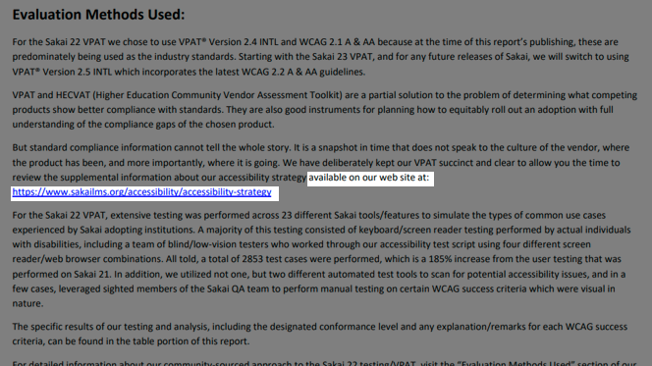
Introducing Your Companion Resource
Notes:
For those of you who are reading ahead, you know that this is also the place in the VPAT where we mention our companion resource for the first time, in our case, the “Sakai Accessibility Strategy” page on the Sakai LMS web site.
Basically, this page serves as a catch-all for housing all of the supplemental information that we just weren’t able to squeeze into the standard VPAT report template.
In retrospect this decision, more than anything else, proved to be a real game changer for us.
For the longest time I had been struggling with how to present the many aspects of our accessibility strategy that I wanted to talk about, without adding pages and pages of narrative to our VPAT report, which I knew could potentially turn off prospective customers who would have to sift through all of that material.
Gonzalo’s suggestion of repurposing this information and moving it over to a separate web page proved to be a surprisingly simple solution.
For starters, it freed up more of the scarce real estate within the VPAT report, so we could focus on those essential elements that we needed to touch on.
There was also this unintended consequence of freeing ourselves from the shackles of an overly rigid template, when we realized that a separate web page represented a sort of clean slate, and we could choose to organize and present this supplemental information however we’d like.
Obviously, as we were thinking about how to organize our page, it made sense for us to use a lot of the same headings that match those used in the VPAT report, which we felt would make it easier for people visiting the web site to find additional information about a particular topic they are wanting to learn more about. But at the same time, we could create our own headings that correspond to other aspects of our accessibility strategy, if there were these other things that we felt were just as important for a prospective customer to know about.
All of the content on the page is neatly indexed, including a series of jump links for each section, so its super easy to peruse and allows users to control the amount and type of information they are digesting.

Slide 11
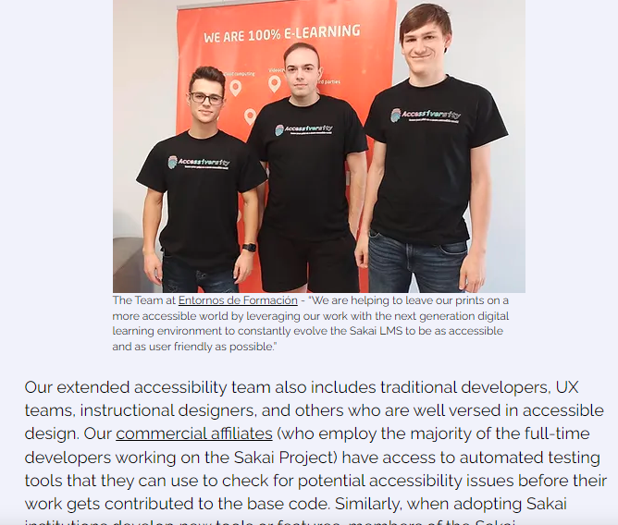
Marketing the Uniqueness & Authenticity of Your Approach
Notes:
The VPAT report was never intended to be a straight-up marketing tool, so you want to avoid turning it into an infomercial for your product.
When doing a formal accessibility assessment like this, you wouldn’t want to blow your own horn too much anyways, as customers tend to see right through that sort of self-serving analysis.
But where does that leave you in terms of talking about those unique attributes of your organization or product that genuinely help you to stand out in the marketplace? Contrast your offerings with those of your competitors?
For example, one of the unique things about the Sakai VPAT is that there is an entire community of people behind this work.
Unlike our competitors, we’re not just hiring an outside consultancy firm to slap together a VPAT for us, or including a few token disabled users as an afterthought, our entire community is involved in our accessibility efforts, including the creation of our VPATs, and that is something that is truly unique, and definitely worth calling out.
The problem, as we have already eluded to, is that the standard VPAT template report doesn’t provide you with a lot of options for talking about these other aspects of your approach.
Instead, on our “Sakai Accessibility Strategy” page, we have carved out some space to include a few brief write-ups along with some photos to showcase our various partnerships, and extoll the benefits of our unique community-sourced approach to accessibility.
Doing it this way doesn’t distract from the VPAT, but you’re still able to leverage this other platform to share supplemental information that the customer can then use to help guide and inform their decision.

Slide 12
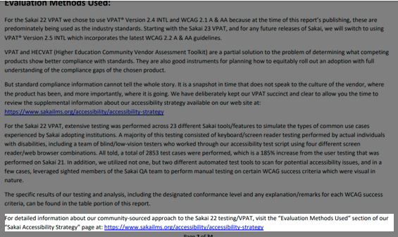
Crosslinking the VPAT to Your Companion Resource
Notes:
Again, this is pretty self-explanatory, and a relatively simple thing you can do to help connect the dots for the VPAT reviewer.
When applicable, consider including a link to your companion resource, like we have done here in the “Evaluation Methods Used” section of the VPAT report.
On the flip side, we already mentioned that a link to the Sakai 22 VPAT can be found in the “Accessibility Conformance Report” section of our “Sakai Accessibility Strategy” page, providing multiple ways for users to navigate to, and between these resources.

Slide 13
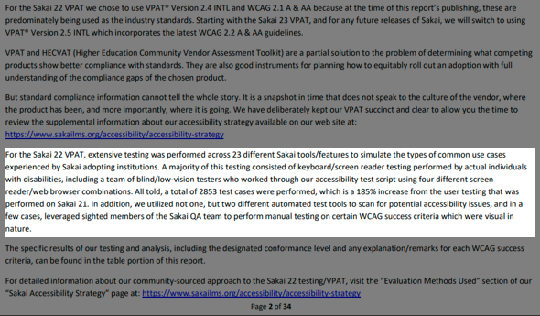
Summarizing Evaluation Methods Used & Quantifying What Got Tested
Notes:
Since there were a number of different things that we needed to cover in the narrative portion of the VPAT report, here we decided to focus on a high-level description of evaluation methods used, including some quantifiable benchmarks that were readily available to us.
For us, these included the total number of tools/features evaluated, different types of testing performed, number of screen reader/web browser combinations used, and total number of test cases performed.
These metrics are important for several different reasons…
First (assuming that you continue to evolve your accessibility strategy) when you look at these numbers from version to version, customers are able to connect the dots to see that there is quantifiable evidence of growth.
For example, 23 Tools/Features were tested for Sakai 22, and for Sakai 23 that increased to a total of 29 Tools/Features. For Sakai 22, there were a total of 2853 test cases performed, and for Sakai 23 that number increased to 5106, which was a 179% increase from the prior version. Like with Sakai 22, we used four different combinations of screen readers and web browsers when performing our testing for Sakai 23, however, we changed out one of the combinations to allow us to test the Voiceover+Safari combination for the first time.
When it comes to existing customers, these sorts of metrics show that you are continuing to make improvements to the product from version to version,
which may factor into their decision whether or not to renew. For prospective customers, this sort of transparency could help to establish your track record with them, especially if they view you as an unknown commodity.

Slide 14
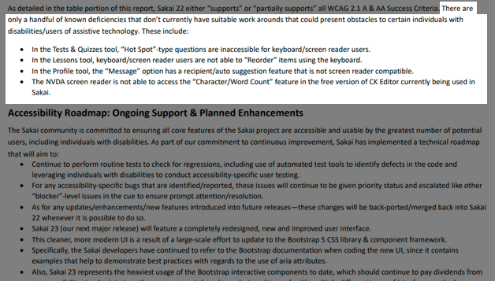
Acknowledging Any Known Deficiencies
Notes:
Whenever you conduct a formal accessibility assessment, inevitably you are going to expose some less than flattering things about your product.
addressing known deficiencies can be a sticky subject, but my advice to you is to hit these sorts of things head on.
The word that immediately comes to mind is “authenticity”.
When you talk about authenticity as it relates to your accessibility strategy and VPAT, this can mean a few different things…
First - a quick public service announcement from me – to the extent you are able, you should try to incorporate individuals with disabilities into your user testing/community.
Individuals with disabilities, for example blind/low-vision users who rely on screen readers and other assistive technology, are able to provide for an authentic accessibility experience, that even the most well intentioned, non-disabled developers and designers will never be able to fully replicate.
Now, as it relates to putting together your VPAT, don’t be afraid to give an honest assessment of your product, warts and all.
No software is perfect – if you are portraying your project as flawless either you’re being disingenuous or you haven’t tested enough.

Slide 15
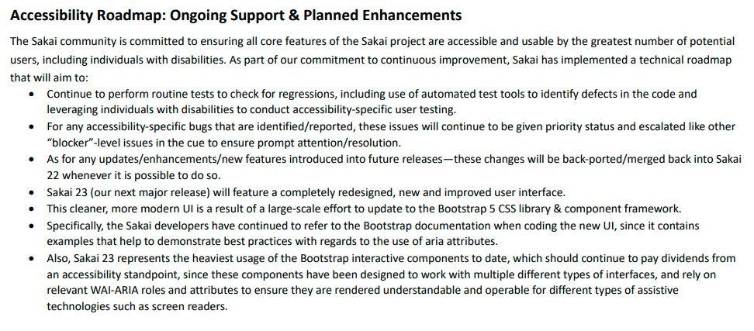
Including A Technical Roadmap/List of Planned Improvements
Notes:
Part of what any current or prospective customer is looking for when reviewing your VPAT, is evidence that you are constantly moving the needle, which means that its incumbent upon you to demonstrate that the product is continuing to evolve from version to version, including talking about what improvements are being planned for future releases.
By definition, this will require you to project into the future, but since most forward-thinking organizations are already using tools like technical roadmaps, it shouldn’t be too difficult to repurpose some of that information for this section of the VPAT report.
If done right, this can provide customers with some powerful insight into your past, present, and future accessibility efforts, which can speak volumes about your organization’s culture, and its ongoing commitment to accessibility.

Slide 16
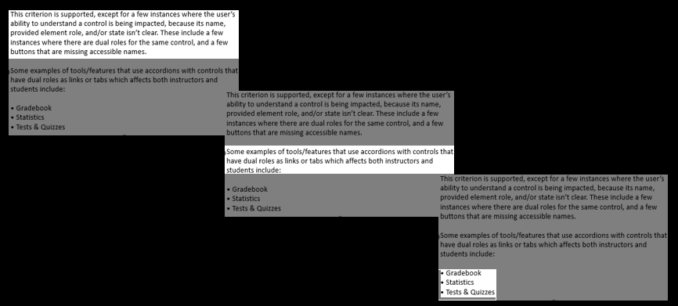
Consistently Presenting “Remarks & Explanations”
Portion of WCAG Success Criteria Table
Notes:
For this next item, we’ll be diving into the WCAG Success Criteria table of the VPAT report.
The WCAG system for assigning conformance levels is somewhat ambiguous.
You can either say the item “Supports” the WCAG success criteria, “Partially Supports” it, “Does Not Support” it, or that it is “Not Applicable”.
The problem is that there really isn’t any grey area between the “Supports” and “Partially Supports”” Options, its kind of an all or nothing deal.
So, for a complex web application like Sakai, with all of the different tools/features that we end up testing, even if we just find a handful of issues, technically, it only “Partially Supports” that WCAG Success Criteria.
Of course, you can use the “Remarks & Explanations” field to provide that additional information/context, but you don’t want to overwhelm the reviewer, so you need to keep your comments succinct and use consistent formatting to make it easier for reviewers to locate pertinent information.
Here, we are using one of the example criteria from our Sakai 22 VPAT to show the system we adopted.
The image on the far left shows the part of the “Remarks & Explanations” field that describes the extent to which Sakai complies with this particular WCAG Success Criteria, including specific types of issues observed during testing which are preventing us from achieving full compliance.
The middle image indicates the types of users impacted.
And the image on the far right shows where we list out the specific Sakai tools/features where these issues were observed.

Slide 17
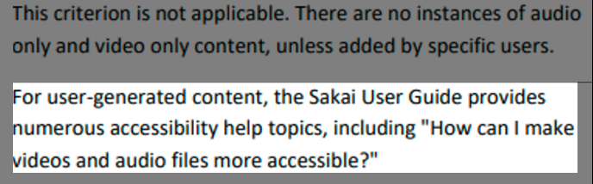
Being Proactive by Including Links to
Help Articles for User-Generated Content
Notes:
For this next example, we’re showing how we were able to incorporate references to our Sakai User Guide, allowing us to highlight our extensive help documentation, which is another potential selling point for a prospective customer.
The distinction here is that we are talking about specific WCAG Success Criteria that were deemed “not applicable” because the corresponding feature is not included in Sakai by default, and only comes into play when there are instances of user-generated content.
Of course, at that point, it is up to the individual user to ensure that the content that they are adding is accessible, so to assist them, we have provided links to several help articles on a variety of accessibility topics.

Slide 18
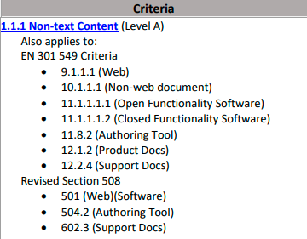
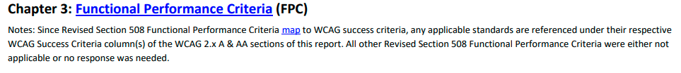
Inserting Blanket Statements To Cut Down On Table Clutter
Notes:
What this slide is showing is how we were able to insert blanket statements into some of the Revised Section 508 and EN 301 549 tables so that we could eliminate all of these unused rows to cut down on clutter
I should pause here to explain that we are using VPAT version 2.4 International, which again, includes the WCAG, Revised Section 508, and European Harmonised standards all in the same report template.
The other thing you need to understand, is that for the most part, the WCAG guidelines are already designed to crosswalk to the Revised Section 508 and EN 301 549 standards.
You can see evidence of this crosswalk here in this image on the top left, which shows one of the WCAG Success Criteria. Notice how it lists out all of the other applicable standards.
So once you’ve gone through and completed the WCAG Success Criteria table, there’s really no compelling reason to fill this information out for a second, or third, or fourth time, unless you’re glutton for punishment, or you’re just really wanting to annoy your VPAT reviewers.
So, when we considered what to do with these other Revised Section 508 and EN 301 549 tables, which again, are essentially reporting duplicative information, we decided to insert a blanket statement like the one shown here on the bottom of the screen and delete the unused portion of the table.

Slide 19

Thank You!
Chris Knapp
517-881-4256
Accessibility@SakaiLMS.org
www.SakaiLMS.org/Accessibility/Accessibility-Strategy
Notes:
So, that’s about all of the time that we have.
I really appreciate having had the opportunity to present to you today.
On behalf of myself and the entire Sakai open source community, thank you all for your time and attentiveness.

