Slide 1
Massively Open Online Courses (MOOCS)
Past, Present, and Future
Dr. Charles Severance
University of Michigan School of Information

Slide 2
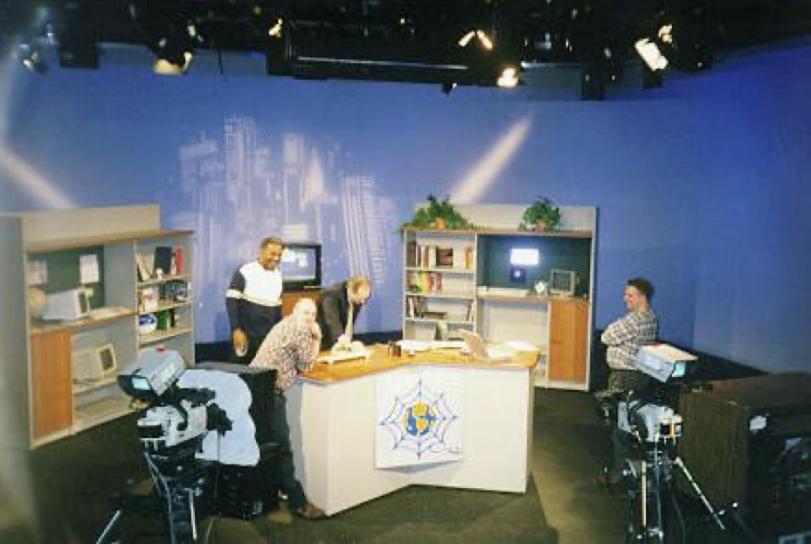
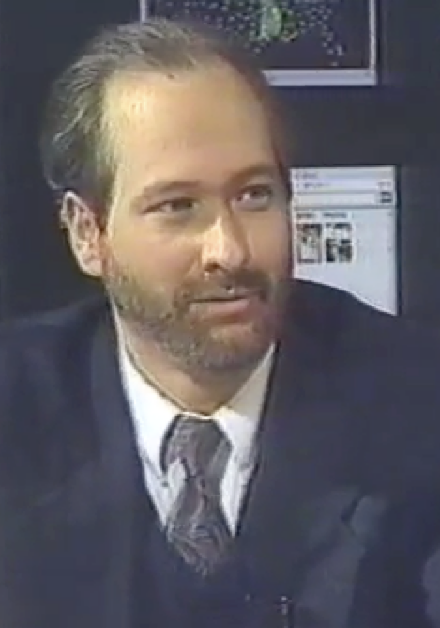
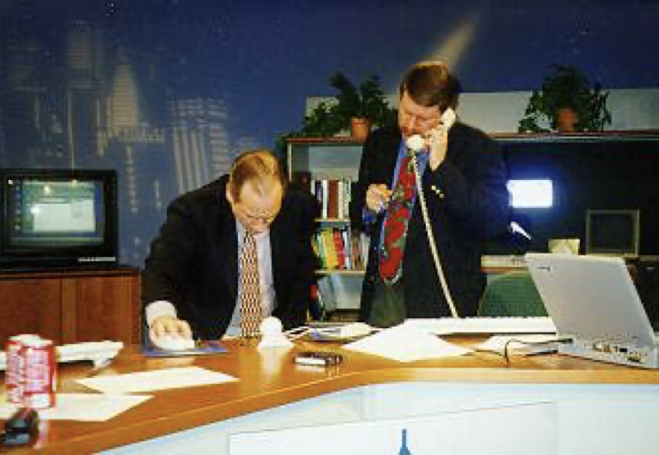
TV "Personality"
Sponsored and distributed by Cable television networks
East Lansing, MI
Promote Cable Modems
Internet:TCI (1996-97)
Nuthin' but Net (1998-99)

Slide 3
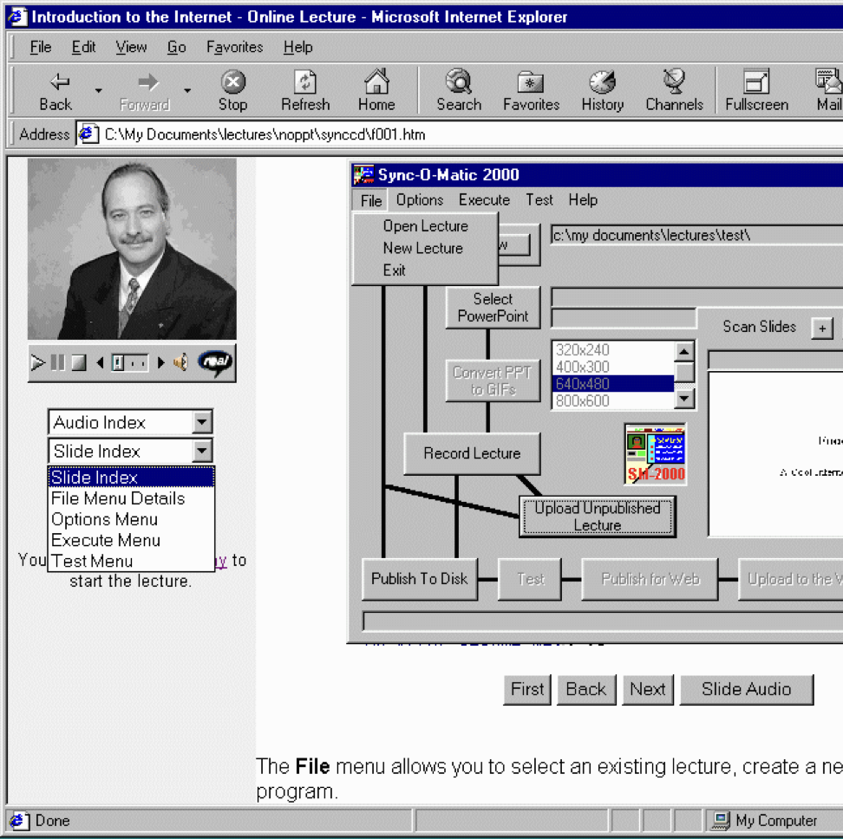
Sync-O-Matic
Michigan State University
First fully online streamed college course
Used RealAudio and 14.4 modems
Windows / Visual Basic
1997 - 1999

Slide 4
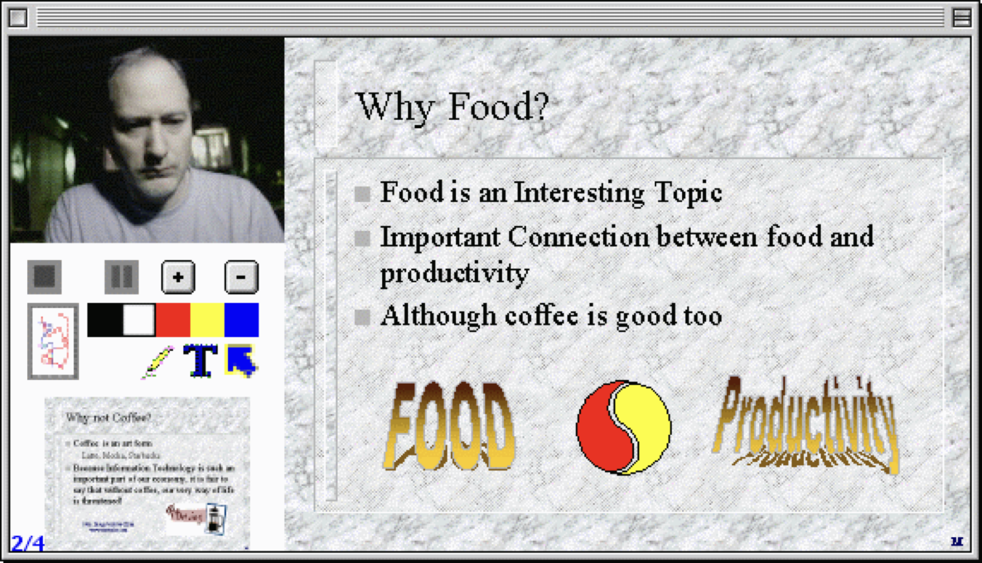
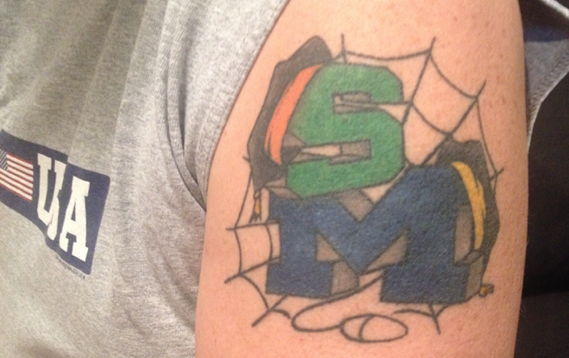
Clipboard 2000
University of Michigan
Complete rewrite – Apple / Quicktime / RealBasic
Taught C++ (EECS 280)

Slide 5
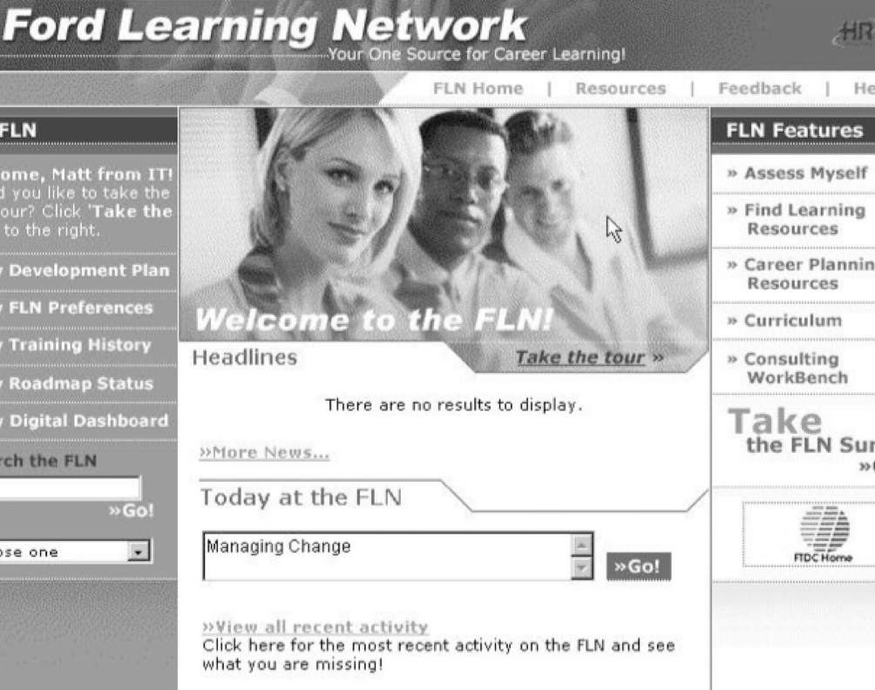
FLN (2001)
Worked at a web-based education startup
  Ford
  General Motors
  Pepsi
Innovative System
Analyze activities and results – adjust search results
Personal learning Roadmap

Slide 6
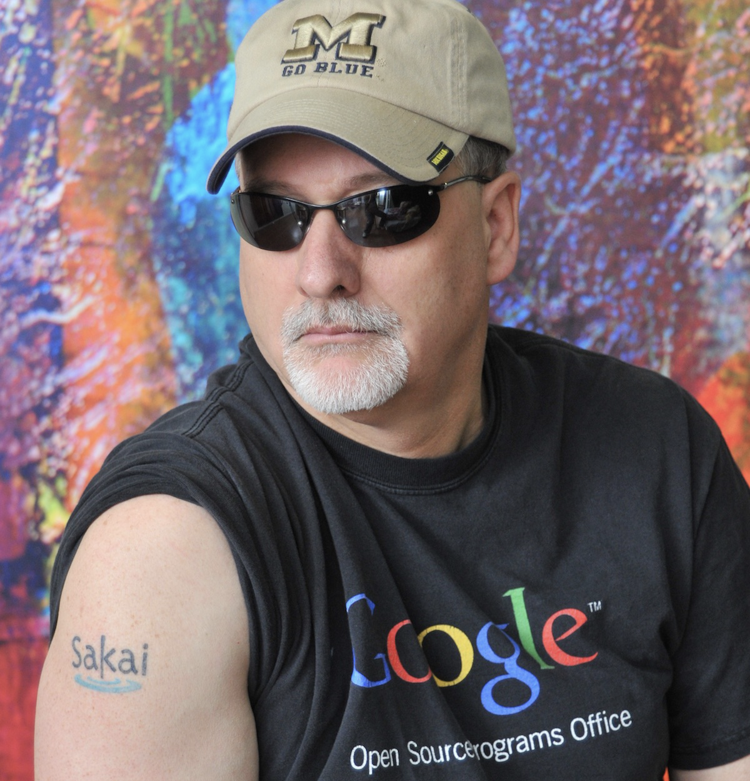
Sakai (2002- )
Back to University of Michigan
Open Source Learning Management System
Written in Java
Challenged the established vendors
  Blackboard
  WebCT
  Angel
  Desire2Learn
Reached 6% Market Share
Canvas borrowed the Sakai design in 2008
Long story (that continues)

Slide 7
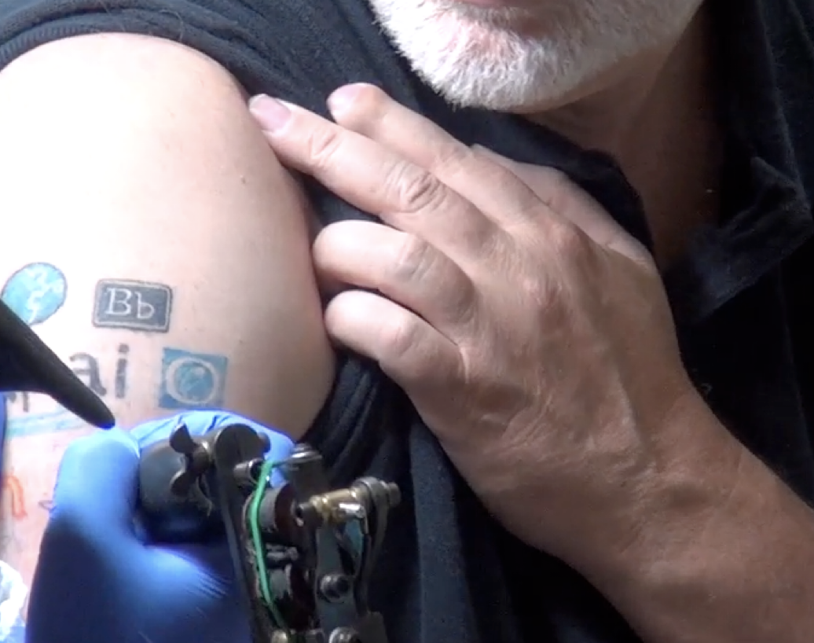
Learning Tools Interoperability (2004 - )
Sakai used our influence to develop LMS interoperability standards
  Learning Tools Interoperability
  Common Cartridge
Canvas did a better job on these standards then the other vendors
  Including Sakai
Long story

Slide 8
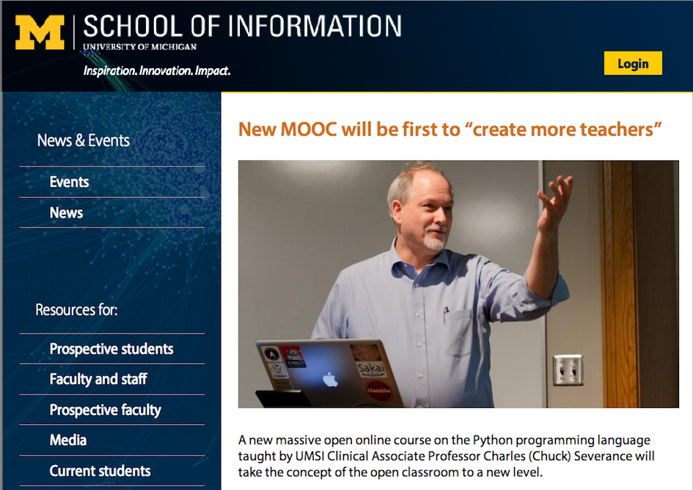
Professor (2007)
University of Michigan School Of Information
  Liberal arts focus
  Library school with tech focus
  HCI with soft skills focus
I taught SI502 – Python for Librarians
  It had to be simple
  Students could not fail
  Fine tuned for a number of years

Slide 9
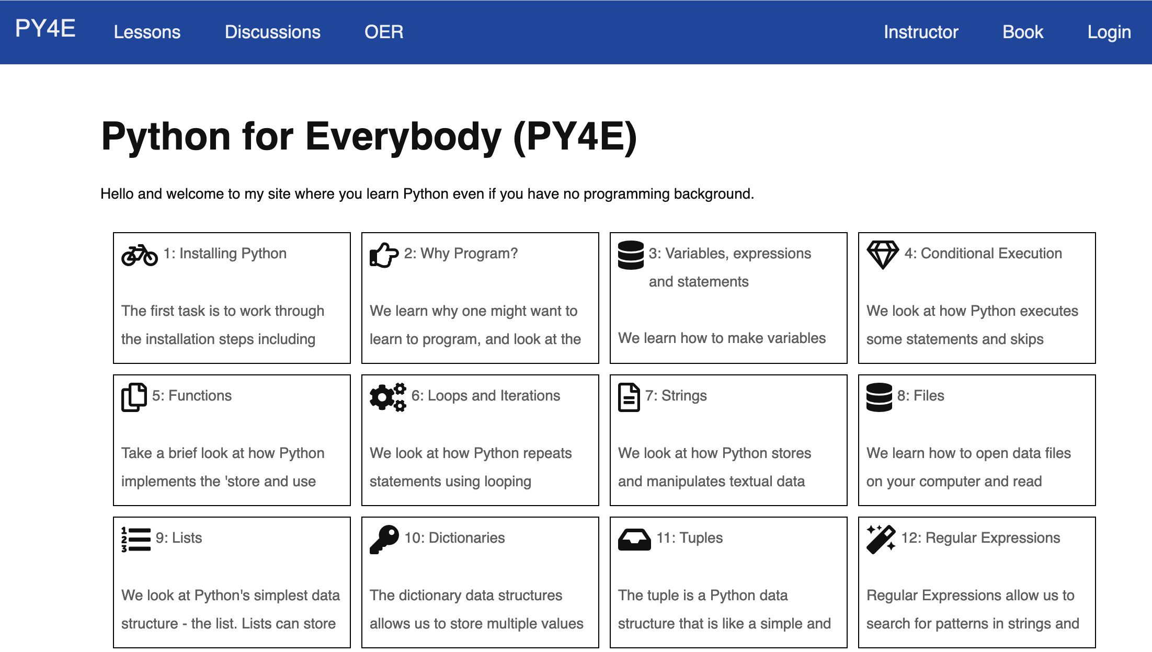
Tsugi (2010-)
PHP Based
Course Authoring Repository
  Learning Tools Interoperability
  Content Cartridge
Could be imported into an LMS
  Sakai
  Canvas
Imported into SI502 each semester

Slide 10

IHTS (2012)
Coursera founded in 2012
U Michigan was a founding partner
The only public university
Internet History, Technology, and Security was one of the "original six" from U Michigan
Built during the "secret phase" of Coursera
Based on two weeks of SI502 (Python)
Intended as an experiment to teach non-trivial technology to liberal arts students by moving slowly and building gradually

Slide 11
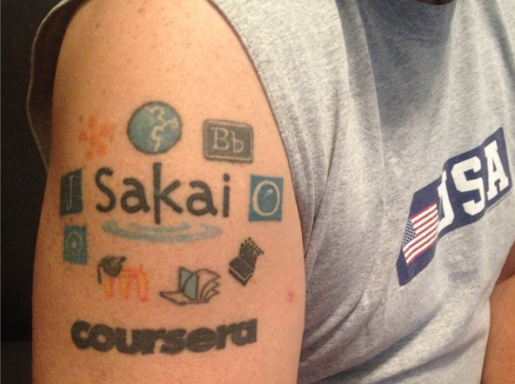
Coursera (2012)
If it only had Learning Tools Interoperability…
I could build a fully auto-graded course in a very short time
I helped code LTI 1.1 in Coursera
I became a publisher (like Pearson)
  Coursera
  edX
  Canvas
  Sakai
  FutureLearn

Slide 12
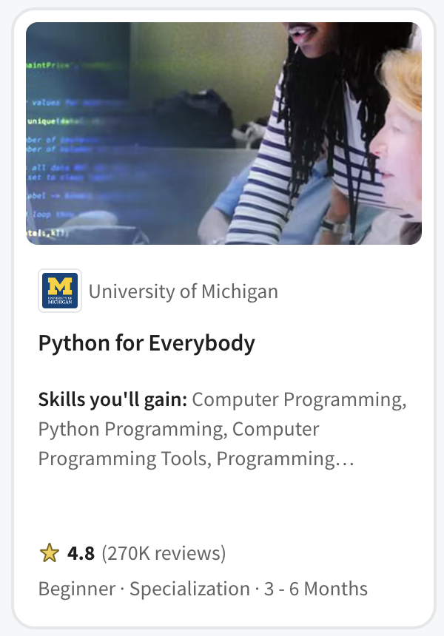
PY4E (2013)
Not a first course in Computer Science
  Programing for Librarians
  The rest of SI502
Quickly became the pre-requisite for
  John Hopkins Data Science
  Rice University Interactive Python
  University of Michigan Applied Data Science with Python
  University of Michigan Python 3
  University of Michigan Statistics with Python
Popular in Coursera for Campus - India

Slide 13
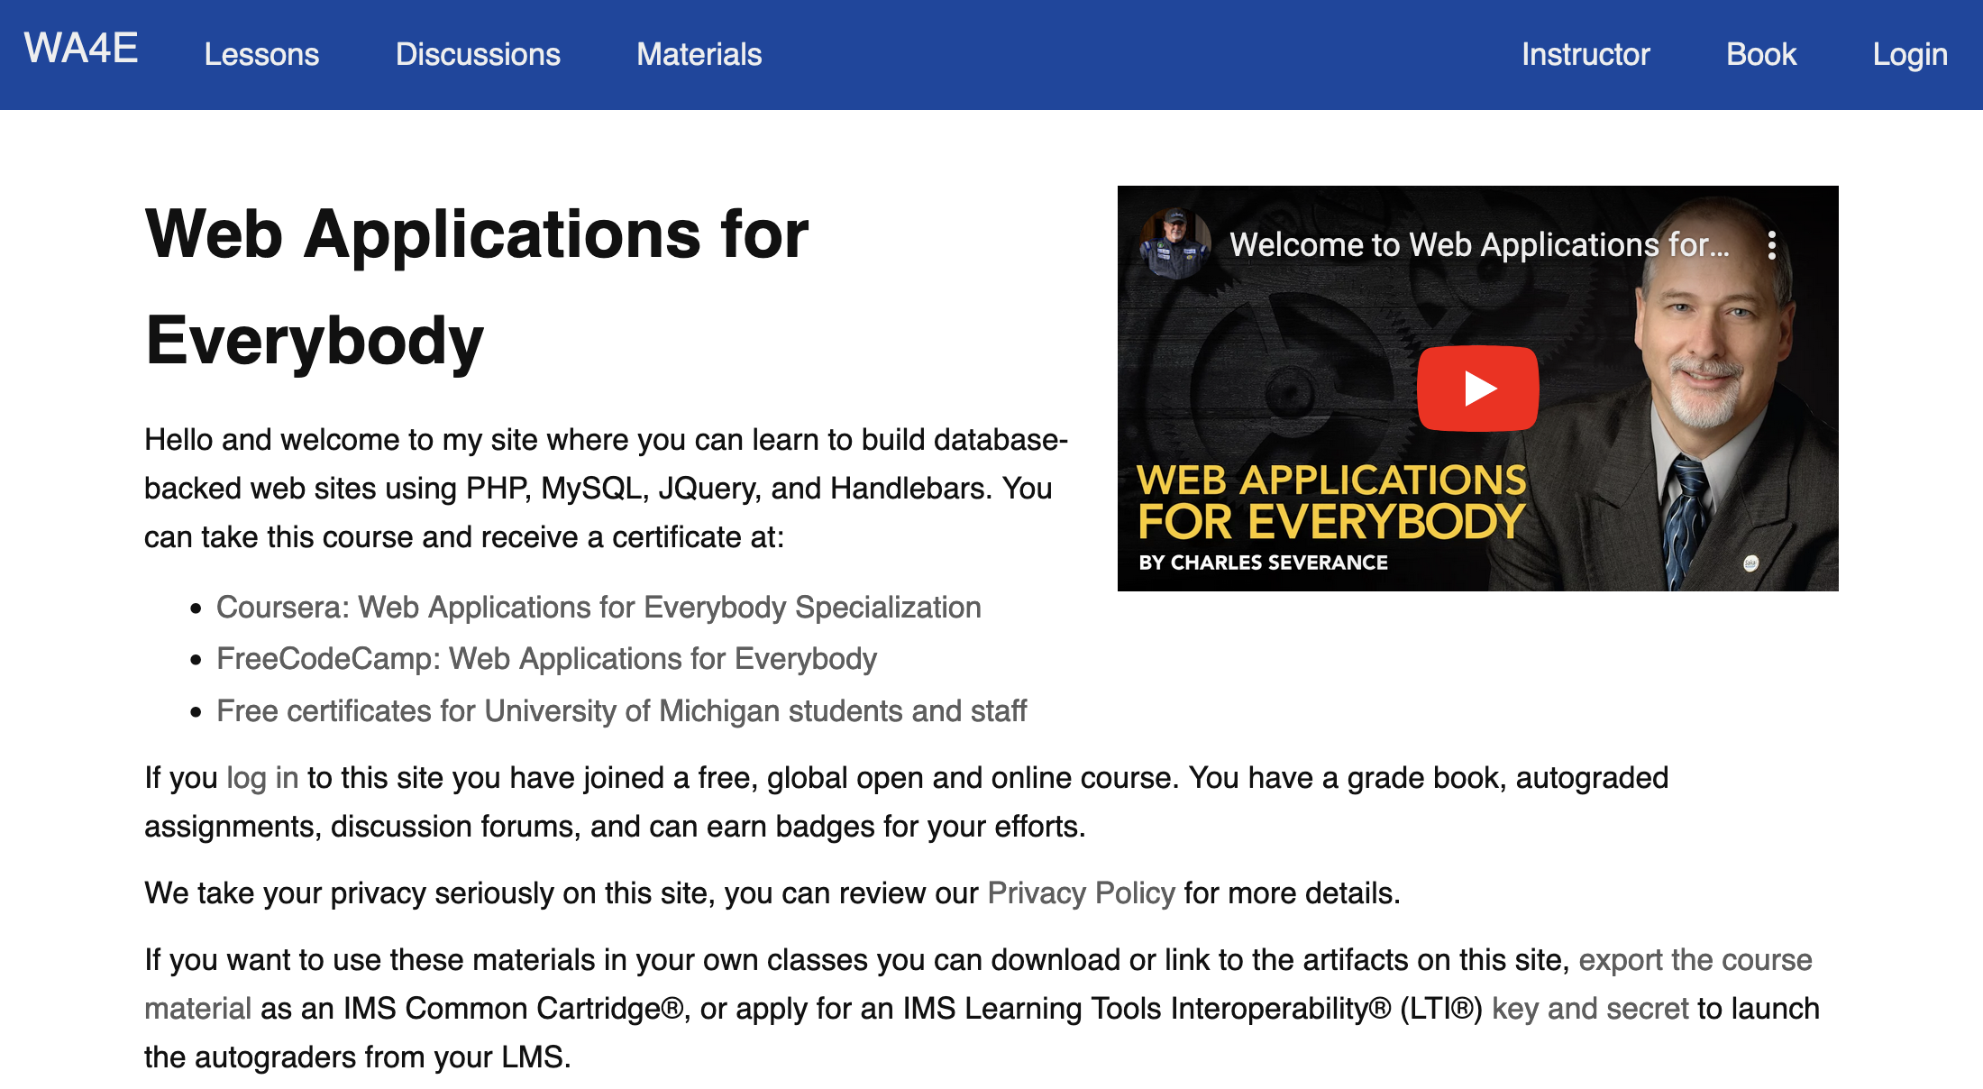
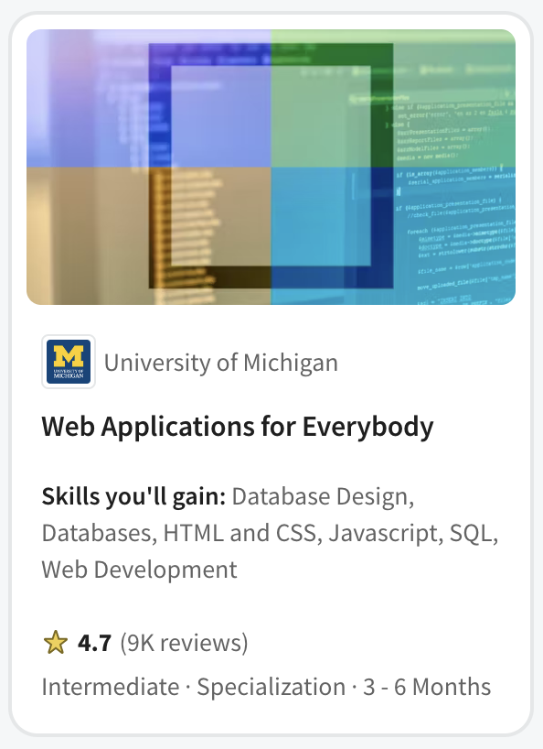
Web Applications for Everybody (2017)
PHP Course
On campus as SI572 / SI664 / SI364 (2012 – 2017)
Canvas, Coursera, edX, FutureLearn

Slide 14
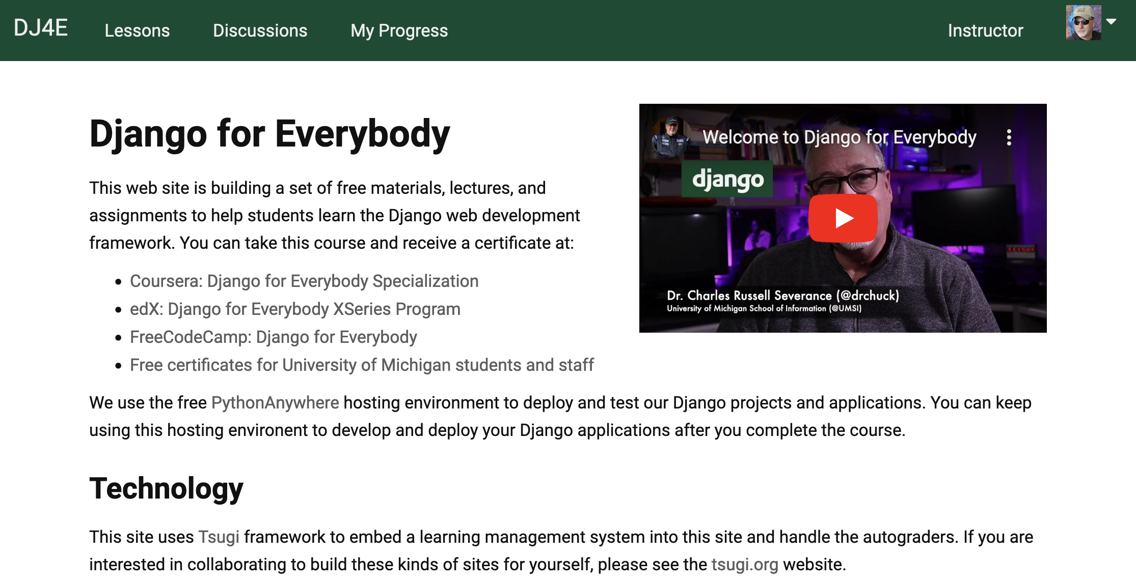
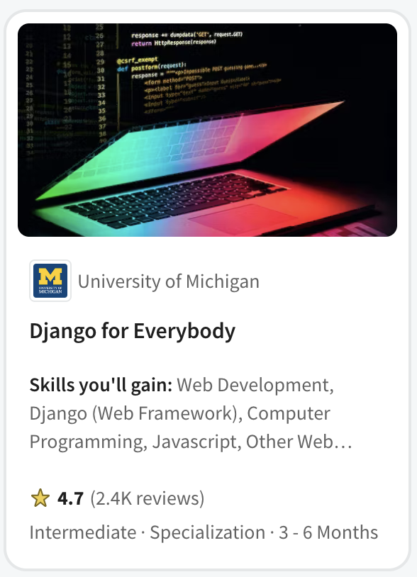
Django for Everybody (2020)
Curriculum committee said, "No more PHP!" (2016)
On campus SI664 / SI364 switched to Django
Canvas, Coursera, edX, FutureLearn

Slide 15
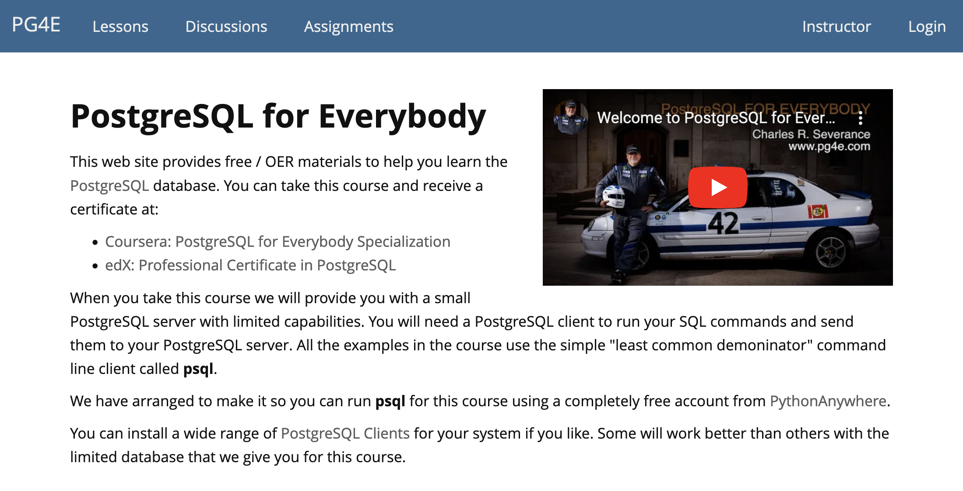
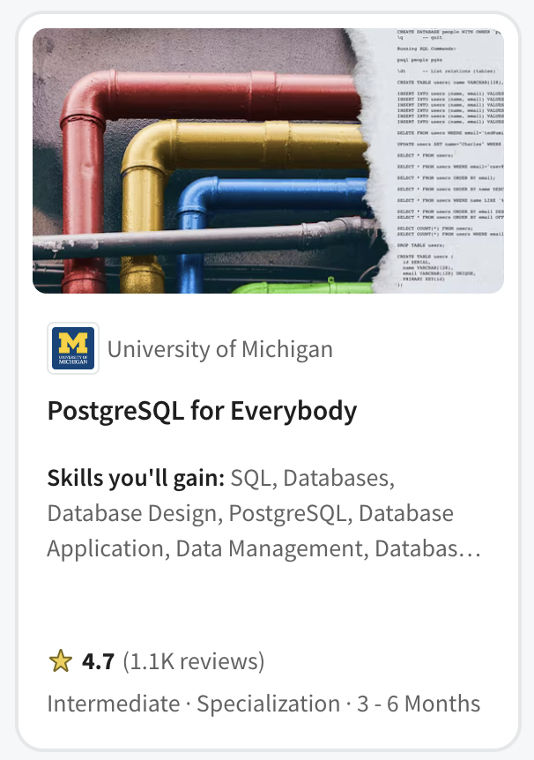
PostgreSQL for Everybody (2021)
Master of Applied Data Science on Coursera
SIADS 511 / 611
Coursera (MADS and Specialization)

Slide 16
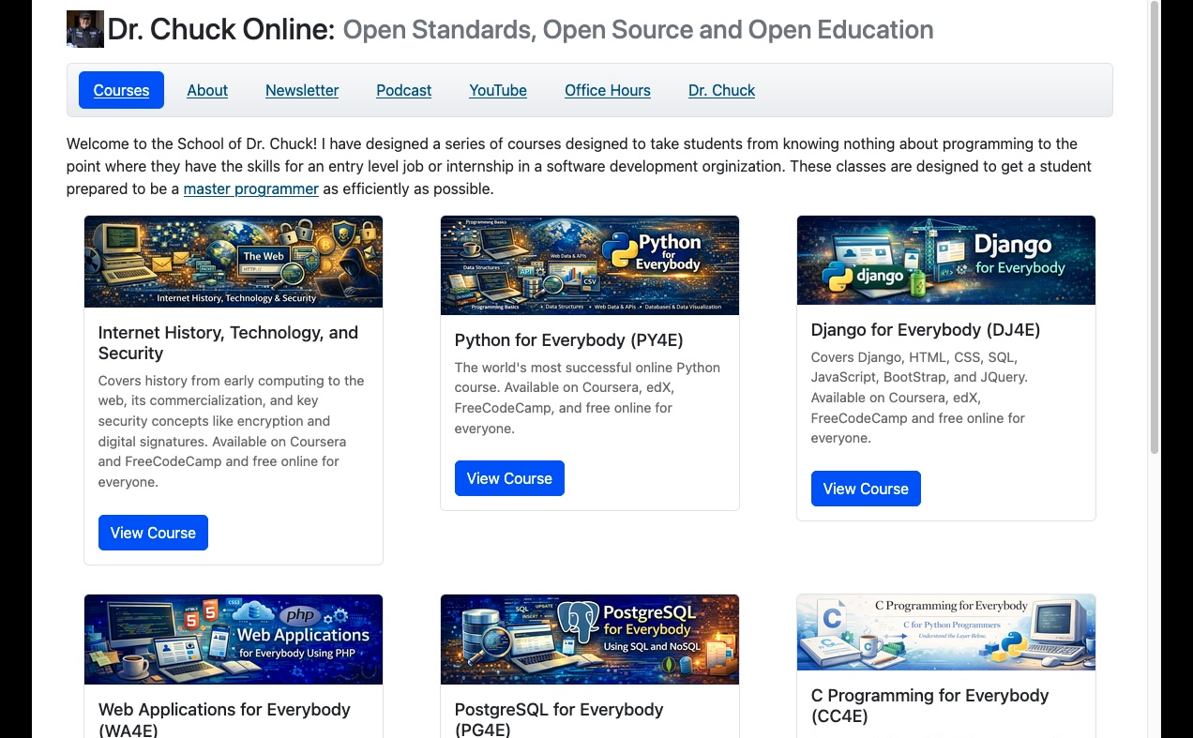

Slide 17
In Educational Technology for 25 years
The most popular programming course in the world
On Coursera
  25 courses
  Five specializations
A solid collection / curriculum
  High school
  Pre-Computer Science
  Adult reskilling
  Two year college
  On the job training / skills Improvements
Ready to integrate into Canvas / Blackboard / Moodle / Desire2Learn

Slide 18
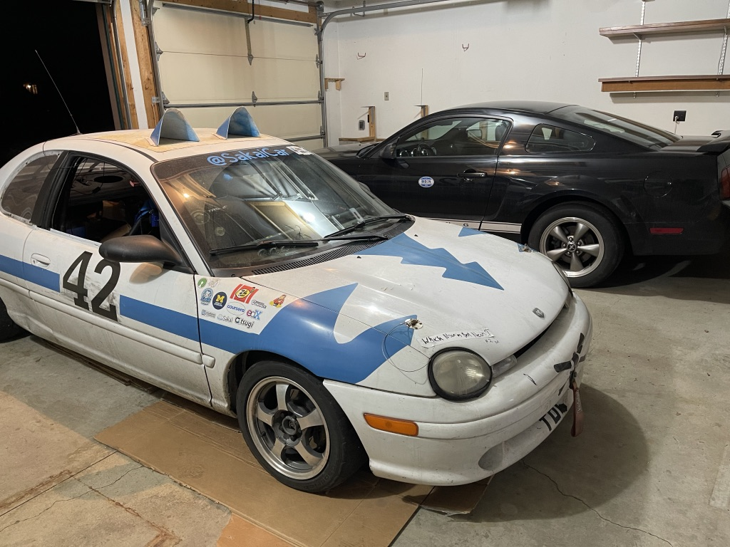

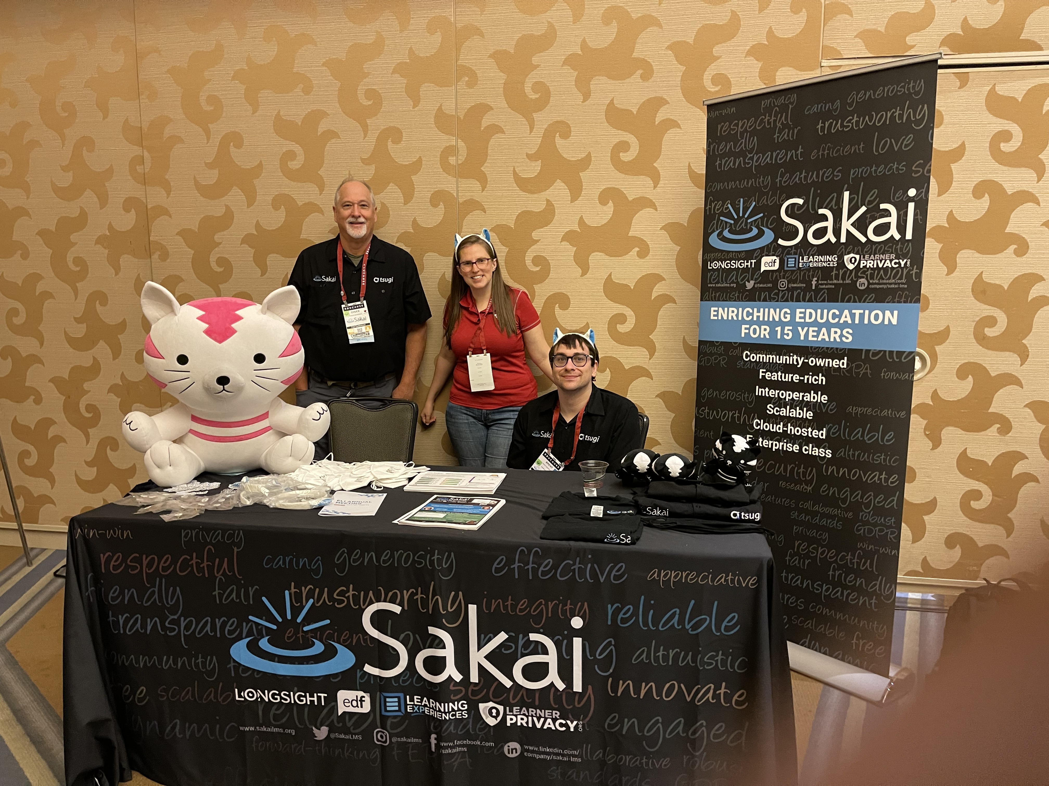
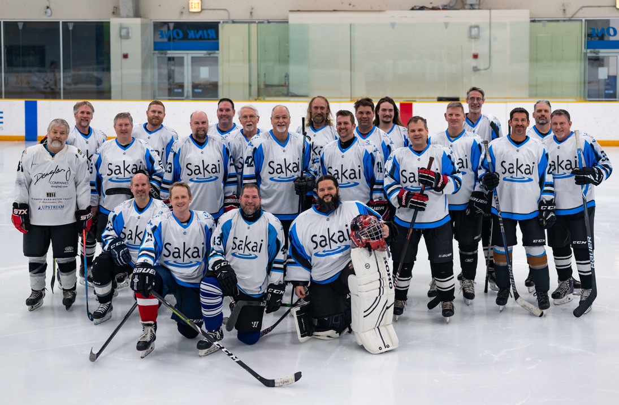

Should I slow down or even retire?
2022

Slide 19
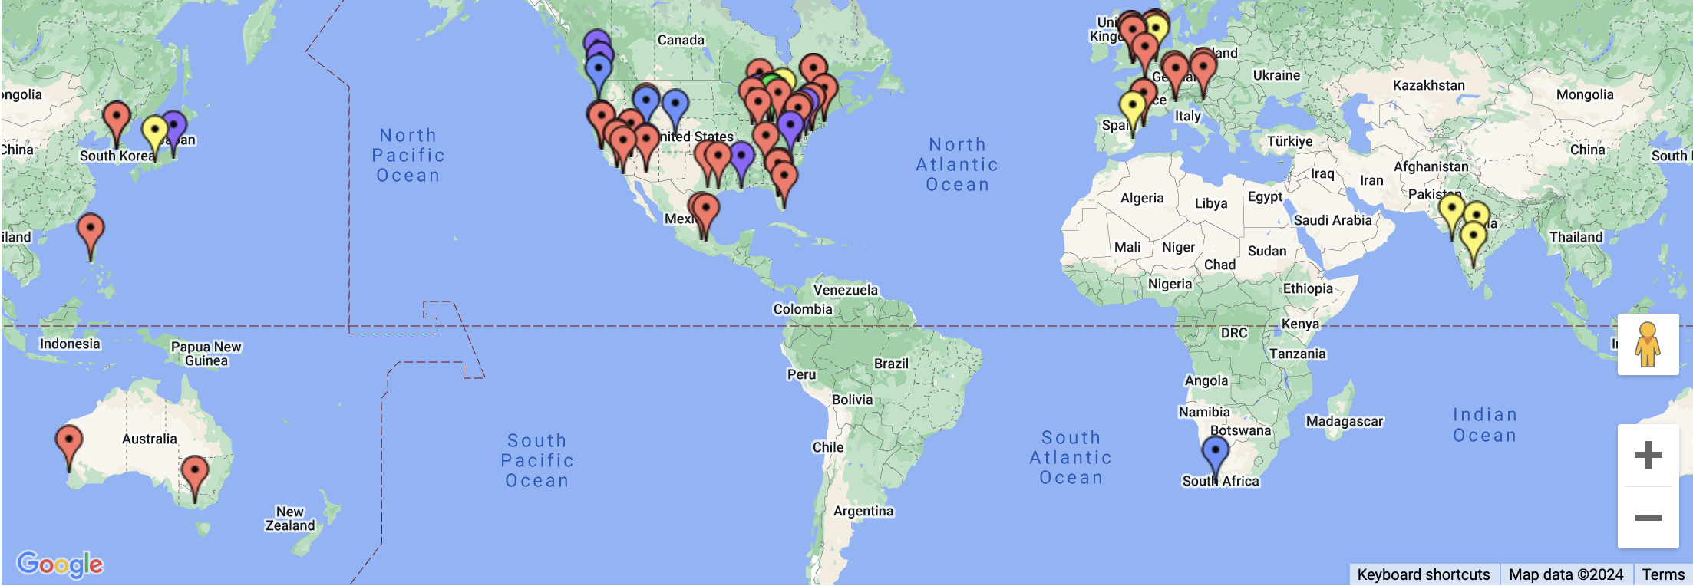
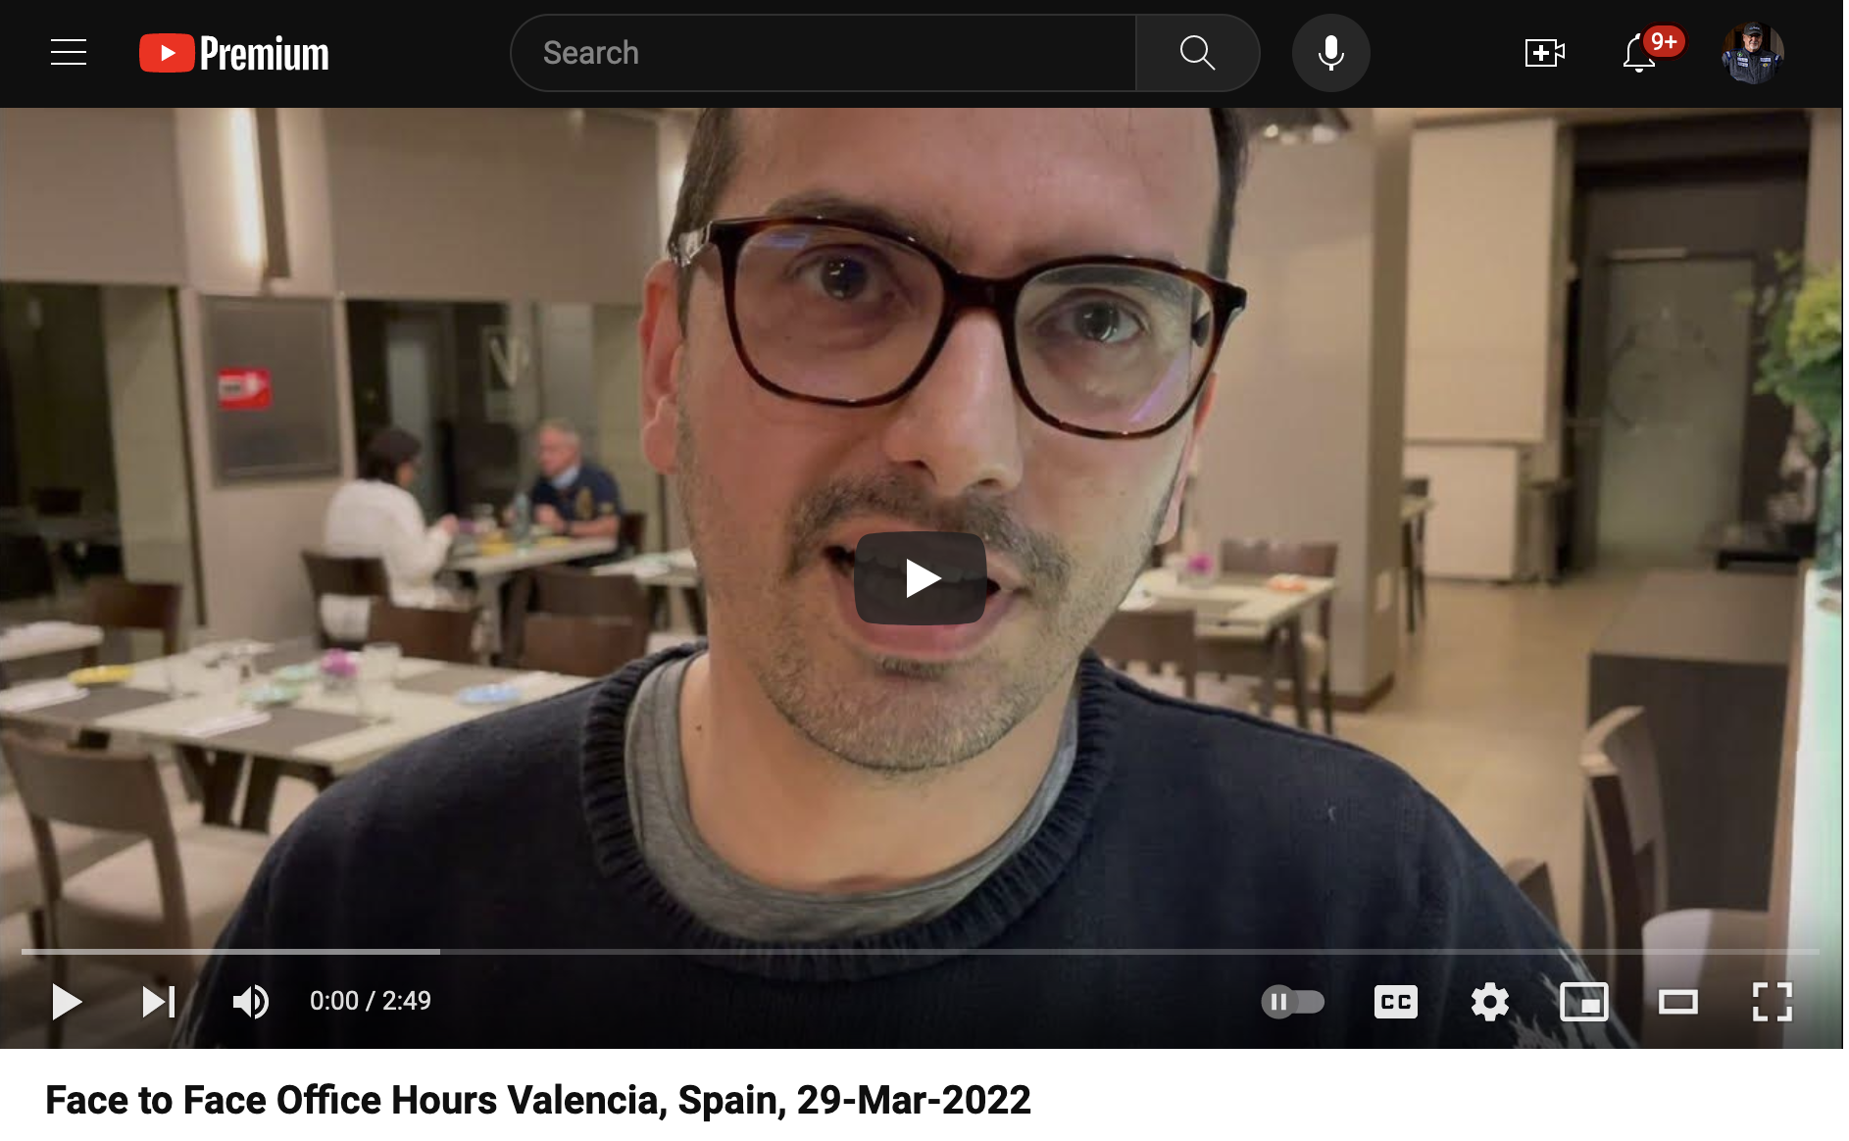
2022

Slide 20
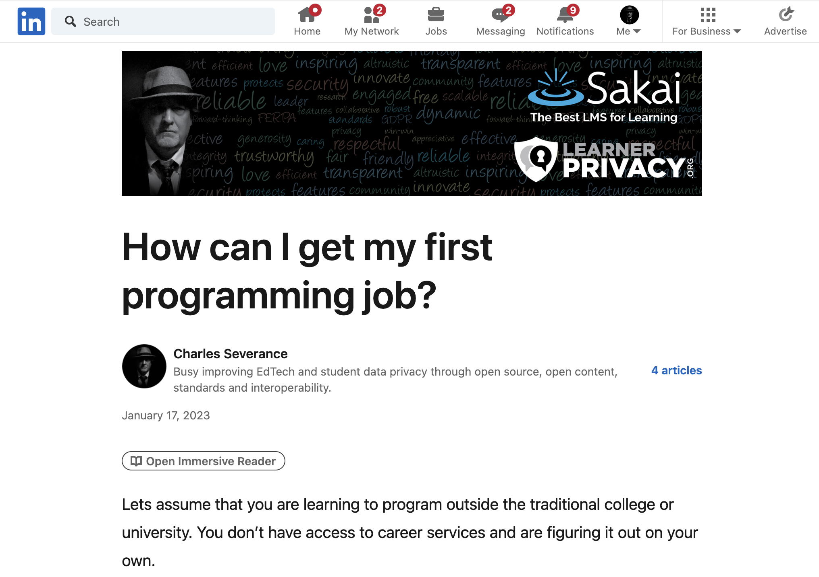

Slide 21

What kind of job can I get?

Slide 22
Would I hire the graduates of my "degree"?

Slide 23

If I would not hire my own graduates, what am I even doing?

Slide 24

A Brief Existential Crisis
Why am I here?
Have I let my students down?
Have I wasted their time?
Have I wasted my time?

Slide 25

Who would I hire?
I have met so many amazing developers over the years
Almost no Computer Scientists
Self taught / learned from mentors
Practical experience in large real-world projects
Work to build other people – great mentors
Not wizards – but quick learners

Slide 26

My next thought..

Slide 27
Can I develop a series of courses to quickly train ready-to-hire programmers?

Slide 28
It is not what they know…
Flask
SpringMVC
RedShift
BigData
Rust
Java
C#
Scala
JavaScript
HTML
Go
C++
VB
Fortran
AI
Kotlin
Node
PHP
C
React
JQuery
Perl
Dart
Backbone
Angular
R
ObjectiveC
Svelte
Lua
Ruby
COBOL
Django
SQL
Assembly
Swift
Python
Jupyter

Slide 29

It is how they learn
Can learn any programming situation and master it in four weeks
See past the syntax (X-ray Vision)
Run-time environments and internal data structures memory use, performance tradeoff
Like a master electrician

Slide 30


Master Electrician

Slide 31
Flask
SpringMVC
Rust
RedShift
BigData
Java
C#
Scala
JavaScript
HTML
Go
C++
VB
Fortran
AI
Kotlin
PHP
Node
JQuery
Perl
C
React
Dart
Backbone
R
ObjectiveC
Angular
Svelte
Lit
Ruby
COBOL
Django
SQL
Assembly
Swift
Python
Jupyter

Slide 32
Flask
SpringMVC
RedShift
BigData
Rust
Java
C#
Scala
JavaScript
HTML
Go
C++
VB
Fortran
AI
Kotlin
Node
PHP
C
React
JQuery
Perl
Dart
Backbone
Angular
R
ObjectiveC
Svelte
Lit
Ruby
COBOL
Django
SQL
Assembly
Swift
Python
Jupyter
???
???
???
???

Slide 33
Flask
SpringMVC
RedShift
BigData
Rust
Java
C#
Scala
JavaScript
HTML
Go
C++
VB
Fortran
AI
Kotlin
Node
PHP
C
React
JQuery
Perl
Dart
Backbone
Angular
R
ObjectiveC
Svelte
Lit
Ruby
COBOL
Django
SQL
Assembly
Swift
Jupyter
Python
???
???
???

Slide 34
Flask
SpringMVC
RedShift
BigData
Rust
Java
C#
Scala
JavaScript
HTML
Go
C++
VB
Fortran
AI
Kotlin
Node
PHP
React
JQuery
Perl
Dart
Backbone
Angular
R
ObjectiveC
Svelte
Lit
Ruby
COBOL
Django
Swift
Jupyter
Python
C
Architecture
Assembly
SQL

Slide 35
Flask
Rust
SpringMVC
RedShift
BigData
Java
C#
Scala
HTML
JavaScript
Go
C++
VB
Fortran
AI
Kotlin
Node
PHP
Perl
React
JQuery
Dart
Backbone
R
ObjectiveC
Angular
Svelte
COBOL
Django
Lua
Ruby
Swift
Jupyter
???
???
???
Python
C
Architecture
Assembly
SQL

Slide 36
Flask
SpringMVC
BigData
Rust
RedShift
Java
Scala
C#
Fortran
Go
C++
VB
AI
Kotlin
PHP
React
Node
JQuery
Perl
Dart
Backbone
R
ObjectiveC
Angular
Svelte
Lua
Ruby
COBOL
Django
Swift
Jupyter
HTML
JavaScript
???
Python
C
Architecture
Assembly
SQL

Slide 37
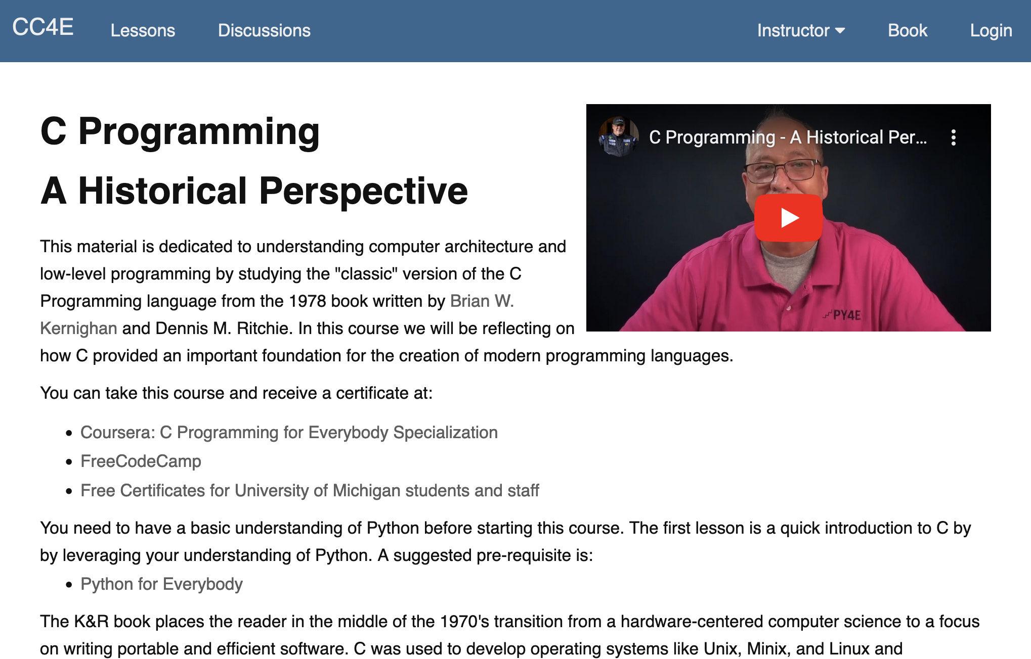
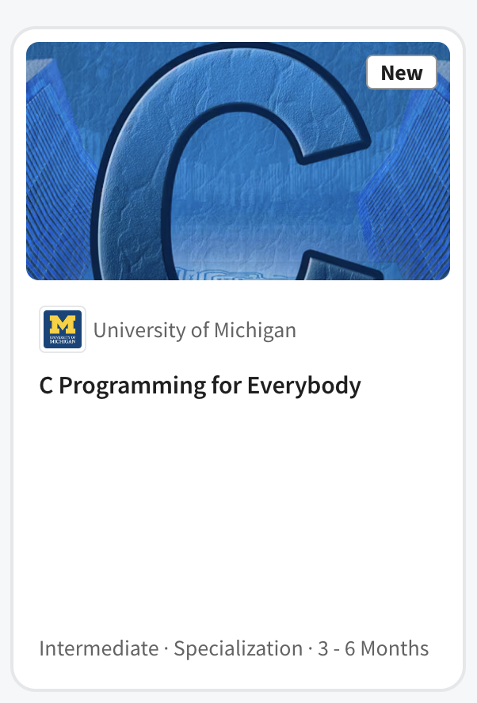
C Programming for Everybody (2023)
Based on the 1978 "C Programming" (45 years later)
Digitized, online, audiobook, accessible, annotated
Auto graders based on an in-browser C Compiler
Took 4 years to develop
Canvas, Coursera

Slide 38
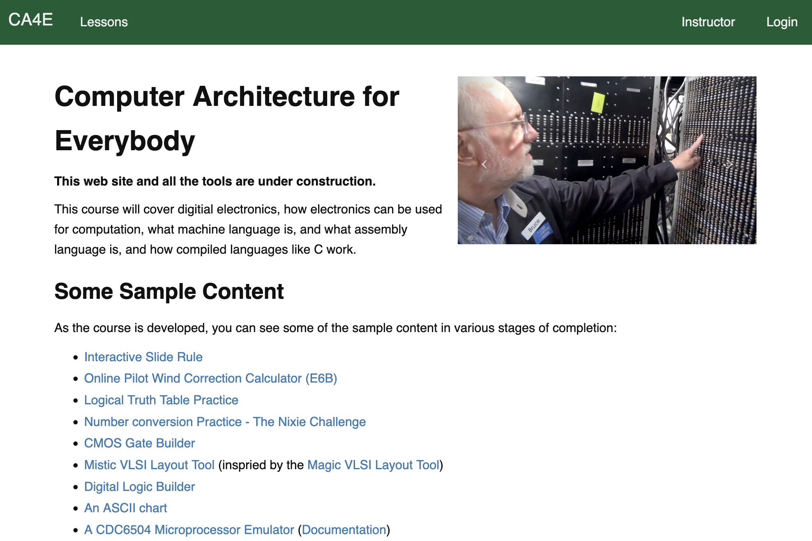
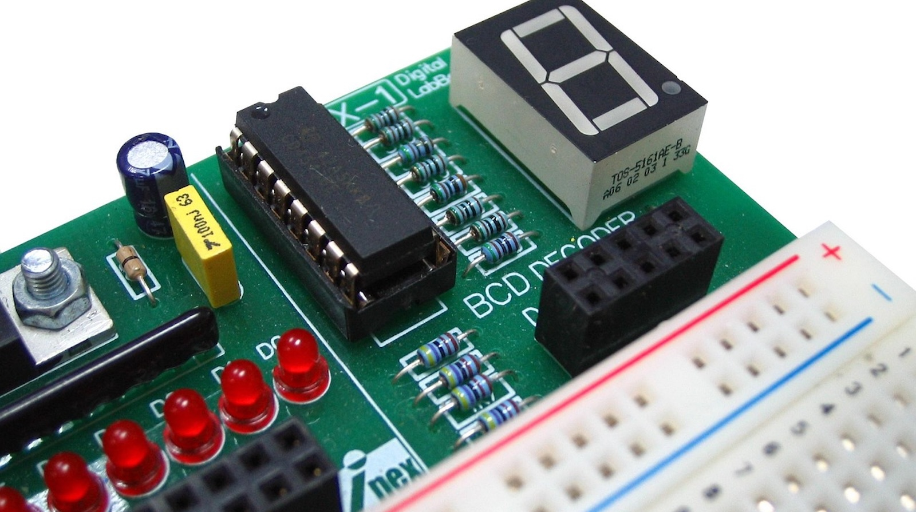
Computer Architecture for Everybody (2026)
Computer Architecture for Everybody
The fun, easy, and useful parts of computer hardware
Short fun lectures from Stonehenge to Microprocessors
Took 3 years to develop
Canvas, Coursera

Slide 39
The Path to the Master Programmer
JavaScript
Paid
Intern
ship
I would hire!
AI??
Computer Architecture for Everybody

Slide 40
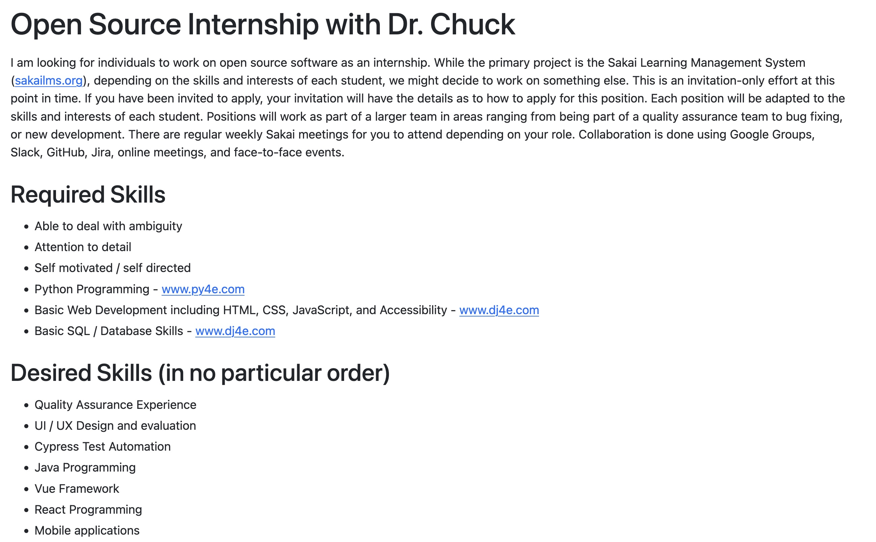

Slide 41
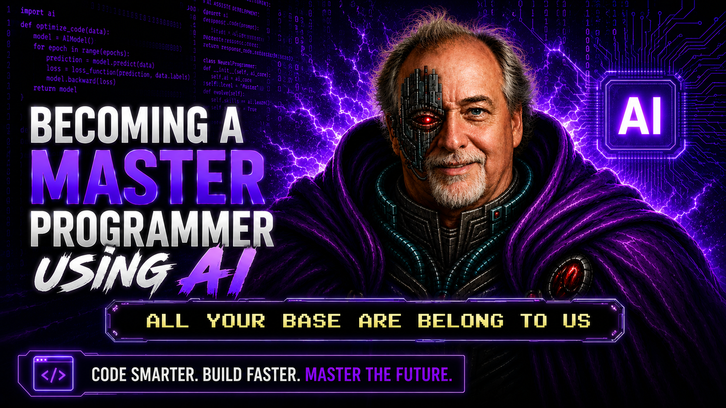

Slide 42
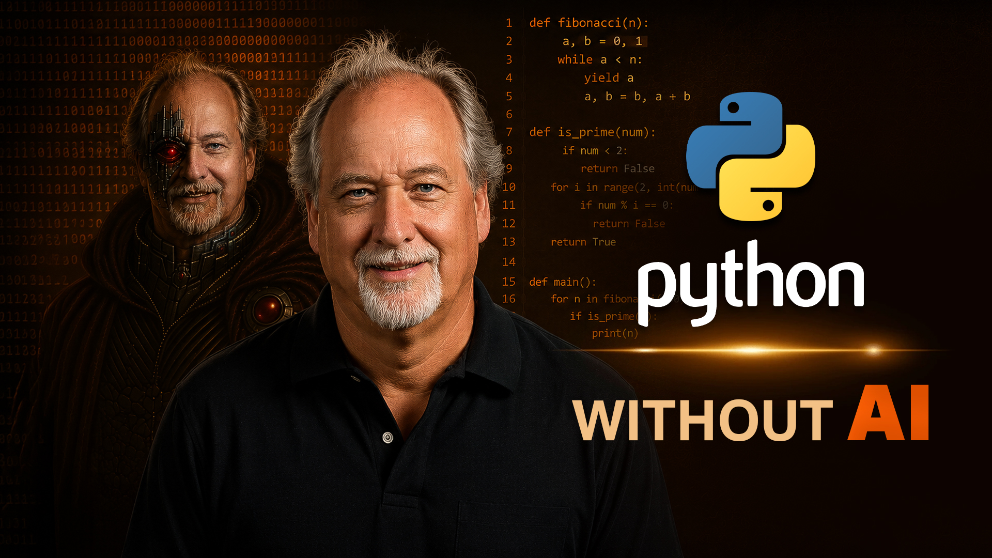
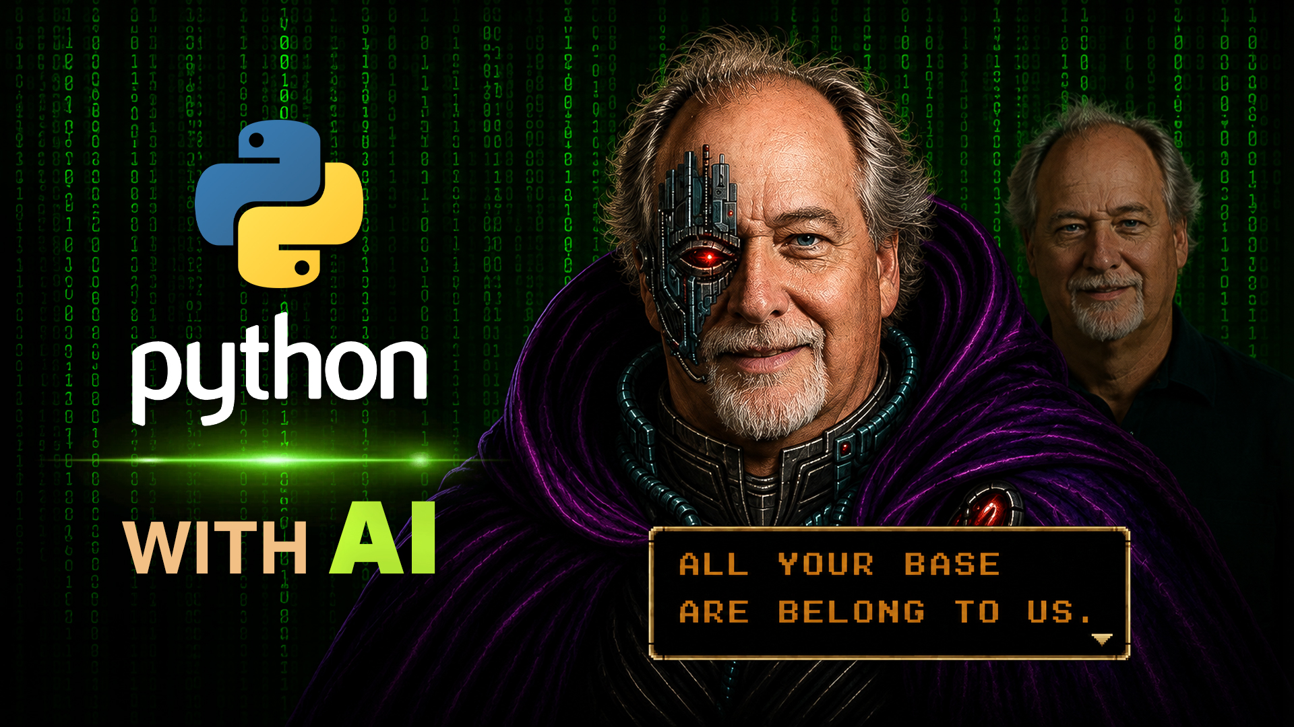
My next experiment – Fall 2026 ☺

Slide 43
Looking at The Future of
Higher Education Broadly

Slide 44
Challenges for Higher Education
Post Graduation Job Market
  We have too many programmer graduates expecting $120K right out of college
  Downward pressure on salaries
  Entry level jobs programming jobs are most vulnerable to AI – Maybe QA
Challenges for Universities
  Grant funding is dropping (support for graduate students)
  International Student Visas
  H1B Visas
Increasingly difficult to go to school full-time, go into debt, be away from the job market for five years, graduate and get a $90K job right out of college

Slide 45
Up Next – Sub-Degree-Non-Credit-Certificates
Bring the MOOC experience closer to the on-campus experience
Can be taken while working
Hybrid between Scheduled Cohort and/or Self Paced
Have regular access to UM-provided teaching staff
Scalable / Reasonable Cost / Profitable ➔ Best educational value
Online with F2F events at campus or at a destination
  Week long intensive educational event – like a boot camp but with context
  Graduation / Celebration
Treat these students like Alumni – long term relationship

Slide 46

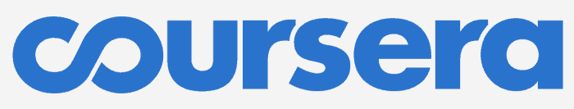


Hard Deadlines / Late Points
$1000 - $3000 Per Course
College Credit / Degree
Office Hours
One Physical Location
Class size 100
Direct Instructor Contact
Regular Teaching Assistant Availability
50% of Revenue to School / Faculty
Self Paced
$100-$300 Per Course
Certificate / No College Credit
No Office Hours
World-Wide
Class size 1000's +
No Instructor Contact
No Help When You Get Stuck
15% Revenue to School + Faculty

Slide 47

Hard Deadlines / Late Points
$1000 - $3000 Per Course
College Credit / Degree
Office Hours
One Physical Location
Class Size 100
Direct Instructor Contact
Regular Teaching Assistant Availability
50% of Revenue to School / Faculty
Hybrid Deadlines
$300 - $600 Per Course
Certificate / No College Credit
Office Hours
World-Wide (*)
Class Size 500
Instructor Contact
Regular Teaching Assistant Availability
100% of Revenue to School / Faculty
Self Paced
$100-$300 Per Course
Certificate / No College Credit
No Office Hours
World-Wide
Class Sise 1000's
No Instructor Contact
No Help When You Get Stuck
15% Revenue to School + Faculty

Slide 48
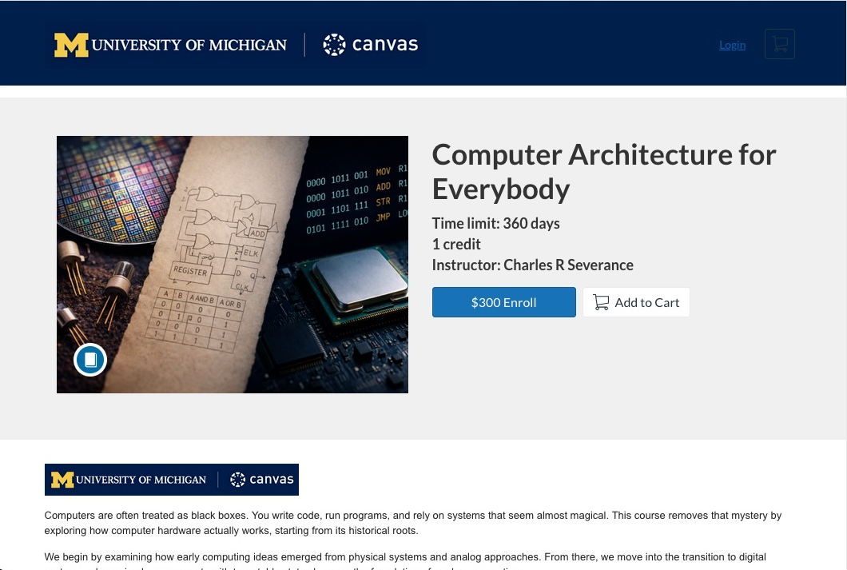

Slide 49
Thank you
Any questions?
Dr. Charles Severance
University of Michigan School of Information

