Slide 1
Understanding OAuth 2.0, Tokens, JWTs, Public / Private Keys, and LTI Advantage
Charles Severance
Sakai Virtual Conference
https://github.com/csev/talks/tree/master/2018

Slide 2
This is the technical talk
The next talk is mostly demo.

Slide 3
LTI Advantage
New Java Web Token / PKI launch – LTI 1.3
LTI 2.0 deprecated
OAuth 2.0 Services
Auto-created grade column (like LTI 1.1)
Members and roles (roster service)
Outcomes Service (tools can make new columns in the gradebook)
Unprecedented effort to simultaneously release by the "big five" LMS vendors

Slide 4
PKI – Public Private Keys
LTI 1.1 Used a shared secret for launches and services
LTI Advantages uses a pair of Public/Private keys for each message flow
Setup is more complex
Excellent libraries in Java
Sample code: basiclti/tsugi-util/src/test/org/tsugi/lti13/LTI13PKITest.java

Slide 5
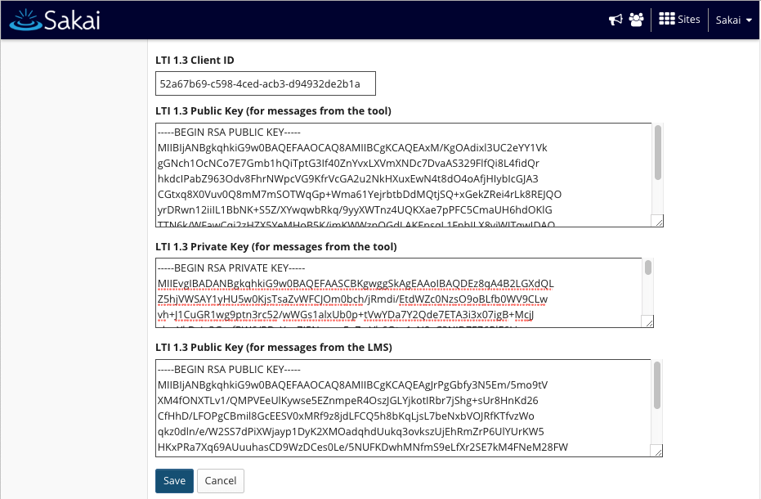

Slide 6
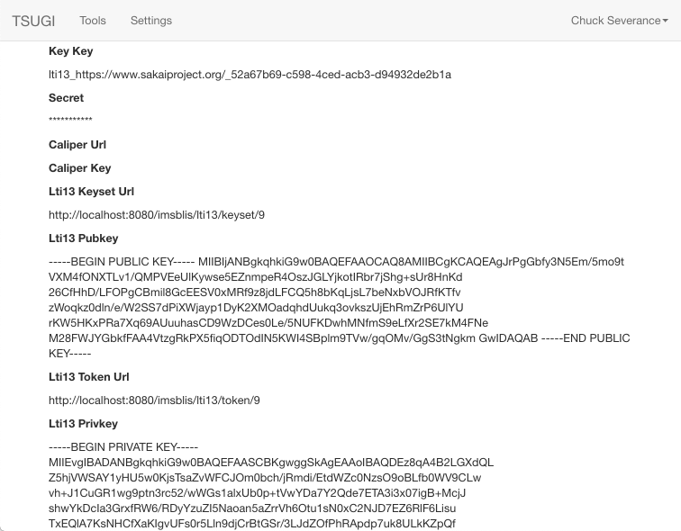

Slide 7
JSON Web Tokens - JWTs
A serialization and signing pattern for exchanging structured JSON
https://jwt.io/
Excellent libraries in Java
Sample code: basiclti/tsugi-util/src/test/org/tsugi/lti13/LLTI13JJWTTest.java

Slide 8
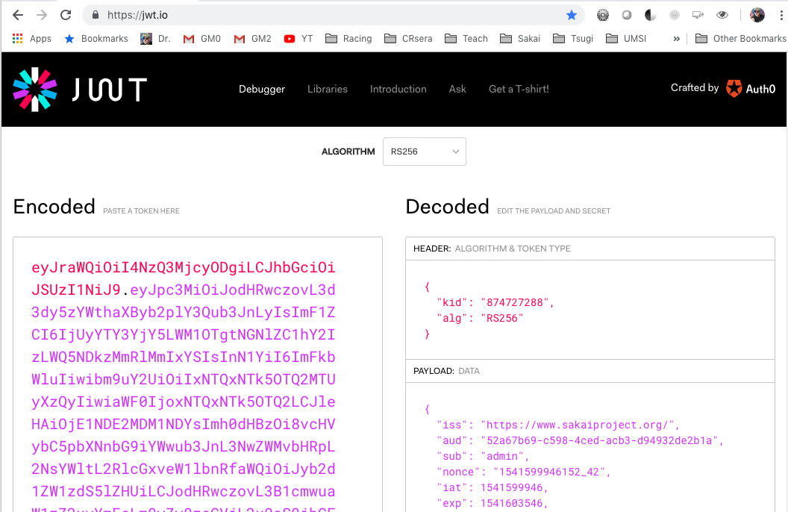

Slide 9
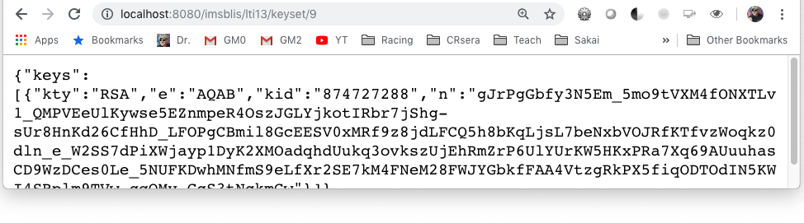
PKI Key Rotation
When the JWT is signed with a "kid", the public key to verify the message is looked up using a keyset url
Clever tools cache the kid / public key until the kid changes on a message

Slide 10
LTI 1.3 Launch
JSON "claims" in a Java Web Token signed with a public key
LMS (Platform) has a private key and shares the public key widely
Key rotation is possible using kid
Java Web Tokens
Like the LTI 1.x "base string"
Serialization and signatures
Sample code: basiclti-common/src/java/org/sakaiproject/basiclti/util/SakaiBLTIUtil.java

Slide 11
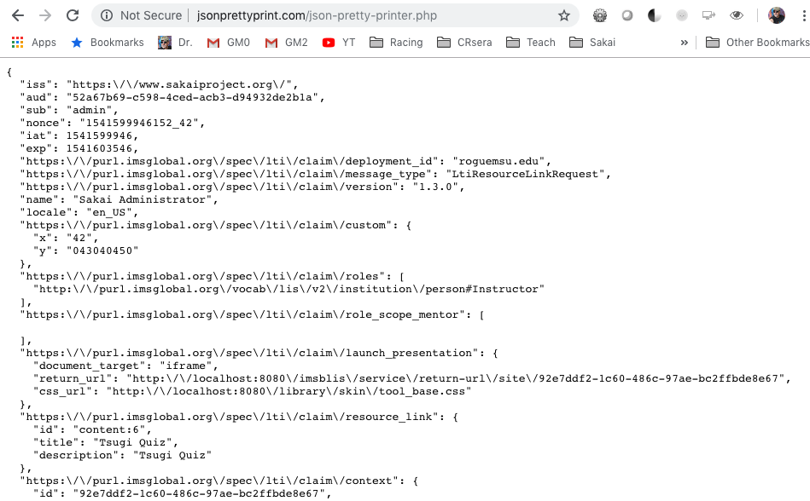

Slide 12
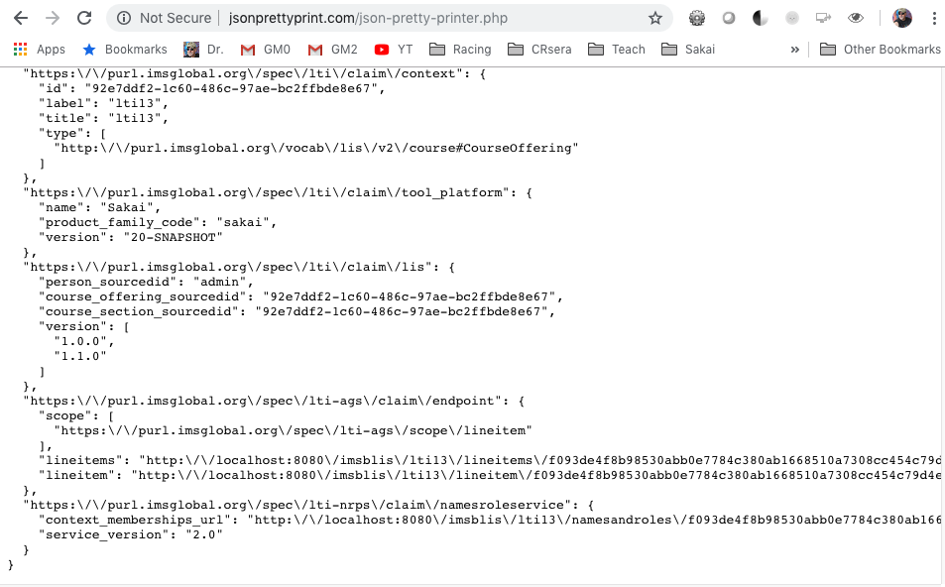

Slide 13
OAuth 2.0 Services
Server to server variant of three legged SSO
Tool has a private key and shares its public key with the LMS
Tool uses message signed with public key to request a "short-lived" token – API token is with API calls to services
When the token expires (an hour usually) the tool must re-request
Tokens have "scopes" – like an AUTHZ grant
Excellent library support in Java for OAuth 2.0

Slide 14
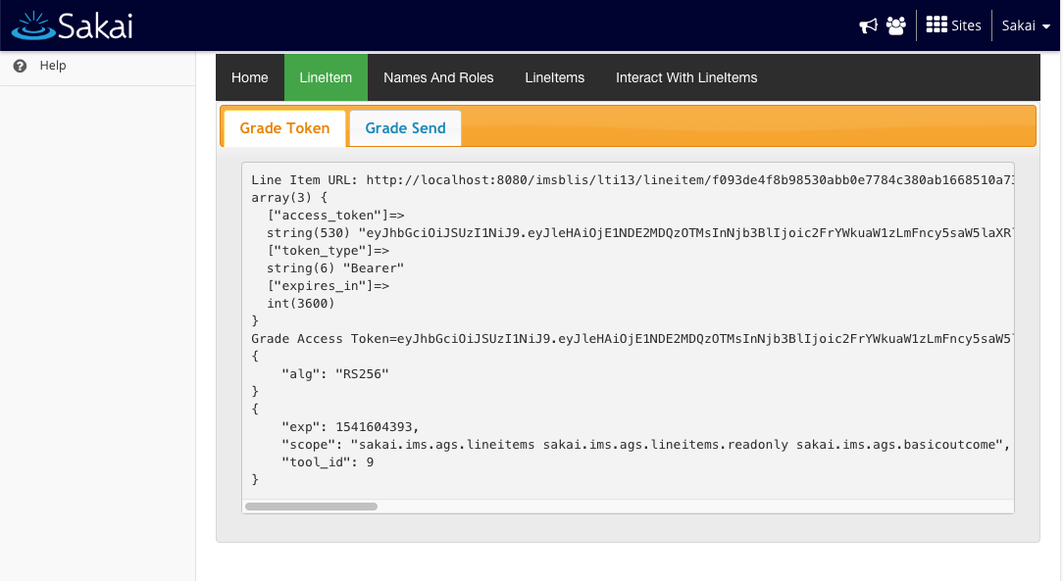

Slide 15
Code for Tokens
Tsugi: Getting an access token
tsugi/lib/src/Util/LTI13.php (418)
Sakai: Producing an Access Token
basiclti-blis/src/java/org/sakaiproject/lti13/LTI13Servlet.java (1533)
Tsugi: Using an access token
tsugi/lib/src/Core/Result.php (231)
tsugi/lib/src/Util/LTI13.php (122)

