Slide 1



Slide 2
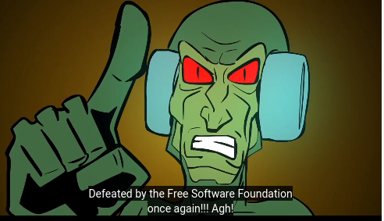
https://u.fsf.org/fsfheroes

Slide 3
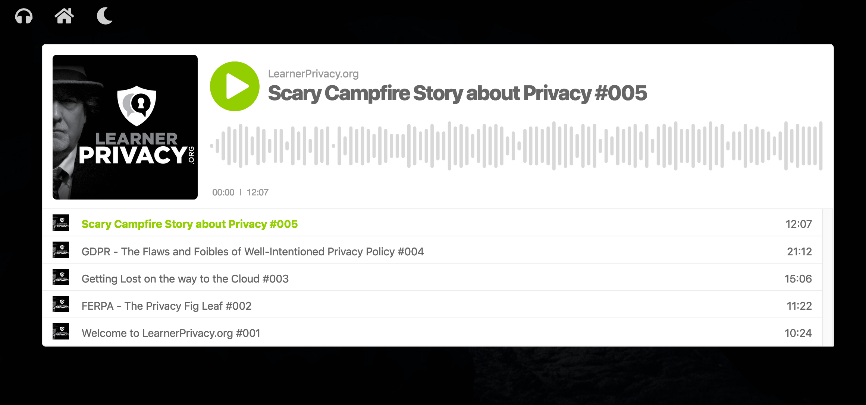

Slide 4
Legal Frameworks
Federal Educational Rights and Privacy Act
Health Insurance Portability and Accountability Act
Privacy Shield
General Data Protection Regulation
California Consumer Privacy Act
Advocacy Matters

Slide 5

EXCELLENT
2000
Blackboard
WebCT
2004
Sakai
Moodle
2030
2008
Canvas
LTI
Student Data Privacy
Student Data Privacy
2020
SASS
LTI
TERRIBLE
TERRIBLE
Flexibility and Interoperability
EXCELLENT

Slide 6
Privacy Audit
ToolCo
ToolCo
ToolCo
LMSCo
ToolCo
ToolCo
ToolCo
ToolCo

Slide 7
For Each Data Holder
Public / Private / For Sale
Is your data their asset?
US / Non-US / Multinational
Upward, flat, or downward?
Future: Limit data to essential only
Future: Limit time to hold data

Slide 8
IMS Privacy Efforts
Things are looking up
Chuck is no longer "part of the problem" ☺
Privacy Working Group
IMS LTI drafting "Privacy Launch" specs
Move from "compliance" to "good UI"

Slide 9
Demo Time
Hey Dr. Chuck, I listen to your podcast. You are always complaining about "Evil Cloud Learning Tool Vendors".
But aren't you PART OF THE PROBLEM?
TsugiCloud is a free cloud service! Dave Eveland gives you our data! Learning Experiences is a privately held company! How do we know you won't sell our data?

Slide 10
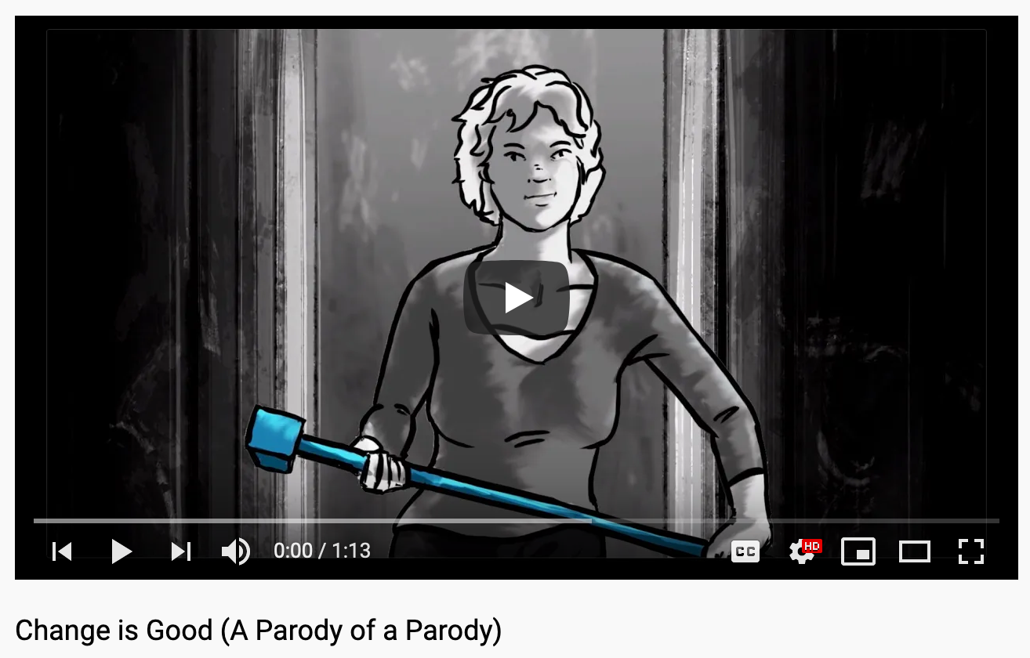
https://youtu.be/9LKmFTgCkj4

Slide 11
Why Make a Podcast?
Advocacy Matters

