Slide 1
Sakai 2.9 Portal Roadmap
Charles Severance
www.dr-chuck.com
csev@umich.edu

Slide 2
Why Now?
Sakai 2.9 development cycle is the longest we have ever had (Jan-Sep 2011)
Build a look-and-feel bridge to the well-thought-out OAE User Interface (and pretty)
Sakai 2.5 – 2.8 were all pretty much bug fixes – that is nearly 4 years of non-progress on UI
The rest of the market has made major UI revisions

Slide 3
Why?
Need to give Sakai commercial affiliates something that will compete
Visible progress will re-energize, re-focus, and give purpose the Sakai developer community
The TCC is the best governance we have ever had for the CLE/2.x
The IMS Common Cartridge Specification is likely to be a major differentiator in 2011-2012

Slide 4
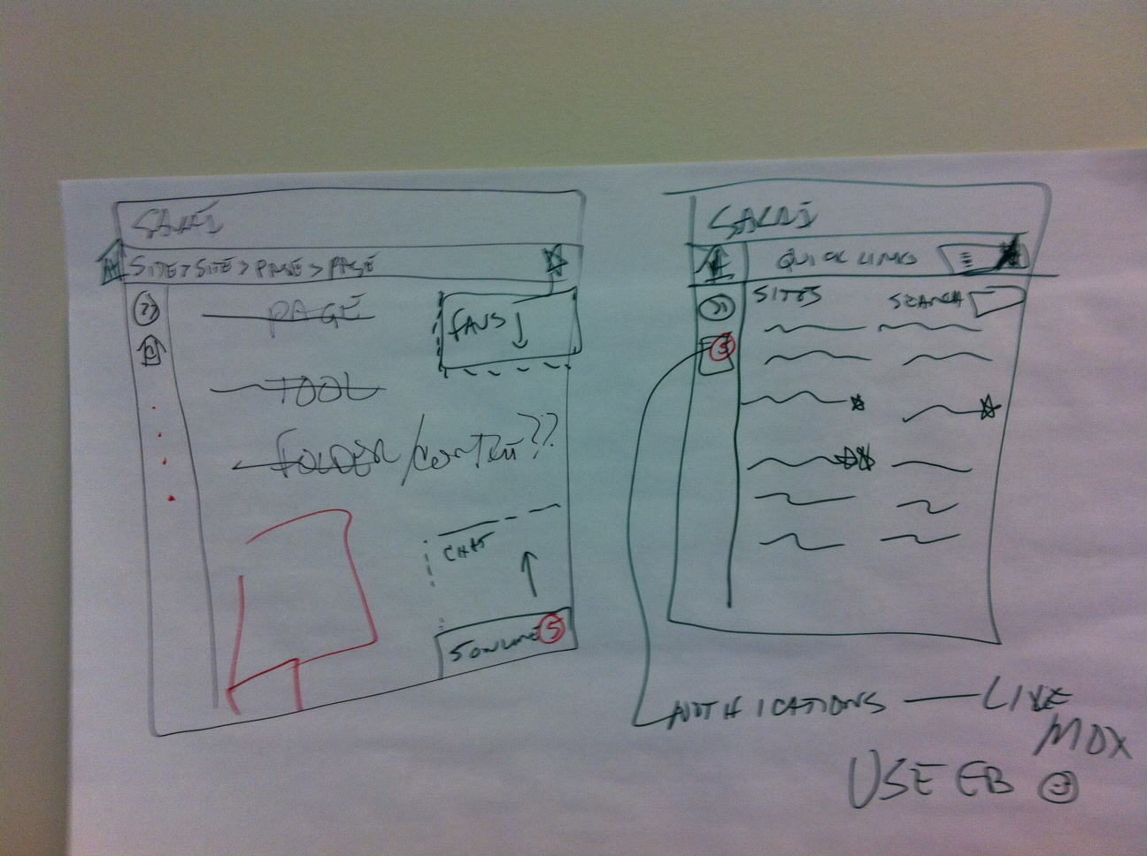

Slide 5
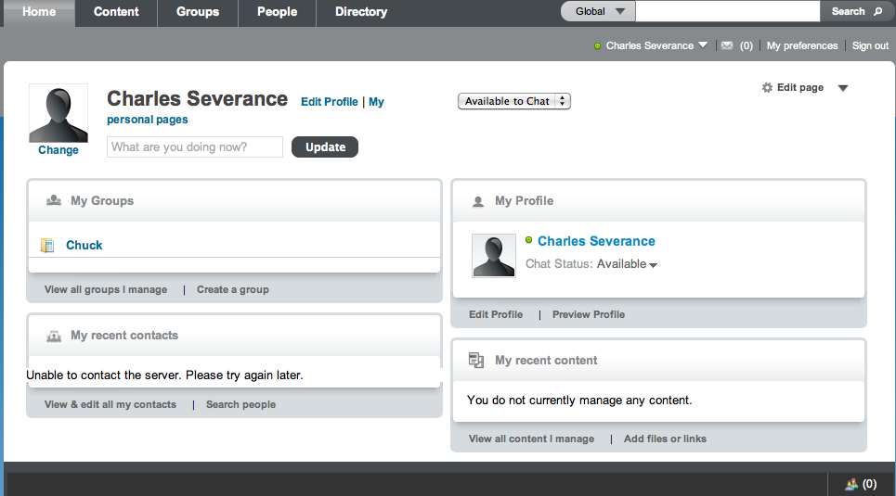
Portal Changes

Slide 6
Rules for 2.9
Evolutionary not revolutionary
Add to – don't rewrite
Maintain compatibility forward and backwards
Few / moderate database conversions
No backslide on performance / scalability
Look at other vendors and emulate wherever possible
Prototype quickly and react

Slide 7


Goals: OAE/CLE Future
OAE
CLE
Hybrid
I expect we will likely see all three permutations in production at scale for years.

Slide 8
Sakai Portal 2.9 Goals
Default CLE Nav to look like OAE Nav – not a clone – homage
Course Navigation Prefs will be in Portal
Integrate parts of Profile2 into the portal
Integrate Lesson Builder into the Portal
New presence/chat (IM/Facebook/OAE style)
New wall tool from Lancaster (Profile2)
New Mobile Portal (already done)

Slide 9
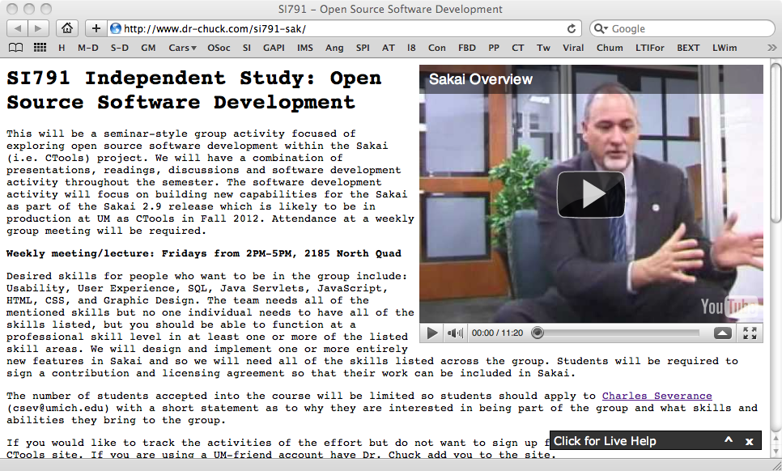
SI791
http://www.dr-chuck.com/si791-sak/

Slide 10
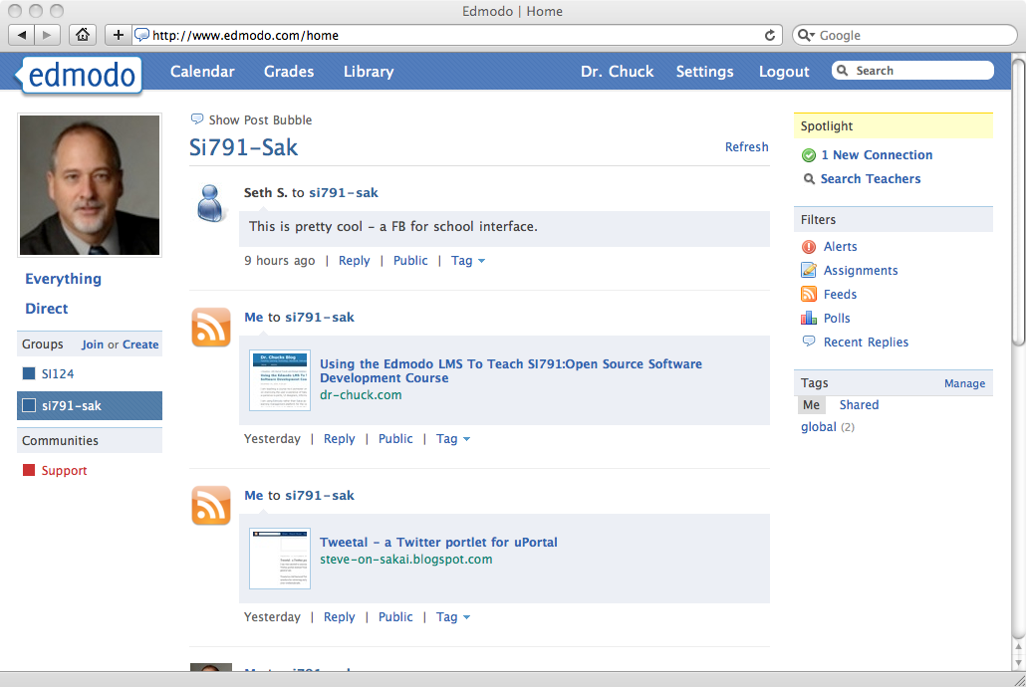
http://www.edmodo.com/public/si791-sak/group_id/161836
Contact Chuck for Edmodo group code

Slide 11
SI791 Plan
Team of Students
  UI/UX
  Graphic Design
  Programming – JAVA/HTML
Start looking at Sakai CLE 2.8
  Usability, brainstorming, maybe even QA
Look at Sakai OAE 1.0
Look at www.edmodo.com

Slide 12
SI791 Plan
Look at Lesson Builder
Look at Adrian's Chat Tool and Wall Tool
All will sign Sakai contribution agreements
Design will be done in the open
Students will make regular reports to the community
Hopefully have majority of design work done and code prototyped in trunk by mid-April

Slide 13
Technical Approach
New OAE look will be Velocity/CSS work – limited tweaks to the Java portal code (vis. PDA-I and PDA-II)
Portal will still produce an entire page for a GET (i.e. no separate AJAX loading of page text)
Page to Page Nav will borrow from Hybrid
AJAX/lazy Loading for user actions like activating chat or changing a preference
New/moved features will use /direct (EB)

Slide 14
Portal Changes

Slide 15
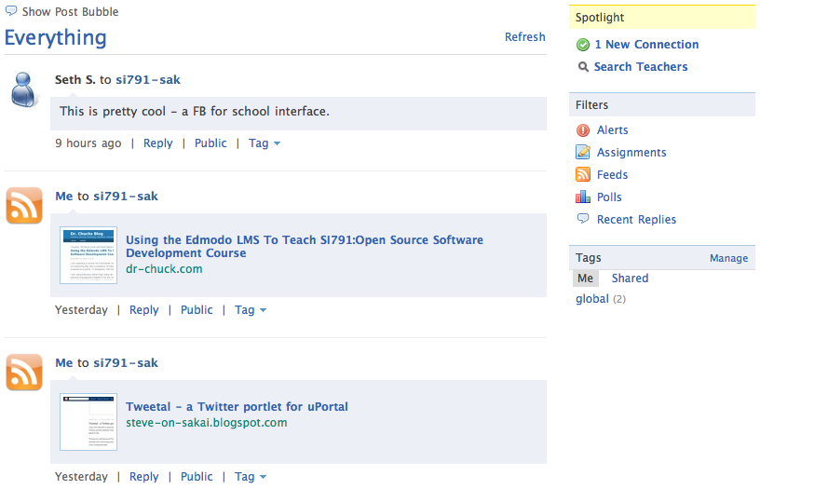
??
Sites
Social
Si539
Si502
http://www.edmodo.com/

Slide 16
Profile2 Tasks
Evaluate Usability / do QA
Evaluate performance if we are making it part of portal
Can we morph Profile2's activities to be the wall tool
Integrate profile friends into presence and add Chat (Adrian Fish's work)
org.apache.shindig.social.opensocial.spi.ActivityService – could we build this?

Slide 17
Home
Sites
Social
Si539
Si502
Courses
SI124
Si539
SI502 F10
Projects
Transition
Next Semester
SI301
SI581
SI791
Sites Page – User adjustable, User Categories,Drag and drop, site search – a div reveal (i.e. no server interaction

Slide 18
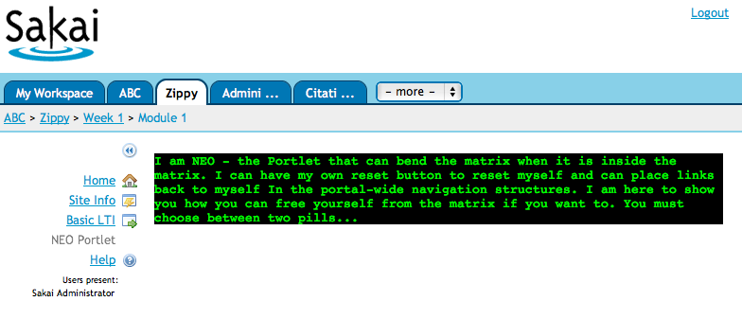
NEO PORTAL FEATURES

Slide 19
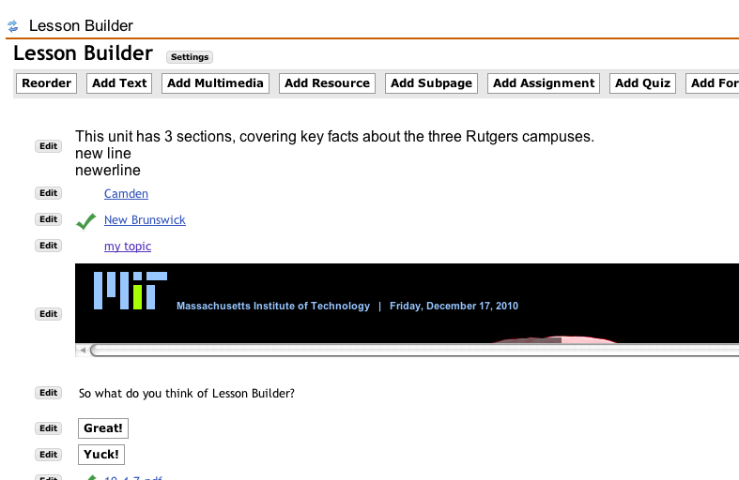
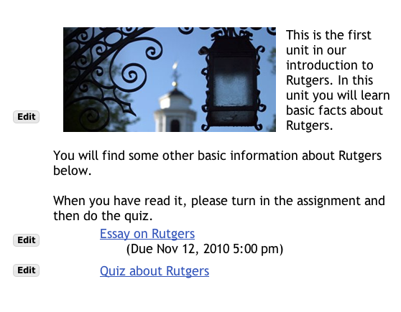
Home
Sites
Social
ABC
Si502
Sites
LESSON BUILDER GOES HERE

Slide 20
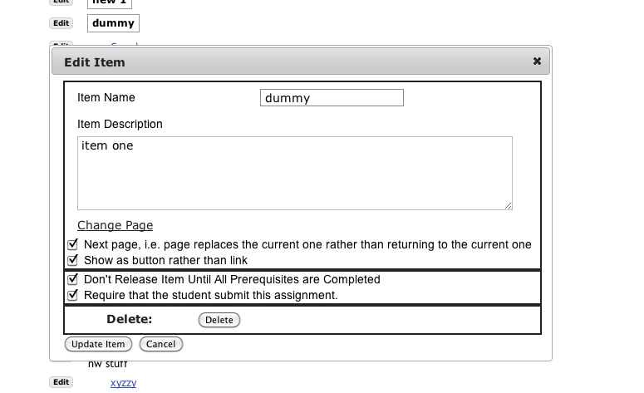

Slide 21
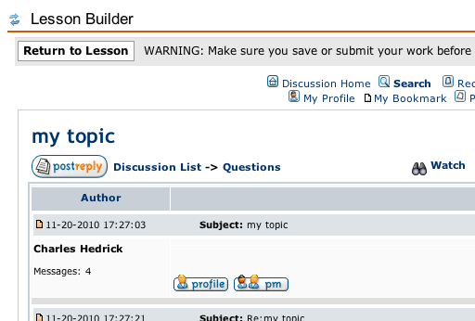
Will benefit from being a NEO Portlet

Slide 22
Lesson Builder Tasks
Evaluate usability
Do QA
Rutgers production experience will be valuable
Improve the UX (evolutionary suggestions)
Switch it to a portlet
Make it a NEO-portlet
Add Common Cartridge Import and Export

Slide 23
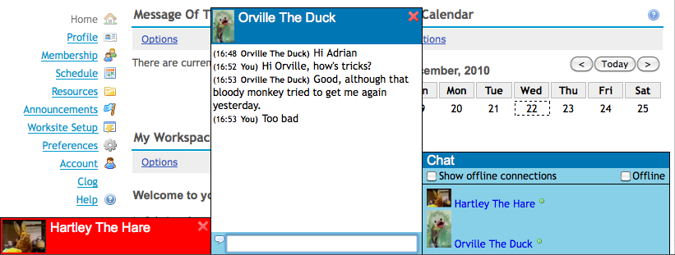
Adrian's Floating Chat
http://jira.sakaiproject.org/browse/SAK-17524

Slide 24
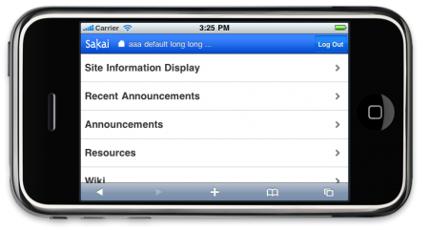
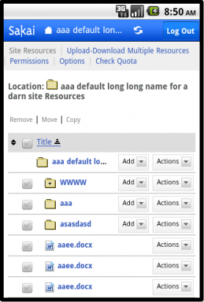
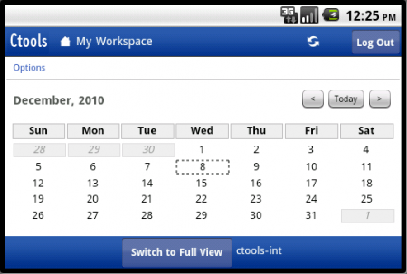
Mobile Portal + Tools
http://gonzalosilverio.wordpress.com/2010/12/09/sakai-mobile-portal/

Slide 25
A Few Tasks Under the Hood
Improve the message pump – ActiveMQ
Make presence very fast – perhaps use XMPP or at least more clever caching
Improve the performance of the Chat infrastructure
Review site caching performance

Slide 26
Community Leadership
I am depending on a lot of community support for this
  Steve Swinsberg
  Chuck Hedrick
  Aaron Zeckowski
  Adrian Fish
  Gonzalo Silverio
  Many others...

Slide 27
Anticipated Schedule
Design and Development feature complete June 2011
Present at the Sakai Conference and get broader community input
Tweaks / performance / review Summer 2011
Code freeze 2.9 September 2011

Slide 28
Summary
This takes a safe path to move the CLE forward toward the OAE – low risk – low hanging fruit
Close the gap with competitors UI-wise
Give commercial partners something to market in 2011
I can see that Sakai 2.10 (if needed) will move the CLE even further towards adopting bits from the OAE to continue the transition

