Slide 1



IMS Basic Learning Tools
Interoperability
Charles Severance, Ph.D.
Affiliate Coordinator
IMS Global Learning Consortium (IMS GLC)
http://www.imsglobal.org/
http://www.dr-chuck.com/

Slide 2
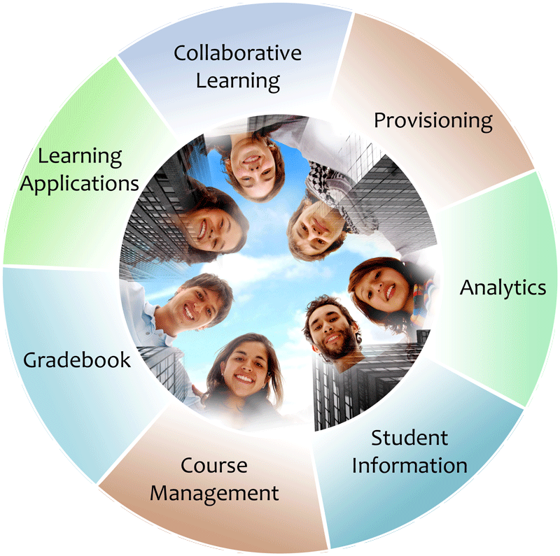


IMS: Digital Learning Standards
The information
architecture for
learning
Seamlessly
connect
to learning
Free the
content
IMS Common Cartridge
IMS Learning Tools
Interoperability (LTI)
IMS Learning Information
Services (LIS)

Slide 3


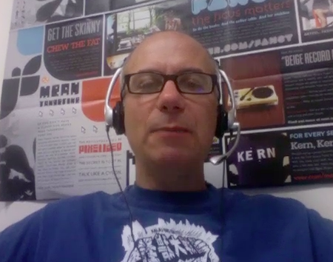

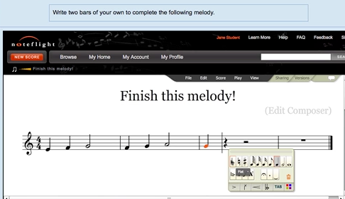







WTD?
...
http://www.flickr.com/photos/lauradye/4917754427/

Slide 4
Solution: Basic Learning Tools Interoperability
Build a simple standard plug-in for all LMS systems
Tool and Content Providers can build one integration and use it in any LMS that supports the standard
Start with low-hanging fruit and then expand feature sets to allow market to acclimate over time

Slide 5
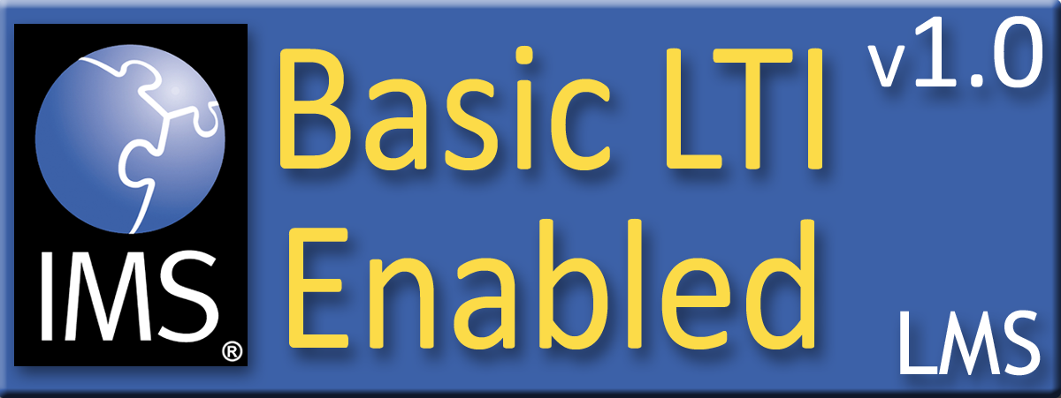

Basic LTI Certification
Assure the end-user/purchaser that products will interoperate
Any certified Provider (Tool) should be able to interoperate with any certified Consumer (LMS)

Slide 6
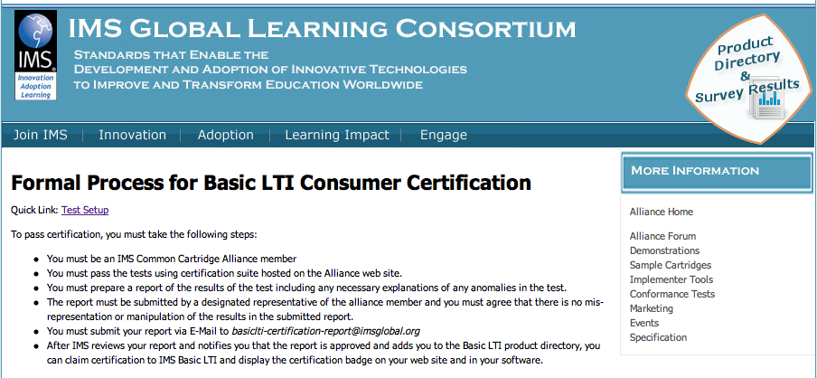
http://www.imsglobal.org/developers/alliance/lti/blti-cert/

Slide 7





Certified - LMS
Desire2Learn Learning Environment v8.4.2 and v9.0
Blackboard Learn v9.1 SP4 / coursesites.com
Jenzabar JICS v7.2 and e-Racer v1.2
Learning Objects Campus Pack v4.2
Sakai v2.7
OLAT 7.0
Moodle 1.9/2.0 Module
GeNIE, Open-Source LMS v1.0
PowerLink for Blackboard WebCT
Sakai 3 v0.4
Atutor 2.0.2
???
http://www.imsglobal.org/cc/statuschart.html

Slide 8


Latest: Blackboard CourseSites
Free in the Cloud
  Blackboard 9.1SP4 free
  Wimba free
  Elluminate free
Teacher Flexibility
  IMS CC 1.0 Import and Export
  Basic LTI Consumer
Notes:
No free puppies

Slide 9
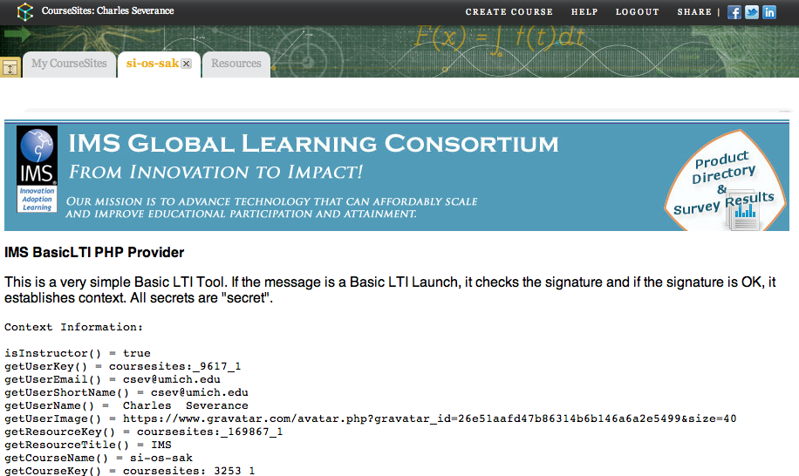

Slide 10
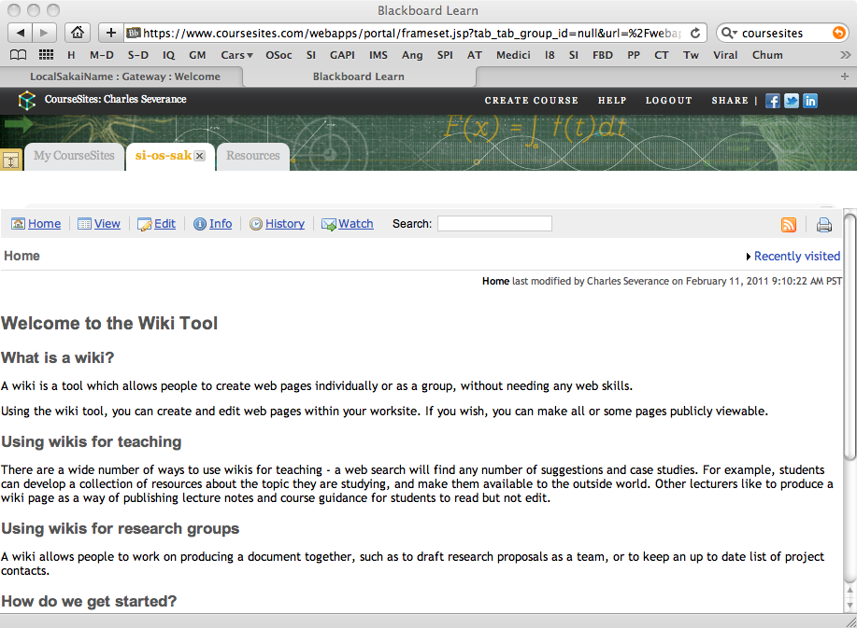

Slide 11
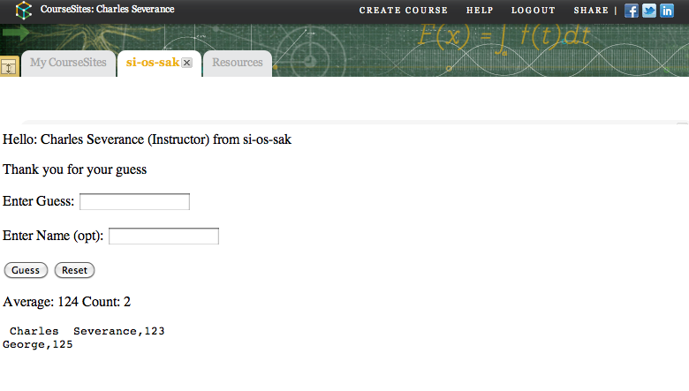

Slide 12






Certified Tools
CourseSmart ServiceHub 2.0
CafeScribe Building Block for Blackboard
Learning Objects Campus Pak v4.2
NoteFlight 2.1
Wimba Basic LTI Components v1.0.2
McGraw-Hill Education
???
http://www.imsglobal.org/cc/statuschart.html

Slide 13
☺
B
L
T
I
...
?????

Slide 14
Basic LTI Sample Launch Data
lti_version=LTI-1p0
lti_message_type=basic-lti-launch-request
oauth_consumer_key=lmsng.school.edu
resource_link_id=120988f929-274612
user_id=292832126
roles=Instructor
lis_person_name_full=Charles R. Severance
lis_person_contact_email_primary = csev@umich.edu
context_id=456434513
context_title=SI301 – PHP
tool_consumer_instance_description=University of School

Slide 15
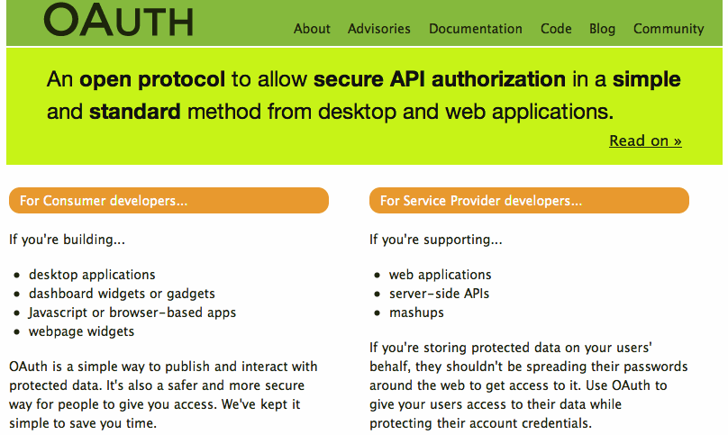

Slide 16
On-Campus Impact to Basic LTI
Basic LTI allows campus services be represented in the LMS
  Library Integration – Reading Lists
  Student Information Systems – Textbook Requirements
  Local / Special LMS Software – Math / Physics
  Campus Blog or Wiki service

Slide 17
Questions
Seamlessly
connect
to learning
IMS – www.imsglobal.org
cseverance@imsglobal.org
IMS Learning Tools
Interoperability (LTI)
  http://www.imsglobal.org/developers/BLTI/

