Slide 1



IMS Basic LTI Extensions Best Practice
Charles Severance, Ph.D.
Affiliate Coordinator
IMS Global Learning Consortium (IMS GLC)
http://www.imsglobal.org/
http://www.dr-chuck.com/

Slide 2

Available on
CreateSpace.com

Slide 3



Available on
CreateSpace.com

Slide 4
IMS Implementation Support
Materials, sample code, sample application
  http://www.imsglobal.org/developers/BLTI/
Additional support and certification
  http://www.imsglobal.org/joinims.html

Slide 5











Tool Consumer
REST Services
Tool Provider
Profile
Launch
Events
Tool
Profile
Tool Proxy Runtime
TC
User
Tool Proxy Runtime
Deployment
Session
Tool Setting
Outcomes
Data
...
Tool Proxy
Tool
Secret
Secret
SOAP Services
TC
Admin
TP
Admin
Learning Tools Interoperability

Slide 6

Tool Consumer
Tool Provider
Tool Proxy Runtime
TC
User
Tool Proxy Runtime
Tool Proxy
Tool
Secret
Launch
Secret
TC
Admin
TP
Admin
Basic Learning Tools Interoperability

Slide 7
Basic LTI Sample Launch Data
lti_version=LTI-1p0
lti_message_type=basic-lti-launch-request
oauth_consumer_key=lmsng.school.edu
resource_link_id=120988f929-274612
user_id=292832126
roles=Instructor
lis_person_name_full=Charles R. Severance
lis_person_contact_email_primary = csev@umich.edu
context_id=456434513
context_title=SI301 – PHP
tool_consumer_instance_description=University of School

Slide 8
Pain Point
Basic LTI is Launch-Only – No Services
Full LTI spec is nearly done but still a long time until it is widely deployed in the marketplace
Basic LTI is solving real problems
We know people will 'jailbreak' Basic LTI
Lets 'jailbreak' it together and call if 'best practice'

Slide 9
Best Practice Document Means:
Not an approved specification
  Not publically released – members only - Alliance
No certification is provided
Test harness supports extensions as an Easter Egg

Slide 10
Important Disclaimer...
Basic LTI Extensions are not a formal standard – they is only an engineering exercise to explore use cases and applications of the IMS Learning Information Services in an IMS Basic Learning Tools Interoperability environment. Since Basic LTI Extensions are not a standard, it is not appropriate to publically claim compliance to it.

Slide 11
Data Extensions
ext_lms=moodle-1
ext_launch_presentation_css_url=
ext_resource_link_content=
ext_resource_link_content_signature=

Slide 12
LMS-Provided Service Extensions
Return Outcome (i.e. grade)
Memberships (i.e. Roster) Retrieval
Settings Service (playlist stored in the LMS)

Slide 13
Implementations of Extensions
Complete and Available
  Sakai – Full Support released in 2.8
  Moodle – Module 1.9 / Module 2.0
  ATutor 2.0.2
Anticipating / Hope
  Moodle 2.1 core
  Jenzabar
  Desire2Learn
  Vickers, Inc. – Blackboard Building Block

Slide 14
Basic LTI Extension Point

Slide 15
BLTI Outcome Extension
Service can be called any time (i.e. no session needed)
Tool sends outcome to service as form-encoded POST data, signed by OAuth shared-secret
lis_result_sourcedid is separately signed by the LMS which checks signature upon receipt

Slide 16
Basic LTI Support for LIS
TOOL CONSUMER
TOOL PROVIDER
BasicLTI Launch with LIS pointers
LIS
SERVICES
The TP calls Learning Information Services
services, if available.

Slide 17
BLTI Outcome Extension
Add fields to launch
  lis_result_sourcedid – represents course, resource, gradebook, user in one id – opaque to tool
  ext_ims_lis_simple_outcome_url – Service URL
  ext_ims_lis_resultvalue_sourcedids – a list of types of outcomes accepted (decimal, percentage, passfail ..)

Slide 18
Basic LTI Sample Launch Data
lti_version=LTI-1p0
lti_message_type=basic-lti-launch-request
oauth_consumer_key=lmsng.school.edu
resource_link_id=120988f929-274612
user_id=292832126
roles=Instructor
context_id=456434513
lis_result_sourcedid=8387364783687634
ext_ims_lis_basic_outcome_url=http://localhost/outcome.php
ext_ims_lis_resultvalue_sourcedids=percentage,decimal,passfail

Slide 19





User, Course, Resource, Callback info
Tool Provider
Tool Consumer
Tool Proxy Runtime
Tool Proxy Runtime
Tool Proxy
Launch
Tool
Secret
Outcome
TC
User
Secret
Result-ID
Grade
Grade Book
TC
Admin
TP
Admin
Simple Outcomes

Slide 20
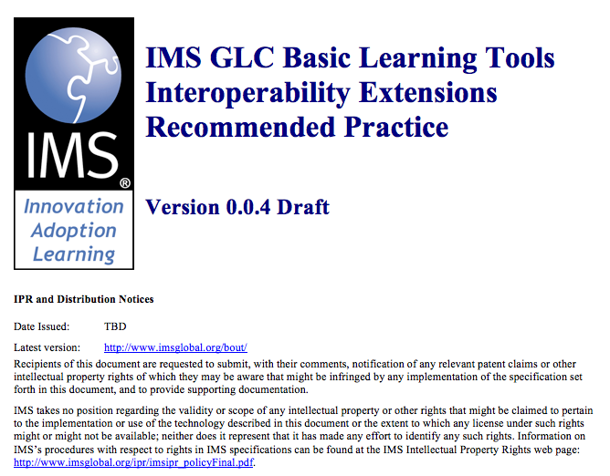

Slide 21







Basic LTI Extensions
Tool Consumer
Tool Provider
Settings
Roster
Tool Proxy Runtime
TC
User
Tool Proxy Runtime
Outcomes
Tool Proxy
Tool
Secret
Launch++
Secret
TC
Admin
TP
Admin

Slide 22
Outcome Extension
Service can be called asynchronously (i.e. no session needed)
Tool sends outcome to service as form-encoded POST data, signed by OAuth shared-secret

Slide 23
IMS Learning Information Services – Outcomes
IMS Learning Information Services is in public draft
  http://www.imsglobal.org/lis/lisv2p0pd/OMSinfoModelv1p0pd.html
This work is based on a REST binding to the LIS data model
  Sections 2.3, 3.3.1, 3.3.3, 3.3.4, 3.3.15, 2.2.16, 5.2, 5.5, 5.14, and Appendix B

Slide 24
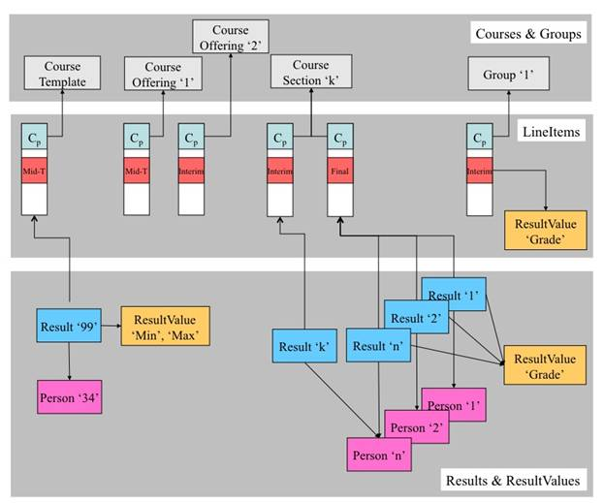
lis_result_sourcedid

Slide 25
Outcome Message From Provider
lti_version=LTI-1p0
lti_message_type=basic-lis-updateresult
sourcedid=123-9299d9f9a-20233-02939393
result_resultscore_textstring=95
result_statusofresult=final
result_resulttvaluesourcedid=percentage
result_personsourcedid=292832126
result_resultscore_language=en_US
result_datasource=1783837472
result_date=2010-08-01T16:43Z

Slide 26
<?xml version="1.0" encoding="UTF-8" ?>
<message_response>
<lti_message_type>basic-lis-readresult</lti_message_type>
<statusinfo>
<codemajor>Success</codemajor>
<severity>Status</severity>
<codeminor>fullsuccess</codeminor>
</statusinfo>
<result>
<sourcedid>123456</sourcedid>
<personsourcedid>9789</personsourcedid>
<statusofresult>interim</statusofresult>
<date>2010-07-18T10:55Z</date>
<resultscore>
<resultvaluesourcedid>ratio</resultvaluesourdedid>
<textstring>18/20</textstring>
<language>en-US</language>
<resultscore>
<datasource>75757</datasource>
</result>
</message_response>
XML Response

Slide 27
lis_result_sourcedid

Slide 28
lis_result_sourcedid issues
Must securely and uniquely identify a course, section, grade book column, and user
We want to keep the authorization for the setting of a particular grade in the LMS (i.e. the tool should not be allowed to set any grade for any person simply knowing the Launch secret)
We also want to be able to revoke the right for a tool to set grades.

Slide 29
Constructing lis_result_sourcedid
(a decent practice)
Inside the LMS, a distinct grade_secret is associated with each resource which is used to message-sign each lis_result_sourcedid
Opaque to the tool provider
signature = SHA1(grade_secret::resource-id::user-id)
lis_result_sourcedid=signature::resource-id::user-id

Slide 30






Tool Consumer
Tool Provider
Tool Proxy Runtime
Tool Proxy
Launch
Secret
TC
User
Tool Proxy Runtime
Tool
Launch
Grade
Secret
Launch
Secret
Outcome
TC
Admin
TP
Admin
lis_result_sourcedid
signature::resource-id::user-id

Slide 31









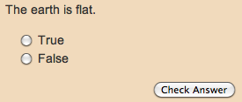
Tool Consumer
Tracker
Launch
Outcome
Content
JavaScript
Flash
...

Slide 32

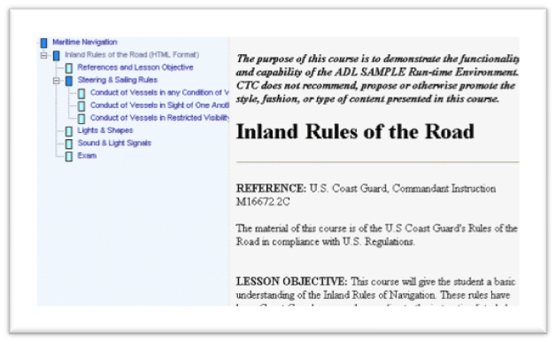
Tool Consumer
SCORM
SERVER
Fine-grain tracking
Launch
Outcome
SCORM
SCORM
Runtime
Content
...

Slide 33
Context Memberships Service
A Simple Binding to LIS data model in XML
Launch Items
  ext_ims_lis_memberships_id=f726-ea827-77edf99
  ext_ims_lis_memberships_url=

Slide 34
Tool Consumer
Tool Provider
Tool Proxy Runtime
Tool Proxy
Launch
Secret
TC
User
Tool Proxy Runtime
Tool
Launch
Memb.
Secret
Launch
Secret
Memberships
TC
Admin
TP
Admin

Slide 35
Retrieving Memberships
Entire roster can be retrieved any time after the first launch because the launch sends the URL and signed context id
Call back parameters
lti_message_type=basic-lis-readmembershipsforcontext
id=32828721987

Slide 37
Tools Settings Service
Allows the Tool Provider to store up to 8K of data per resource_link_id – (i.e. not per user)
Use case – Instructor launches tool and configured the tool *within the iframe* - pick a 'play list'
Tool stores playlist in the LMS
Playlist is sent to tool on each launch

Slide 38
Tool Settings – Why?
Some services that are effectively a content archive that is "free" may not want to support millions of little playlists
When a course or link is deleted – there is no notification to the Tool Provider
If we can store this in the LMS, it may enable free services that might otherwise need to charge.

Slide 39
Calling Tool Settings
lti_message_type=basic-lti-loadsetting | basic-lti-savesetting | basic-lti-deletesetting
id=32828721987
setting=

Slide 40

Tool Consumer
Tool Provider
Tool Proxy Runtime
Tool Proxy
Launch
Secret
TC
User
Tool Proxy Runtime
Tool
Launch+Settings
Sestings
Secret
Launch
Secret
Settings
TC
Admin
TP
Admin

Slide 41
Demonstration

Slide 42
More desired extensions...
Send tenant_id in multi-tenancy situations
Call back to a "Post Announcement" service
Subsituting custom parameters (from Full LTI)

Slide 43
Full LTI Mappable Custom Fields

Slide 44
Open Source Communities
Apache 2 Licensed Code Samples and Libraries
  http://code.google.com/p/ims-dev/
  Basic LTI: Java, PHP, Python
  Common Cartridge: Java
Open Mailing List / Forum
  http://www.imsglobal.org/community/forum/index.cfm?forumid=11
  http://groups.google.com/group/ims-dev

Slide 45
IMS Implementation Support
Materials, sample code, sample application
  http://www.imsglobal.org/developers/BLTI/
Additional support and certification
  http://www.imsglobal.org/joinims.html

Slide 46

Questions
Seamlessly
connect
to learning
IMS – www.imsglobal.org
cseverance@imsglobal.org
IMS Learning Tools
Interoperability (LTI)
  http://www.imsglobal.org/developers/BLTI/

