Slide 1


App Store for Education
Charles Severance, U Michigan, www.imsglobal.org
Roby John, www.taptolearn.com
Aamir Poonawalla

Slide 2
Pain Points
Educators
  Find , Select and Sequence Educational Apps
  Collect progress and results from multiple sources
Students
  single starting point, integrated progress reporting
App Providers
  Provision User Profiles
  Reporting Data to existing Learning Management Systems
Notes:
1. Many Great Apps there today related to Education.

Slide 3



Educational
App Store
App
App
App
App
App
App

Slide 4





IMS Learning Tools Interoperability Standard
L
T
I
LEARNING
TOOL
...
Sends, identity, course, and role
?????

Slide 5
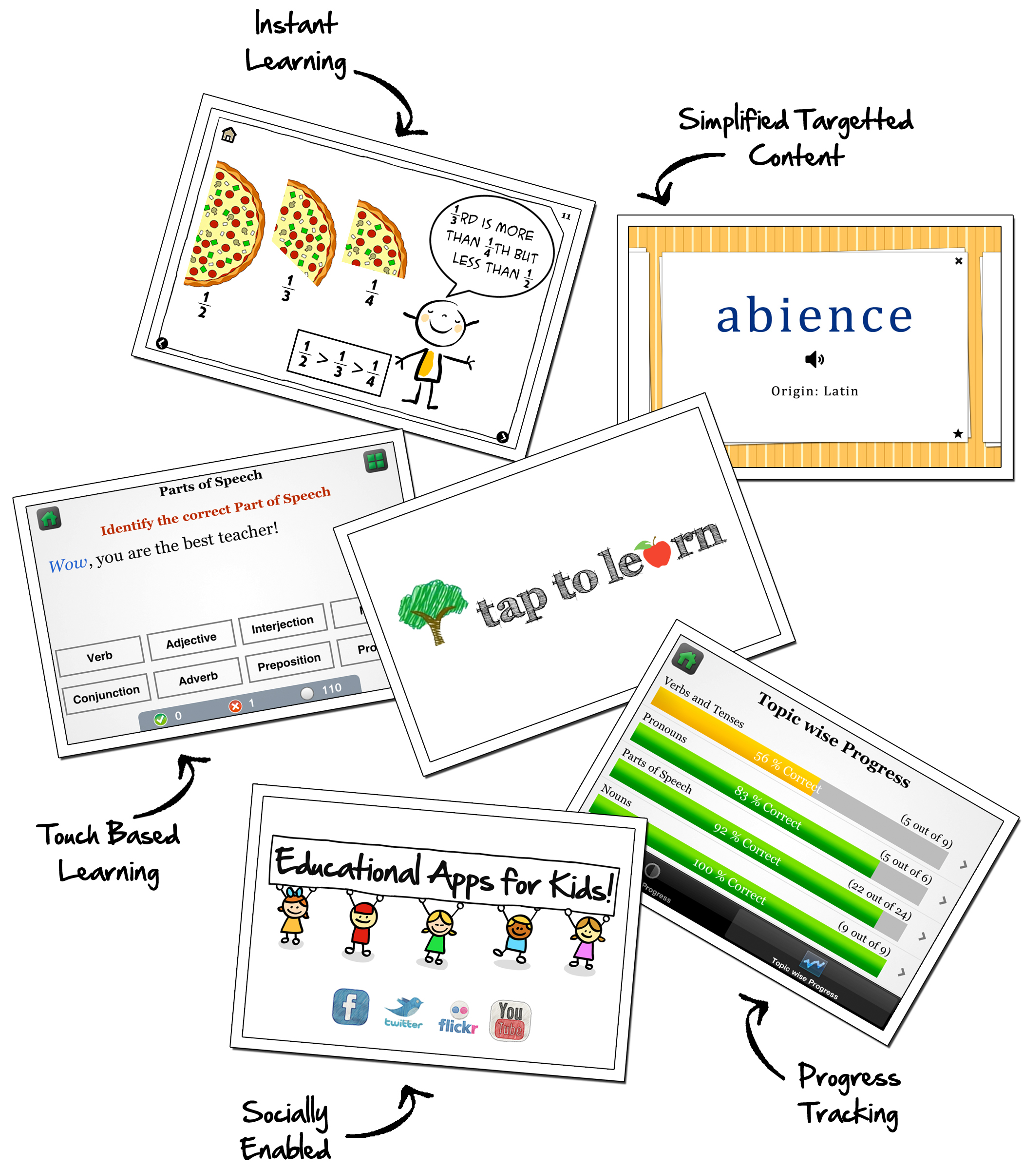

Slide 6
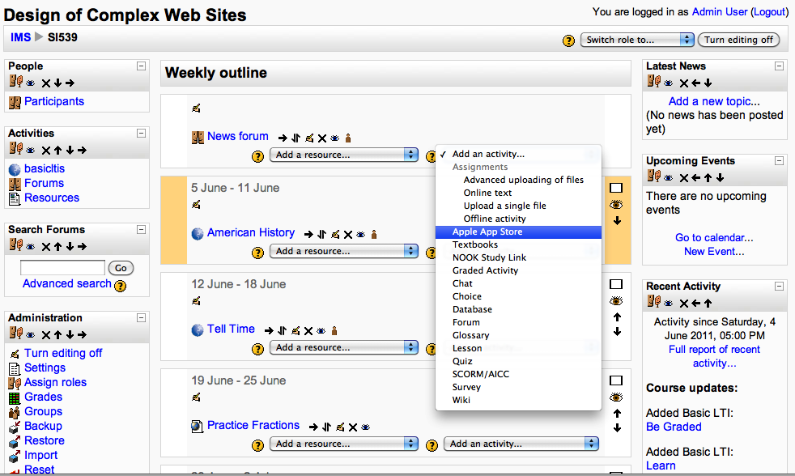
Notes:
No way to integrate an extremely wide range of tools into their LMS.

Slide 7
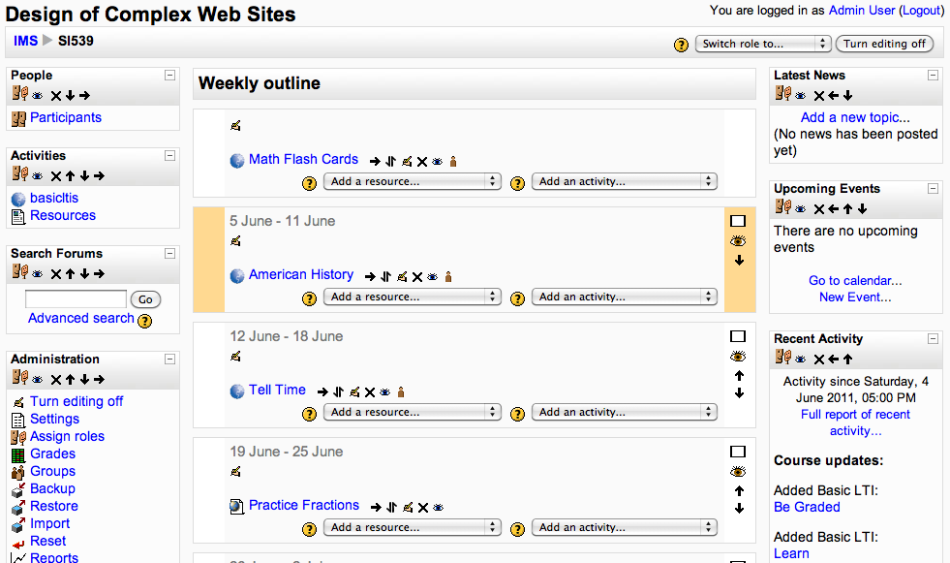

Slide 8
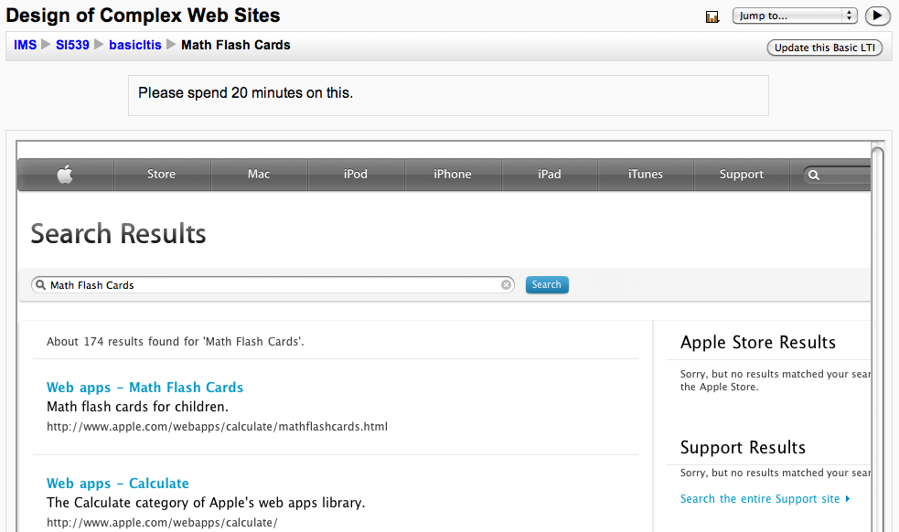
Select
Select

Slide 9
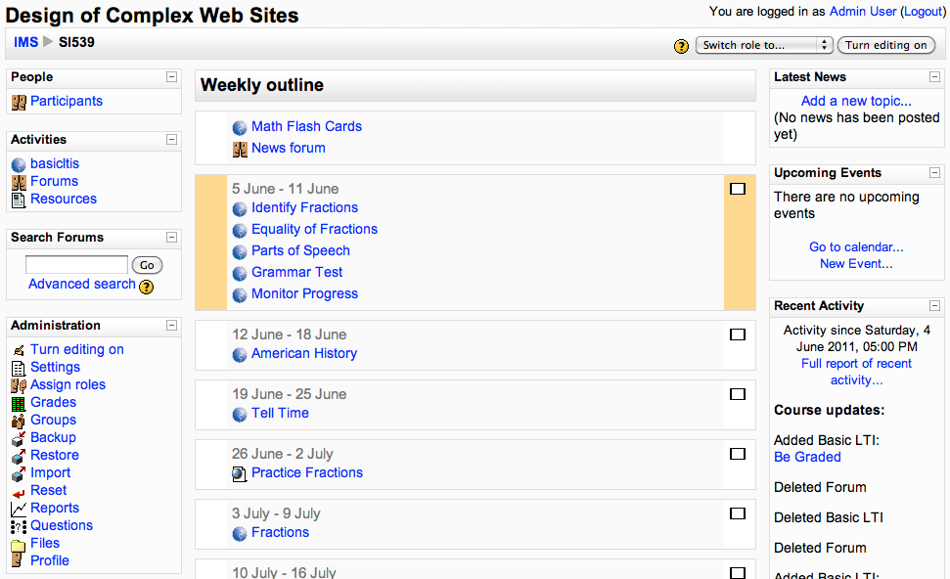

Slide 10
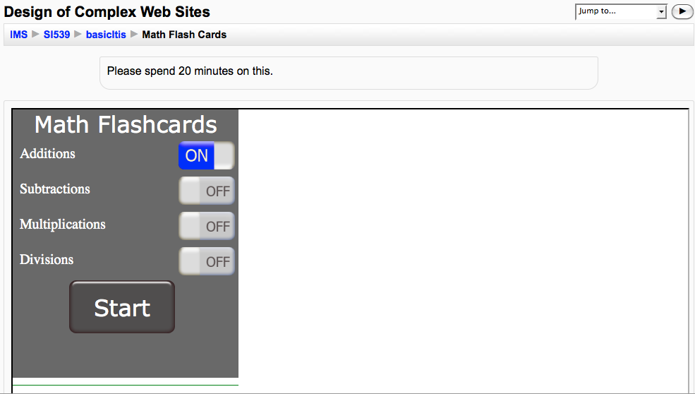
Video
Demo

Slide 11
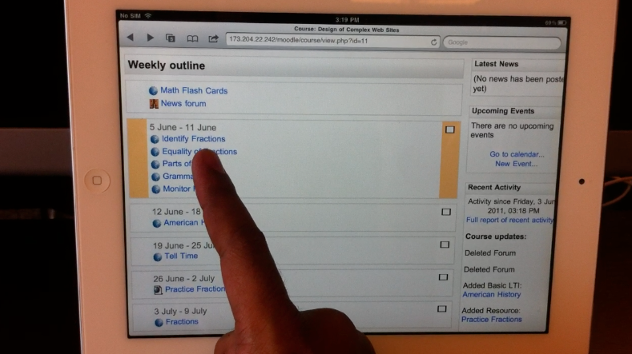
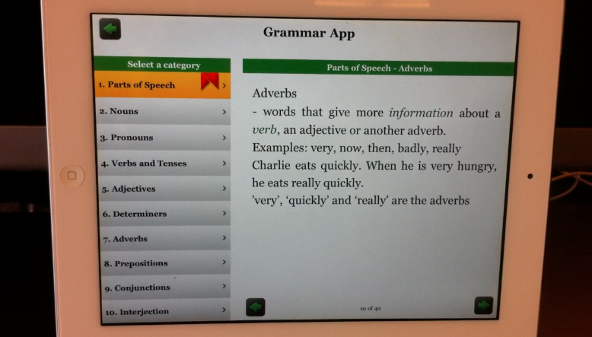
iPad Launch
Video Demo
http://www.vimeo.com/24699223

Slide 12
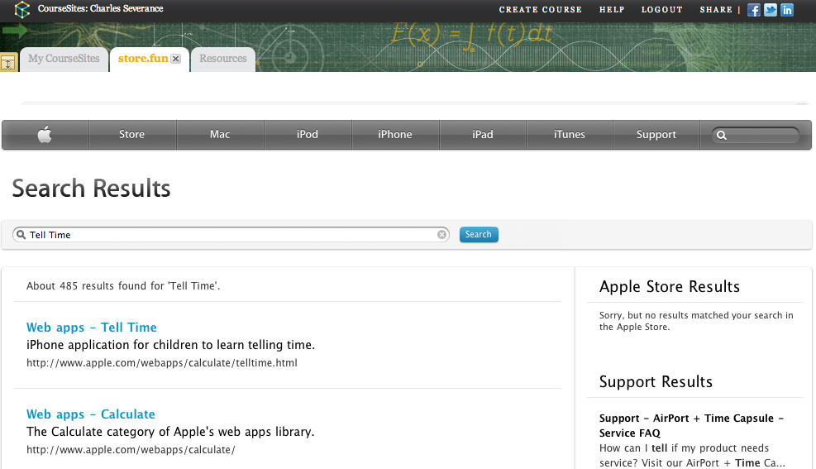
This also works in Blackboard
www.coursesites.com

Slide 13
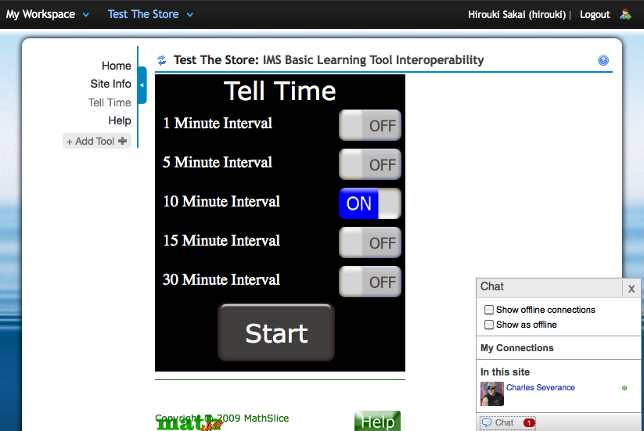
This also works in Sakai

Slide 14

Business Model
We are a market and profit from transactions
Teachers <> App Publishers <> Students
Enable Additional Pricing Scenarios
  Site Licenses, Per Use , Per Term
Affiliate Programs within App Stores

Slide 15
App Store for Education
Charles Severance, U Michigan, www.imsglobal.org
Roby John, www.taptolearn.com
Aamir Poonawalla

